Slide 1

AI Study Assistant Chatbot Using Generative AI
Learning Block 1 — Generative AI Application
Submitted by ANAGANDULA SHIVANI (236F1A6703) | Pallavi Engineering College
Department of CSE (Data Science) · Academic Year: 2026–2027
Guided by: Mr. Ragavendra Roa

Slide 2
Navigation
Index
01
02
03
Introduction
Problem Statement & Objectives
Scope & Methodology
Overview of the application, its purpose, and key features
The real-world gap this project addresses and measurable goals
Project boundaries, target users, and end-to-end approach
04
05
Architecture & Implementation
Results, Challenges & Future
System design, technology stack, and integration details
UI walkthrough, limitations, conclusion, and roadmap

Slide 3

CHAPTER 1
Introduction
AI Study Assistant is a Generative AI–powered web application designed to answer students' study questions in simple, exam-oriented language. The application addresses a genuine need faced by college students, providing an intelligent, automated alternative to searching through books and websites.
Role of GenAI
Generative AI (Google Gemini) drives query answering and personalisation at the core of the application, producing clear text explanations in the answer style the student selects.
Key Features
The application offers 4 primary user-facing features including AI question answering, three answer styles (Simple, Exam-oriented, Example-based), chat memory for follow-up questions, and a clear-chat option.
Target Audience
Built for college students who require quick, clear explanations of AI, Data Science and Python topics, making their study faster, smarter, and more effective.

Slide 4
CHAPTER 2
Problem Statement
The Problem Today
Why GenAI is the Answer
Students currently face difficulty in finding clear, exam-ready explanations when studying technical topics. Existing tools rely on search engines, textbooks and fixed-answer FAQ bots, leading to wasted time and scattered, inconsistent answers. The gap between what students need and what current solutions offer is significant.
A Generative AI–based solution is uniquely suited to this problem because it can understand natural language input, reason over context, and generate nuanced, high-quality output at scale — something no rule-based system can replicate.
Time saved: Automation reduces effort from hours to seconds
Accuracy gained: AI-driven reasoning outperforms rigid rules
Outcome: Students receive clear, exam-ready answers in seconds, transforming their study routine
Slow, manual searching across many websites
Fixed-answer bots that cannot adapt to the question
Inconsistent quality and hard-to-understand wording

Slide 5
CHAPTER 3
Objectives
The following objectives are measurable and directly map to deliverables present in the finished application.
1
Build a Functional, Deployable Application
Develop a complete, working GenAI-based website or application that is accessible to end users without technical setup.
2
Select an Appropriate GenAI Model or API
Evaluate and integrate a Generative AI model or API — Google Gemini, accessed through the google-genai SDK — that is well-matched to the study-assistant problem domain.
3
Design Effective Prompts and Inputs
Engineer structured prompts or input schemas that consistently yield accurate, relevant, and useful AI-generated responses.
4
Deliver an Intuitive User Interface
Design and implement a clean, accessible, and user-friendly frontend that requires no technical expertise to operate.
5
Evaluate Output Quality
Assess the accuracy, relevance, and overall quality of the AI-generated outputs through structured testing and user feedback.

Slide 6

CHAPTER 4
Project Scope
What Is Included
Current Limitations & Boundaries
Use Cases Covered
Target Users
The following are known boundaries of this version and are addressed in the Future Scope section.
AI-based answering of study questions on AI, Data Science, Python and Computer Science — clearly defined and implemented in this version.
College students with requirements including quick explanations and exam-ready answers.
Supports a single language (English) only
Dependent on external API availability and rate limits
No dedicated mobile application in this release
Domain coverage is limited to study topics in AI, Data Science and Python
Edge cases involving very long or unclear questions are not yet handled
GenAI Features
Input / Output Types
Features powered by AI in this release: question answering, answer-style control, and context-aware follow-up replies.
Accepts a text question typed in the chat box and produces a generated text answer as output.

Slide 7
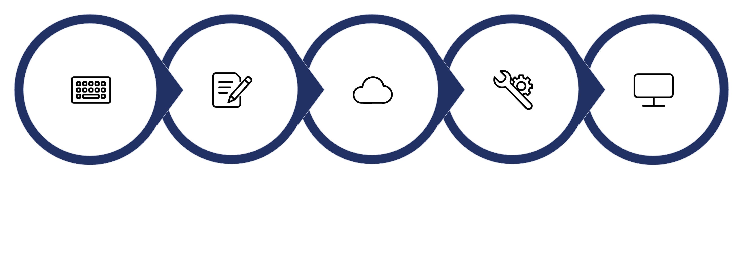
CHAPTER 5
Proposed System / Methodology
The application follows a structured end-to-end pipeline — from user input collection through AI processing to final output delivery.
Prompt Construction
GenAI Model API Call
Response Processing
Output Display
User Input
Step-by-Step Process
Key Design Decisions
User Input: The user types a study question in the chat box of the web interface.
Prompt Construction: The question is combined with a system prompt and the selected answer style to build an effective prompt.
API Call: The constructed prompt is sent to the Google Gemini model via a secure, authenticated request using an API key.
Processing: The model generates a response, which is parsed, validated, and post-processed as needed.
Output Display: The formatted result is rendered back to the user in a clear, readable, and actionable format.
Answer-style prompt templates keep responses consistent
Input validation blocks empty text and limits question length
Fallback to alternate Gemini models handles API errors gracefully

Slide 8
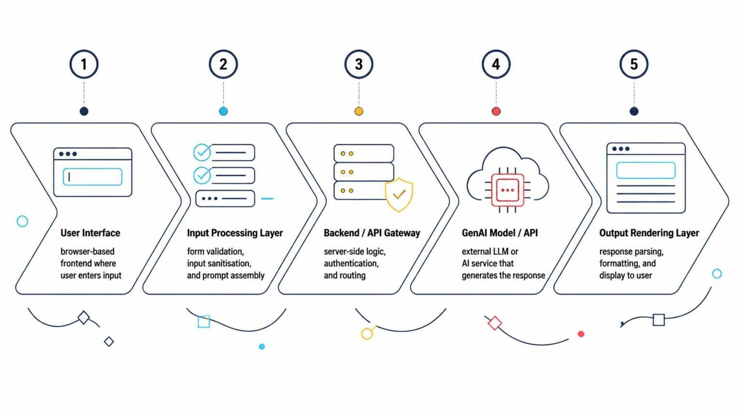
CHAPTER 6
System Architecture & Workflow
The architecture diagram below illustrates the complete data flow from user interaction to AI-generated response and back.
Frontend Layer
Backend & AI Layer
Users interact through a browser-based Streamlit UI. The question is typed in a chat box, validated (empty or over-long input) and forwarded to the backend.
The Python backend builds the prompt, authenticates the Gemini API call, tries fallback models if needed, and returns the generated answer to the chat window.

Slide 9
CHAPTER 7
Implementation
Technology Stack
Integration & Prompt Engineering
The GenAI model is integrated via authenticated API calls using Google's official google-genai SDK. The API key is entered in the sidebar as a password field and is never written in the code.
Prompts are constructed dynamically using a template system:
Frontend
Backend
Streamlit (Python) — chat-style web interface and user interaction layer.
Python 3.13 — application logic, prompt building and API calls.
system_prompt = "You are a friendly AI Study Assistant..."
style = STYLES[selected_style]
prompt = f"{style}\nQuestion: {question}"
response = client.models.generate_content(
model="gemini-3.8-flash",
contents=prompt, config=config
)
GenAI Model
Google Gemini API (google-genai SDK) — core AI generation engine.
The response text is checked for errors and rendered in the chat window by Streamlit.

Slide 10
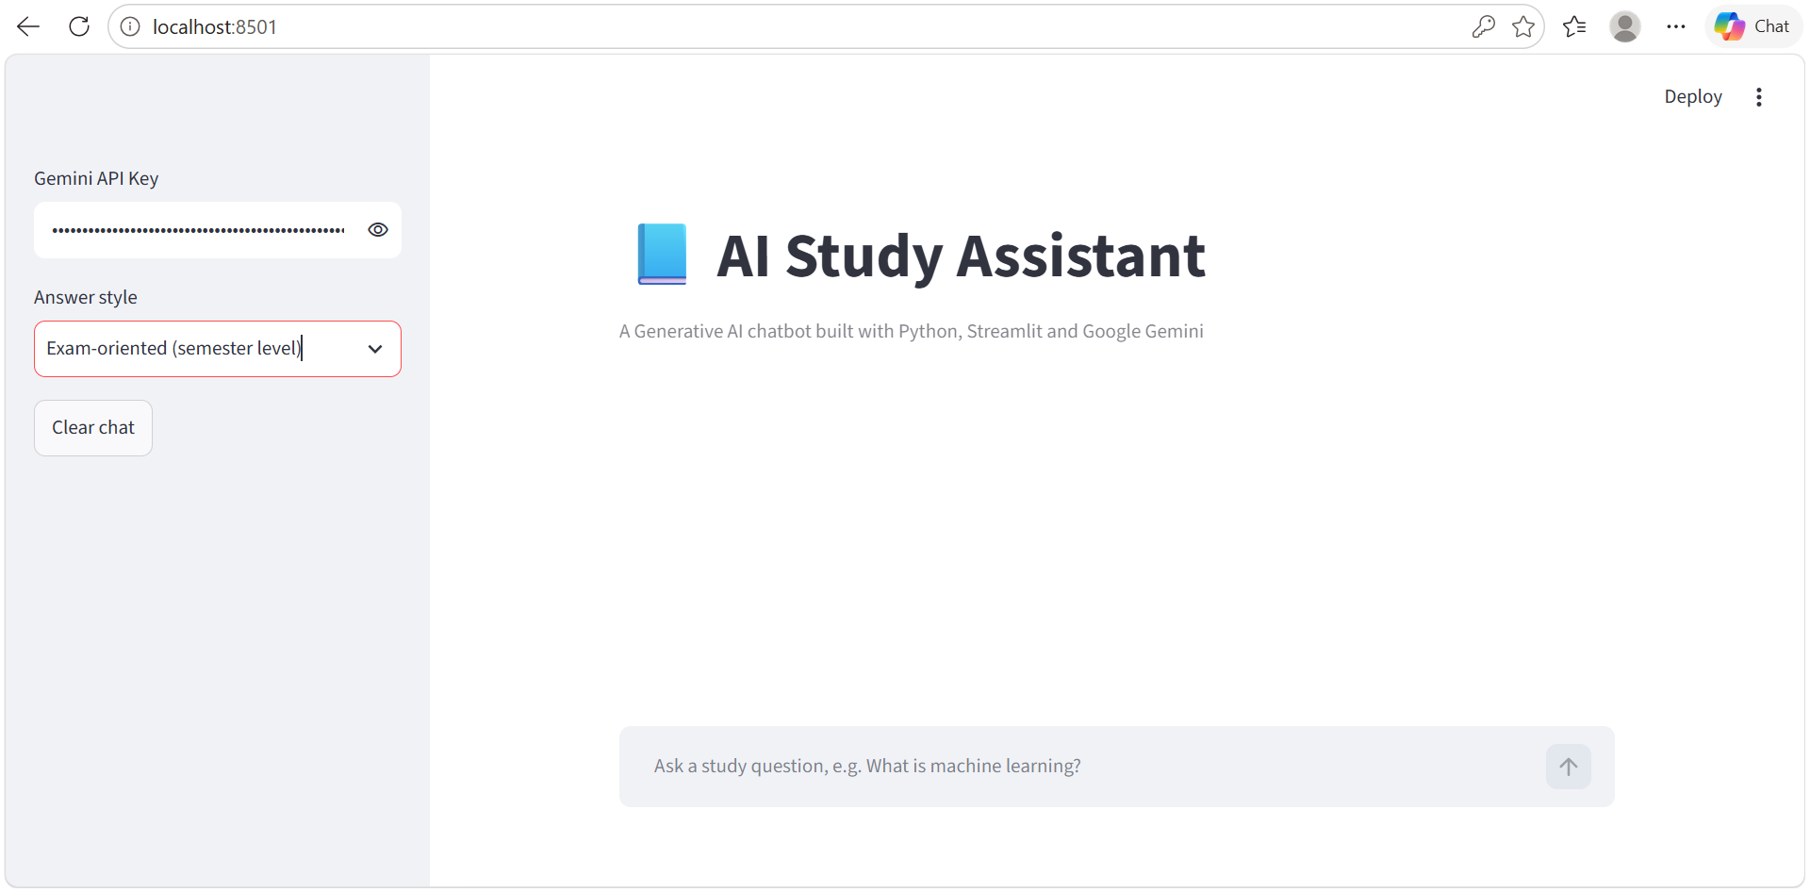
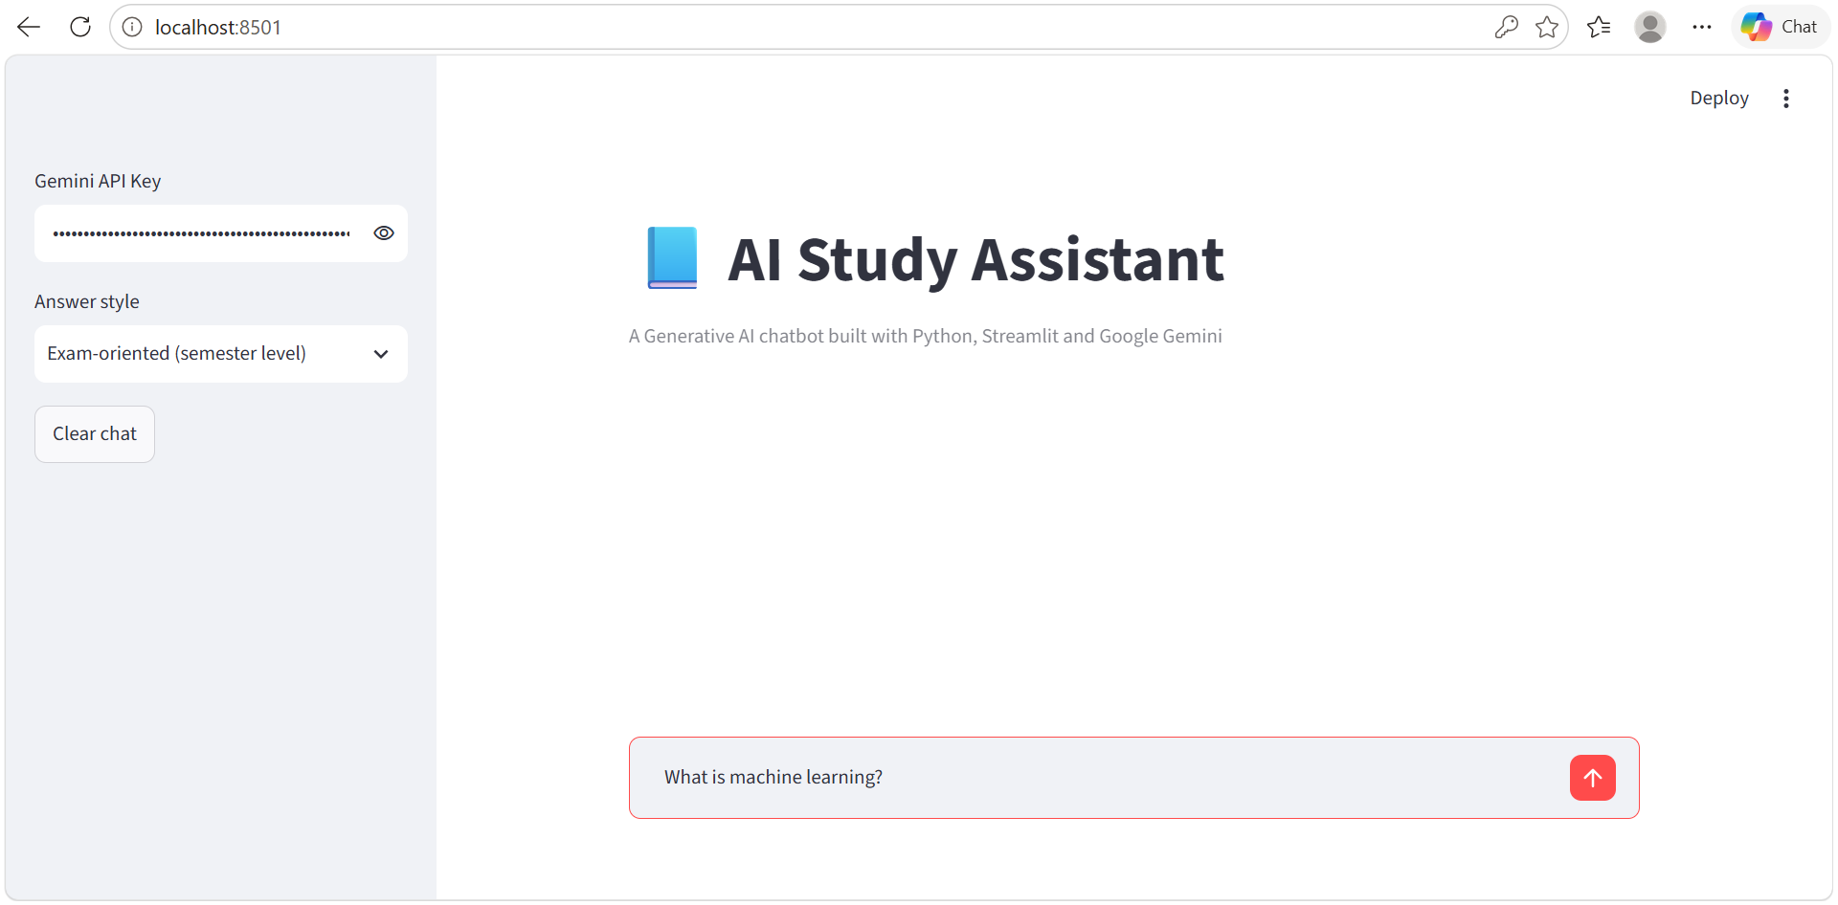
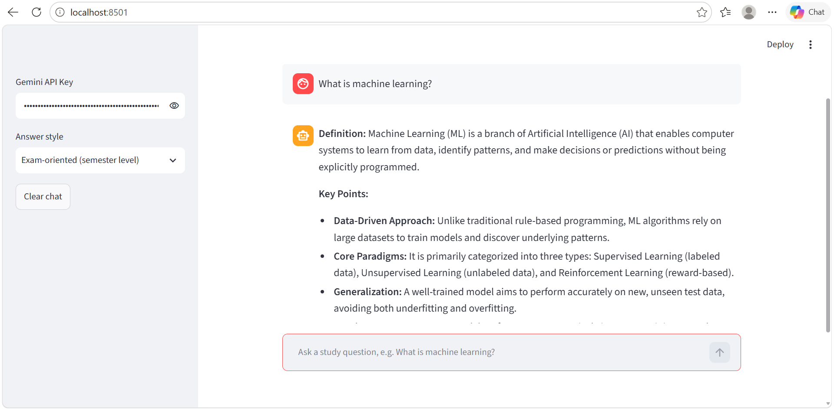
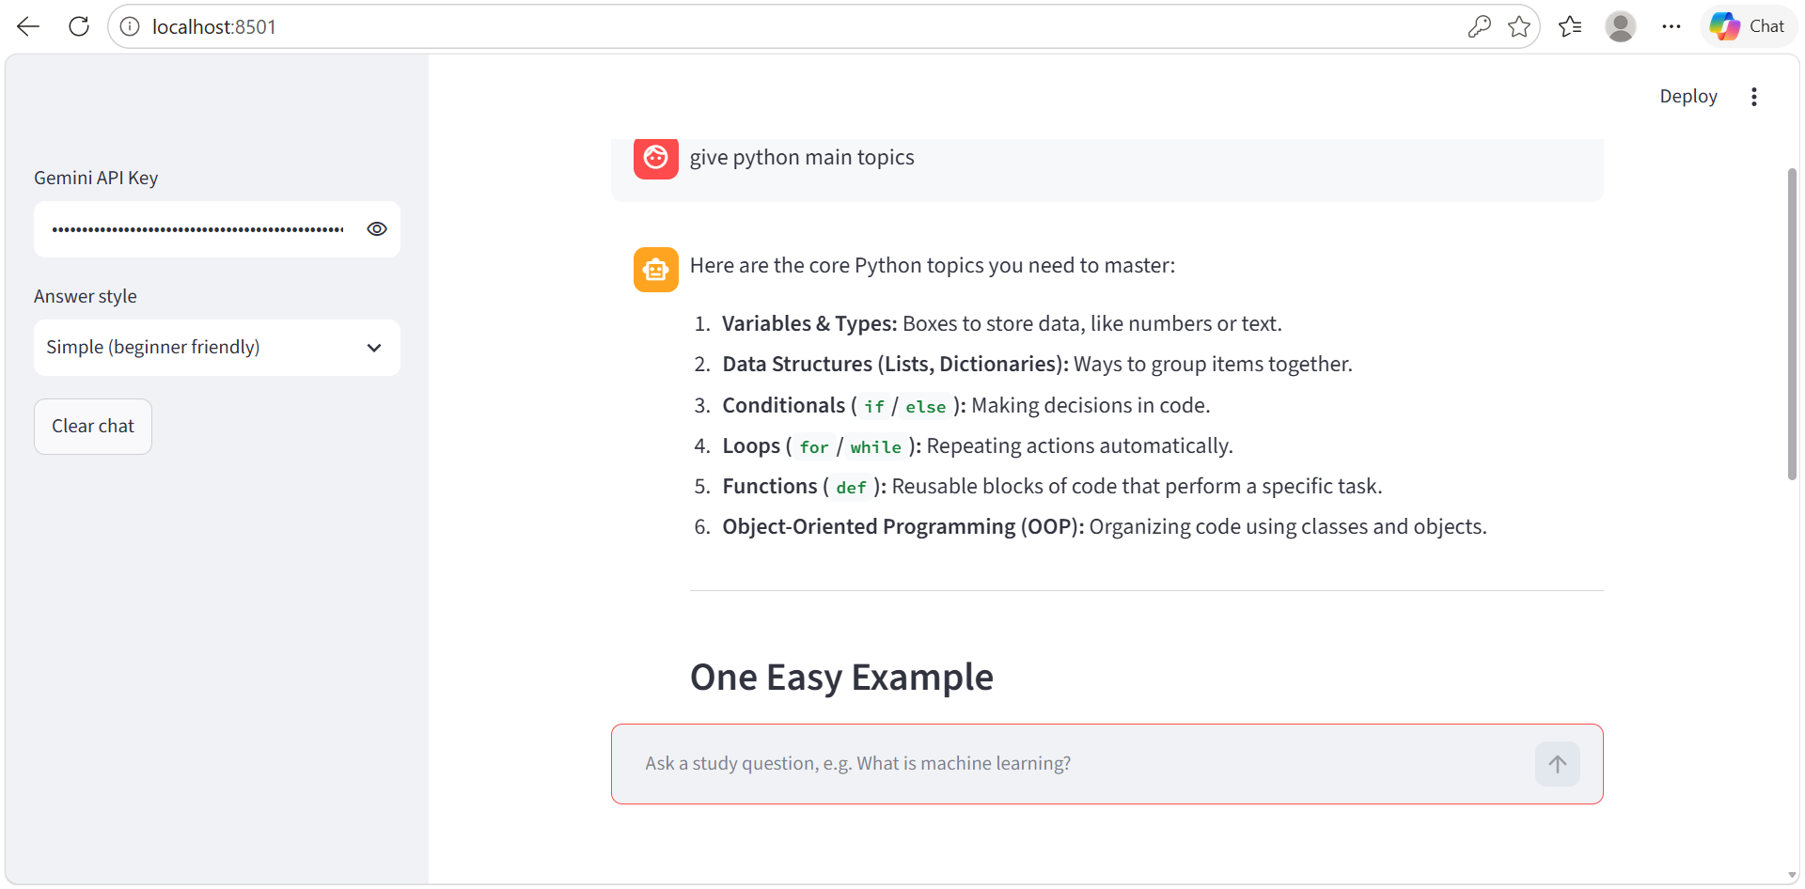


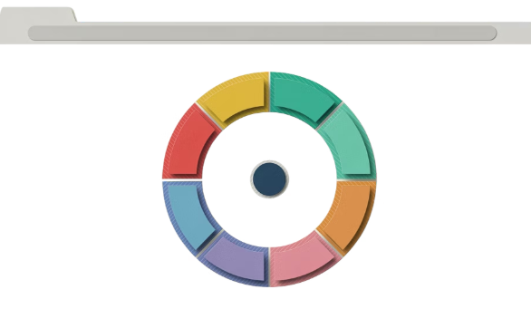


CHAPTER 8
User Interface & Application Screenshots
The following screens represent the complete user journey through the application — from landing on the home screen to receiving AI-generated results.
Home / Main Screen
Input / Prompt Screen
Exam-Style AI Answer
Simple-Style AI Answer
The AI Study Assistant home page with the API key field, answer-style selector, Clear chat button and the chat input box.
The student types a study question, such as 'What is machine learning?'. Empty or over-long input is handled before the AI is called.
With the Exam-oriented style, Gemini generates a definition followed by key points, as expected in a semester exam.
With the Simple style, the same assistant gives a short, beginner-friendly list of Python topics with easy explanations.

Slide 11
CHAPTER 9
Challenges & Limitations
Technical Challenges Faced
Current Limitations
Model Selection
API Dependency
Token & Cost Constraints
Evaluating and selecting the right GenAI model required testing multiple Gemini model versions for output quality, speed and availability.
The application requires continuous access to an external API. Downtime or rate-limiting directly impacts availability.
Token limits restrict the length of input and output. High API usage incurs cost, making large-scale deployment expensive without optimisation.
Prompt Engineering
Crafting reliable prompts that consistently produce accurate, well-formatted outputs required iterative refinement and extensive testing.
Unexpected AI Outputs
Security & Privacy
The model occasionally produced incomplete or off-topic responses. These were handled via output validation, retries, and fallback messages.
User-provided data is sent to a third-party API. Sensitive inputs must be flagged, and data handling policies must be clearly communicated.

Slide 12

CHAPTER 10
Conclusion
This project successfully demonstrates the development of a GenAI-powered application that addresses the difficulty students face in finding clear study explanations. By integrating Google Gemini, the system automates question answering, replacing slow manual searching with an intelligent, responsive solution.
What Was Built
Impact & Output
A functional web chatbot featuring AI question answering, three answer styles, and chat memory, integrated with Google Gemini.
The system produces text answers that are clear, relevant and useful, saving students time and effort compared to prior approaches.
Key Learnings
This project provided hands-on experience in prompt engineering, API integration, full-stack development, and AI output evaluation.

Slide 13
CHAPTER 11
Future Scope
The current implementation establishes a solid foundation. The following enhancements are planned or recommended for future iterations.
Multimodal Input Support
Model Fine-Tuning
Extend the system to accept image, audio, and video inputs using multimodal GenAI models such as GPT-4o or Gemini 1.5 Pro.
Fine-tune the base model on domain-specific datasets to improve output accuracy, relevance, and tone for study and exam preparation.
Multilingual Support
Production Deployment & Scaling
Add support for additional Indian and international languages to broaden the application's accessibility and user reach.
Deploy on a cloud platform (AWS / GCP / Azure) with proper load balancing, caching, and monitoring for real-world scale use.

Slide 14

CHAPTER 12
References
All sources consulted during the design, development, and evaluation of this project are listed below.
AI Model & API Documentation
Books & Articles
Google Gemini API Official Documentation — https://ai.google.dev/gemini-api/docs
Google AI Studio (API key and model access) — https://aistudio.google.com
Google GenAI Python SDK Getting Started — https://ai.google.dev/gemini-api/docs/generate-content/get-started
S. Russell and P. Norvig, Artificial Intelligence: A Modern Approach, Pearson, 2020.
A. Géron, Hands-On Machine Learning with Scikit-Learn, Keras and TensorFlow, O'Reilly, 2022.
Websites & Tutorials
Research Papers
Streamlit Documentation — https://docs.streamlit.io
Python Official Documentation — https://docs.python.org
A. Vaswani et al., "Attention Is All You Need", NeurIPS, 2017.
T. Brown et al., "Language Models are Few-Shot Learners", NeurIPS, 2020.
GitHub Repositories
Datasets & External Resources
Streamlit — https://github.com/streamlit/streamlit
Google GenAI Python SDK — https://github.com/googleapis/python-genai
Dataset — Not used; answers are generated by the pre-trained Gemini model
Python Package Index (streamlit, google-genai) — https://pypi.org
Use a consistent citation style (e.g., IEEE or APA) throughout this section. Replace all placeholders with actual sources used.

