Slide 1

Flutter News Application
RNS INSTITUTE OF TECHNOLOGY
BENGALURU - 98
DEPARTMENT OF INFORMATION SCIENCE & ENGINEERING
Presentation on Internship
Anagha
USN: 1RN18IS016
ENMAZ Engineering Services Pvt. Ltd.
Internal Guide
MS. Sunitha K
Asst. Prof, Dept of ISE, RNSIT
External Guide
Mr. Akshay D
Co-Founder & CEO, Enmaz Engineering Services Pvt. Ltd., Bangalore

Slide 2
AGENDA
Abstract
About the Company
Introduction
Literature Survey
Requirements
System Design
Detailed Design
Implementation
Testing
Conclusion and Future Enhancements
References
Q & A

Slide 3
ABSTRACT
The purpose of Flutter News Application is to automate the existing manual system with the help of computerized equipment.
The project describes news data available with ease and have good performance and better services for the users.
Project work carried out is News application using flutter. Flutter is a hybrid mobile application development framework.
It consists of flutter for frontend, firebase for backend authentication and news Api for real time json data of world news.

Slide 4
About the Company
Enmaz Engineering Pvt. Ltd is a Service based company founded in the year 2019.
It specializes in
Embedded H/W Development
Embedded Firmware Development
Cloud support
Big Data Analysis and Reporting
Dashboard UX/UI design and development
Model Analysis.

Slide 5
INTRODUCTION
Flutter is an open-source UI software development kit created by Google.
Dart is a programming language developed by google for client development, such as mobile and web apps.
The "News Application" has been developed to override the problems prevailing in the practicing manual system.
The main aim is to have all the world news in a single system and reduce the user’s burden of managing multiple such apps.

Slide 6
LITERATURE SURVEY
Location based news app project: Jon Smith PhD(Paper-1):
This professional project centered around the construction and design of an app for the iPhone and iOS that would allow users to access news from a variety of sources based on their location as determined by their smartphone.
In addition, users would be able to post their own content and observations of news as it happens and geolocate their posts so other users would be able to learn about what’s taking place in their community.

Slide 7
LITERATURE SURVEY
Exploring mobile news reading interactions for news app personalization: Marios constantindes, John dowell(Paper-2):
They implemented and deployed an Android news app that logs users’ interactions with the app
Finally they evaluated alternative, adaptive user interfaces for each reader type. The evaluation demonstrates the differential benefit of the adaptation for different users of the news app and the feasibility of adaptive interfaces for news apps.

Slide 8
Requirements
Hardware Requirements
CPU: Core i5, Ryzen 5
RAM: 8 GB
HDD: 100 GB
Software Requirements
Operating System: Windows 8 and above
Editor: Visual Studio Code
IDE: VS Code
Front-end Language: Dart
Minimum Android Version : Froyo (API Level 8)

Slide 9
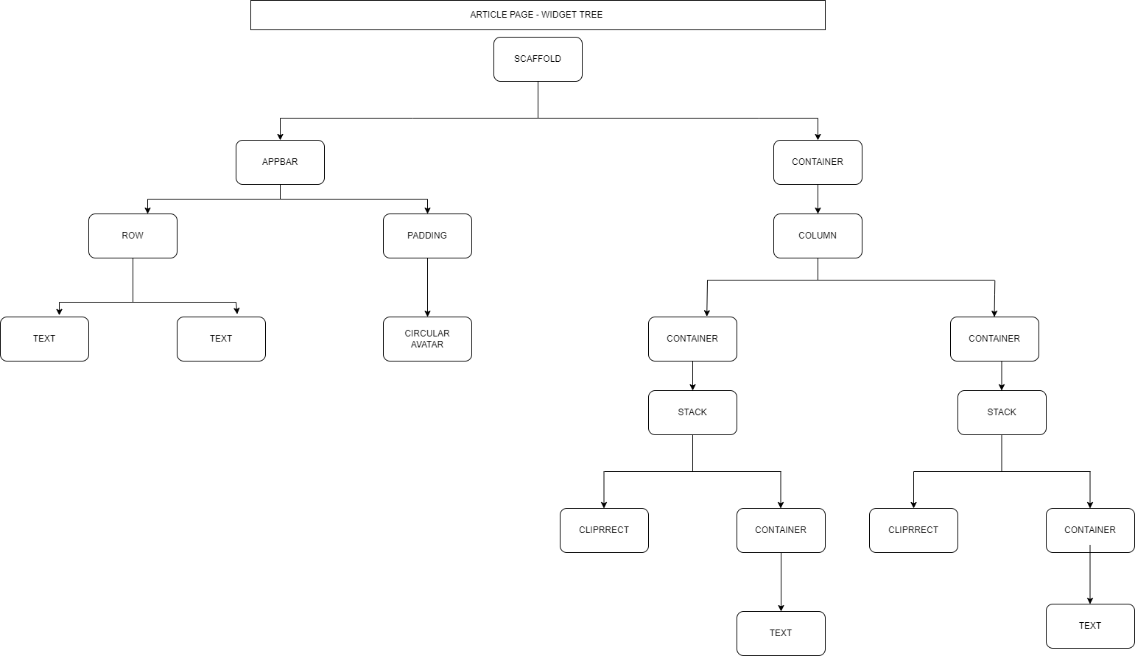
System Design
Widget tree for home page

Slide 10
Detailed Design
Detailed design of database schema
Uid | isAnonymous | ProviderId | CreationTime | LastSignInTime | IsEmailVerified
1 | false | firebase | 156974482357 | 15928445141358 | True
2 | false | firebase | 156974482389 | 15928445141390 | False
Author | Title | Description | Url | ImgUrl | PublishedAt | SourceId
noreply@blogger.com | Bitcoin | Elon Musk reveals who bitcoin's creator Satoshi Nakamoto might be | https://techncruncher.blogspot.com | https://blogger.googleusercontent.com/img | 2021-12-29T20:41:00Z | engadget
Shoshana Wodinsky | Crypto Dev | crypto community have set a high bar for devising the worst ways to hawk | https://gizmodo.com/ | https://i.kinja-img.com/ | 2022-01-07T19:30:00Z | reuters

Slide 11
Implementation / Coding
void main() {
runApp(MyApp());
}
class MyApp extends StatelessWidget {
const MyApp({ Key? key }) : super(key: key);
@override
Widget build(BuildContext context) {
return MaterialApp(
title: "News App",
debugShowCheckedModeBanner: false,
theme: ThemeData(
primaryColor: Colors.black
),
home:Home()
}
);
}
}

Slide 12
Testing
Validation testing: Validation testing in software engineering is in place to determine if the existing system complies with the system requirements and performs the dedicated functions for which it is designed along with meeting the goals and needs of the organisation. Below table shows the validation testing.
SL.NO | TESTCASE | RESULT
1 | https://newsapi.org/v2/everything?q=apple&from=2022-01-09&to=2022-01-09&sortBy=popularity&apiKey={correctApiKey} | News api key authentication success
2 | https://newsapi.org/v2/everything?q=apple&from=2022-01-09&to=2022-01-09&sortBy=popularity&apiKey={wrongApiKey} | News api key authentication failed

Slide 13
TESTING
Unit testing: A unit test is a way of testing a unit - the smallest piece of code that can be logically isolated in a system. Below tables indicate unit testing.
SL.NO | TESTCASE
1 | USERNAME: titangmail.com PASSWORD: titan123
2 | USERNAME: titan@gmail.com PASSWORD: titan123
3 | USERNAME: titan@gmail.com PASSWORD: titan
4 | USERNAME: titan@gmail.com PASSWORD: titan123
5 | USERNAME: PASSWORD: titan123
6 | USERNAME: titan@gmail.com PASSWORD:
SL.NO | TESTCASE | RESULT
1 | https://newsapi.org/v2/everything?q=apple&from=2022-01-09&to=2022-01-09&sortBy=popularity&apiKey={correctApiKey} | News api key authentication success
2 | https://newsapi.org/v2/everything?q=apple&from=2022-01-09&to=2022-01-09&sortBy=popularity&apiKey={wrongApiKey} | News api key authentication failed
3 | https://newsapi.org/v2/top-headlines?country=us&category=business&apiKey={apiKey} | Successful loading of business data
4 | https://newsapi.org/v2/top-headlines?country=us&category=businessss&apiKey={apiKey} | Failed to load business data
5 | https://newsapi.org/v2/topheadlines?country=us&category= entertainment&apiKey={apiKey} | Successful loading of entertainment data
6 | https://newsapi.org/v2/topheadlines?country=us&category= entertainmentttss&apiKey={apiKey} | Failed to load entertainment data

Slide 14
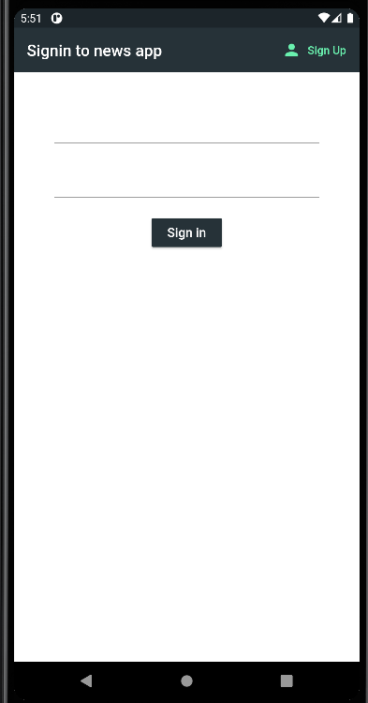
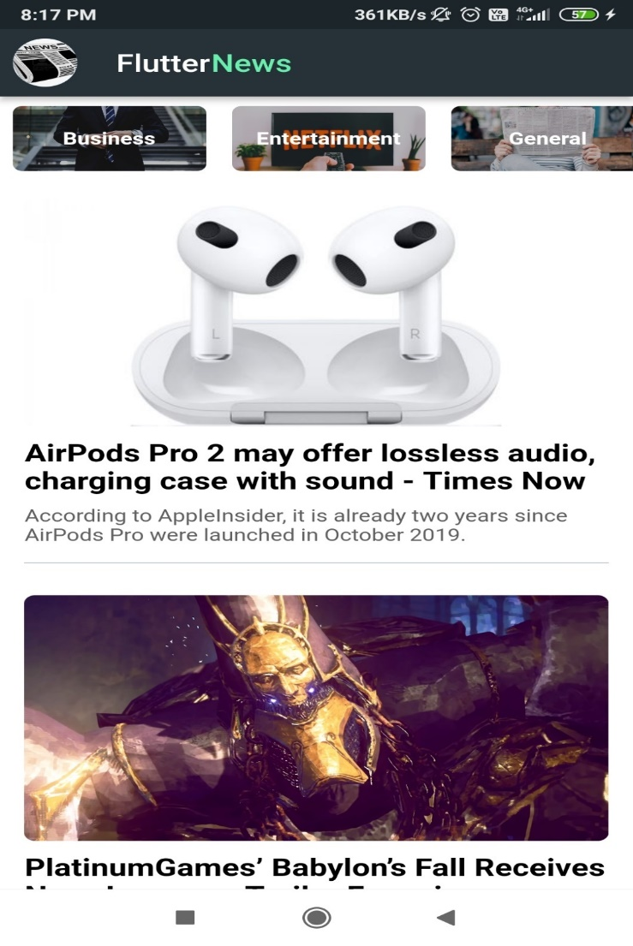
Results
Sign-In Page
Home page

Slide 15
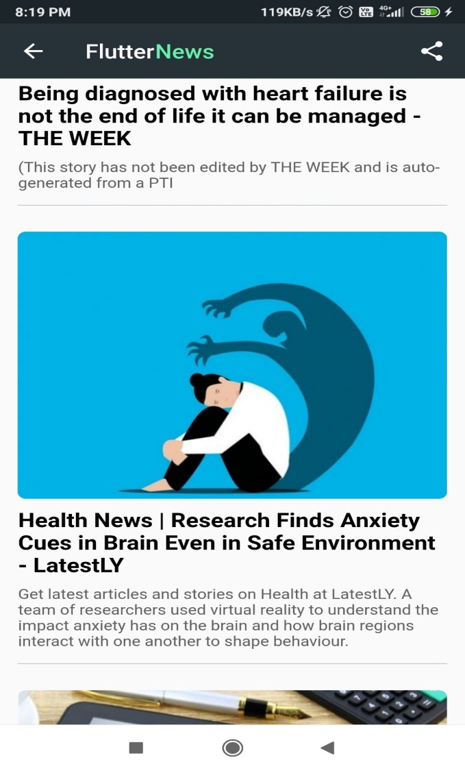
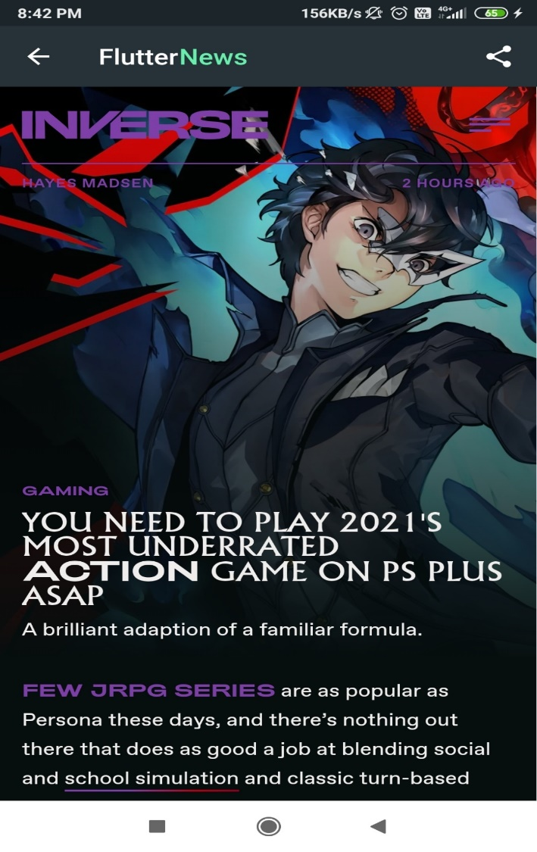
Results
Health Page
Entertainment Web View

Slide 16
CONCLUSIONS
News Application is real time application which is currently in use by the end-users to view and get the news at moment.
The application can be used by any one including kids, teachers, etc.
Since this a basic application it has a greater scope to add more features as required

Slide 17
Future Enhancements
The application can be enhanced to cover below business scenarios
Including sorting based on news fame.
Feature of uploading news.
Include two factor authorization.
Ai Ml can used to recommend user’s preferred news.

Slide 18
REFERENCES
https://www.studocu.com/in/document/kannur-university/computer-organization/flutter-general-report/11039857
Ramez Elmasri and Shamkant B. Navathe, Fundamentals of Database Systems, Pearson, 7th Edition.
https://www.irjmets.com/uploadedfiles/paper/volume2/issue_8_august_2020/3180/1628083124.pdf
https://docs.flutter.dev/
https://www.tutorialspoint.com/flutter

Slide 19
Question and Answer

Slide 20
THANK YOU

