Slide 1
Arduino Boards
Course contents:
1. Introduction to Arduino.
2. Types of Arduino.
3. Importance of Arduino.
4. Advantages of Arduino.
5. Disadvantages of Arduino.
6. Programming an Arduino.

Slide 2
Introduction to Arduino.
Arduino is a Open-source electronic prototyping platform enabling users to create interactive electronic objects based on easy-to-use hardware and software.
Arduino is generally preferred because of its easy to use and can be programmed easily using C++.
Majority of Internet Of Things [A.K.A. IOT] is based on Arduino and its types.
Arduino can be easily integrated with other hardware components.

Slide 3
Types of Arduino
The Arduino series range from:
1. Arduino Uno.
2. Arduino Mega.
3. Arduino Nano
4. Arduino Leonard.
5. Arduino Micro.

Slide 4
Importance of Arduino
The Internet of Things (IoT) is a popular phrase used in the tech community to describe everyday items that are connected to the internet and able to share information. Public perception is shifting toward integrating technology into the fabric of everyday life.
Open source projects like Arduino lower the barrier of entry for developers that are looking to experiment with interactive objects. These innovators will be able to rapidly prototype and experiment with interactive devices by using the Arduino platform, before creating a production-ready offering. Arduino is a great way to experiment with the possibilities of smart devices.

Slide 5
Advantages of Arduino
Arduino is a free Open Source platform.
Arduino can be used in creating IOT application prototype.
Arduino is a great way to experiment with the possibilities of smart devices.
Arduino board design can be utilized to create a custom board because of its Open Source nature and can be sold publicly as a distributor.

Slide 6
Disadvantages of Arduino
Arduino being an electronic application has the same disadvantages of common electronics.
The board gets burned of if a higher voltage of more than 5V is applied to the Vin terminal.
The pin points of Arduino are comparatively of smaller dimension which makes it harder to connect via jumper wires.
Arduino must be used under normal environmental condition with neutral humidity.

Slide 7
Programming Arduino
Arduino progamming is based on C++ programming language with extra Arduino functions available in Arduino library.
Arduino has an IDE for programming board known as Arduino IDE available for both Windows and Linux based OS.
Reference links: https://www.arduino.cc/reference/en/

Slide 8
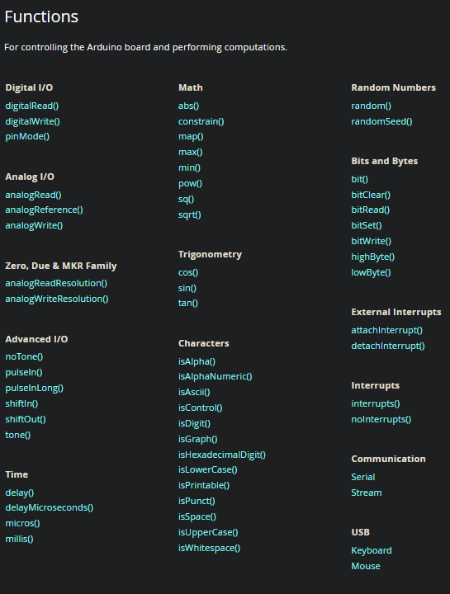
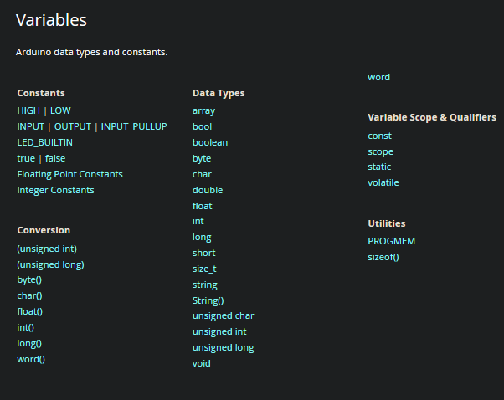

Slide 9
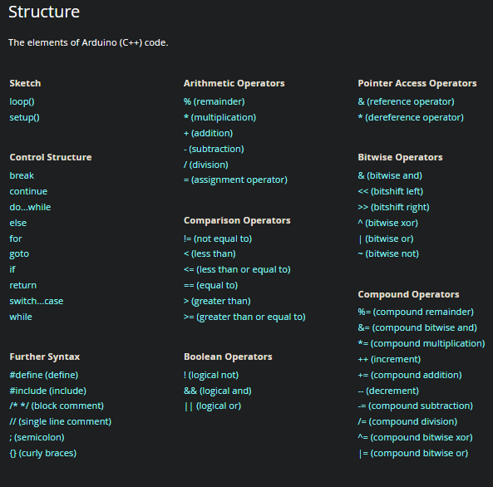

Slide 10
Thank You.

