Slide 1


Slide 2
Functional Testing
Functional testing is a type of software testing that verifies the functionality of a software system or application.
The goal of functional testing is to validate the system’s features, capabilities, and interactions with different components.
It involves testing the software’s input and output, data manipulation, user interactions, and the system’s response to various scenarios and conditions.

Slide 3
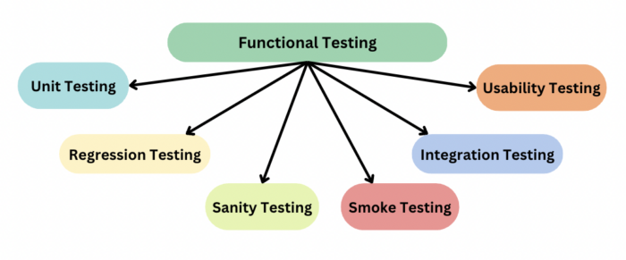
Types of Functional Testing
Unit Testing
Integration Testing
System Testing
User Acceptance Testing
Smoke Testing
Exploratory Testing
Boundary Value Analysis

Slide 4
Unit Testing
The process where you test the smallest functional unit of code.
Unit testing is a software development process in which the smallest testable parts of an application, called units, are individually scrutinized for proper operation.
Helpful for the developers and testers to understand the core base.
Unit testing helps:-
To isolate a section of code.
To verify the correctness of the code.
To test every function and procedure.
To fix bugs early in the development cycle and to save costs.
To help the developers understand the code base and enable them to make changes quickly.To help with code reuse.

Slide 5

Example – Sandwich
Units: Bread, cheese, and lettuce.
Unit Tests: Check individual aspects of each ingredient (freshness, quality, melting, taste, crunchiness).
Combining Units: Ensure that combining these units (making the sandwich) results in a successful sandwich.
Unit testing in software follows a similar principle, where individual functions or components are tested in isolation to ensure they behave correctly, and then higher-level tests verify that combining these components also produces the desired outcomes. This approach helps catch issues early, just as testing each ingredient individually helps ensure a delicious sandwich.

Slide 6
Integration Testing
The process of testing the interface between two software units or modules. It focuses on determining the correctness of the interface.
The purpose of integration testing is to expose faults in the interaction between integrated units.
Once all the modules have been unit-tested, integration testing is performed.
Integration testing helps:-
It is convenient for small systems.
Simple and straightforward approach.
Can be completed quickly.
Does not require a lot of planning or coordination.
May be suitable for small systems or projects with a low degree of interdependence between components.

Slide 7

Example – Online Banking System
User Authentication Service (UAS):Responsible for user login, authentication, and authorization.
Account Management Service (AMS):Manages user accounts, including balance information, transactions, and account details.
Notification Service (NS):Sends notifications to users for various events, such as transactions or account updates.
Integration Testing Example: Consider a scenario where a user logs into the online banking system, checks their account balance, and initiates a transaction.
In the context of the online banking system, integration testing ensures that the User Authentication Service, Account Management Service, and Notification Service collaborate effectively to provide a smooth and accurate user experience during transactions. This type of testing helps identify and address issues that may arise when different parts of the system interact with each other.

Slide 8


