Slide 1
H R ANALYT I CS
Project

Slide 2


A G E N DA
Introduction
Problem Statement
Overview of project
Kpi’s
Dashboard
Conclusion

Slide 3



I N T RO D U C T I O N
Human Resources (HR) plays a crucial role in managing an organization’s most
valuable asset — its people
The purpose of this project is to analyze the factors influencing employee attrition and satisfaction, helping organizations design better retention strategies.
This project utilizes the HR Analytics Attrition Dataset, comprising two files (HR_1 and HR_2) with 18 columns each and a total of 50,000 rows, providing a substantial dataset for analysis.
To conduct this analysis, I utilized BI Tools, enabling us for data cleaning, transformation, visualization, and dashboard creation.
Through these tools, I gained practical knowledge in data transformation, interactive dashboard creation, advanced visualization, and statistical analysis to derive actionable insights.

Slide 4



P RO B L E M S TAT E M E N T
AVERAGE ATTRITION RATE FOR ALL DEPARTMENTS AVERAGE
HOURLY RATE OF MALE RESEARCH SCIENTIST
ATTRITION RATE VS MONTHLY INCOME STATS
AVERAGE WORKING YEARS FOR EACH DEPARTMENT
JOB ROLE VS WORK LIFE BALANCE
ATTRITION RATE VS YEAR SINCE LAST PROMOTION RELATION

Slide 5

OV E RVI E W O F PROJ EC T
The project utilizes datasets from the HR Analytics platform, providing critical information such as employee demographics, job roles, monthly income, work-life balance ratings, and years since the last promotion to analyze employee attrition and satisfaction effectively.
Data manipulation and preliminary analysis Ire performed using Excel and SQL to clean and structure the dataset, ensuring its accuracy and consistency for exploring patterns and trends in workforce attrition and performance.
Key performance indicators (KPIs) were used to design an interactive dashboard with Tableau and Power BI, highlighting important metrics like attrition rates by department, average years of experience, and factors influencing employee attrition rate. The dashboard provides a clear view of workforce trends, making it easier to identify patterns in employee satisfaction, retention, and potential areas for improvement in HR strategies.
The dashboard enables users to analyze trends such as department-specific attrition, salary brackets influencing employee turnover, and job roles facing work-life balance challenges, offering deep insights into organizational dynamics and employee satisfaction for better HR strategies and operational efficiency

Slide 6

Average attrition rate for all departments

Slide 7


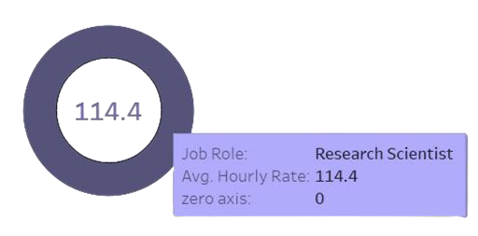
Average Hourly rate of Male Research Scientist

Slide 8

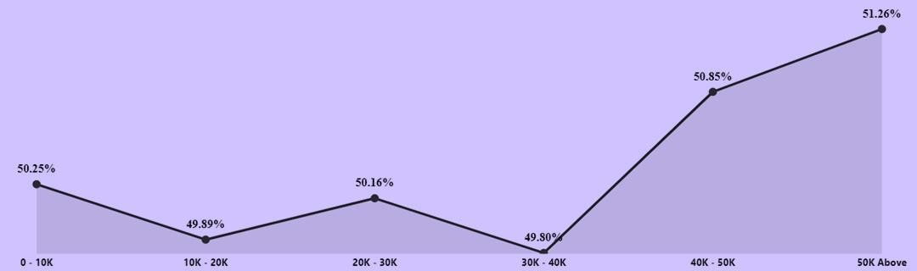
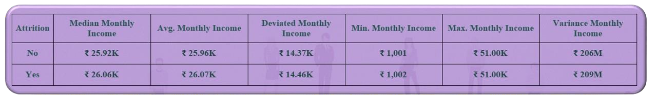
Attrition rate Vs Monthly income stats

Slide 9

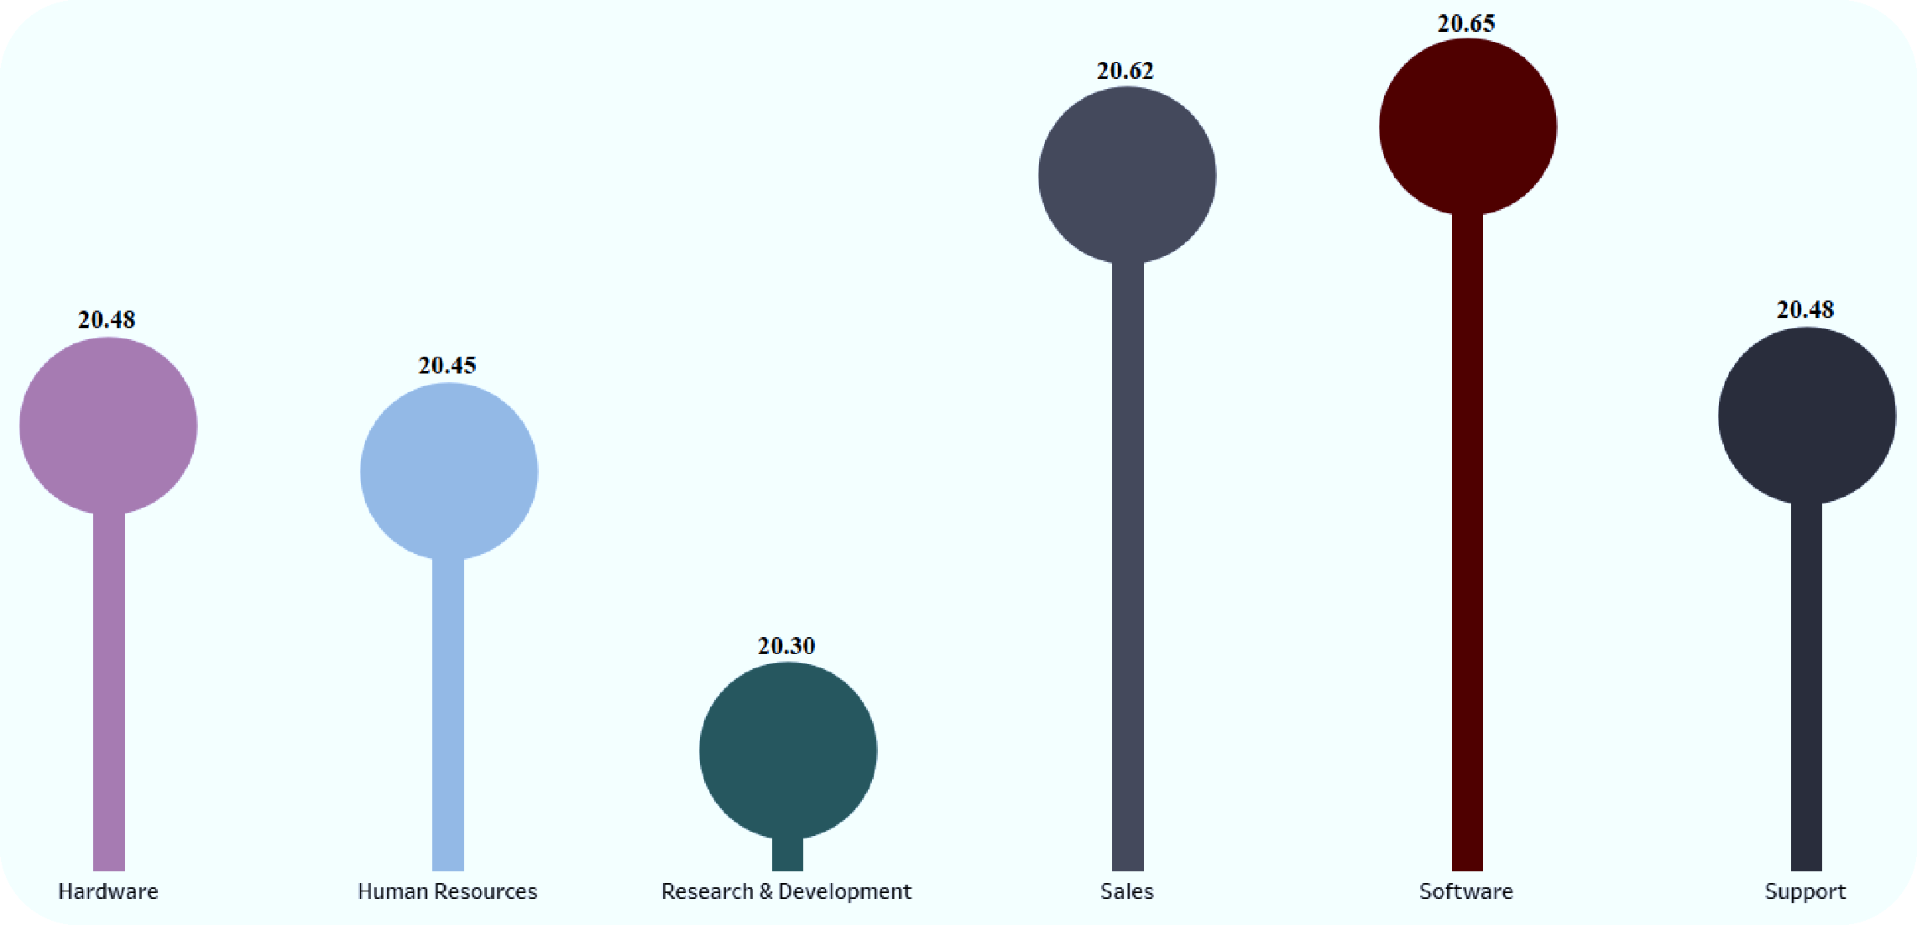
Average working years for each Department

Slide 10

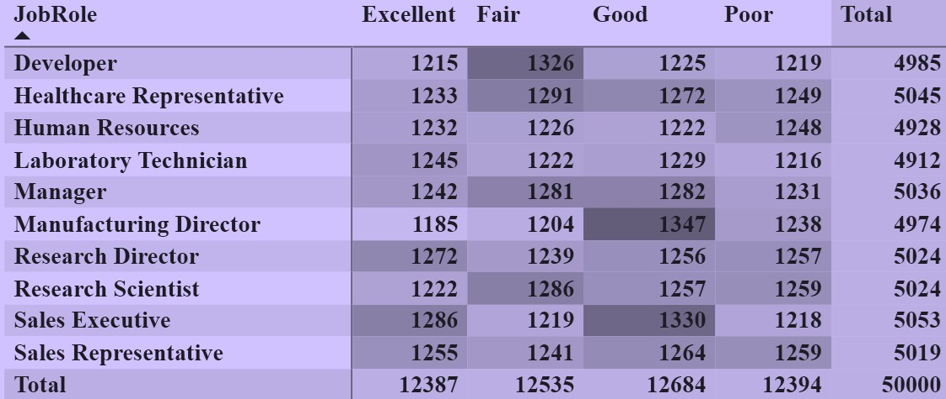
Job Role Vs Work life balance

Slide 11






Attrition rate Vs Year since last promotion relation
1 - 10 Yrs
20.72K
11 - 20 Yrs
3.43K
21 - 30 Yrs
0.85K
30 plus Yrs
0.11K

Slide 12
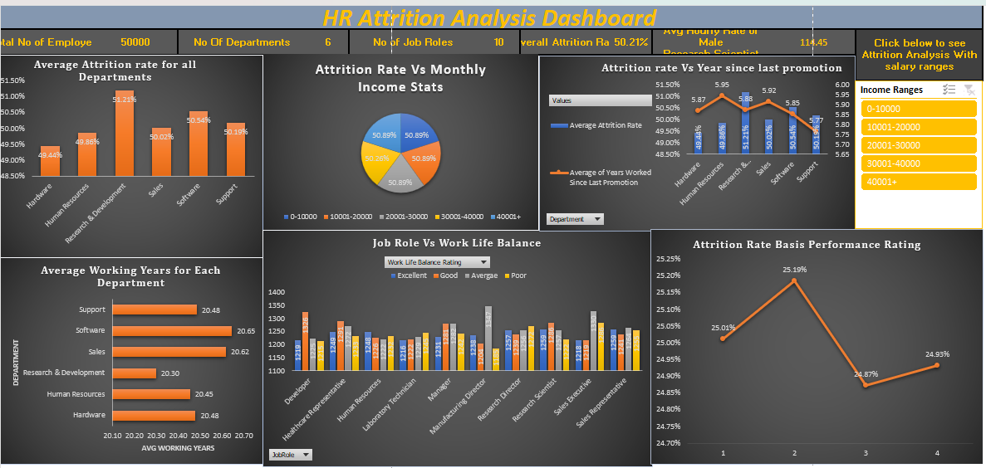
EXCEL DASHBOARD

Slide 13
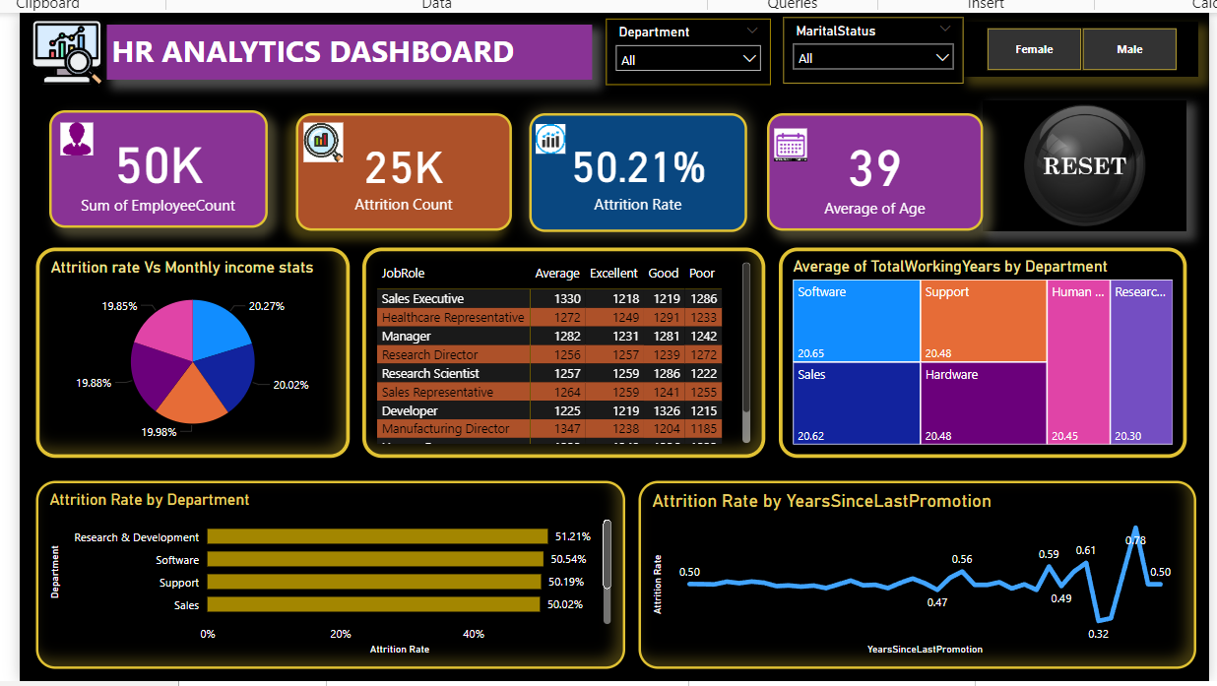
POWER BI DASHBOARD

Slide 14
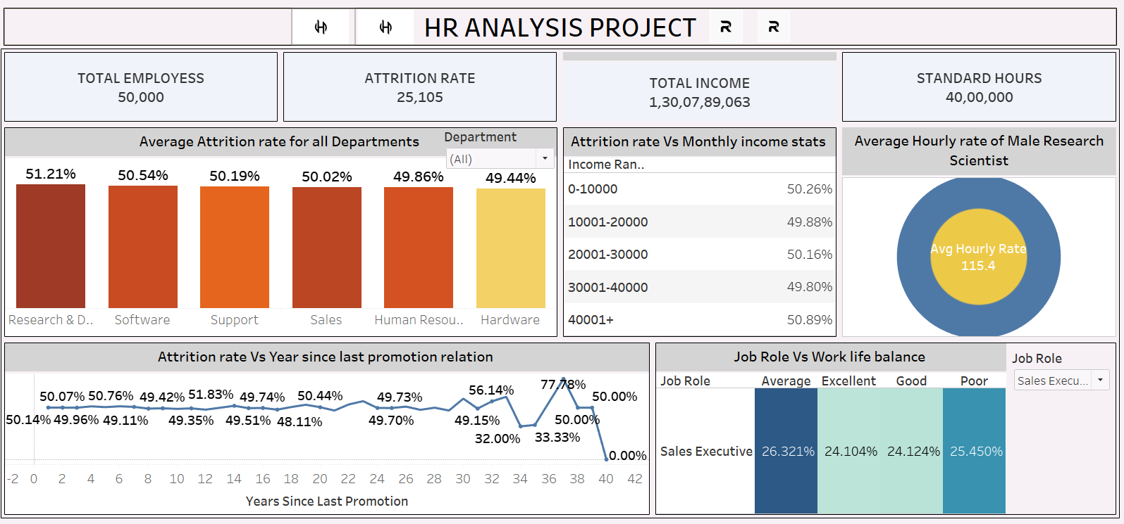
TABLEAU DASHBOARD

Slide 15
Conclusion
HR Analytics has become a powerful tool for organizations, enabling data-driven decision-making in the management of human resources. Through the analysis of employee data, HR professionals can gain a deeper understanding of key workforce trends, including performance, turnover, recruitment effectiveness, employee engagement, and training needs.
This data-driven approach offers several benefits, such as optimizing HR strategies, improving workforce planning, and enhancing overall business outcomes.
One of the key insights from HR Analytics is the identification of patterns that can explain employee turnover. By analyzing factors like tenure, compensation, job satisfaction, and work environment, organizations can pinpoint the root causes of attrition and implement targeted retention strategies.
Predictive analytics, in particular, can help forecast potential turnover risks, enabling HR teams to proactively address issues before they result in high turnover rates.

Slide 16


THANK YOU
Our team
Kaveri nimbalkar
Kareena
Sreeja Tuniki
Anagha
Sridhar
Mahadev

