Slide 1
PROJECT TITLE
CAPSTONE PROJECT
Presented By:
1. ANAGHA N PATIL - Bapuji Institute of Engineering and Technology - CSE

Slide 2
OUTLINE
Problem Statement (Should not include solution)
Proposed System/Solution
System Development Approach (Technology Used)
Algorithm & Deployment
Result (Output Image)
Conclusion
Future Scope
References

Slide 3
Problem Statement
AI agent for chronic disease monitoring :
The Challenge - An AI agent for chronic disease monitoring helps patients and healthcare providers manage long-term conditions effectively. It continuously analyzes health data from wearables, medical records, and patient inputs to detect early warning signs. Using AI and predictive analytics, it offers personalized insights, medication reminders, and lifestyle recommendations. The agent supports diseases like diabetes, hypertension, and heart conditions with real-time monitoring and alerts. It enables proactive care, reduces hospital visits, and improves patient adherence to treatment plans. This intelligent assistant bridges the gap between patients and providers, enhancing chronic care outcomes. Technology - Use of IBM cloud lite services /IBM Granity

Slide 4
Proposed Solution
The proposed system aims to address the challenge of early detection and monitoring of diabetes by using machine learning and cloud-based AI services.
It provides real-time predictions to assist healthcare professionals and patients in managing chronic conditions effectively.
Data Collection:
Use the PIMA Indian Diabetes Dataset containing features like glucose, BMI, age, and blood pressure
Additional real-time data (from wearables or manual input) can be integrated to enhance prediction
Data Preprocessing:
Handle missing values and normalize data
Perform feature engineering to identify key risk indicators

Slide 5
Machine Learning Algorithm:
Implement Logistic Regression for binary classification (diabetic or non-diabetic)
Consider alternative algorithms (Random Forest, XGBoost) for better accuracy
Deployment:
Deploy the trained model on IBM Watson Machine Learning (IBM Cloud).
Enable API access to get predictions via real-time JSON input
Evaluation:
Measure model performance using metrics like Accuracy, Precision, Recall.
Monitor and fine-tune the model for better reliability and robustness.

Slide 6
System Approach
1. IBM Cloud Watson Studio: Used to build, train, and deploy the machine learning model.
2. IBM Watson Machine Learning: Hosted the deployed logistic regression model.
3. PIMA Diabetes Dataset (CSV): Used as input for model training.
4. JSON API Testing: Used to send real-time input and receive predictions
5. GitHub: For version control and project documentation

Slide 7
Algorithm & Deployment
1. IBM Cloud Deployment Endpoint:
https://eu-de.ml.cloud.ibm.com/ml/v4/deployments/159d6a90-8e0f-4c42-a684-06077e317ef1/predictions?version=2021-05-01
NOTE: This is a REST API endpoint used programmatically — not a web page.
2. Algorithm Selection:
The chosen algorithm is Logistic Regression, a supervised classification algorithm that is well-suited for binary outcomes like predicting the presence or absence of diabetes. It was selected because:
The target variable is binary (diabetic or not)
The input features are structured and numeric
Logistic Regression is interpretable and performs well with medical datasets

Slide 8
Data Input:
The model uses the following input features from the PIMA Indian Diabetes dataset:
Pregnancies
Glucose
Blood Pressure
Skin Thickness
Insulin
BMI
Diabetes Pedigree Function
Age
These features are considered medically relevant indicators for diabetes risk.

Slide 9
Training Process:
The model was trained using the PIMA Diabetes Dataset available publicly via Kaggle. Key steps in training included:
Data cleaning and handling missing values
Feature normalization
Splitting into training and testing datasets
Applying k-fold cross-validation to evaluate model performance
Hyperparameter tuning to optimize classification accuracy

Slide 10
The model processes this input and returns a risk prediction in real time.
The result indicates whether the patient is likely to have diabetes (1) or (0), along with confidence scores.
This real-time prediction can be used for early warnings or alerts.

Slide 11
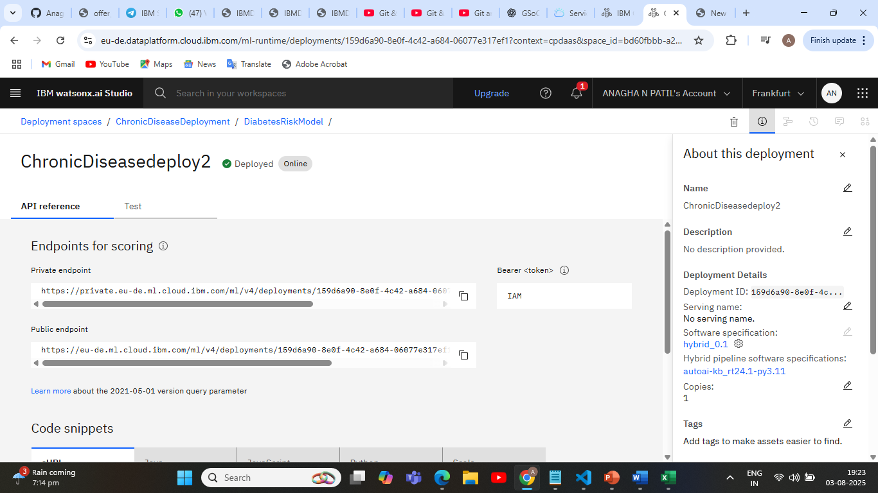
Model deployment overview

Slide 12
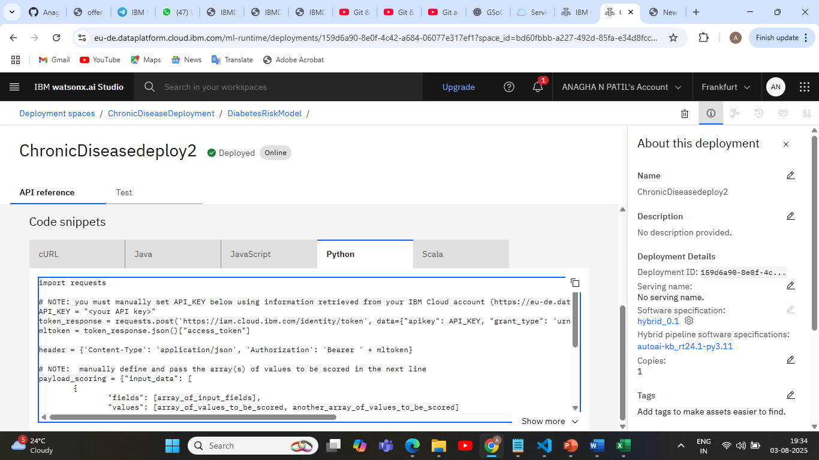
Model deployment overview

Slide 13
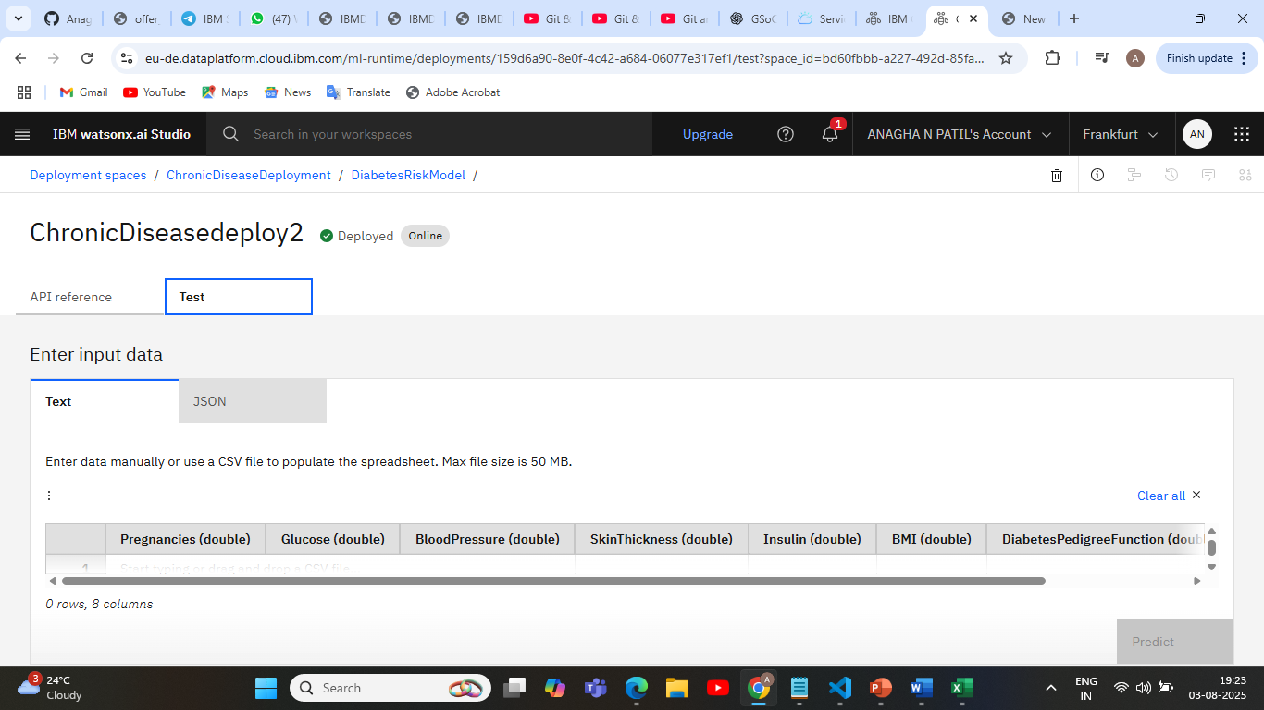
Model deployment overview

Slide 14
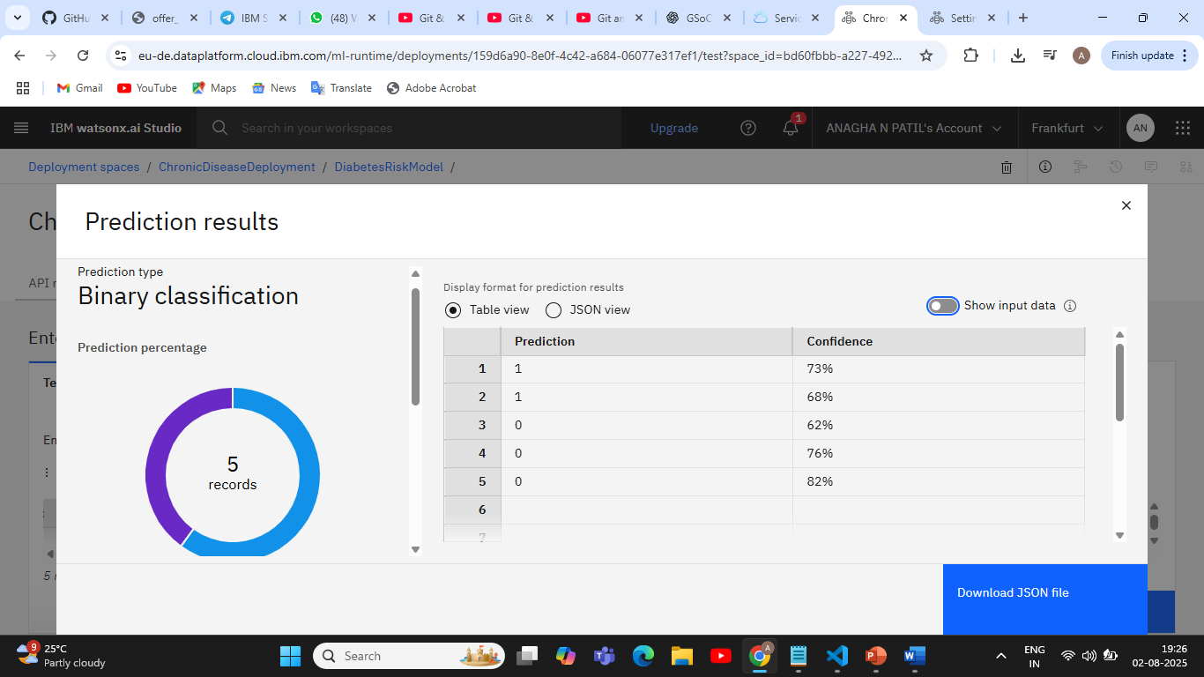
Result

Slide 15
Conclusion
The project effectively predicts diabetes risk using patient data through an AI model deployed on IBM Cloud. It offers quick, reliable results to support early intervention.
Key Findings:
Real-time predictions via API
Simple and efficient deployment
Accurate classification of diabetes risk
Challenges:
1.Data preprocessing
2.IBM Cloud configuration
This solution can support smarter, proactive healthcare decisions.

Slide 16
Future scope
1. Integrate data from wearable health devices for real-time monitoring .
2. Use more advanced ML algorithms (e.g., XGBoost, Random Forest).
3. Develop a user-friendly mobile/web app for patients and doctors.
4. Expand the system to monitor other chronic diseases like hypertension and heart conditions
.
5. Enable multilingual voice or chatbot support for better accessibility.

Slide 17
References
1. Dataset : PIMA Diabetes Dataset on Kaggle
2. GitHub Repository Link:
https://github.com/Anaghanpatil/chronic-disease-diabetes-prediction

Slide 18
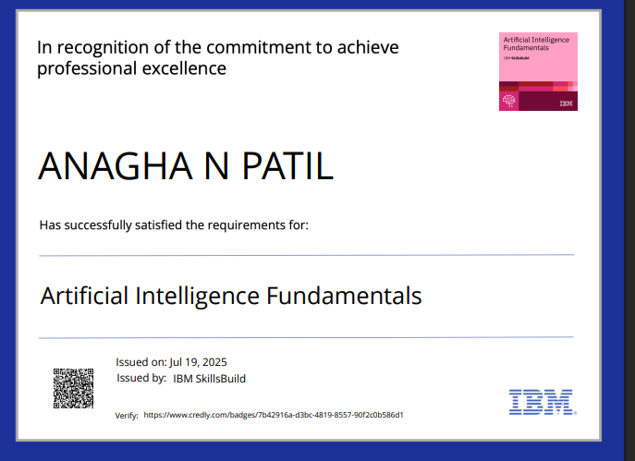
IBM Certifications

Slide 19
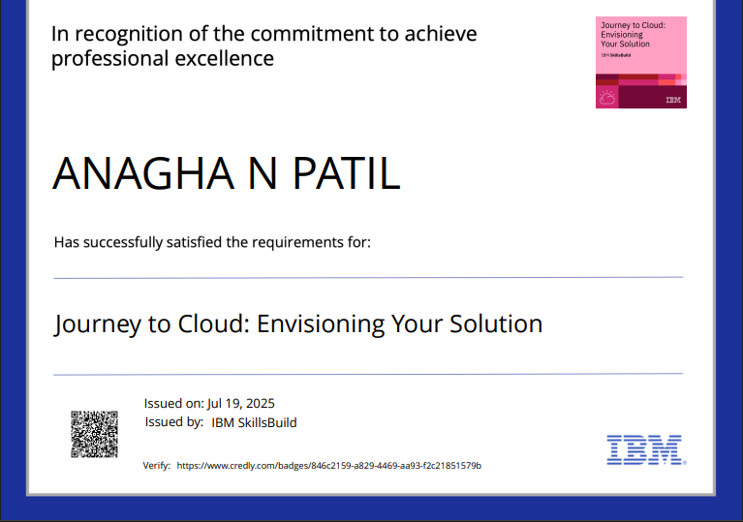
IBM Certifications

Slide 20
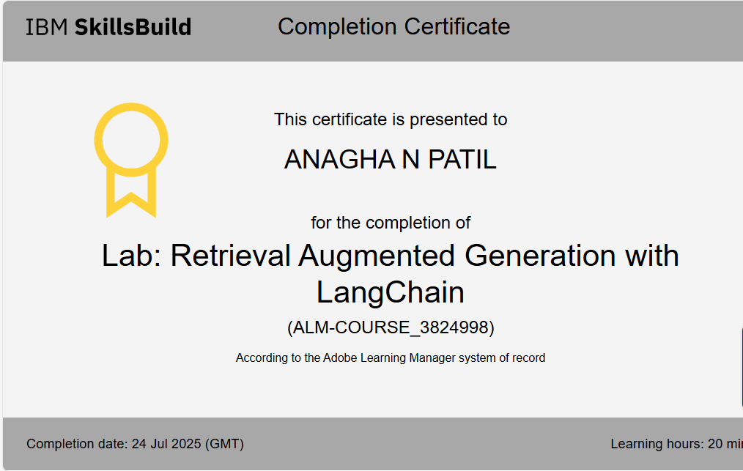
IBM Certifications

Slide 21
THANK YOU

