Slide 1
Industry Payments and Brand-Name Prescribing in Medicare Part D
Week 2 update (Oct 26 - Nov 6): propensity models, balance, benchmark and first causal estimates
DS5500 Data Science Capstone | Group 16
Anagha Raveendra, Rohan Chandrashekhar, Sri Sai Charan Yarlagadda
Sponsor: Prof. Kylie Bemis
Notes:
Week 2 covers stage 3 of our plan, the propensity model and balancing, plus the IHDP benchmark and our first causal estimates.

Slide 2




All four Week 2 steps are complete
+0.35
Calibrated propensity models
Weighted sample and love plot
points: first causal estimate (ATE) of a 2023 payment on 2024 brand share
Logistic and boosting, 5-fold cross-fitted; calibration error 0.002
All 99 covariates below SMD 0.1 after weighting
0.46 to 0.004
largest covariate imbalance, before vs after weighting
Overlap diagnostics
IHDP benchmark
By cohort and by specialty; trainees, ophthalmology and cardiology flagged
DR-learner and causal forest recover known effects
1.91
error of DR-learner effects on IHDP, half the naive error
Notes:
These are the four next steps from our Week 1 deck. We also went one step further and ran the first causal models.

Slide 3
Who we compare decides how fair the comparison is
 | All prescribers | + 2022 payment history | Newly paid vs never paid
Prescribers | 1,383,580 | 1,383,580 | 737,618
Propensity AUC (boosting) | 0.786 | 0.871 | 0.692
Propensity between 0.1 and 0.9 | 90.6% | 72.2% | 87.0%
Largest weight | 66 | 768 | 22
Effective sample size | 61% | 17% | 86%
Our choice: newly paid vs never paid
Adding 2022 payments makes the groups too easy to tell apart: one prescriber would carry a weight of 768. Comparing only prescribers with no 2022 payment keeps weights small and 86% of the sample effective.
All prescribers is kept as a secondary analysis. 530K prescribers paid in both years already had payments in their 2022 baseline.
Notes:
We fit the propensity model three ways. Adding 2022 payment history makes payment very predictable, which destroys overlap. Newly paid versus never paid gives the cleanest comparison and is our main analysis.

Slide 4
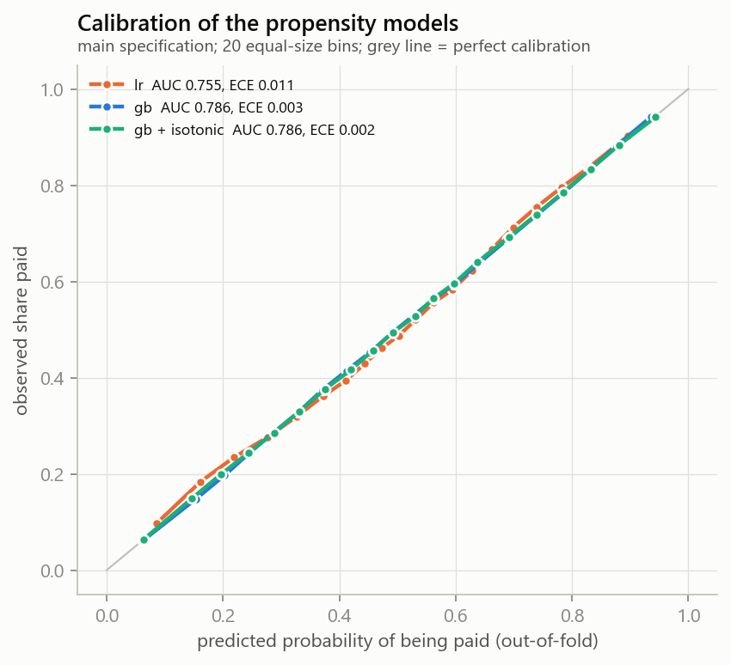
The propensity models are well calibrated
0.755
0.786
AUC, logistic regression
AUC, gradient boosting
Every score comes from a model that never saw that prescriber (5-fold cross-fitting), as the doubly robust methods require
Calibration error is 0.003: a predicted 60% means about 60% are paid
Isotonic recalibration changed almost nothing, so boosting is used as is
Figure 1. Predicted vs observed share paid, out-of-fold, all-prescribers cohort (the main cohort is equally well calibrated)
Notes:
Calibration matters because the weights are one over the propensity. Both models are well calibrated; boosting separates slightly better, so it is our primary model.

Slide 5
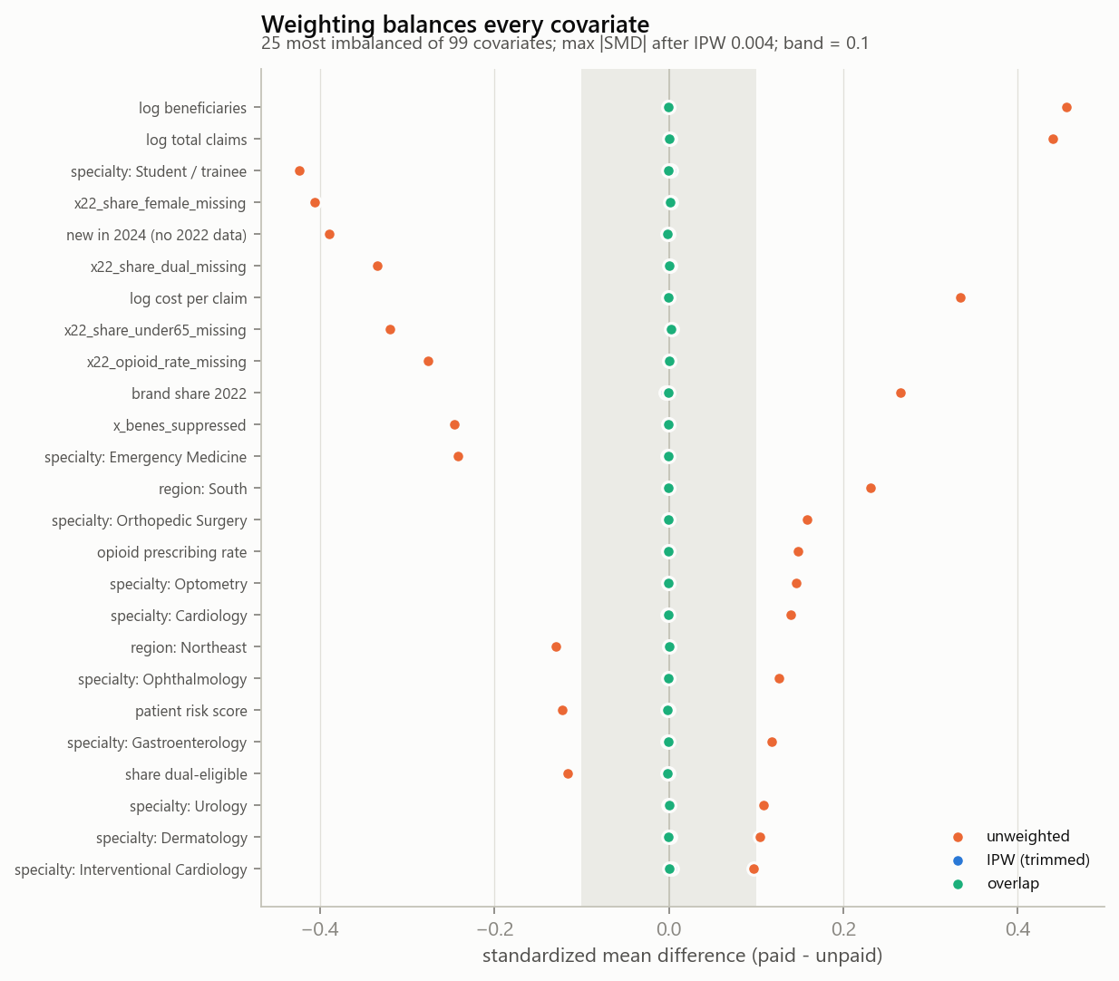
Weighting makes the two groups comparable
24 to 0
0.006
covariates above SMD 0.1, out of 99
largest imbalance after weighting, main cohort
What balance means
After weighting, paid and unpaid prescribers look alike on specialty, region, practice size, patient mix and 2022 brand share. Balance holds for IPW, ATT and overlap weights, in all three cohorts.
Figure 2. Standardized mean differences, 25 most imbalanced covariates
Notes:
Our success criterion from Report 1 was every SMD below 0.1. Before weighting 24 covariates failed; after weighting none do, and the worst is under 0.01.

Slide 6
Specialty drives who gets paid
Weakest overlap (share of prescribers with propensity 0.1 to 0.9)
Students / trainees
54%
Ophthalmology
71%
Cardiology
75%
Gastroenterology
77%
Layer A explainability: diagnostic only. It shows the shape of the confounding, not who responds to payment.
Notes:
SHAP on the propensity model confirms specialty is the biggest driver of who gets paid. Trainees are rarely paid and cardiology, ophthalmology and GI are mostly paid, so their estimates rest on fewer comparable prescribers.

Slide 7
Our estimators recover known effects on IHDP
What we learned
DR-learner has the lowest individual-effect error
First version failed: boosting propensities hit 0 or 1 with few treated. Logistic + clipping at 0.05 fixed it
Same setting is used on CMS
IHDP: 747 children, 10 replications, true effect known for everyone. Out-of-sample, 90/10 split; lower is better.
Notes:
IHDP is a standard benchmark where the true effect is known. The causal methods recover individual effects with about half the error of naive approaches. The benchmark also caught a configuration problem, which we fixed before touching the real data.

Slide 8
A first payment raises brand share by about 0.35 points
0.27 to 0.42
range across the hidden-count bounds; positive at every bound
+0.49
among prescribers with a 2022 baseline (most reliable)
-0.26
prescribers new in 2024, with no baseline: weak adjustment, reported separately
610,137 prescribers after trimming. 95% CI for the ATE: 0.30 to 0.39.
Notes:
Adjusting for who gets paid removes about 70% of the raw gap. The doubly robust and causal forest estimates agree at about 0.35 points. Among prescribers with a 2022 baseline it is about 0.5. Prescribers new in 2024 show a negative estimate, but they have no baseline, so we treat that group with caution.

Slide 9
The effect varies, and the variation is real
1.33
points: top fifth minus bottom fifth (z = 13)
Why this matters
If the variation were noise, observed effects would be flat across the fifths. They rise steadily with the prediction, so the model separates prescribers who respond from those who do not.
Notes:
This is a check on the CATE model. We group prescribers by their predicted effect and compute the observed doubly robust effect in each group. Observed effects rise from below zero to about one point, so the heterogeneity is real.

Slide 10
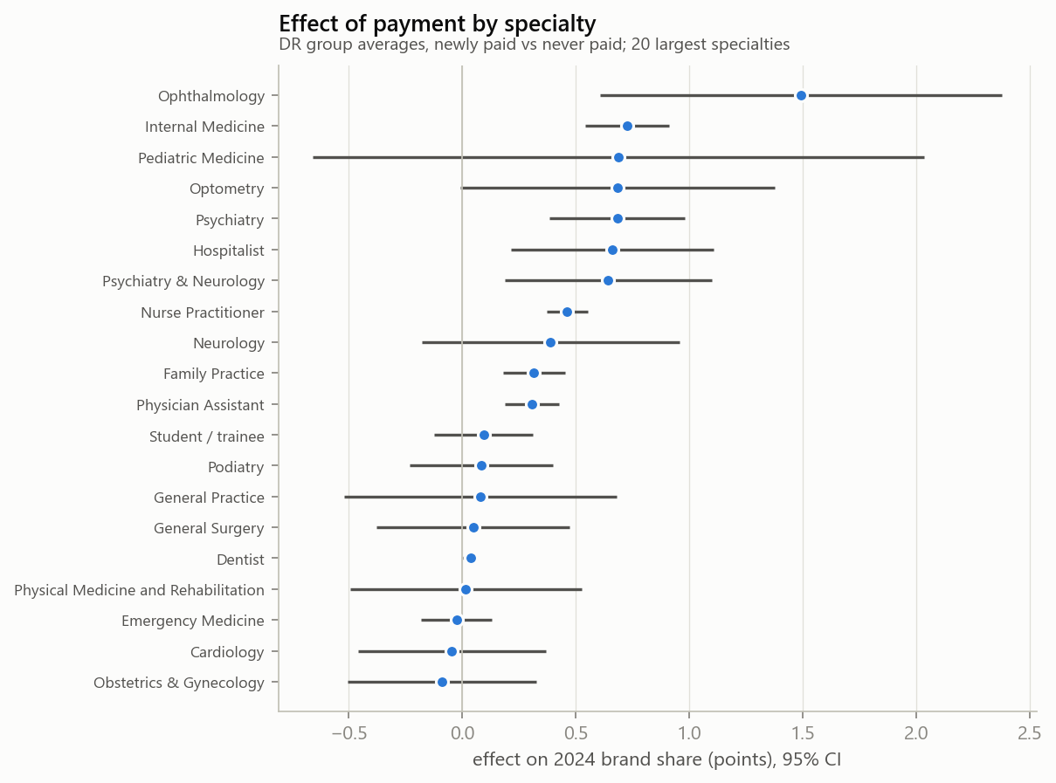




Who responds most
Larger practices respond less
+0.44 in the smallest third vs +0.16 in the largest
Mid-range brand prescribers respond most
2022 brand share: middle third +0.66, lowest +0.42, highest +0.41
Ophthalmology, internal medicine, psychiatry lead
group estimates; internal medicine also significant in the linear projection
About zero: dentists, emergency medicine, trainees
Figure 3. Effect by specialty, 95% CI, 20 largest specialties
groups that rarely prescribe brand drugs
Notes:
Layer B: these are effect modifiers, traits that change the size of the payment effect. Smaller practices and prescribers with mid-range brand share respond most. By specialty, ophthalmology, internal medicine and psychiatry have the largest group estimates; internal medicine is also significant in the linear projection, while dentists and emergency medicine show essentially no effect.

Slide 11
Key takeaways
1
The comparison is fair
What this means for Medicare
Calibrated propensities, every covariate balanced, good overlap outside a few specialties.
Raw comparisons overstate the effect about 3.5 times
A small shift per prescriber, across hundreds of thousands, still adds up in brand spending
Effects concentrate in identifiable groups, where disclosure and oversight matter most
2
The methods work
On IHDP, DR-learner and causal forest recover known effects; the benchmark caught and fixed a setup problem.
3
A small causal effect, unevenly spread
About 0.35 points on average, larger for smaller practices and some specialties.
Notes:
Our comparison is fair, our methods are validated, and the effect is small on average but concentrated in specific groups.

Slide 12
Limitations and next steps
Limitations
Next steps
Unmeasured confounding: reps may target prescribers about to adopt new brands
Prescribers new in 2024 lack a baseline; their estimate is not reliable
Thin overlap for trainees, cardiology, ophthalmology and GI
Forest interval is wide because it ran on a 200K subsample
1
Sensitivity analysis
How strong would a hidden confounder have to be to erase the effect? (Cinelli and Hazlett)
2
Layer B explainability
SHAP on the effect model and a short rule tree of who responds
3
More benchmarks
ACIC and Twins, beyond IHDP
4
Payment amount as treatment
Effect per dollar, and by payment type
Notes:
The main open question is unmeasured confounding, so the sensitivity analysis is our first next step.

Slide 13
Thank you
Questions and feedback welcome
DS5500 Data Science Capstone | Group 16
Anagha Raveendra, Rohan Chandrashekhar, Sri Sai Charan Yarlagadda
Sponsor: Prof. Kylie Bemis

