Slide 1
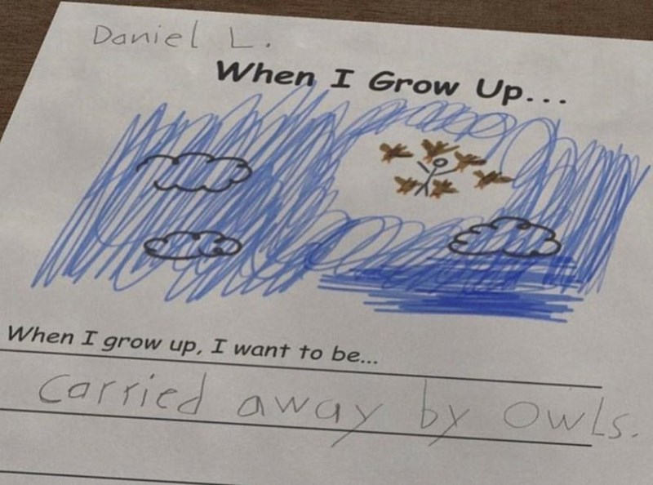
CM515 recap and review
are we meeting DREAms/expectations?

Slide 2
review
ChatGPT –
Analyze R code. Add comments, ask questions.
Practice with prompts (ChatGPT examples).
Finding and loading your dataset
RStudio –
Panes and tabs: edit, console, file browser, git, environment
Opening files
Setting Working directory in the console, in RMarkdown, in the Filebrowser
Set As Working Directory
Go To Working Directory
Synchronize Working Directory!!!

Slide 3
R: What have we learned 🤯🫠💪
Syntax (what are these construct/operators called?)
varname <- value
==
%>%
df[, 1:10]
Concepts
Data types and variables (what is the data/object type)?
greeting <- "hi there"
fave_number <- 1.618
yes_no_maybe <- TRUE
fibba_notshe <- c(1,1,2,3,5,8,13)
df <- read.csv("my_dataset.csv")
Assignment
Comparison
Pipe
Indexing
String (character)
Numeric
Logical
Vector
DataFrame

Slide 4
R: What have we learned 🤯🫠💪
Concepts: Tidyverse (Convert to Tidyverse pipes)
1. Non Pipe: function(variable_or_value)
Example: nrows(df)
Pipe: _________ %>% _________
2. Non Pipe: function(variable_or_value, argument)
Example: mean(c(1,NA,2), na.rm = TRUE)
Pipe: _________ %>% _________
3. Non Pipe: function2((function1(value_or_variable))
Example: nrows(read_csv("my_data_file.csv"))
Pipe: _________ %>% _________
df %>% nrows()
c(1,NA,2) %>% mean(na.rm = TRUE)
read_csv("my_data_file.csv") %>% nrows()

Slide 5
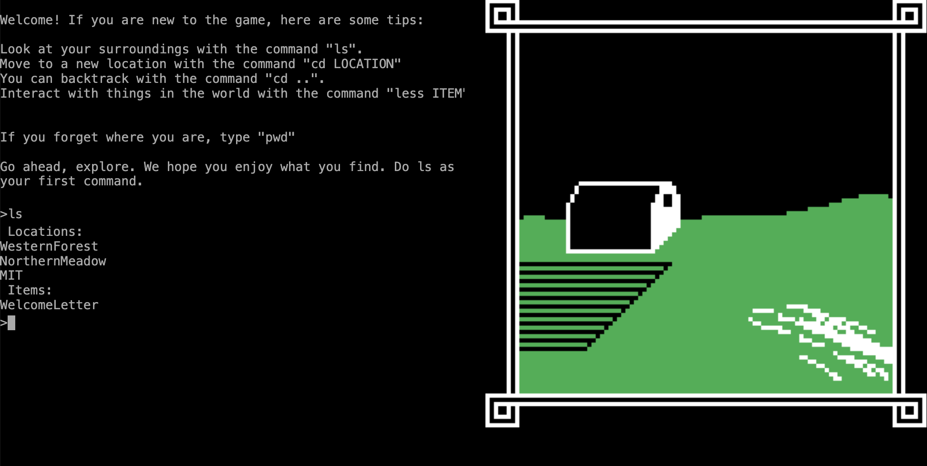
BASH What have we learned 🤔🤔🤔
Action | R | BASH
Change directories | ? | cd
Print working directory | getwd() | ?
List files/folders | ? | ls
? | ls() | will learn later
Something from terminus | ? | Something from terminus

Slide 6
you are now ReadY for ggplot

