Slide 1


Spooky Authors Predictive Analysis of Natural Language

Slide 2


Team Members
Kali Blevins (Team Lead)
Anais Dotis-Georgiou (Tester)
Danny Lu (Data Engineer)
Bharathy Natarajan (Scrum Master)

Slide 3
Overview
Using the raw datasets from the Kaggle data competition 'Spooky Authors', we performed a basic natural language analysis with the aim of identifying particular authors based on a sample of their writing.

Slide 4
NLTK (Natural Language Toolkit)
‘NLTK is a leading platform for building Python programs to work with human language data. It provides … text processing libraries for classification, tokenization, stemming, tagging, parsing, and semantic reasoning, [and] wrappers for industrial-strength NLP libraries...’
Free & open source
http://www.nltk.org/

Slide 5
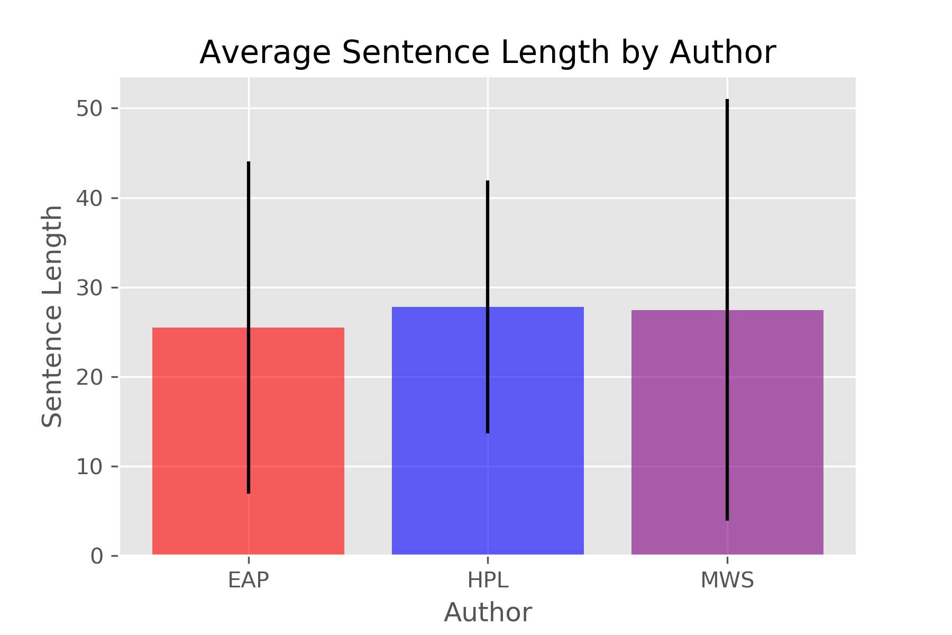
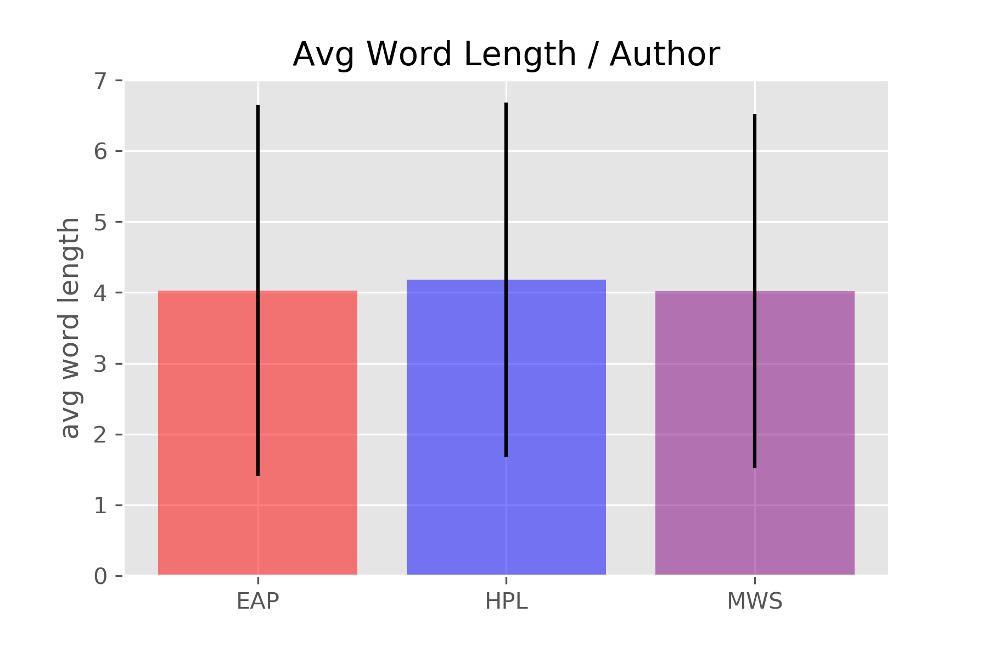
Basic Sentence structure – length & variety

Slide 6
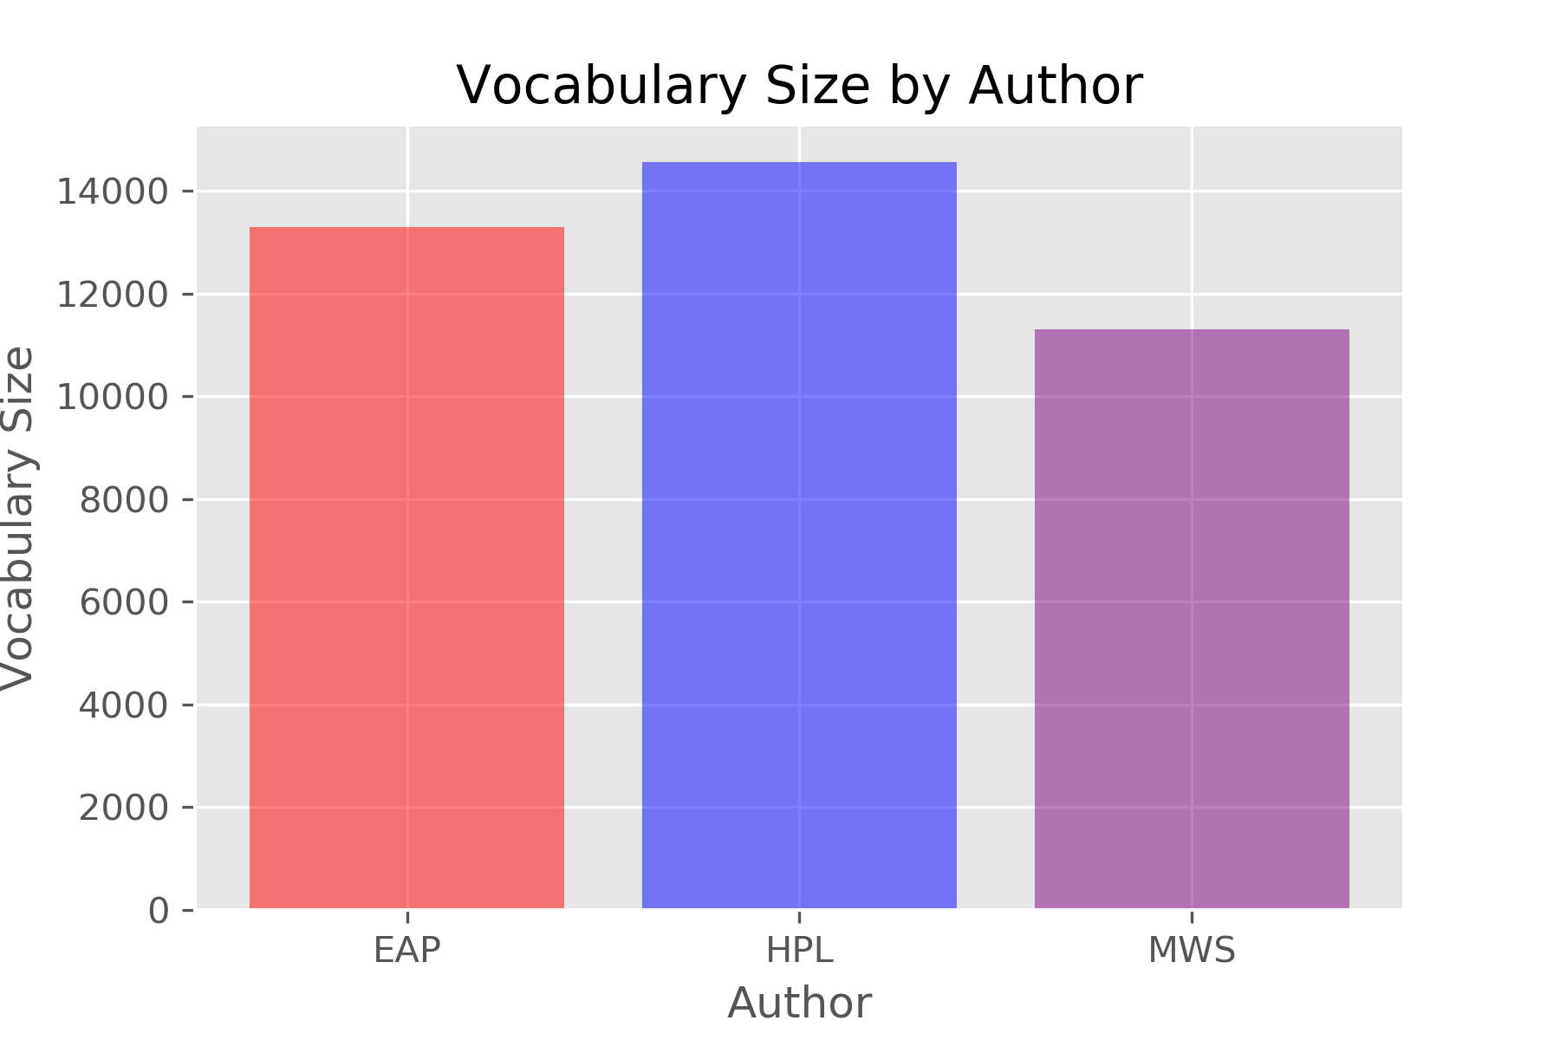
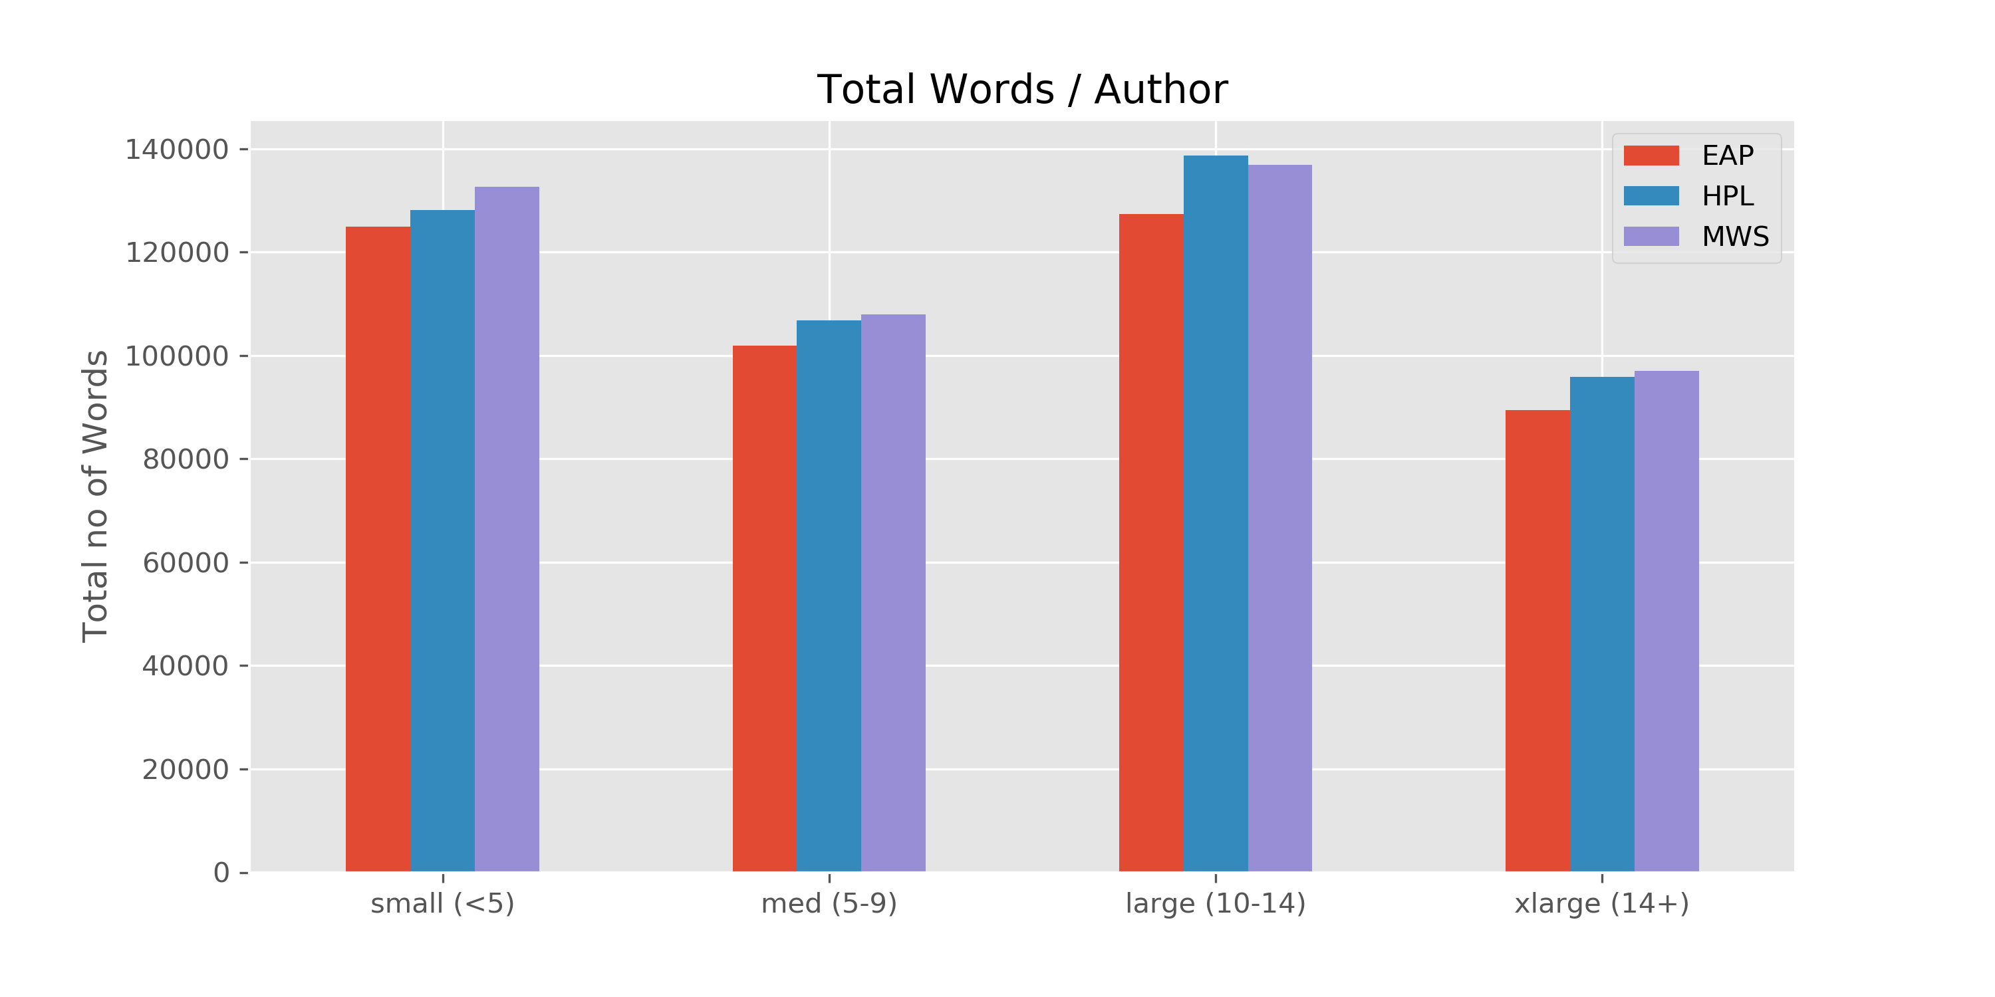
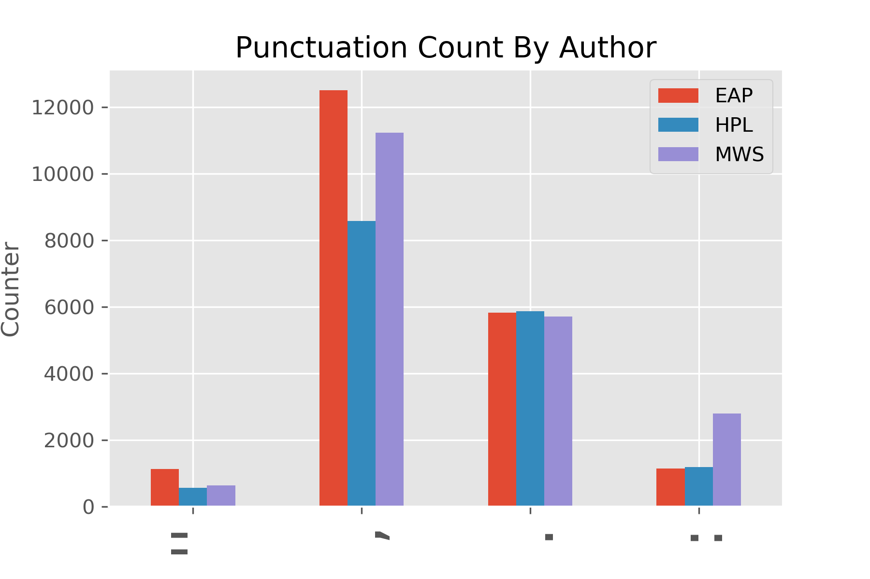
Vocabulary & Punctuation

Slide 7
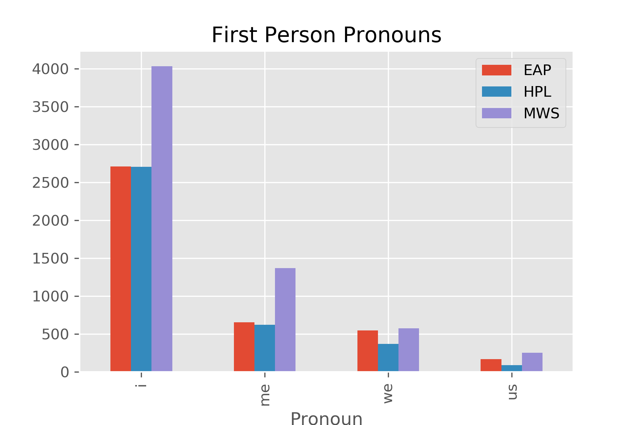
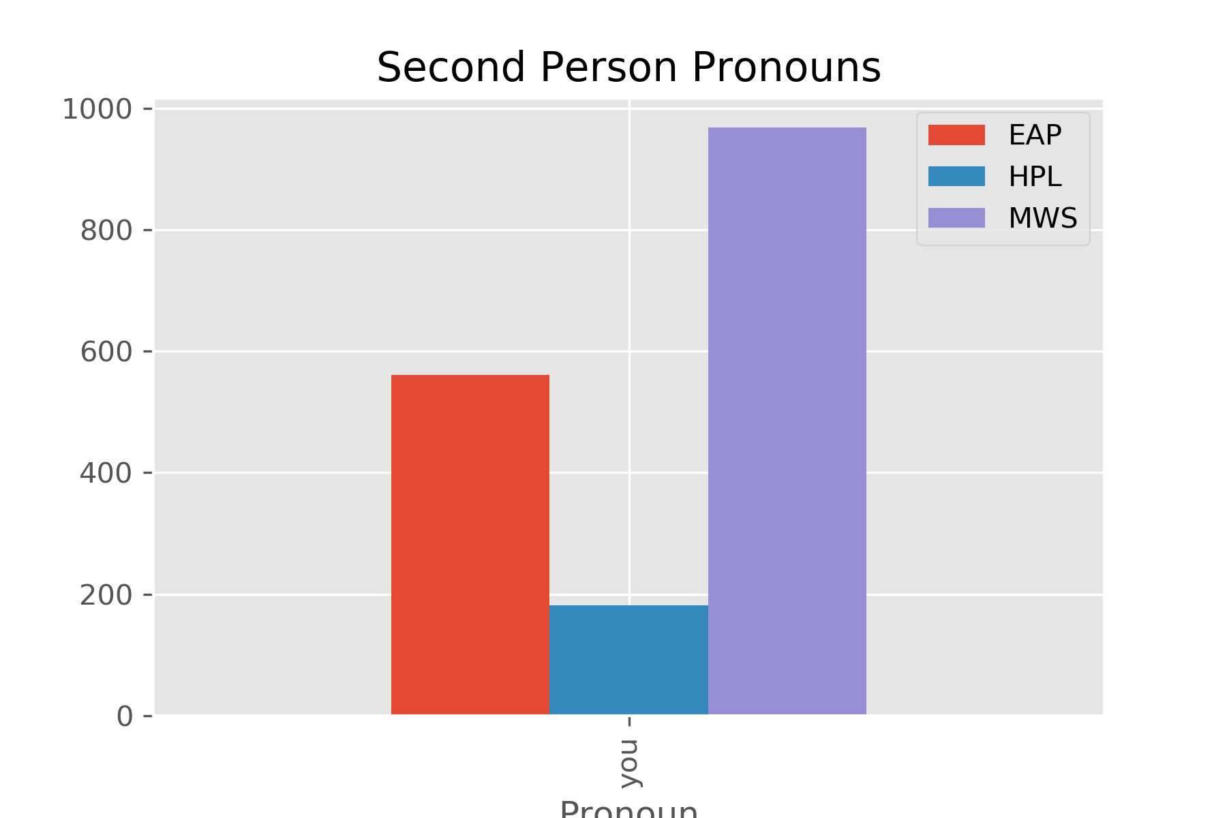
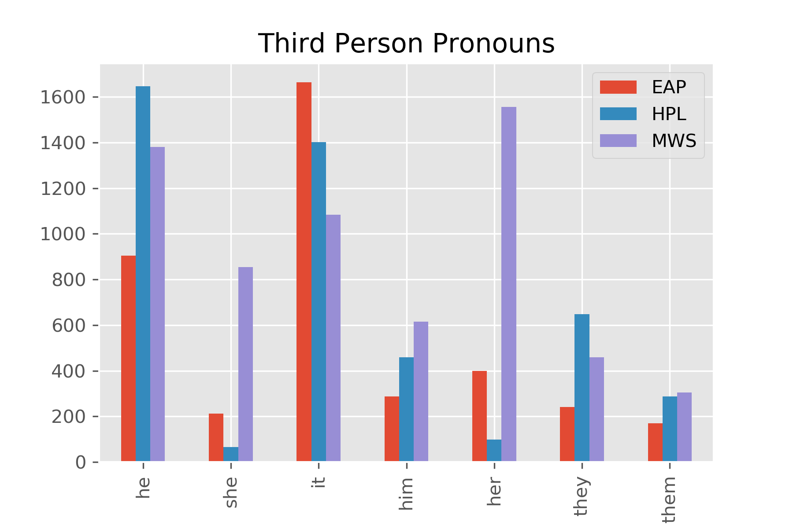
Point of View

Slide 8
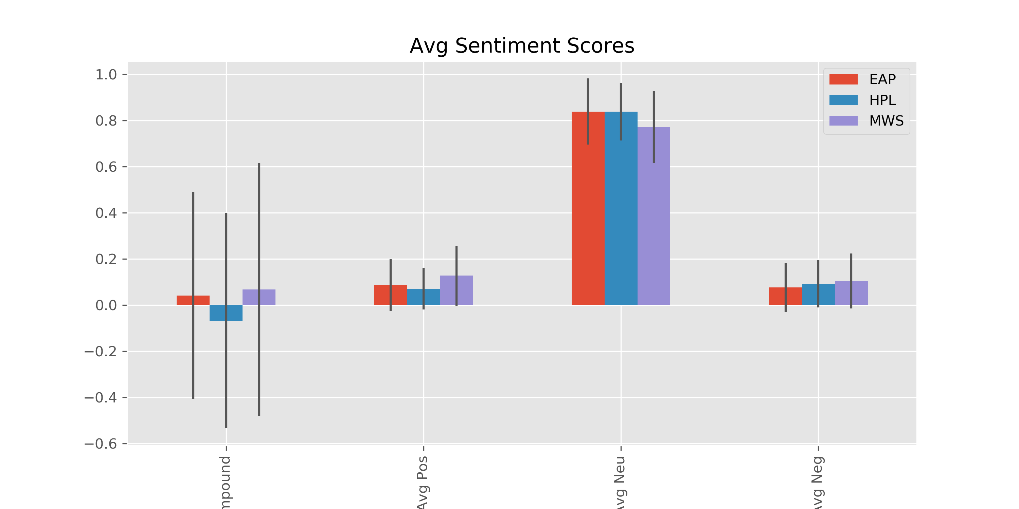
Sentiment Scores

Slide 9
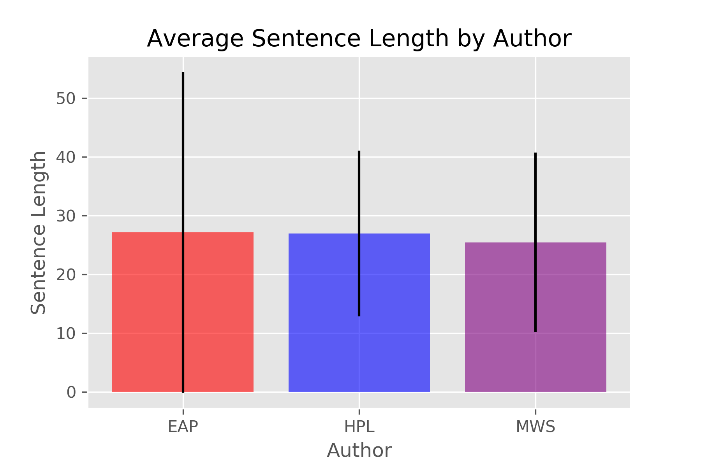

Train Data
Test Data

Slide 10
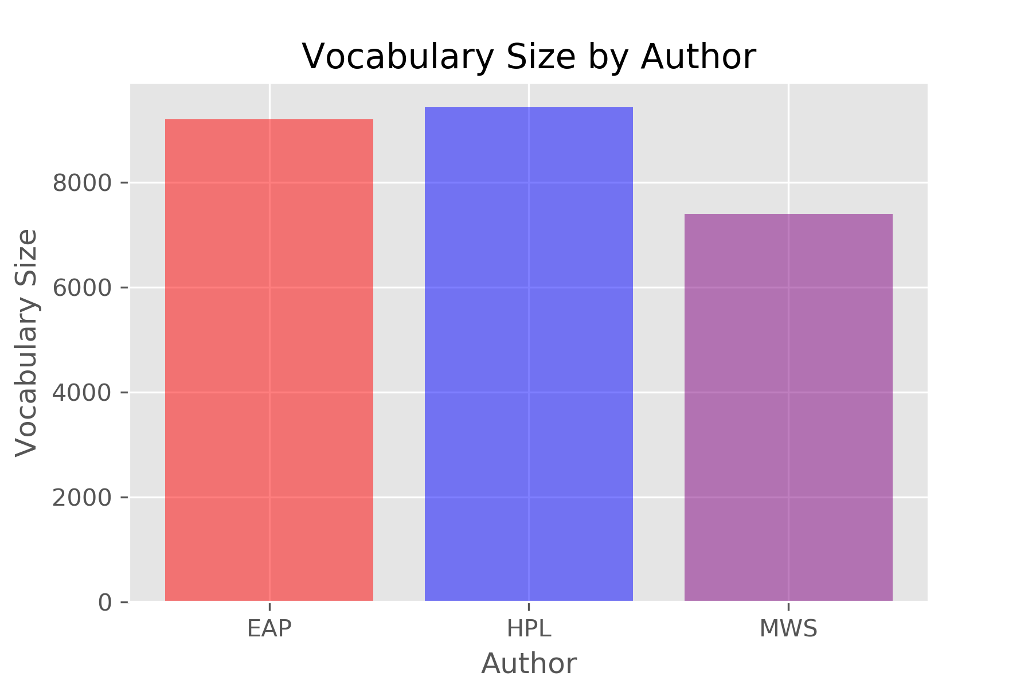
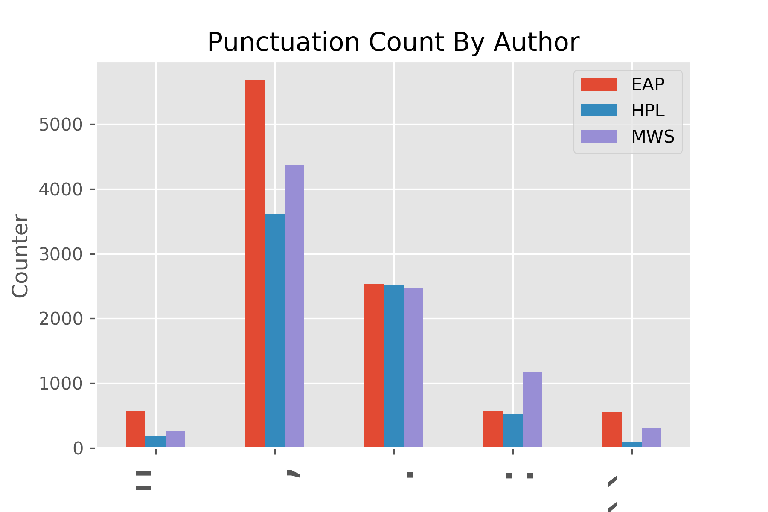
Train Data
Test Data

Slide 11
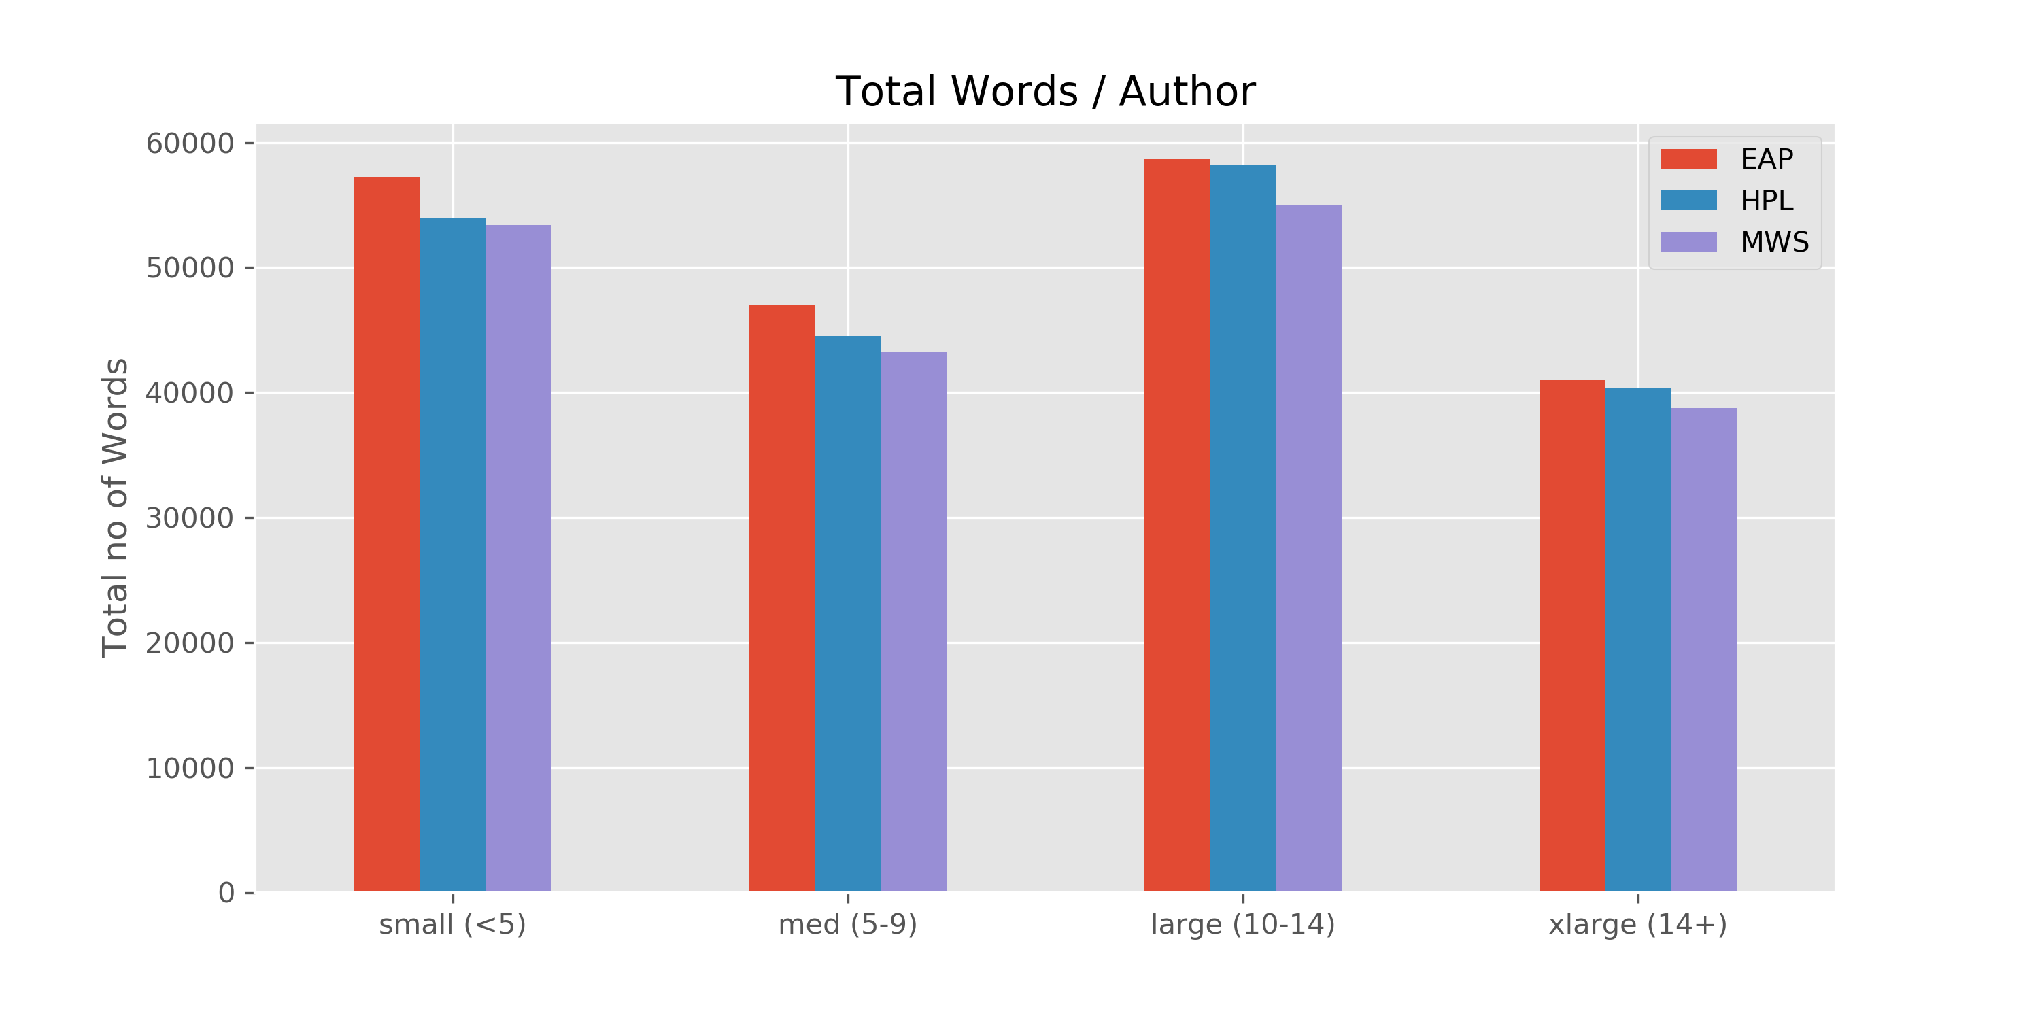
Train Data
Test Data

Slide 12
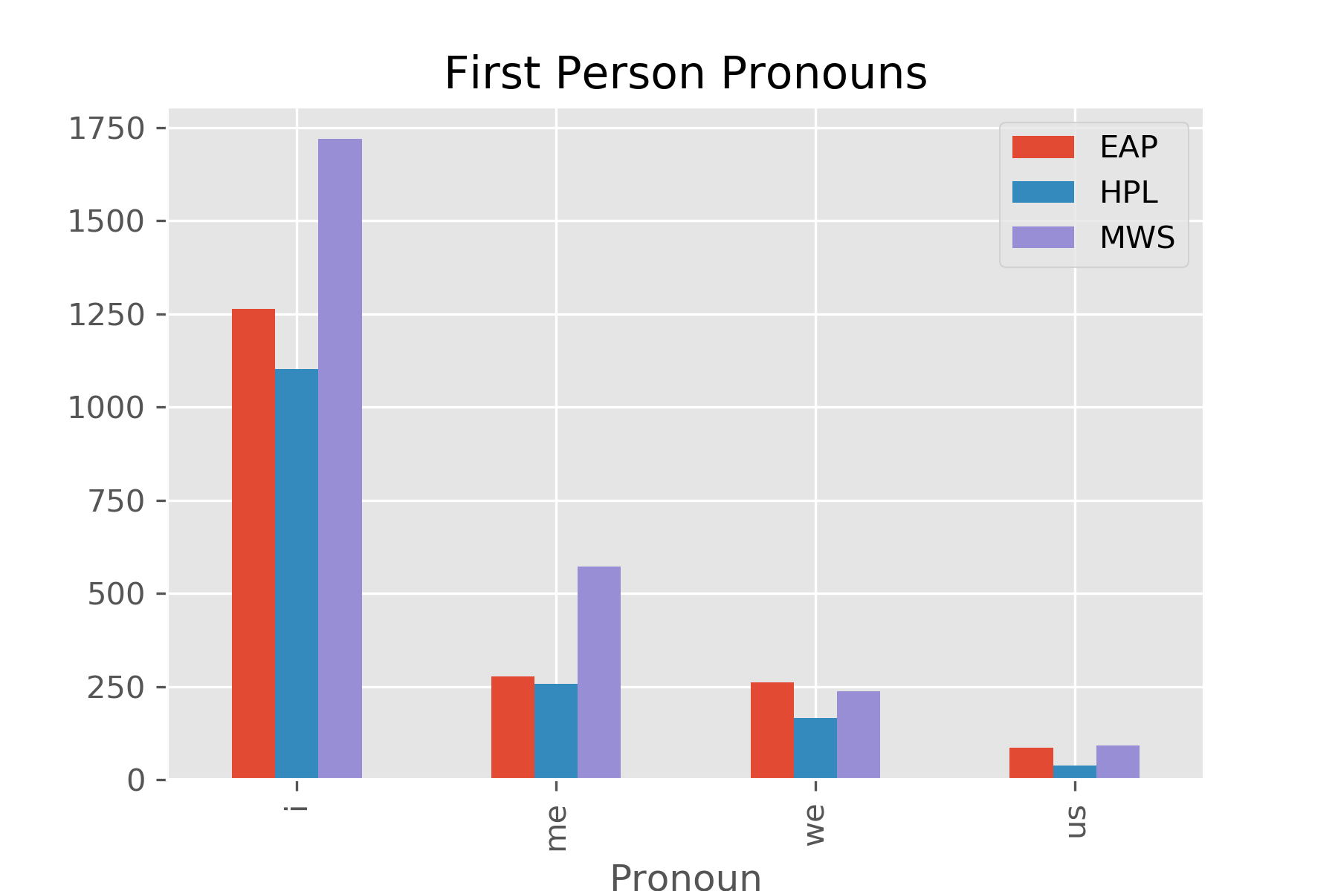
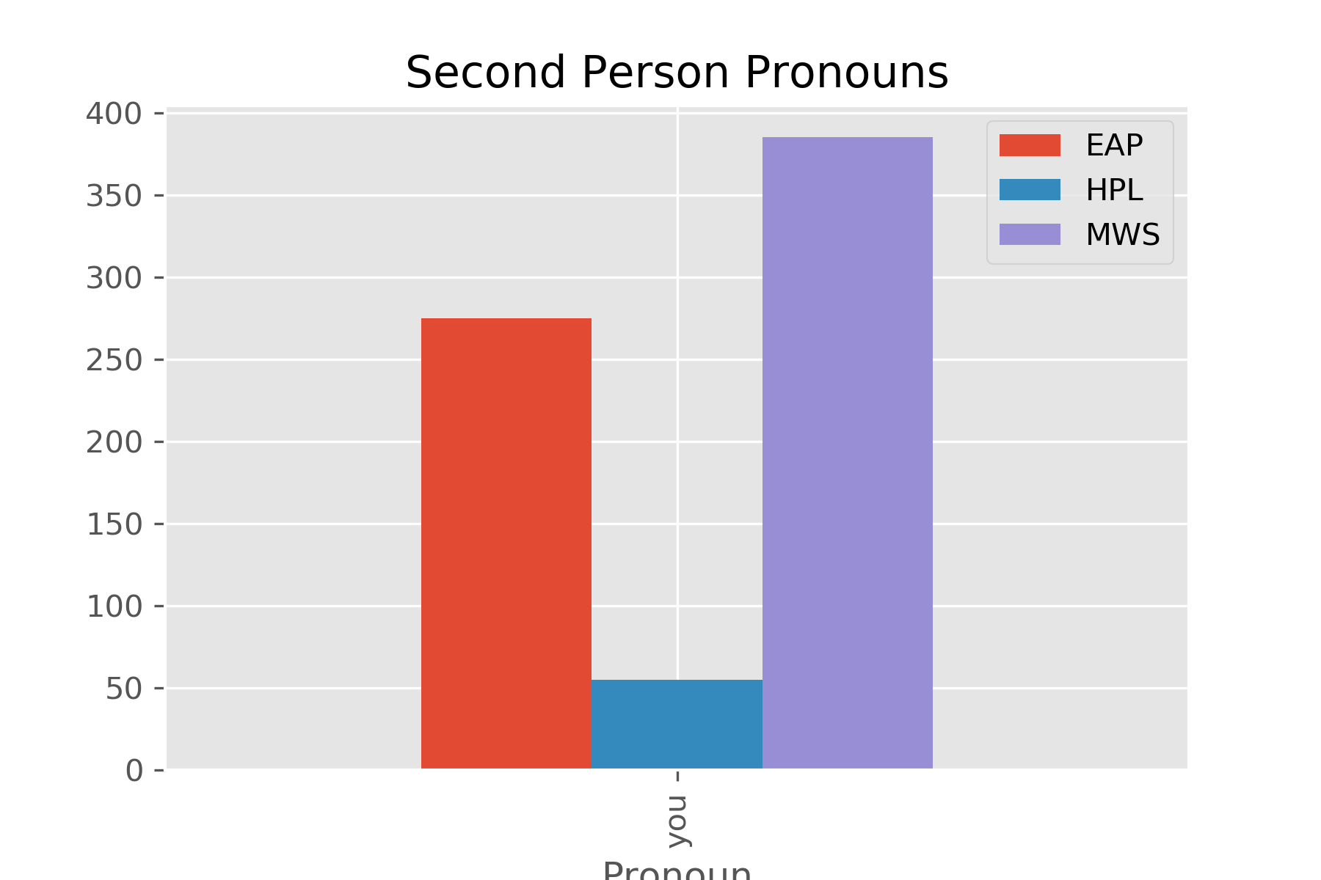
Train Data
Test Data

Slide 13
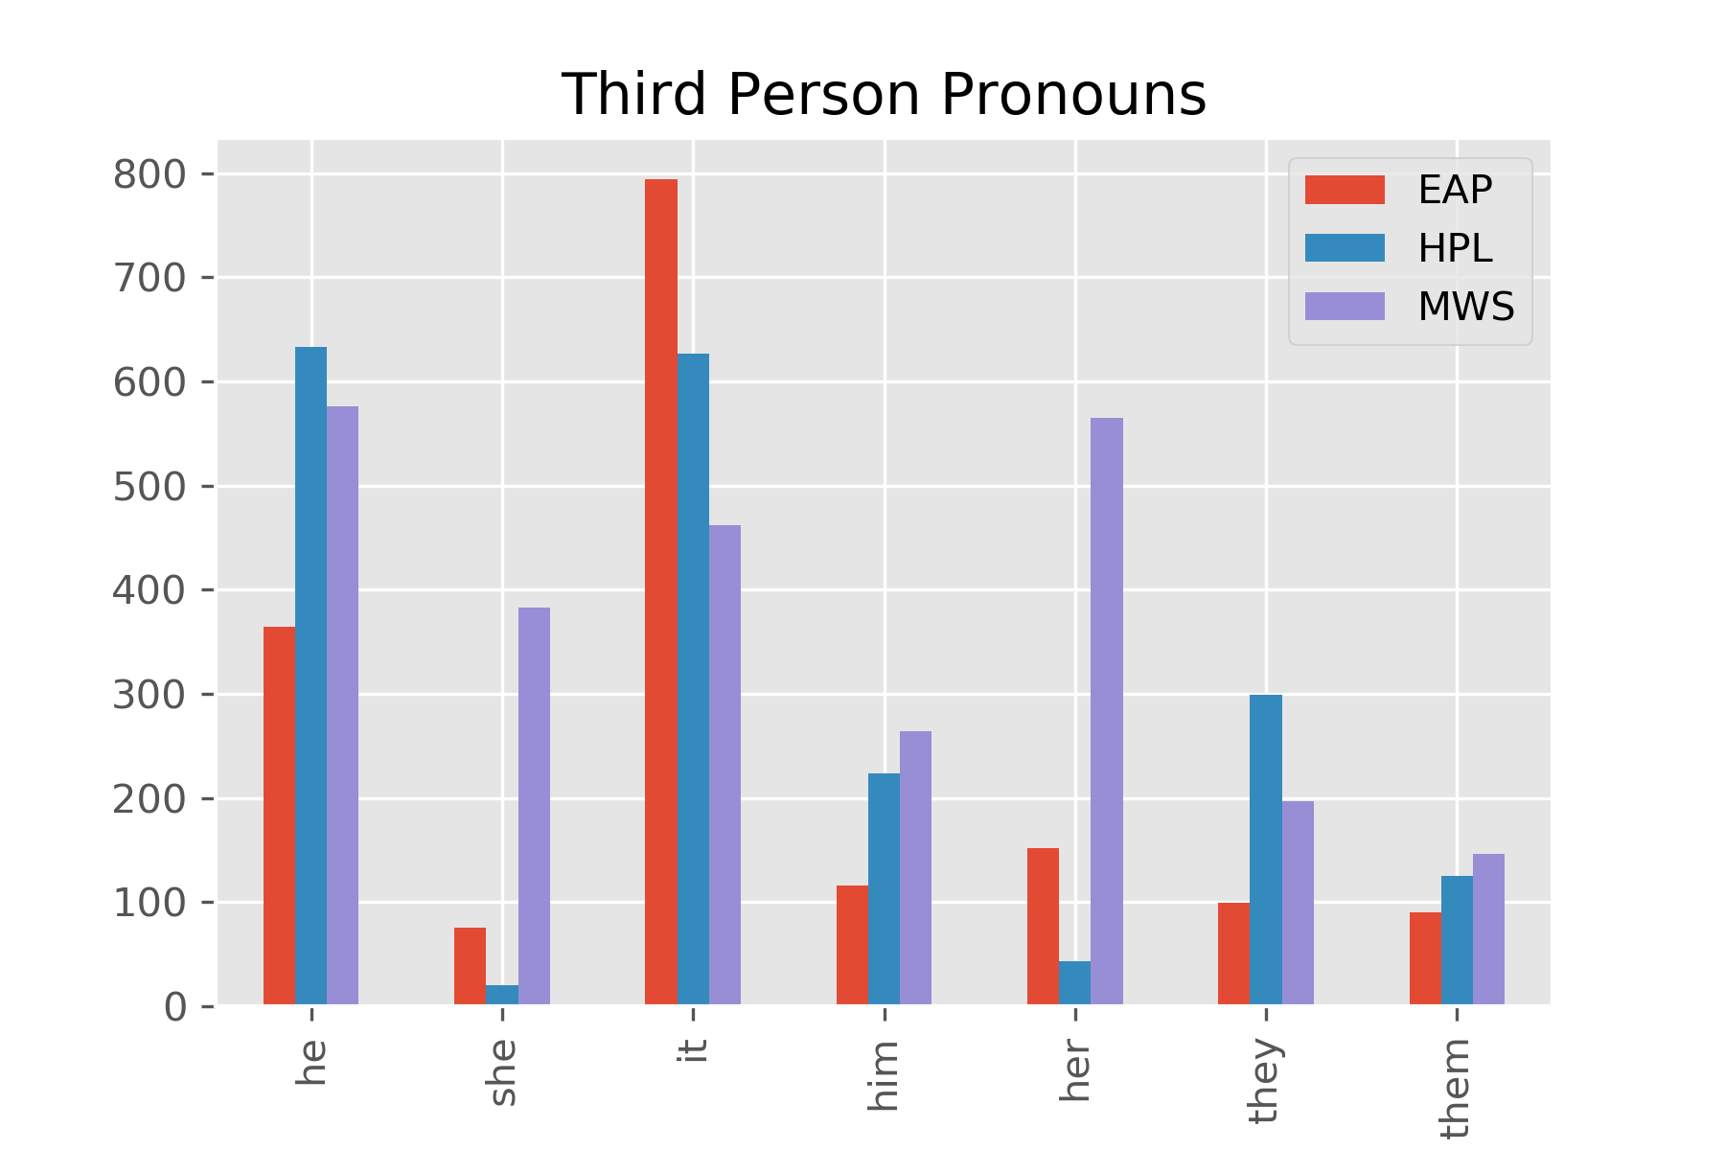
Train Data
Test Data

Slide 14
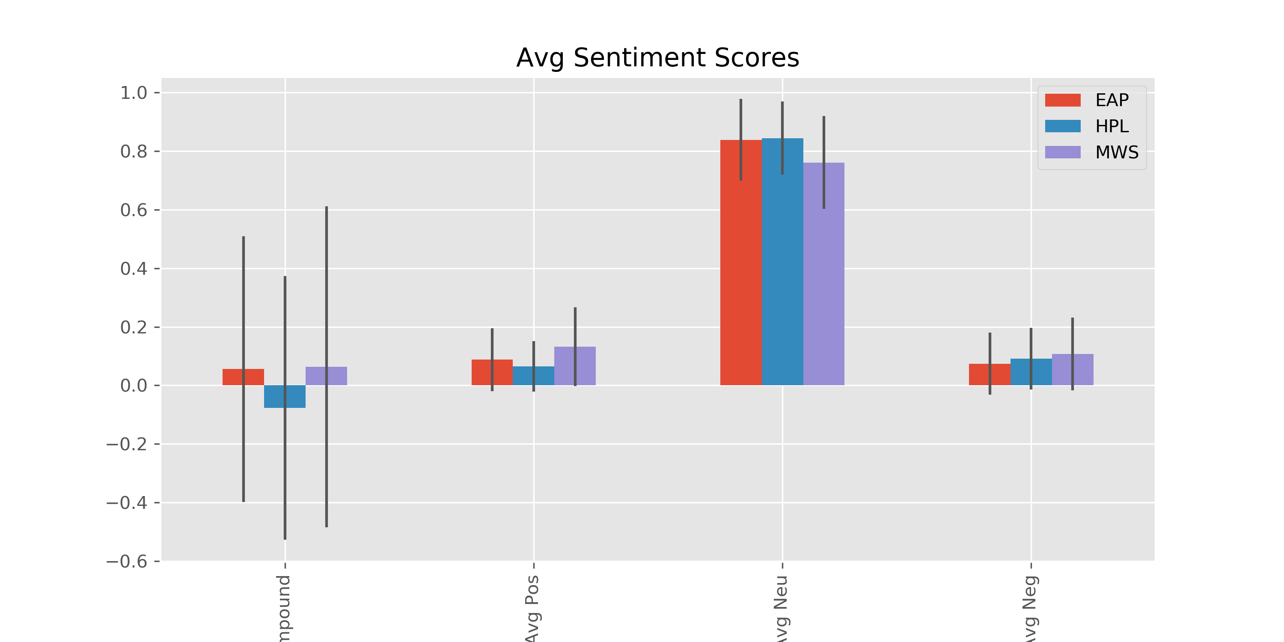
Train Data
Test Data

