Slide 1


Spooky Authors Predictive Analysis of Natural Language
Kali Blevins (Team Lead)
Anais Dotis-Georgiou (Tester)
Danny Lu (Data Engineer)
Bharathy Natarajan (Scrum Master)

Slide 2
Overview
Using the raw datasets from the Kaggle data competition 'Spooky Authors', we performed a basic natural language analysis with the aim of identifying particular authors based on a sample of their writing.

Slide 3
Questions
What are the sentiment scores for each author?
How does each author vary with respect to:
sentence length
word length
special characters usage
word variety
pronoun usage
Can we assign authorship to sentences?
How does the assigned authorship dataset compare to the provided dataset with author already assigned?

Slide 4
Data Exploration & Cleanup
Group dataset by author
Create equal length datasets for each author in the training data
Count length of each author dataset
Randomly sample the datasets for the authors with longer datasets to subset for equal lengths
Remove outliers for really long passages

Slide 5
Analyses

Slide 6
NLTK (Natural Language Toolkit)
‘NLTK is a leading platform for building Python programs to work with human language data. It provides … text processing libraries for classification, tokenization, stemming, tagging, parsing, and semantic reasoning, [and] wrappers for industrial-strength NLP libraries...’
Free & open source
http://www.nltk.org/

Slide 7
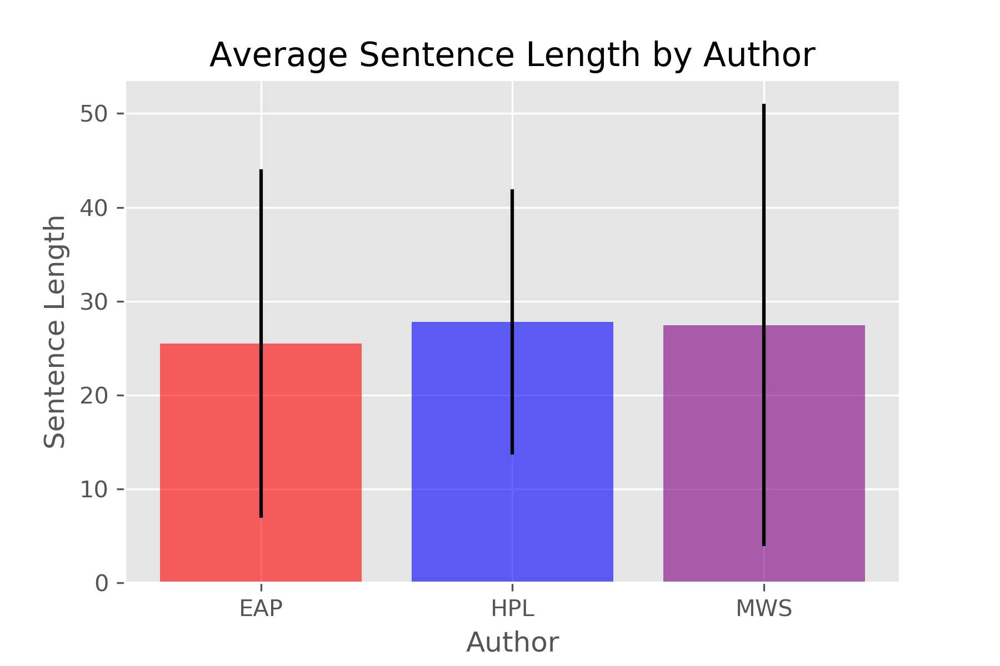
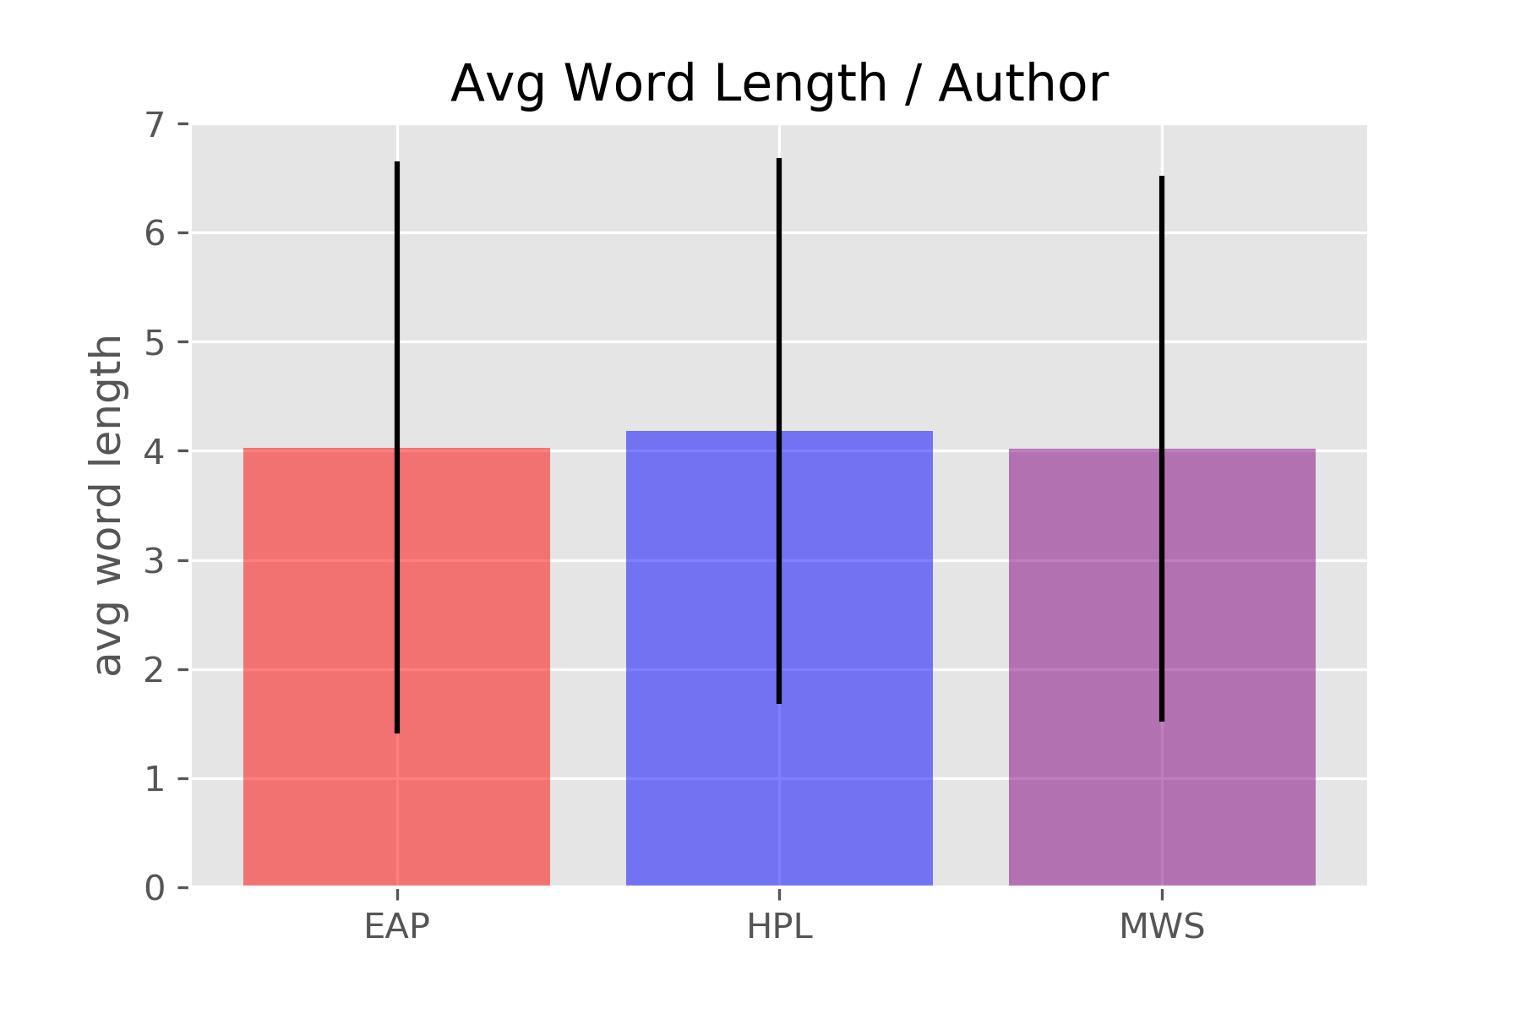
Basic Sentence structure – length & variety

Slide 8
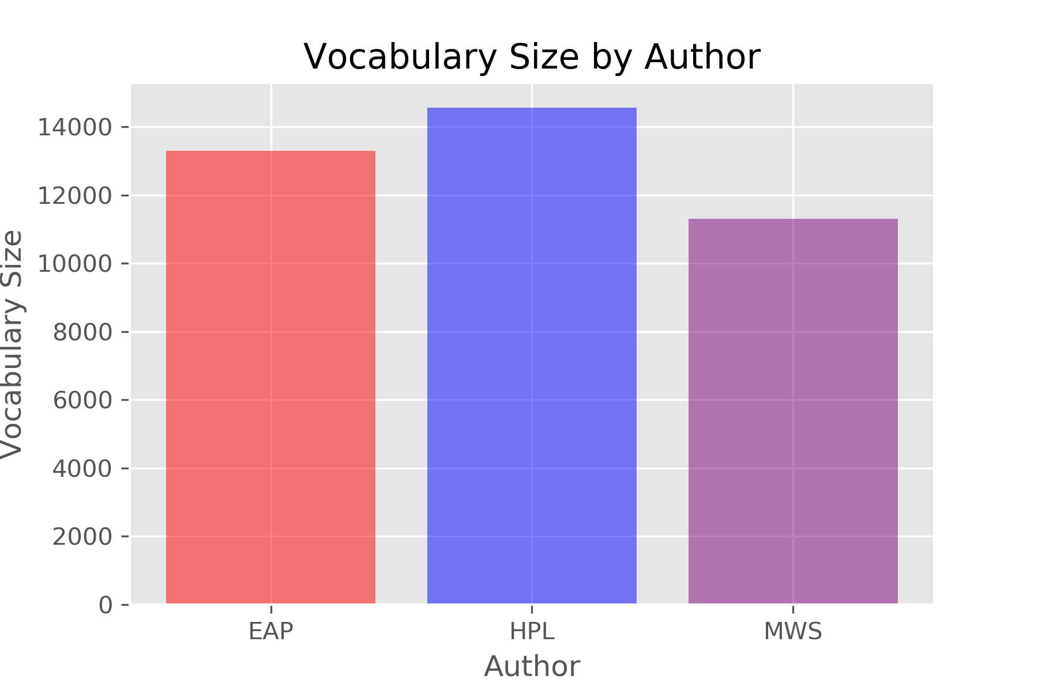
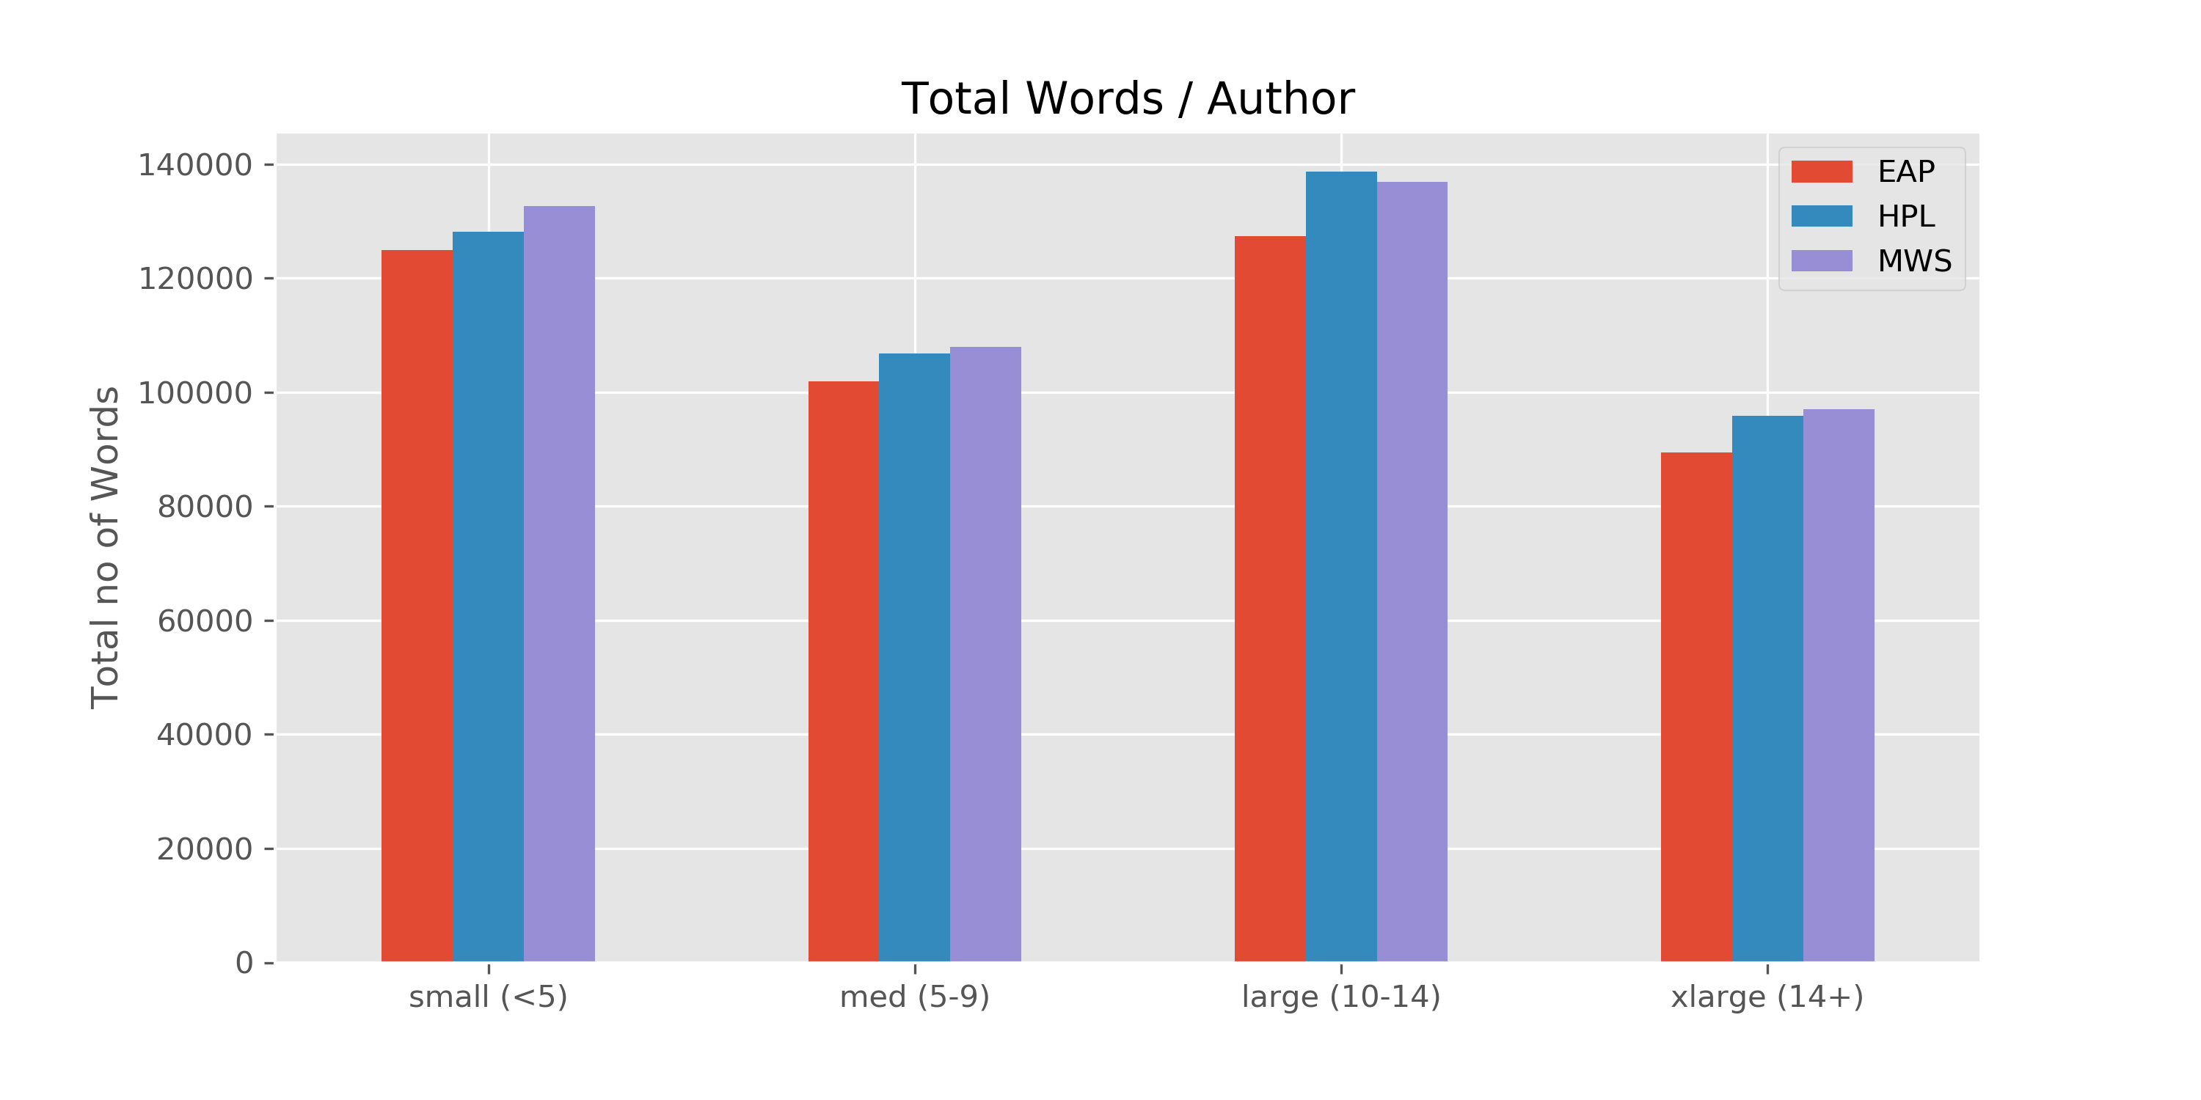
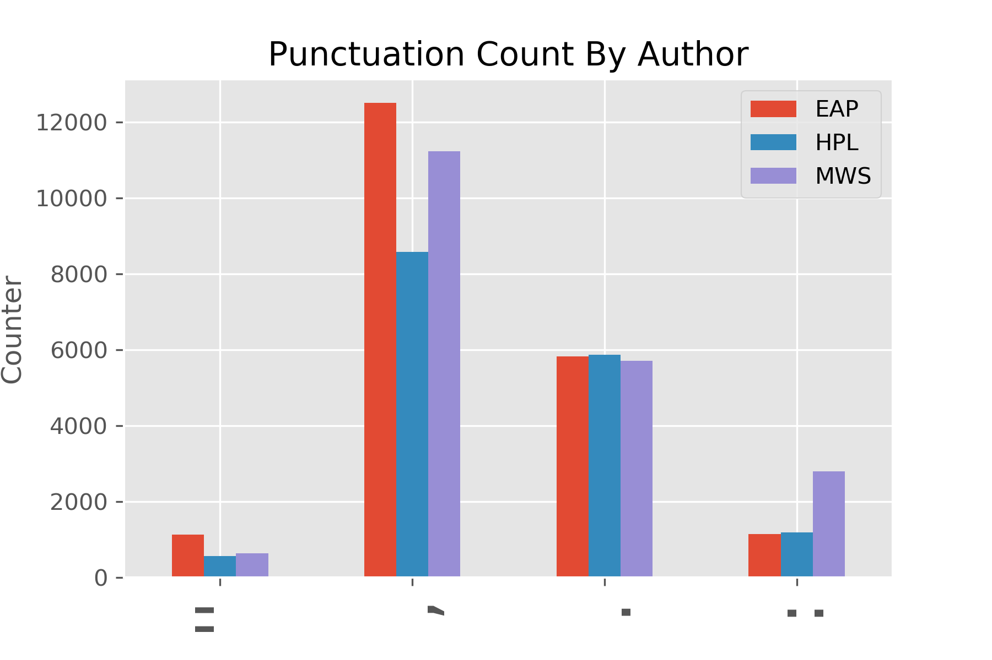
Vocabulary & Punctuation

Slide 9
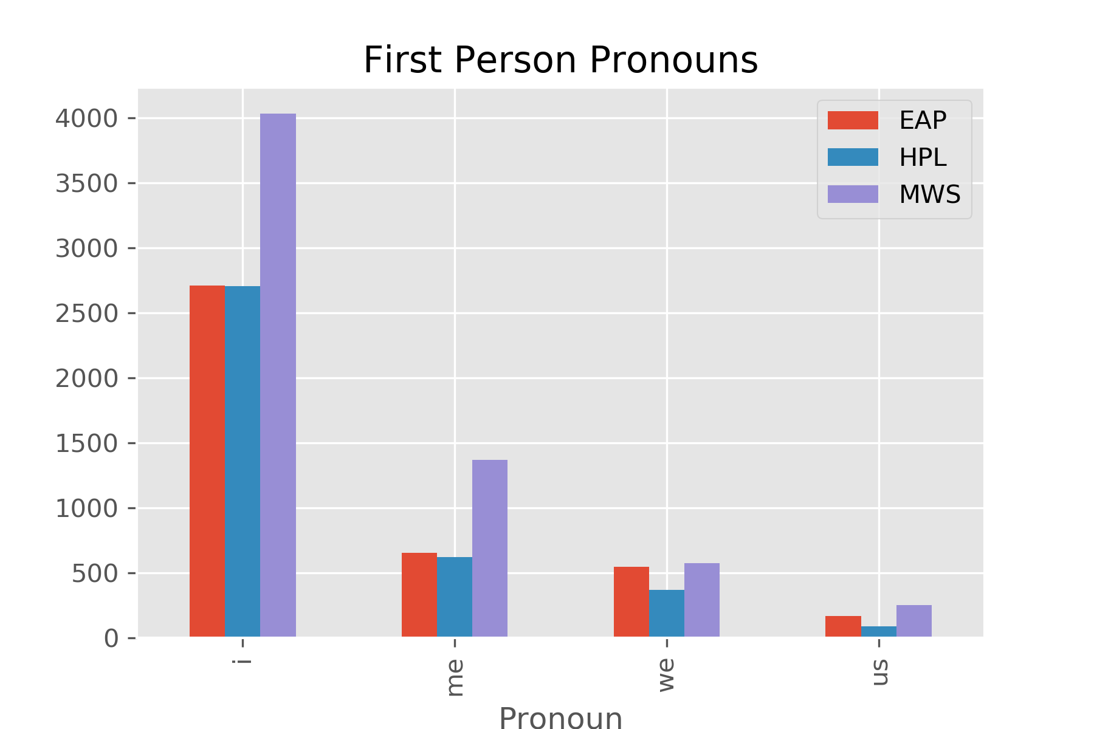
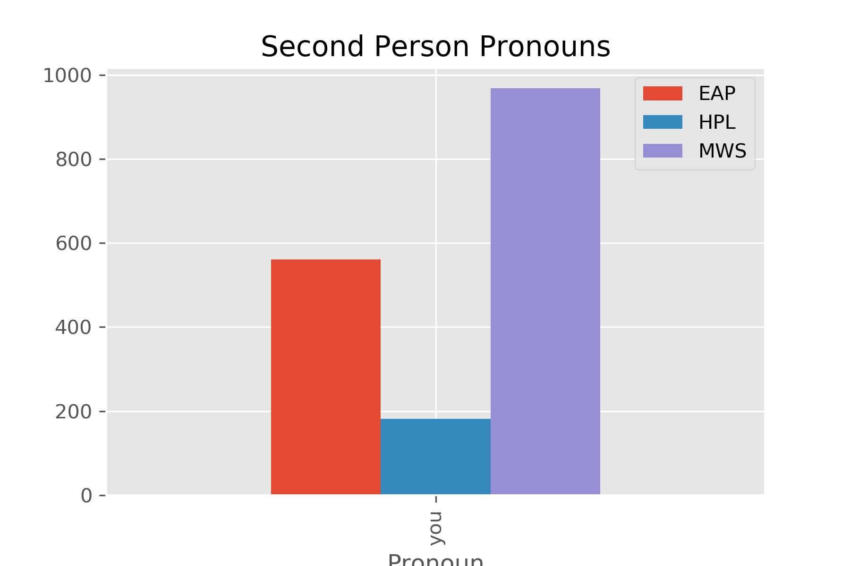
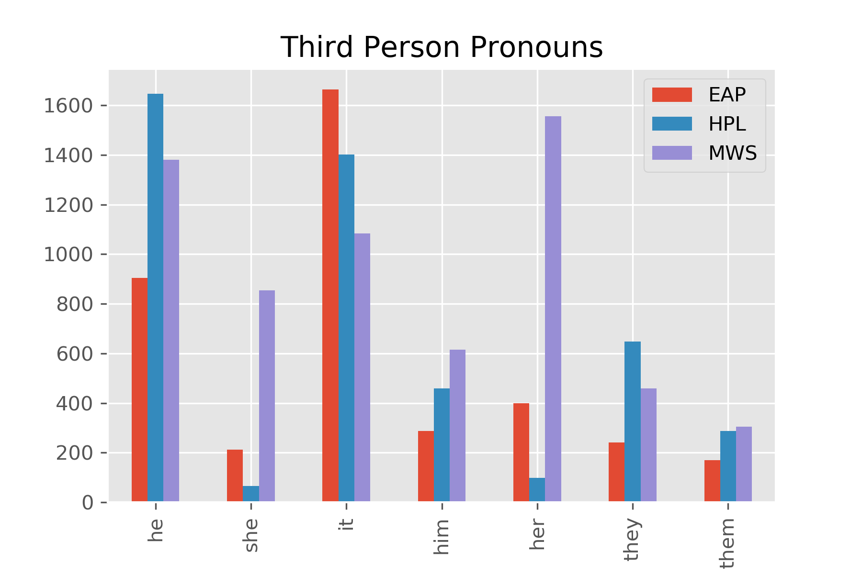
Point of View

Slide 10
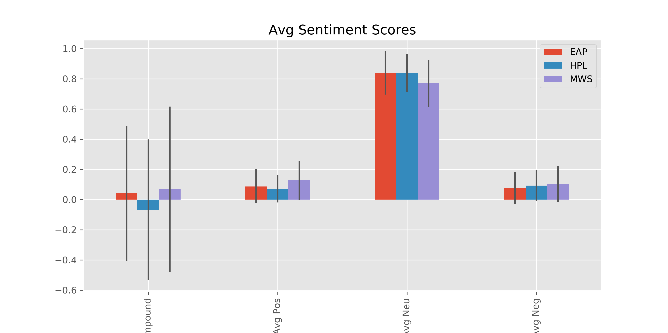
Sentiment Scores

Slide 11
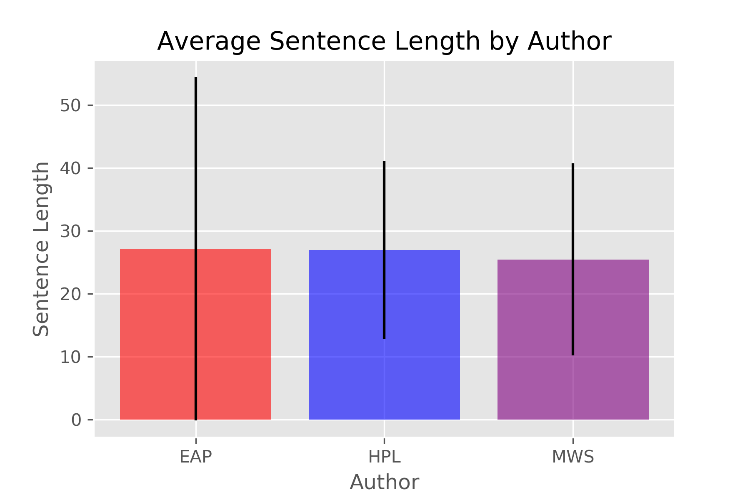

Train Data
Test Data

Slide 12
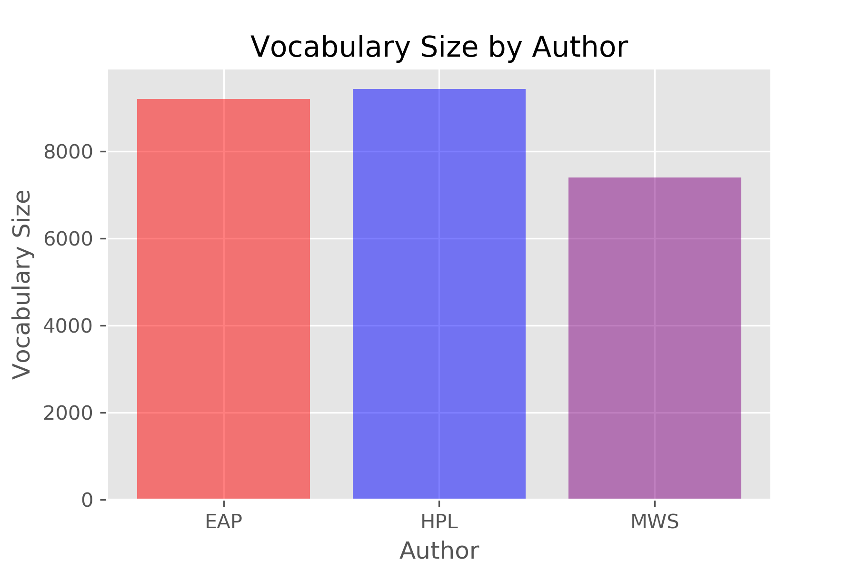
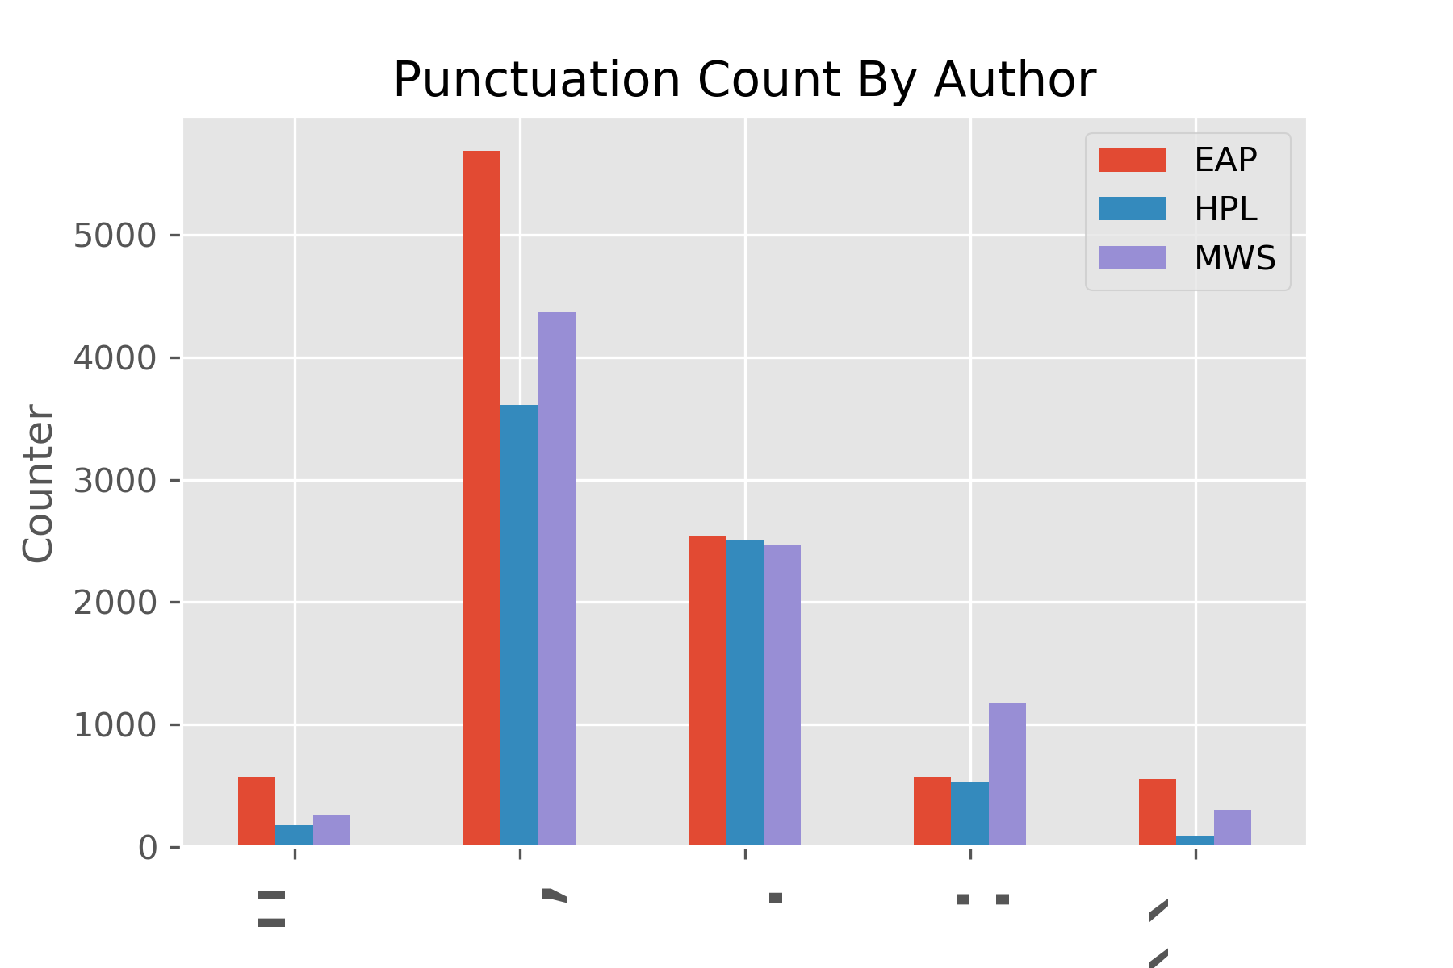
Train Data
Test Data

Slide 13
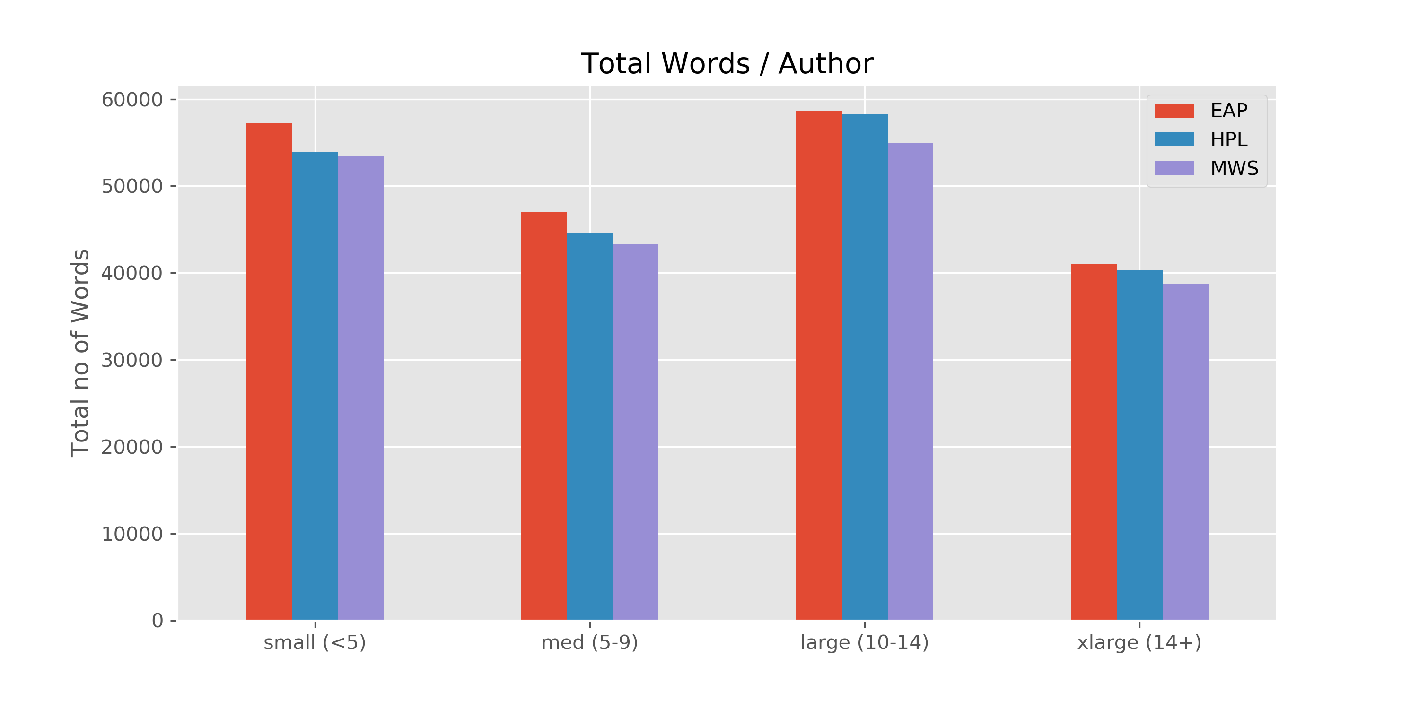
Train Data
Test Data

Slide 14
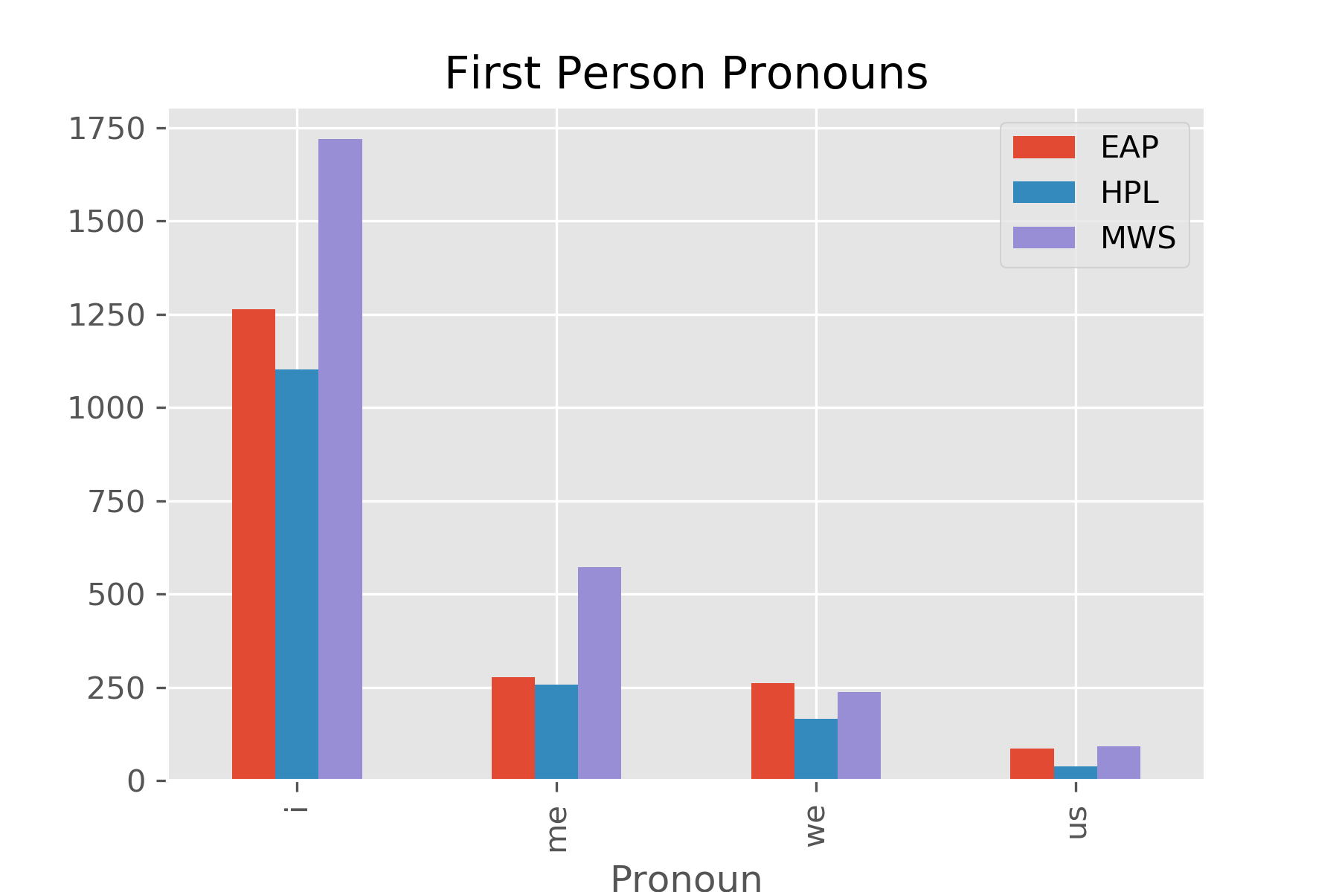
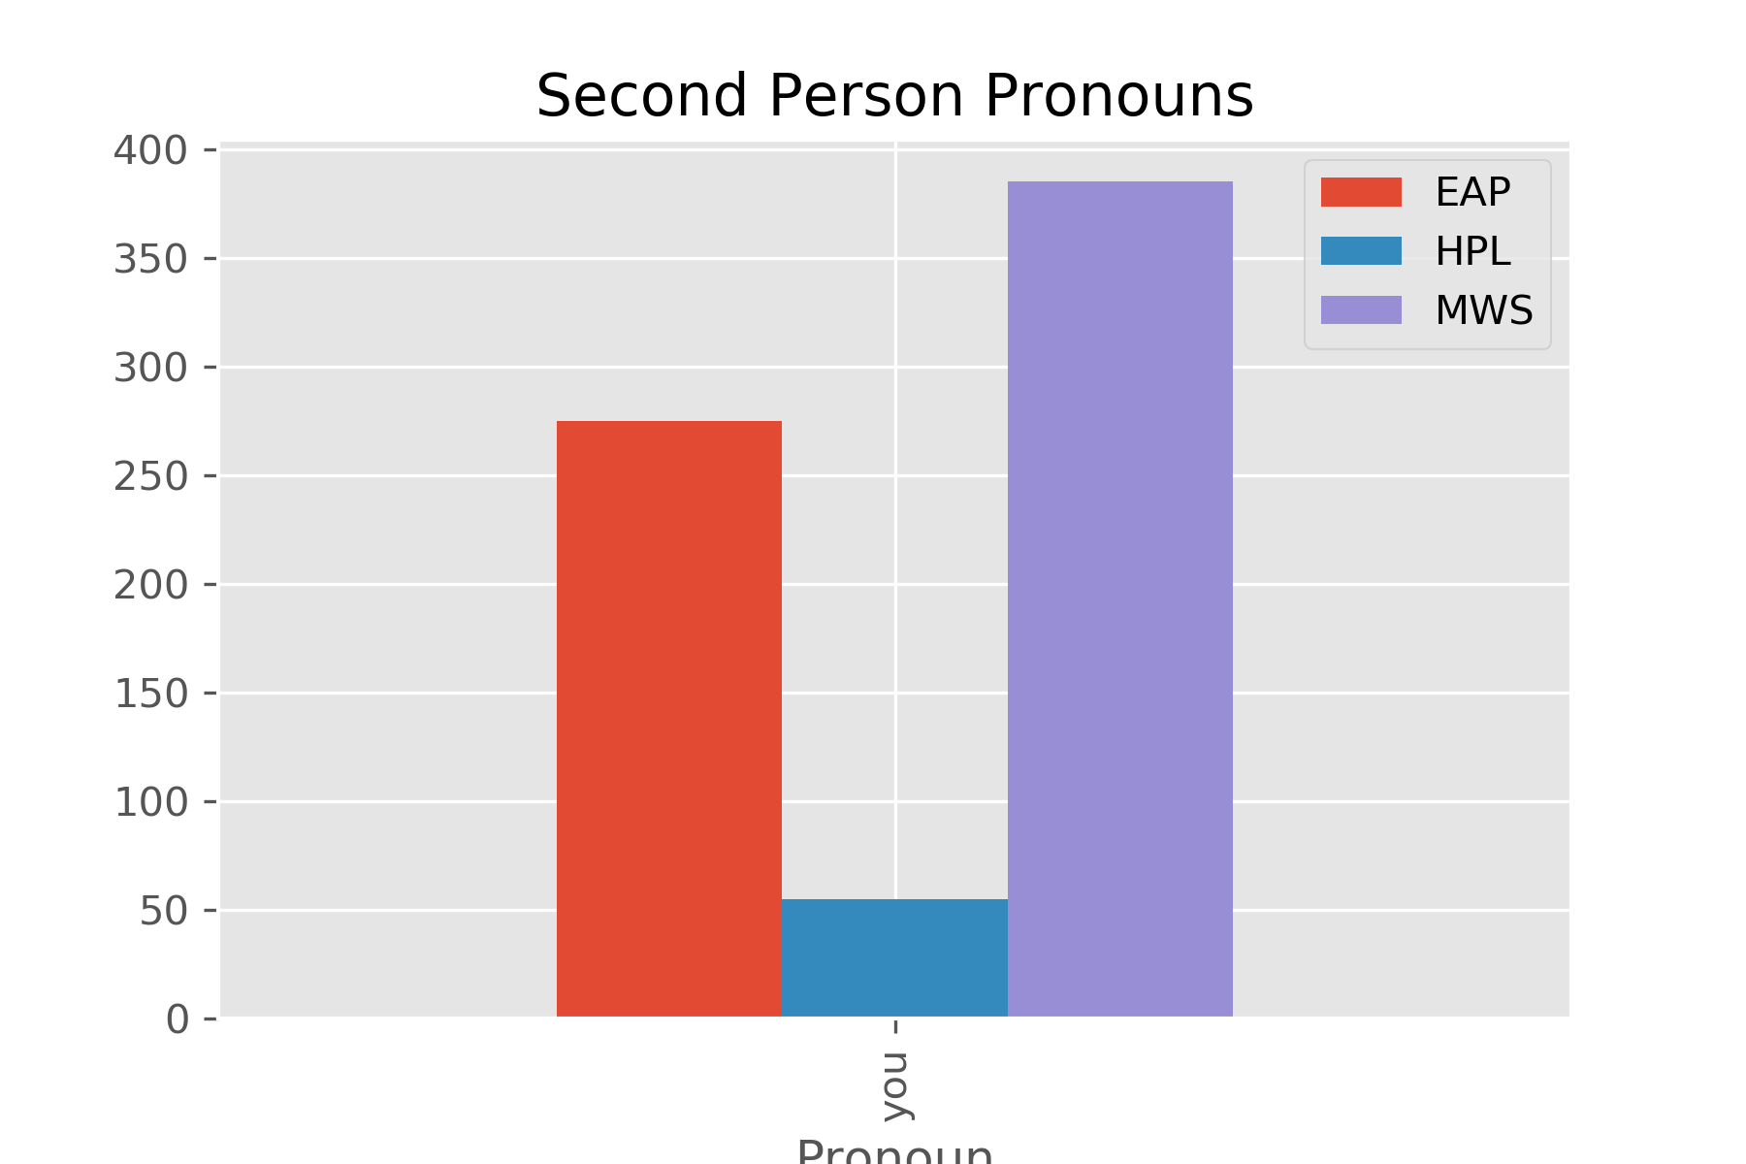
Train Data
Test Data

Slide 15
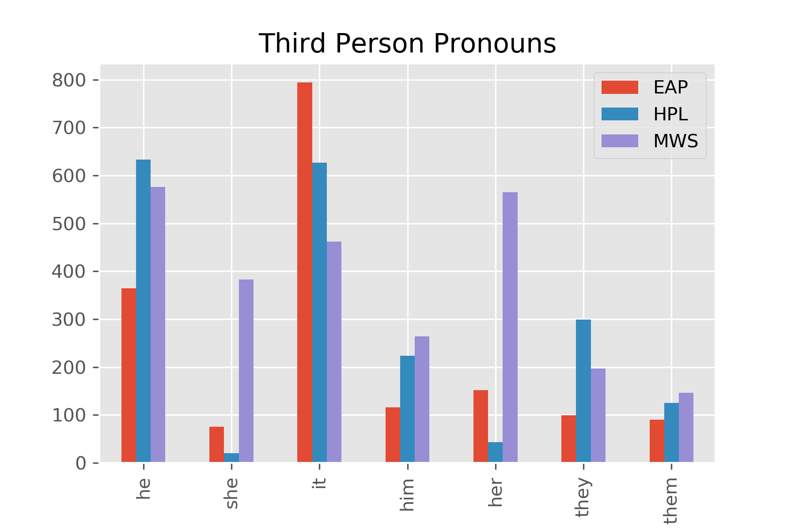
Train Data
Test Data

Slide 16
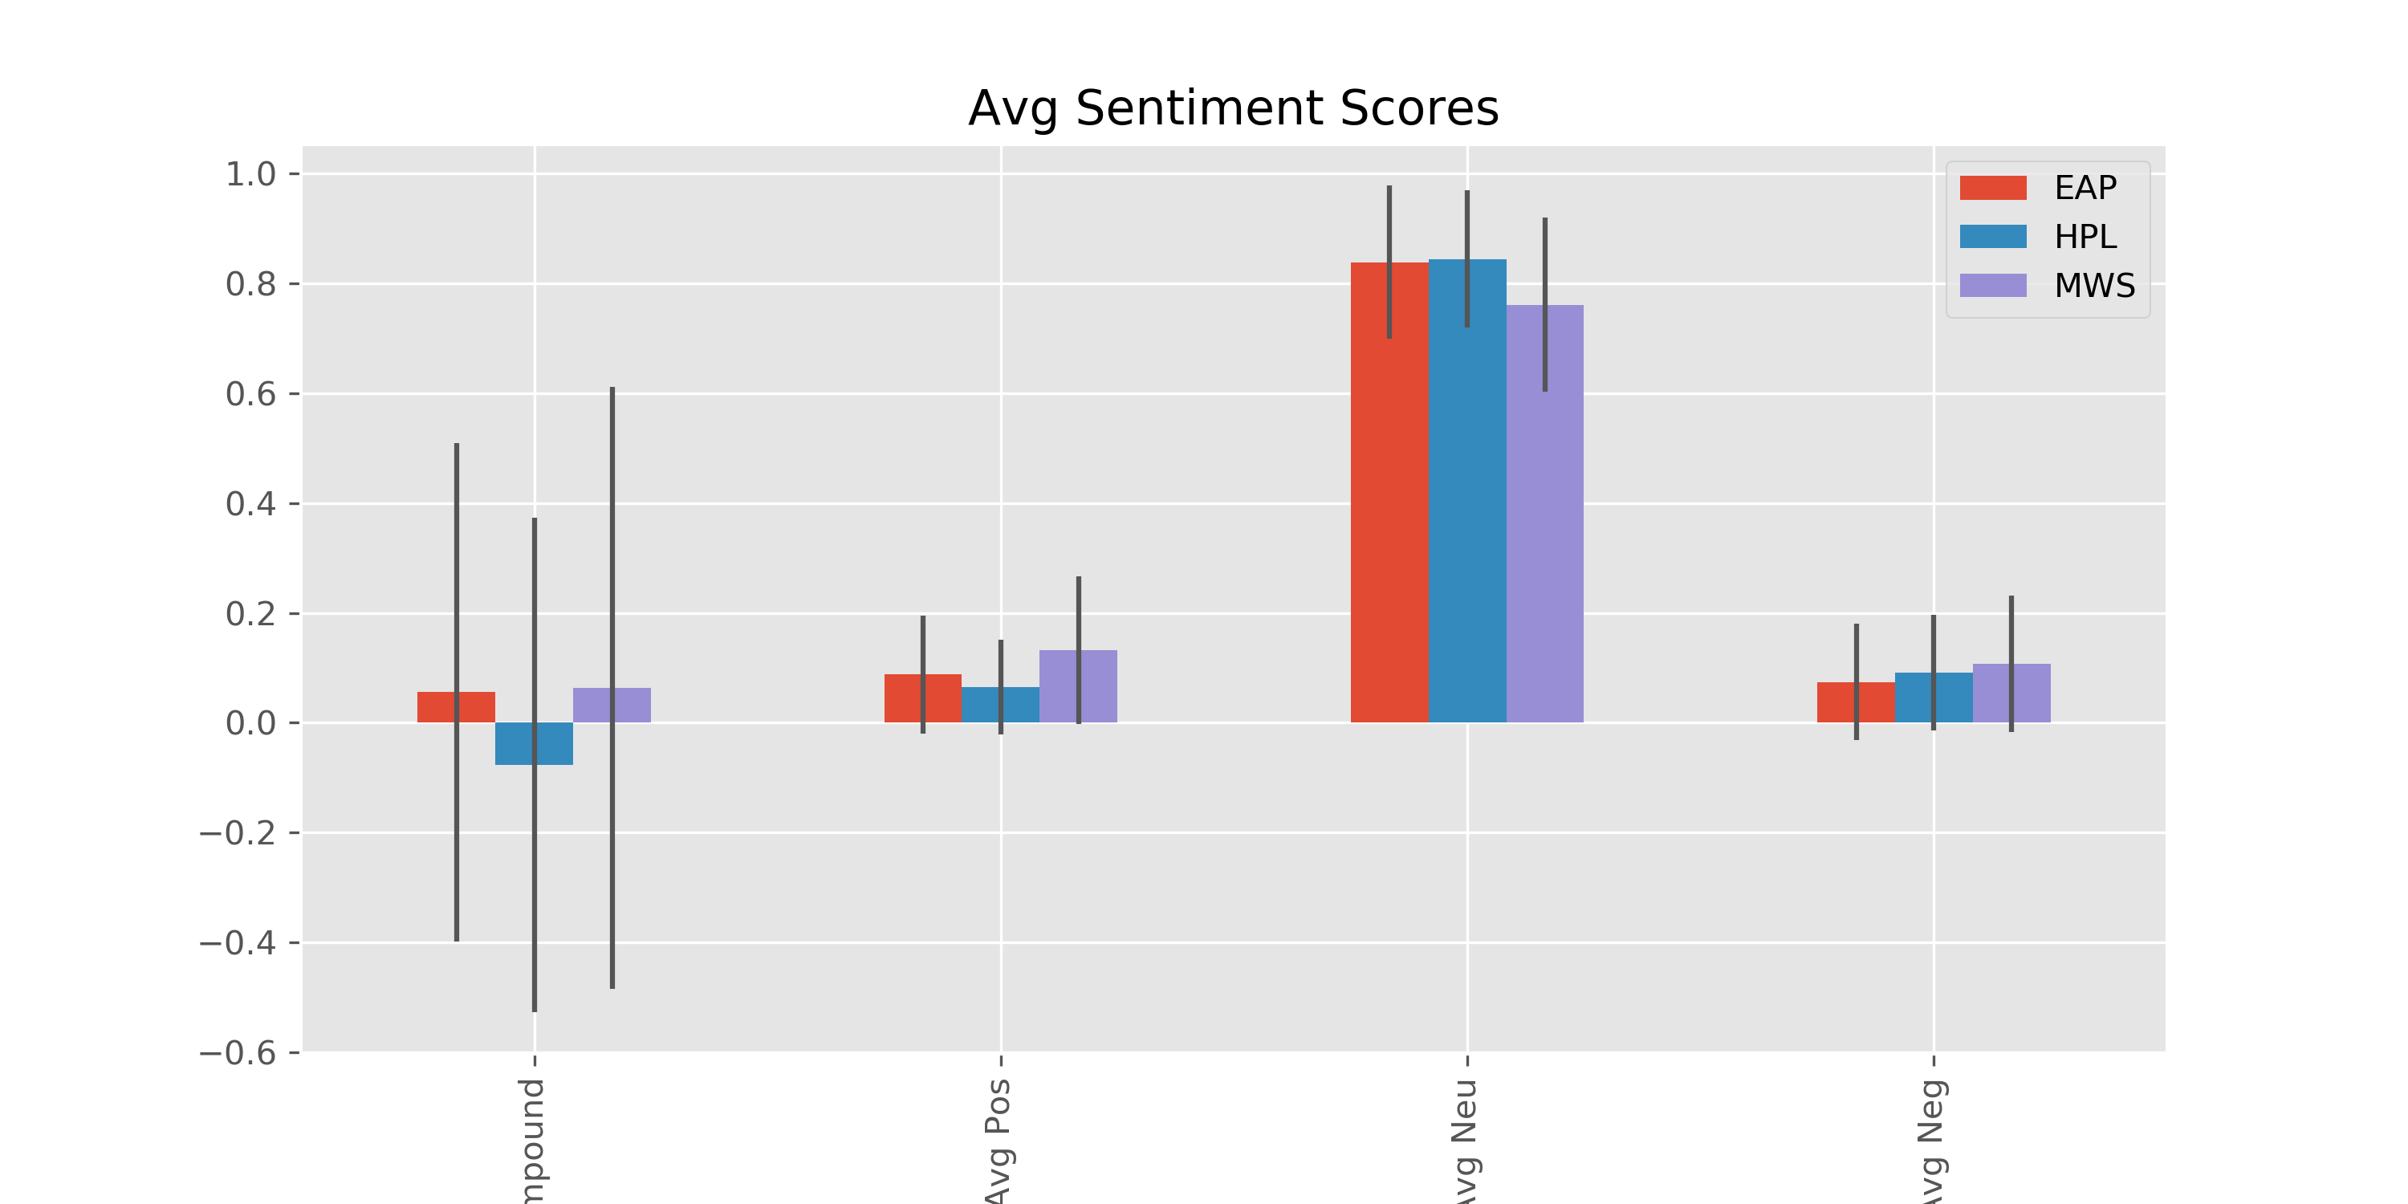
Train Data
Test Data

