Slide 1


Spooky Authors: Predictive Analysis of Natural Language
Kali Blevins (Team Lead)
Anais Dotis-Georgiou (Tester)
Danny Lu (Data Engineer)
Bharathy Natarajan (Scrum Master)

Slide 2
Overview
Using the raw datasets from the Kaggle data competition 'Spooky Authors', we performed a basic natural language analysis with the aim of identifying particular authors based on a sample of their writing.

Slide 3
Questions
How does each author vary with respect to basic sentence structure & vocabulary?
What are the sentiment scores for each author?
How do we assign authorship to sentences?
Training dataset – already has author assigned
Test dataset – needs authorship assigned
How does the assigned authorship dataset compare to the provided dataset with author already assigned?

Slide 4
Data Exploration & Cleanup
Group dataset by author
Create equal length datasets for each author in the training data
Count length of each author dataset
Randomly sample the datasets for the authors with longer datasets to subset for equal lengths
Remove outliers for really long passages

Slide 5
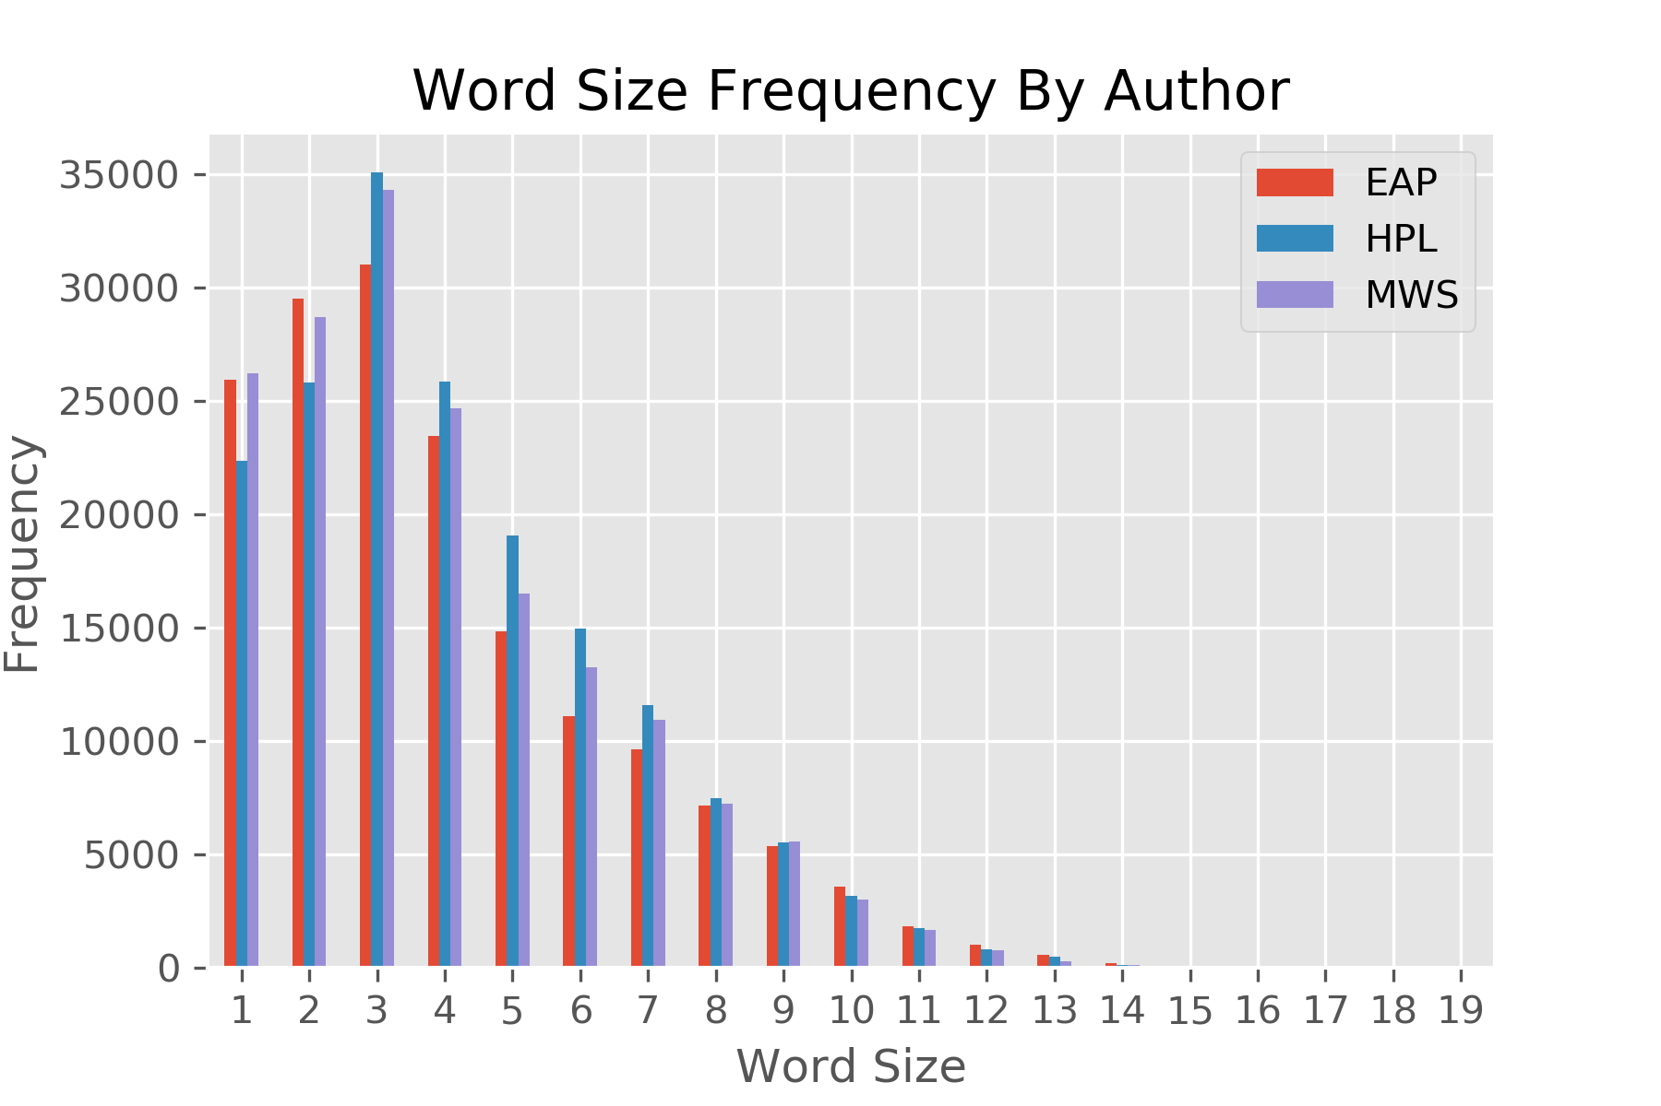
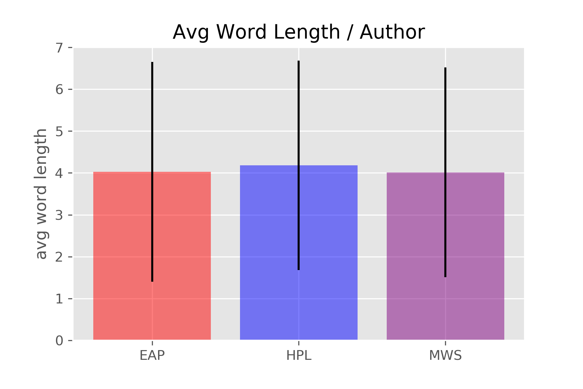
How does each author vary with respect to basic sentence structure & vocabulary?

Slide 6
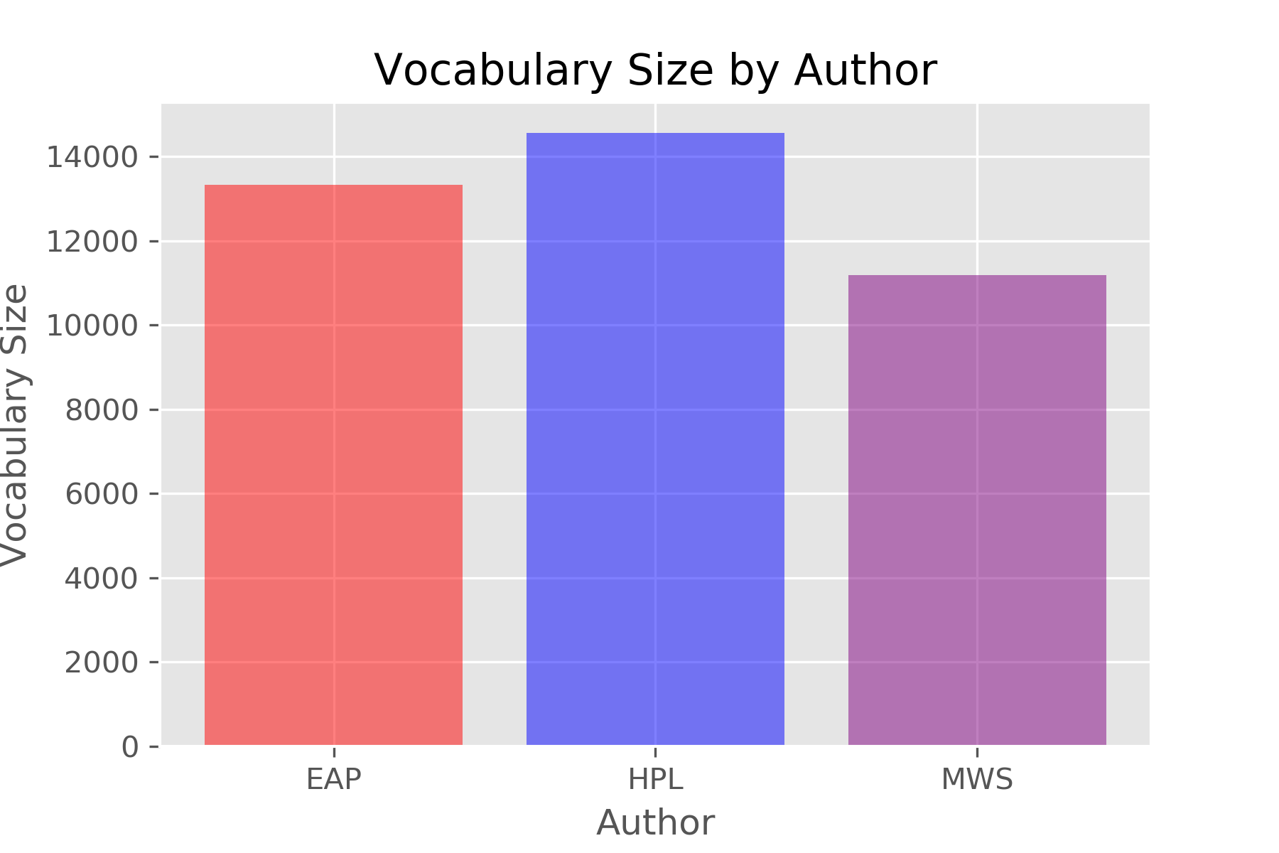
How does each author vary with respect to basic sentence structure & vocabulary?

Slide 7
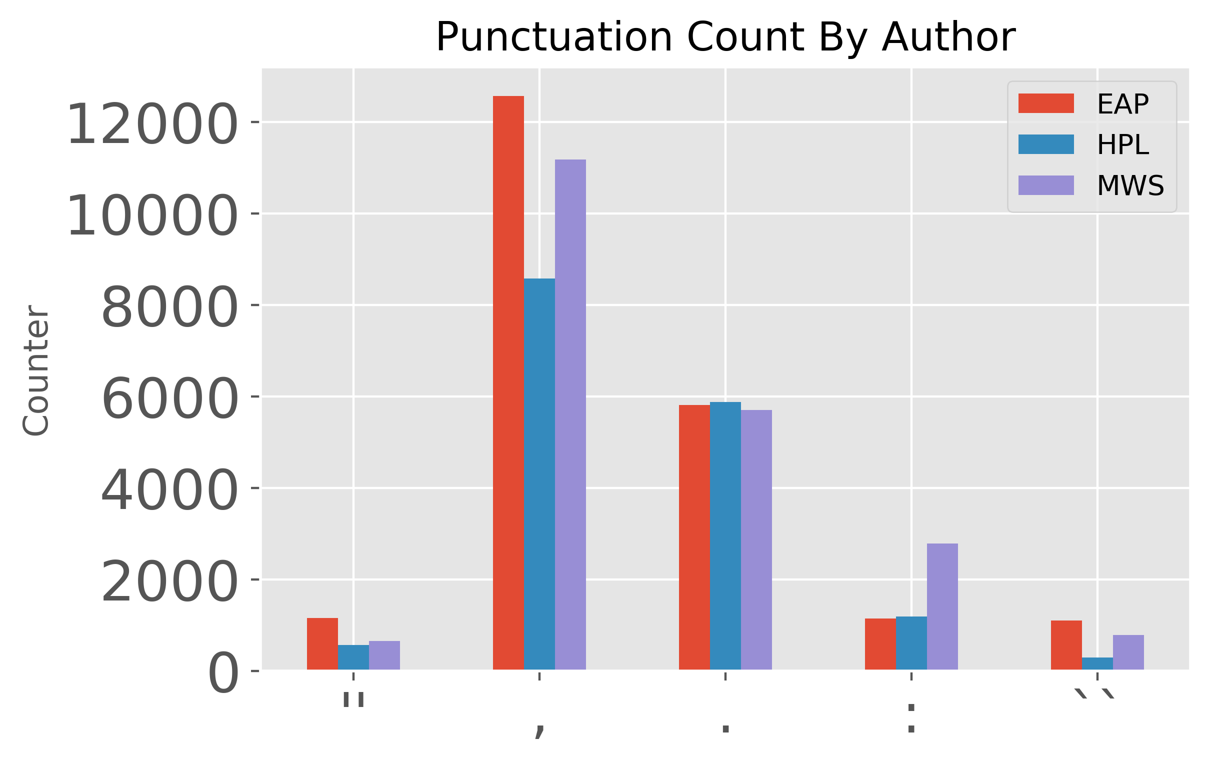
How does each author vary with respect to basic sentence structure & vocabulary?

Slide 8
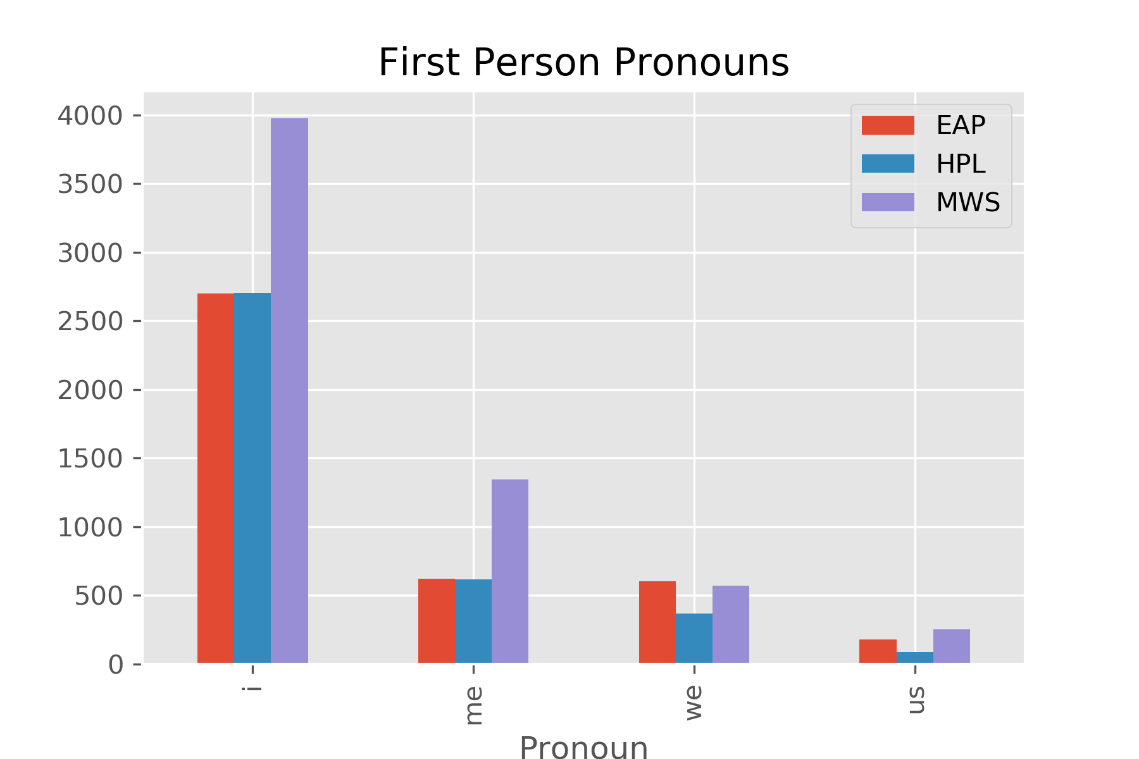
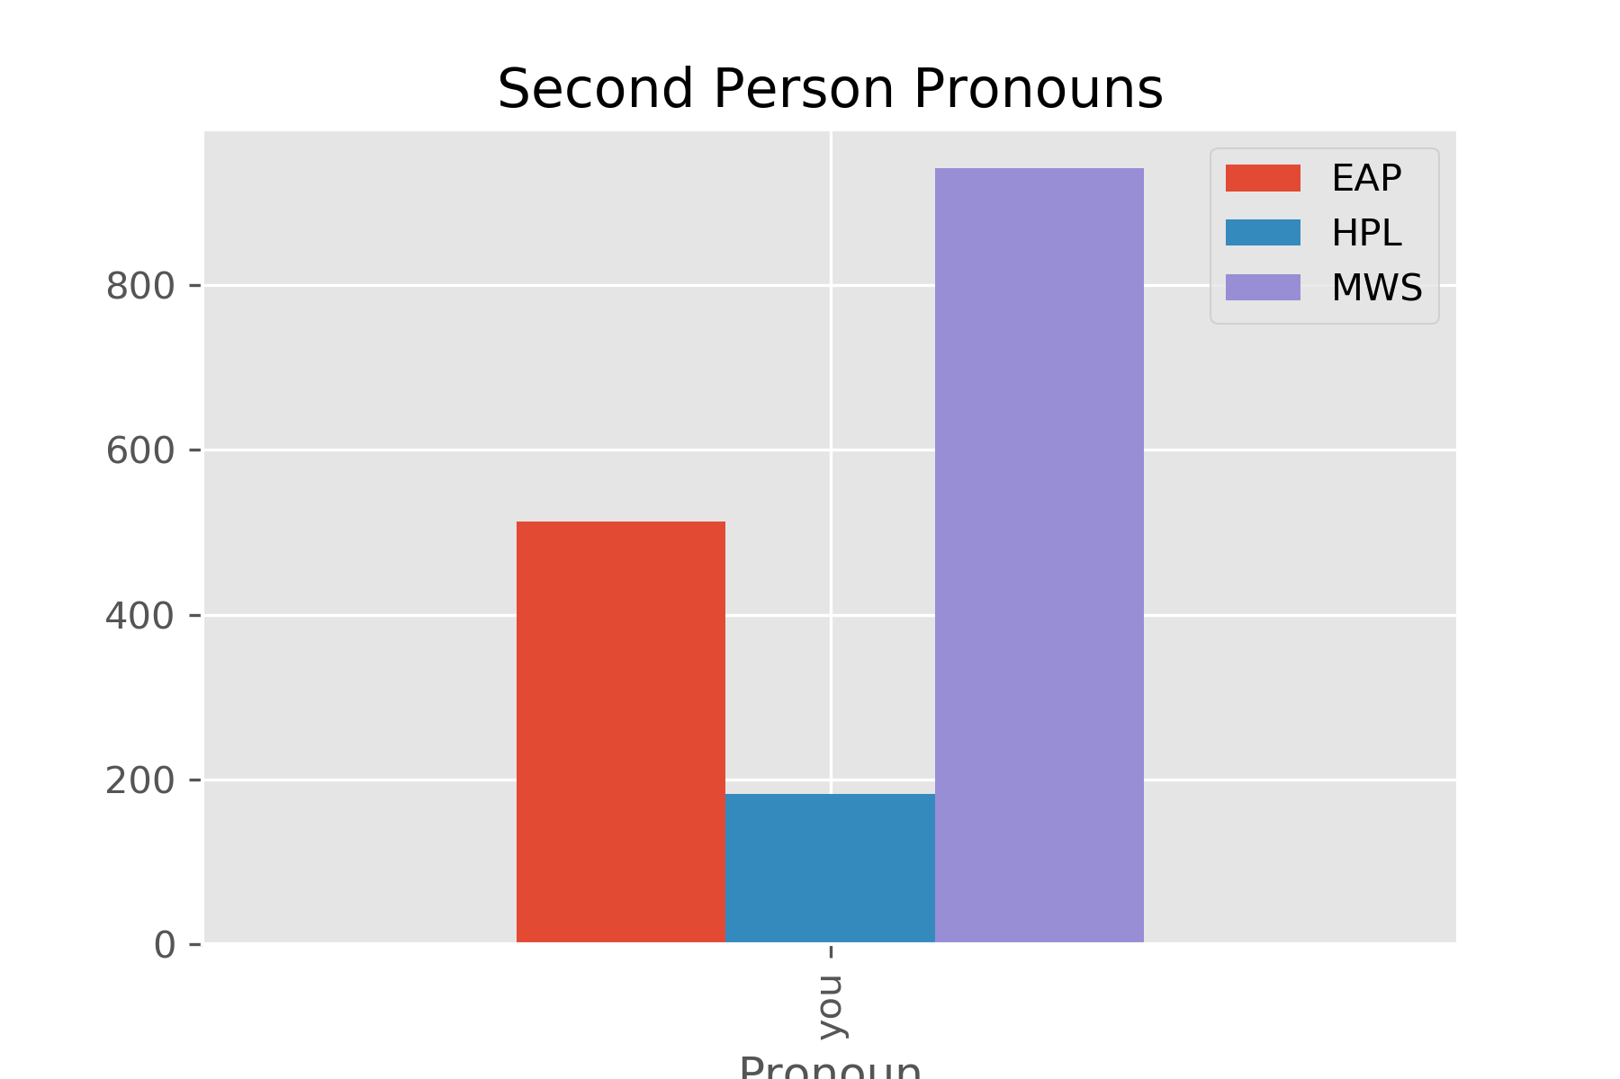
How does each author vary with respect to basic sentence structure & vocabulary?

Slide 9
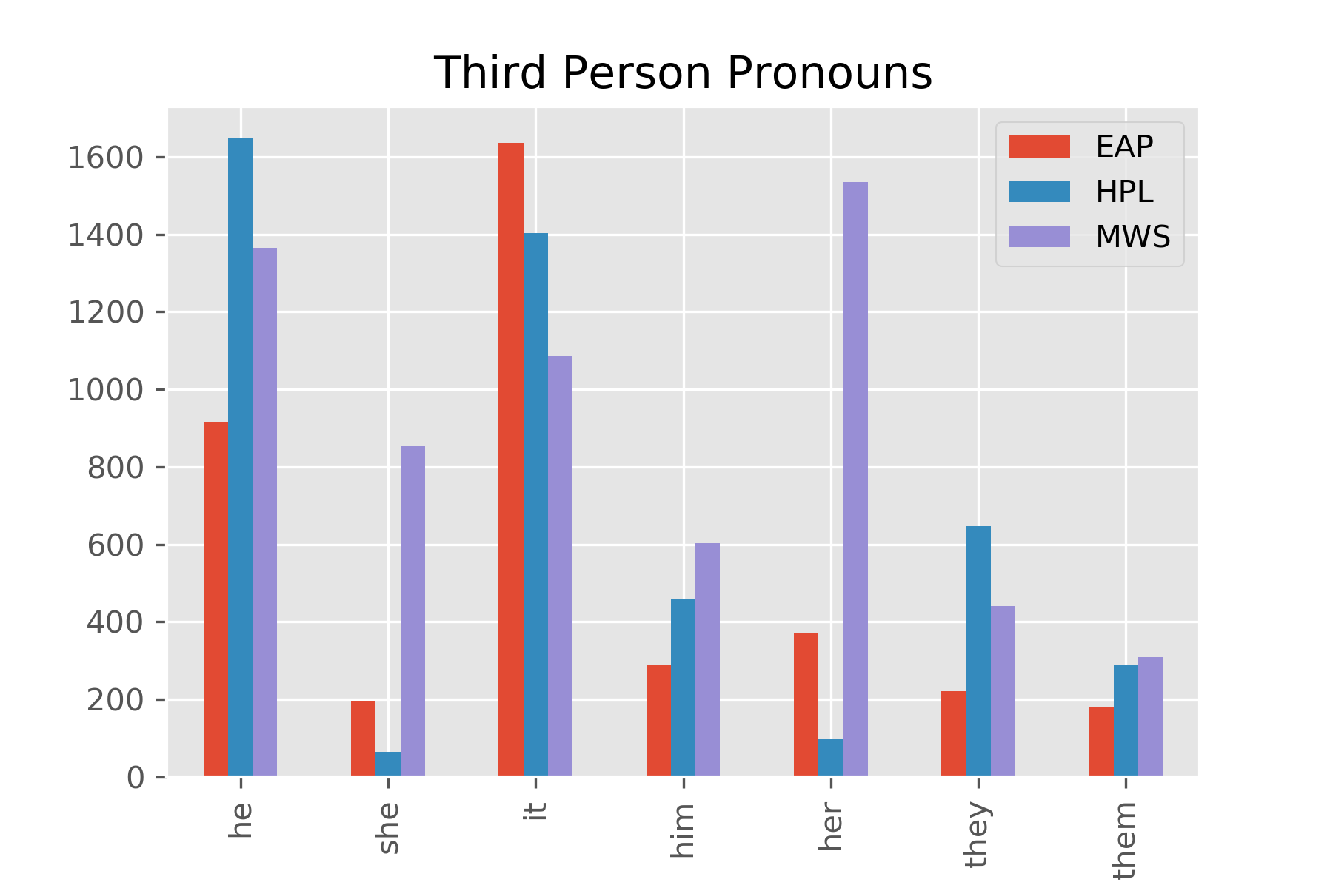
How does each author vary with respect to basic sentence structure & vocabulary?

Slide 10
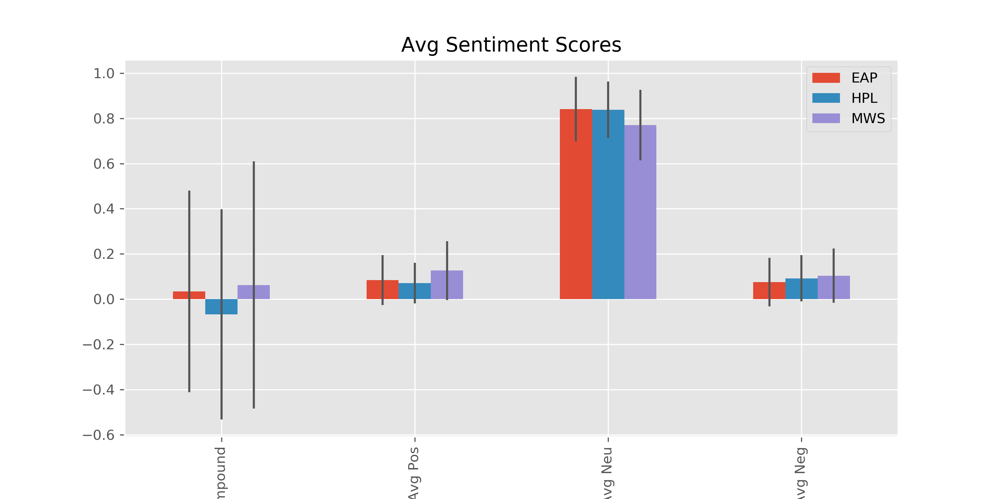
What are the sentiment scores for each author?

Slide 11
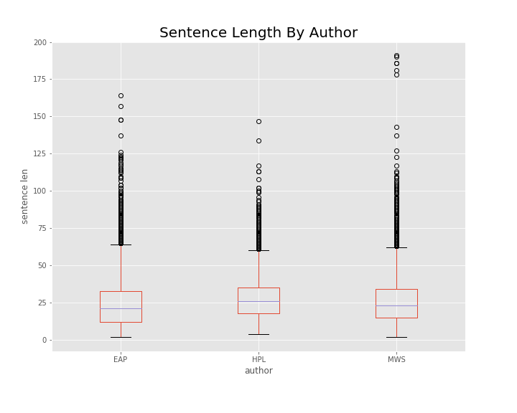
How does each author vary with respect to basic sentence structure & vocabulary?

Slide 12
ANOVA scores
 | sent_len | word_var | word_len | compound | pos | neu | neg
F | 30.11198 | 58.58519 | 235.5922 | 111.2549 | 384.527 | 445.7831 | 91.9655
p | 8.83E-14 | 4.41E-26 | 5.38E-103 | 9.95E-49 | 4.91E-164 | 2.16E-189 | 1.89E-40

Slide 13
NLTK (Natural Language Toolkit)
‘NLTK is a leading platform for building Python programs to work with human language data. It provides … text processing libraries for classification, tokenization, stemming, tagging, parsing, and semantic reasoning, [and] wrappers for industrial-strength NLP libraries...’
Free & open source
http://www.nltk.org/

Slide 14
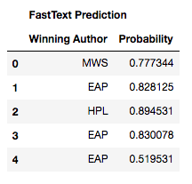
How do we assign authorship to sentences?
Create dictionary of word frequencies for each author for training dataset
For each sentence in the test dataset
create a table with the frequency with which each author uses each word
For each author, multiply together all the frequencies for the words in the sentence
Identify which author has the highest number – that’s the winner!
Can also use fastText—Facebook’s library for fast text representation and classification.
Frequency Predictions
id | EAP | HPL | MWS
id02310 | 0.000157 | 1.25E-05 | 0.99983
id24541 | 1 | 3.34E-08 | 2.29E-10
id00134 | 0.002127 | 0.997873 | 2.41E-08
id27757 | 0.198285 | 0.801715 | 8.94E-10
id04081 | 0.965762 | 0.00947 | 0.024767
id27337 | 0.993074 | 0.006916 | 9.55E-06

Slide 15
Success rate with frequency method
Overall: 85% accurate
 | EAP | HPL | MWS
EAP | 80% | 8% | 12%
HPL | 8% | 88% | 5%
MWS | 7% | 3% | 90%

Slide 16
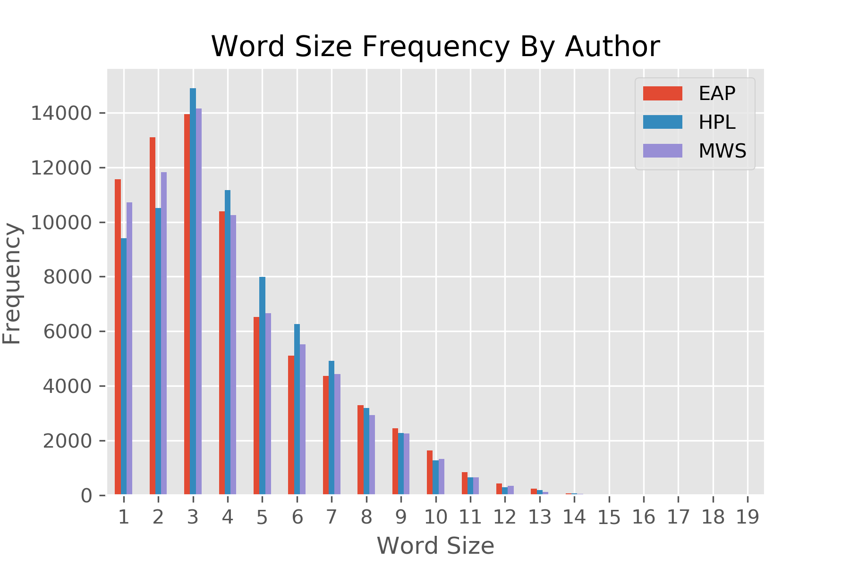
How does the assigned authorship dataset compare to the provided dataset with author already assigned?
Train
Test

Slide 17
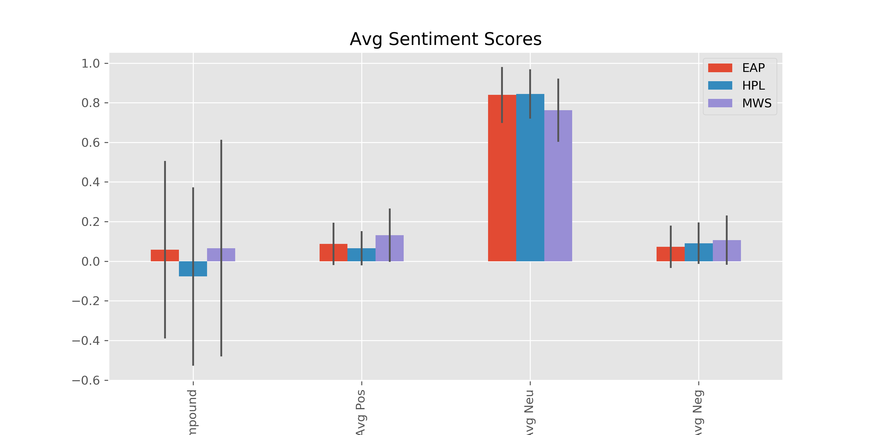
How does the assigned authorship dataset compare to the provided dataset with author already assigned?
Train
Test

Slide 18
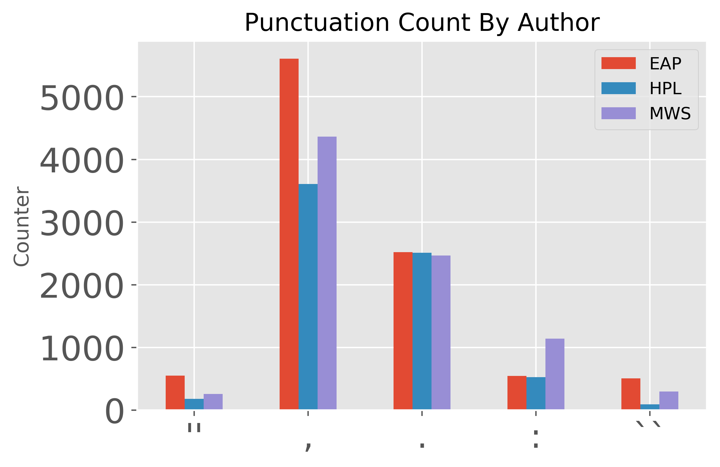
How does the assigned authorship dataset compare to the provided dataset with author already assigned?
Train
Test

Slide 19
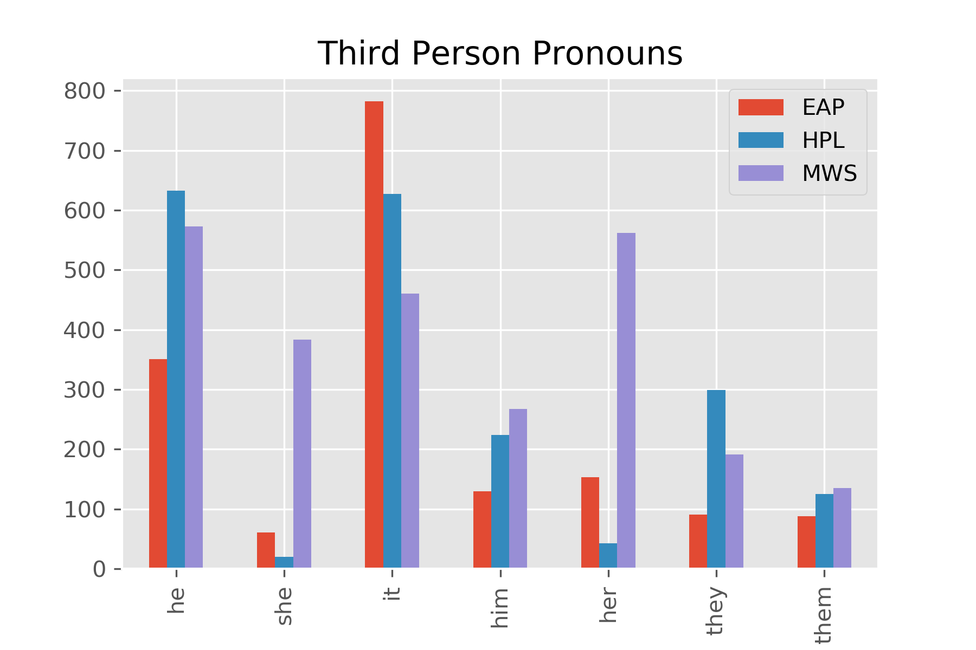
How does the assigned authorship dataset compare to the provided dataset with author already assigned?
Train
Test

Slide 20
If we had all the time in the world…
Test more machine learning techniques

Slide 21
Questions?

