Slide 1

AI-Based Cyberbullying Detection & Content Moderation Platform
An intelligent, AI-powered solution for educational communities — enabling real-time detection, anonymous reporting, and automated moderation to protect every student's digital well-being.
ARTIFICIAL INTELLIGENCE
NLP
STUDENT SAFETY
CONTENT MODERATION
ANAKAPALLI PUJITHA
324129512002

Slide 2

The Growing Crisis of Cyberbullying in Education
With digital learning platforms now central to education, cyberbullying has escalated into a critical institutional challenge — harming students' mental health, academic performance, and campus safety.
Harassment & Abuse
Offensive messages, threats, and targeted attacks go undetected on unmonitored platforms.
Delayed Reporting
Students lack safe, confidential channels — incidents escalate before reaching administrators.
Mental Health Impact
Anxiety, depression, and academic decline are direct consequences of unchecked online abuse.
Anonymous Threats
Unidentified perpetrators exploit anonymity, making investigation and accountability nearly impossible.

Slide 3
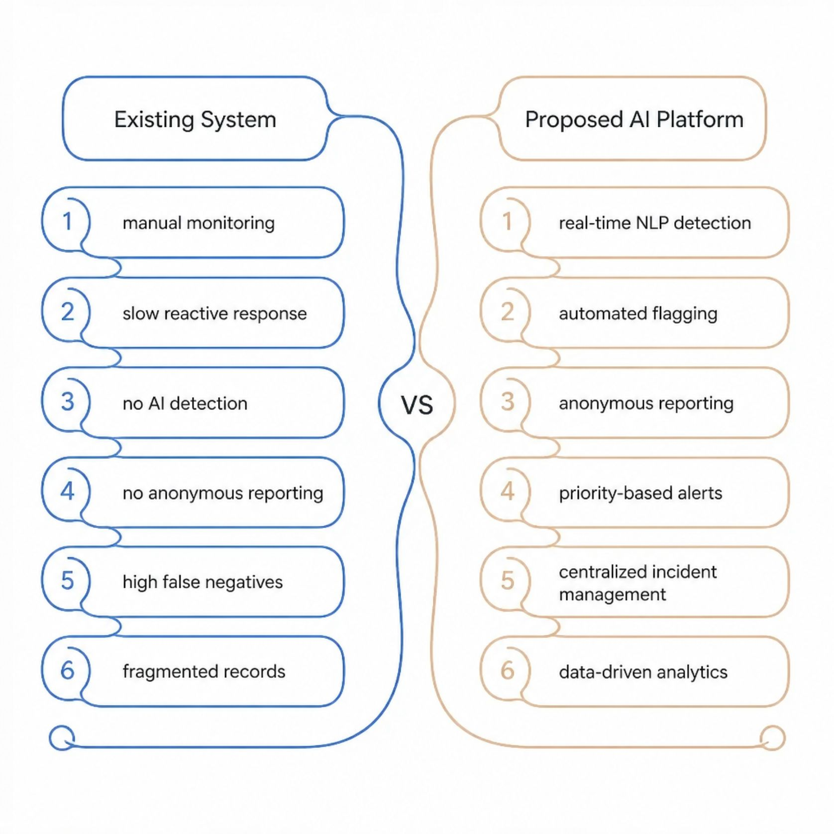
Existing Systems vs. The Proposed AI Platform
Why Current Approaches Fall Short
Traditional moderation relies on manual reviews and reactive reporting — creating dangerous gaps in student protection.
No real-time content analysis or automated detection
Reporting channels are visible and intimidating for victims
High volume of false negatives allows harmful content to persist
Incident records are fragmented, inconsistent, and non-actionable
The proposed AI platform addresses every gap — enabling proactive, intelligent, and scalable content moderation for educational institutions.

Slide 4
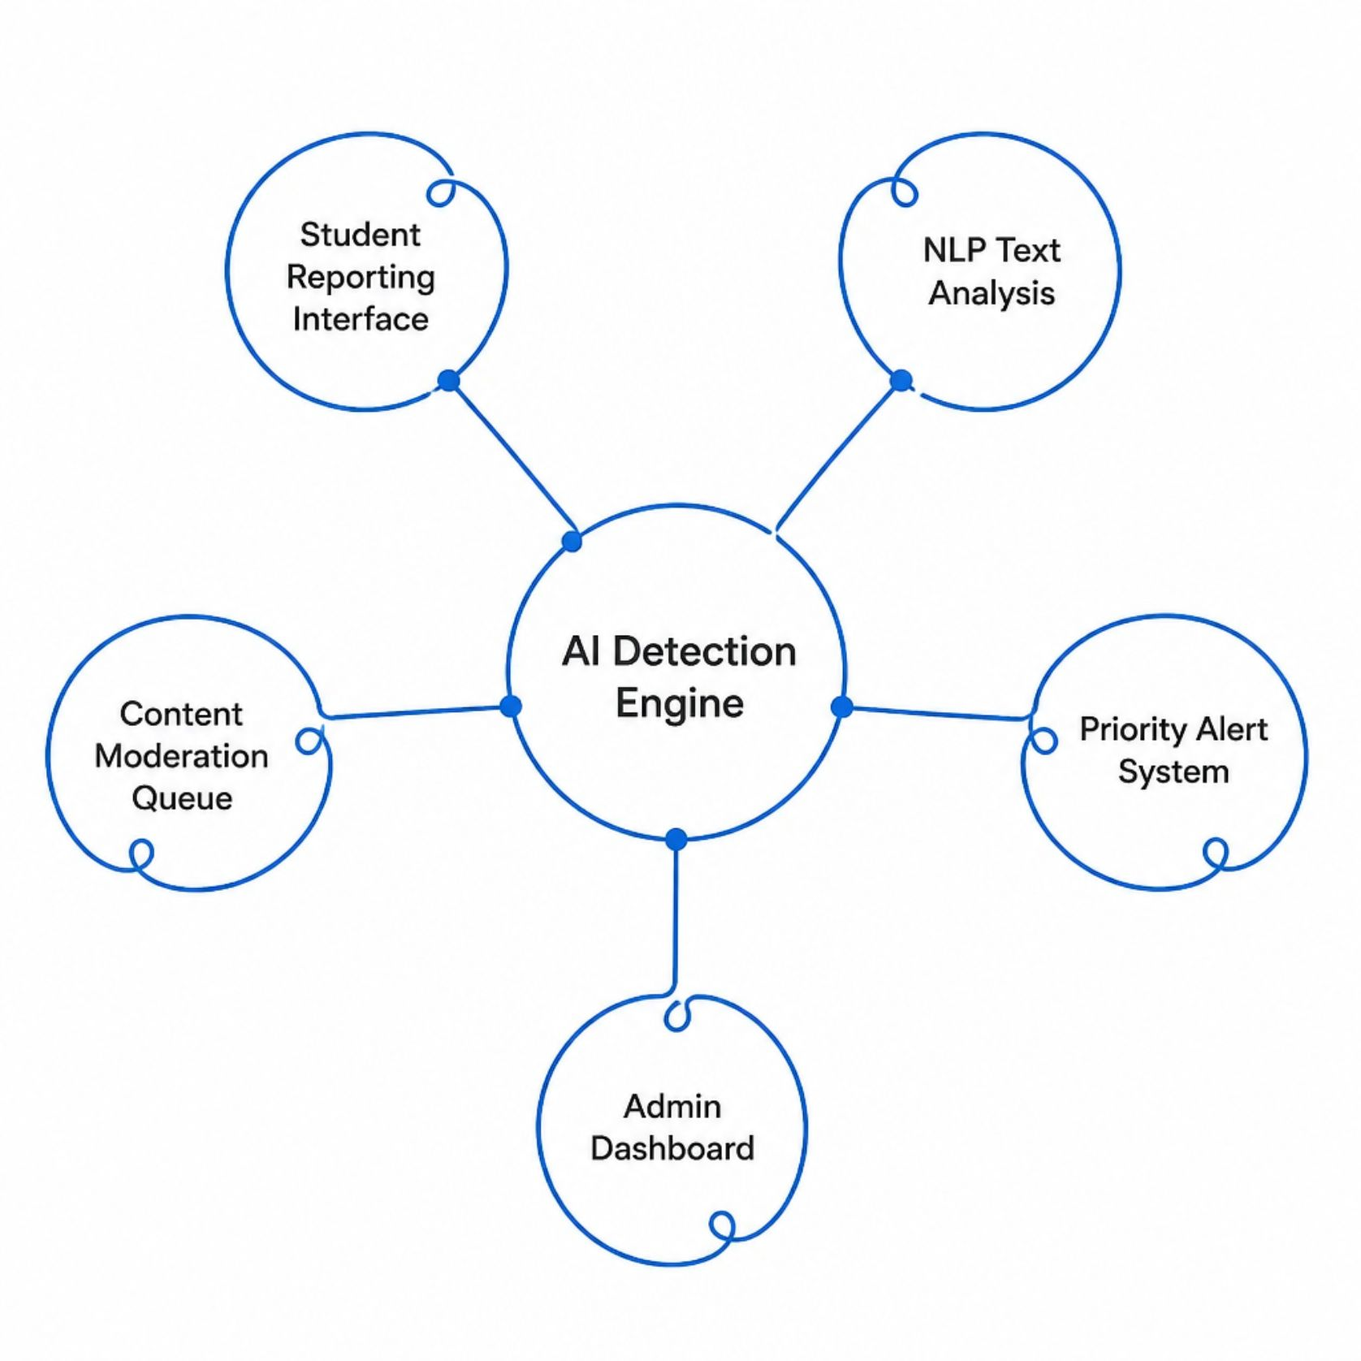
Platform Objectives & System Overview
Core Objectives
Detect cyberbullying in real time using AI and NLP
Enable confidential, anonymous incident reporting
Automate content flagging and priority-based alert generation
Provide administrators with actionable safety analytics
Maintain student privacy and data security at all times

Slide 5



Key Features & User Roles
Student
Moderator
Administrator
Anonymous incident reporting
Safe content browsing with AI filtering
Real-time safety notifications
Priority-based alert dashboard
AI-assisted content review tools
Incident investigation and resolution
Institutional safety analytics
Policy configuration and user management
Comprehensive incident reports

Slide 6
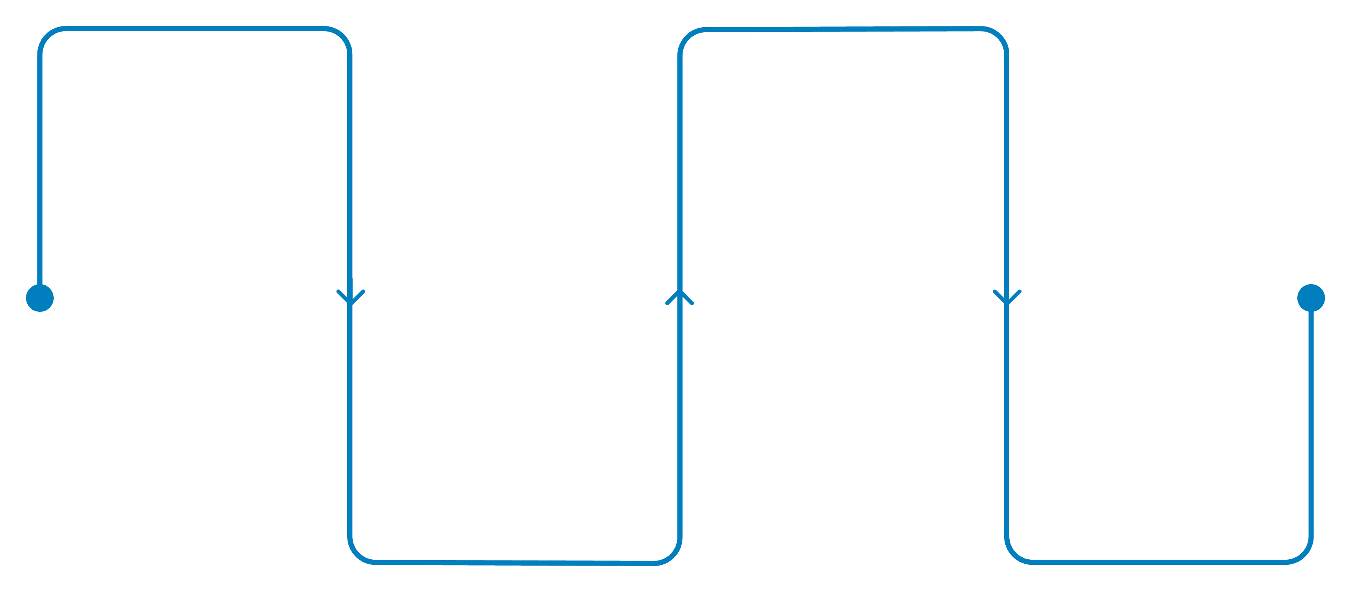
AI-Powered Detection & NLP Analysis Pipeline
Content Input
Threat Scoring
Ingest messages, posts, comments
Model assigns severity and category
NLP Processing
Automated Action
Tokenization, sentiment, classification
Flag, alert priority, notify moderator
The platform leverages Natural Language Processing (NLP) to analyze text in real time — detecting offensive language, threats, and harassment patterns. A trained ML model assigns severity scores, automatically flags suspicious content, and routes high-priority incidents to moderators within seconds.

Slide 7

Content Moderation & Incident Management Workflow
Alert Generation
Action Taken
AI Detection
Moderator Review
Resolution Logged
Priority-based notification sent to moderator
Remove content, warn user, or escalate
Content flagged automatically in real time
Human verification of flagged content
Incident recorded and analytics updated
Every flagged incident follows a structured, auditable resolution path — ensuring accountability, consistency, and institutional transparency at every stage of the moderation process.

Slide 8
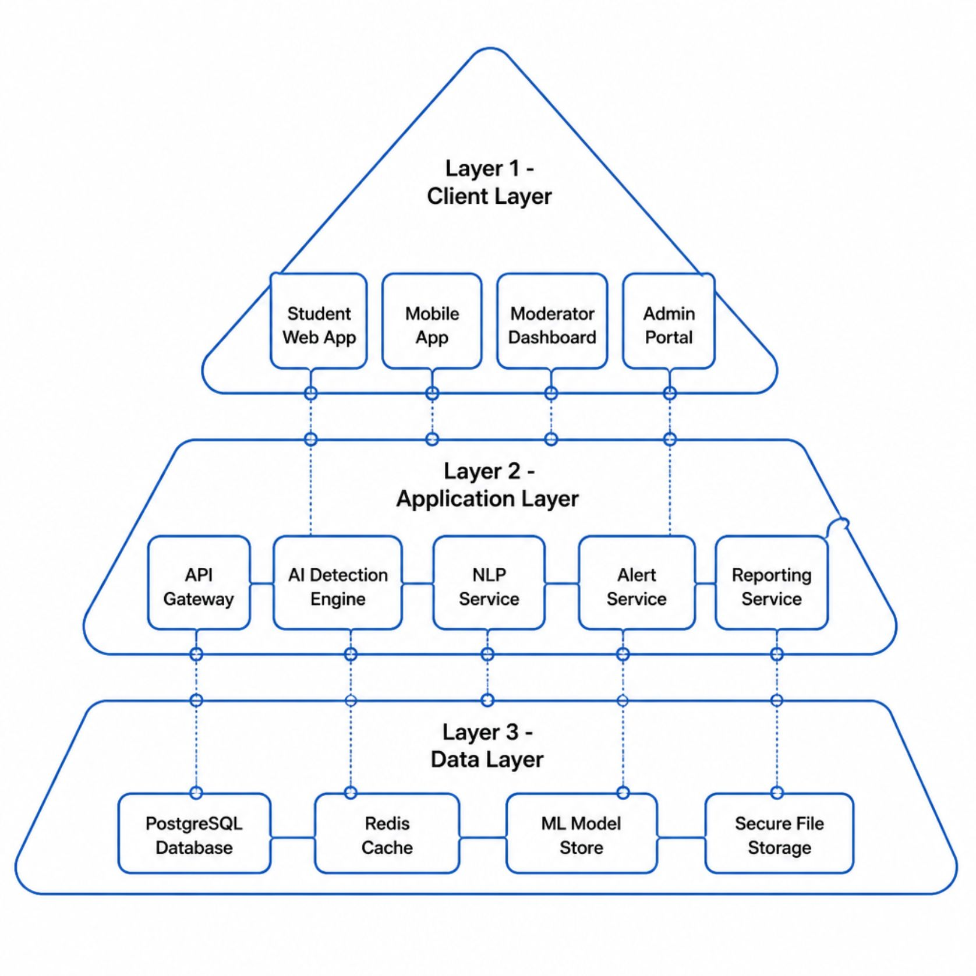
System Architecture & Technology Stack
Technology Stack
Frontend
Backend
React.js / Flutter
Python · Django / Flask
AI / NLP
Database
TensorFlow · BERT · spaCy
PostgreSQL · Redis
Security
AES-256 · OAuth 2.0 · SSL/TLS

Slide 9

Reports, Analytics & Expected Outcomes
<1s
Detection Speed
AI flags harmful content in under one second
24/7
Monitoring
Continuous automated surveillance, zero downtime
~90%
Accuracy Rate
Target detection accuracy with NLP models
100%
Anonymity
Full reporter identity protection guaranteed
Administrators gain data-driven insights into recurring threats, peak incident periods, and platform-wide safety trends — enabling proactive policy improvements and institutional decision-making.

Slide 10


Advantages, Applications & Future Roadmap
Key Advantages
Faster detection, reduced manual effort, scalable moderation, enhanced student privacy, and a safer, more inclusive digital learning environment.
Institutional Applications
Schools, universities, e-learning platforms, student forums, and digital campus communication systems.
Future Enhancements
Image and video analysis, multilingual NLP support, predictive risk modeling, and integration with national student safety networks.
This platform represents a proactive, AI-driven commitment to student safety — transforming how educational institutions detect, respond to, and prevent cyberbullying.

