Slide 1



Mathematics for Computing - 22MAT122
Elements of Computing II - 22AIE113
IMAGE ENCRYPTION AND DECRYPTION USING CNNs

Slide 2
GROUP DESCRIPTION
Anakha S- CB.SC.U4AIE24006
Chaithanya G Nambiar-CB.SC.U4AIE24013
Surabhi Saha-CB.SC.U4AIE24057
Sriram S - CB.SC.U4AIE24066

Slide 3
INTRODUCTION
Image encryption secures data privacy.
AES offers strong security but can cause data loss.
CNN-based encryption aims for high accuracy with less noise.
This project explores CNN-based cryptography and AES (Cipher Block Chaining framework in Python.
This project compares both methods on accuracy, efficiency, and security.

Slide 4
OBJECTIVES
Implement AES and CNN for image
encryption/decryption.Compare their accuracy, security, and efficiency.
Evaluate impact on image quality.
Assess CNN's feasibility for cryptography.

Slide 5
PROBLEM STATEMENT
Challenge: While AES encryption is widely used for image data security, it often leads to significant image quality loss during the encryption and decryption process.
Solution: Investigate whether CNN-based cryptography can maintain or even improve image quality during encryption while offering similar or better security features than AES encryption.

Slide 6
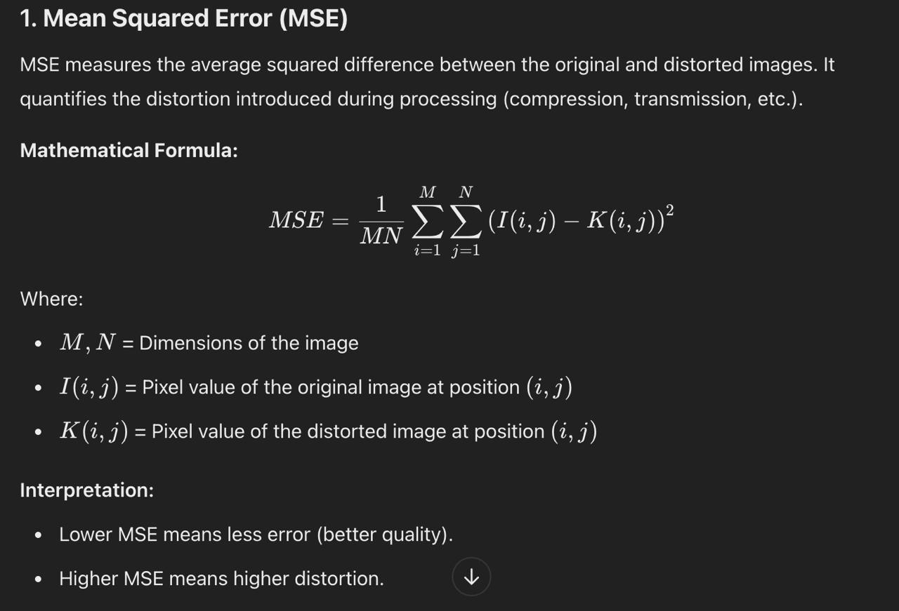
METRICS USED

Slide 7
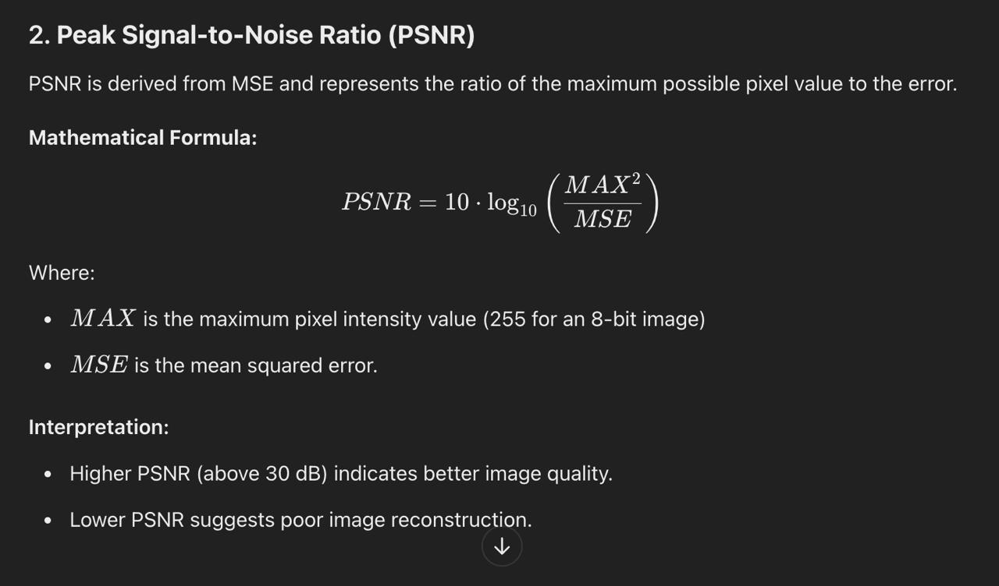

Slide 8
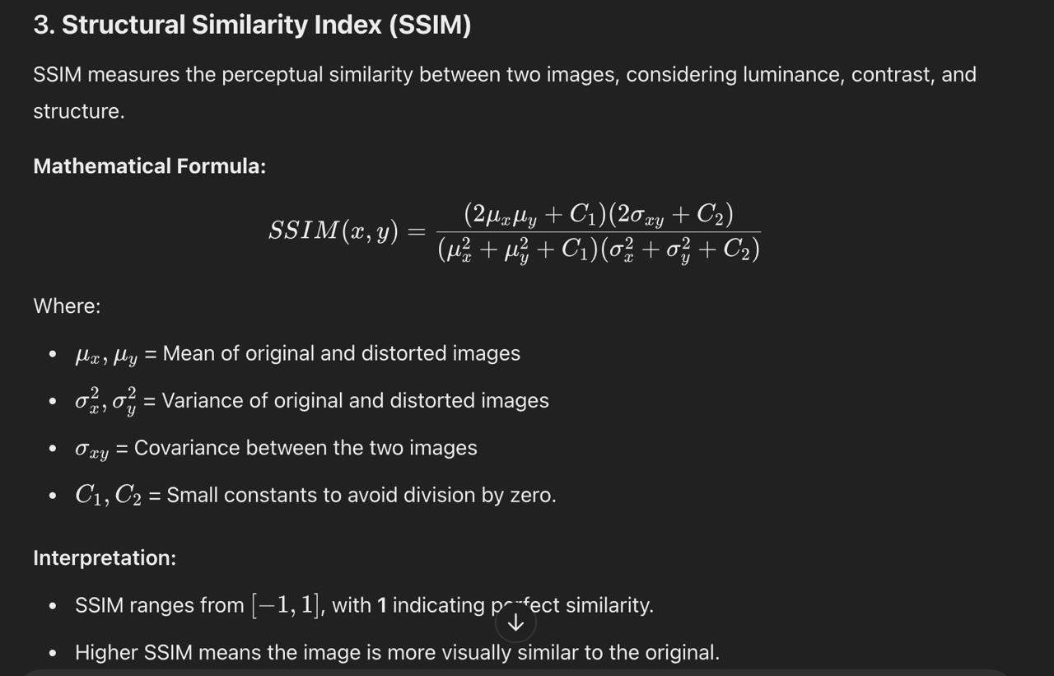

Slide 9
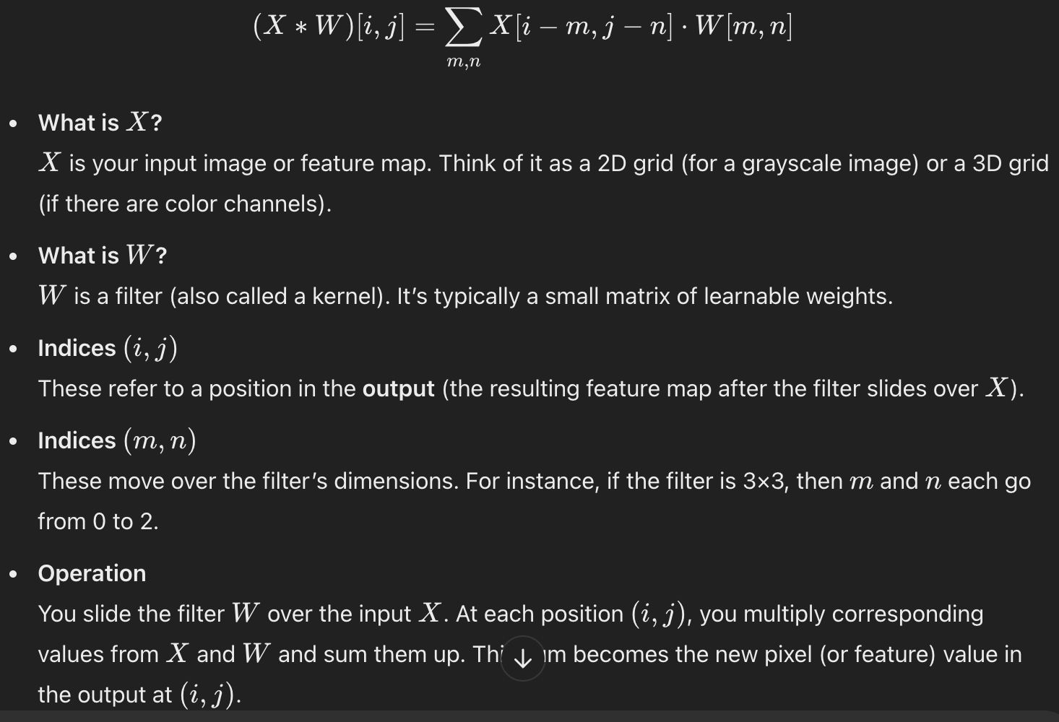
CNN METHOD
Purpose: Convolution helps extract specific features (edges, textures, shapes) from the input. Different filters learn to detect different patterns.

Slide 10
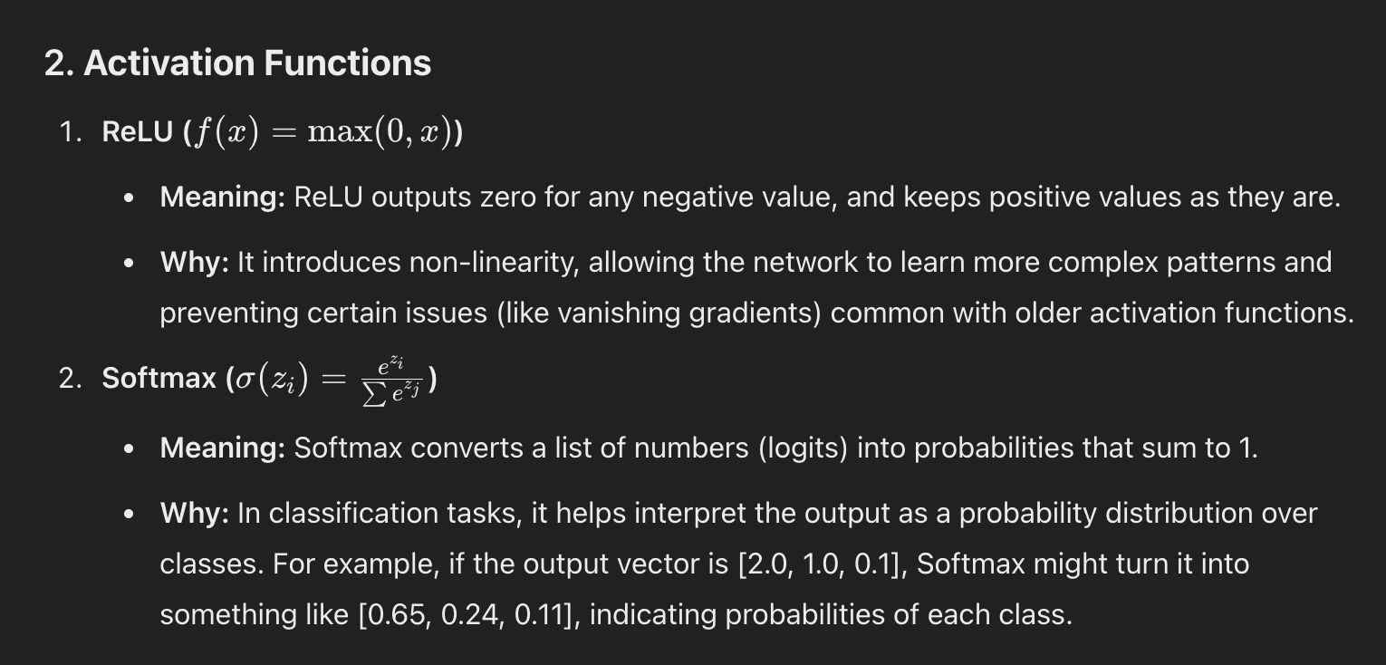

Slide 11
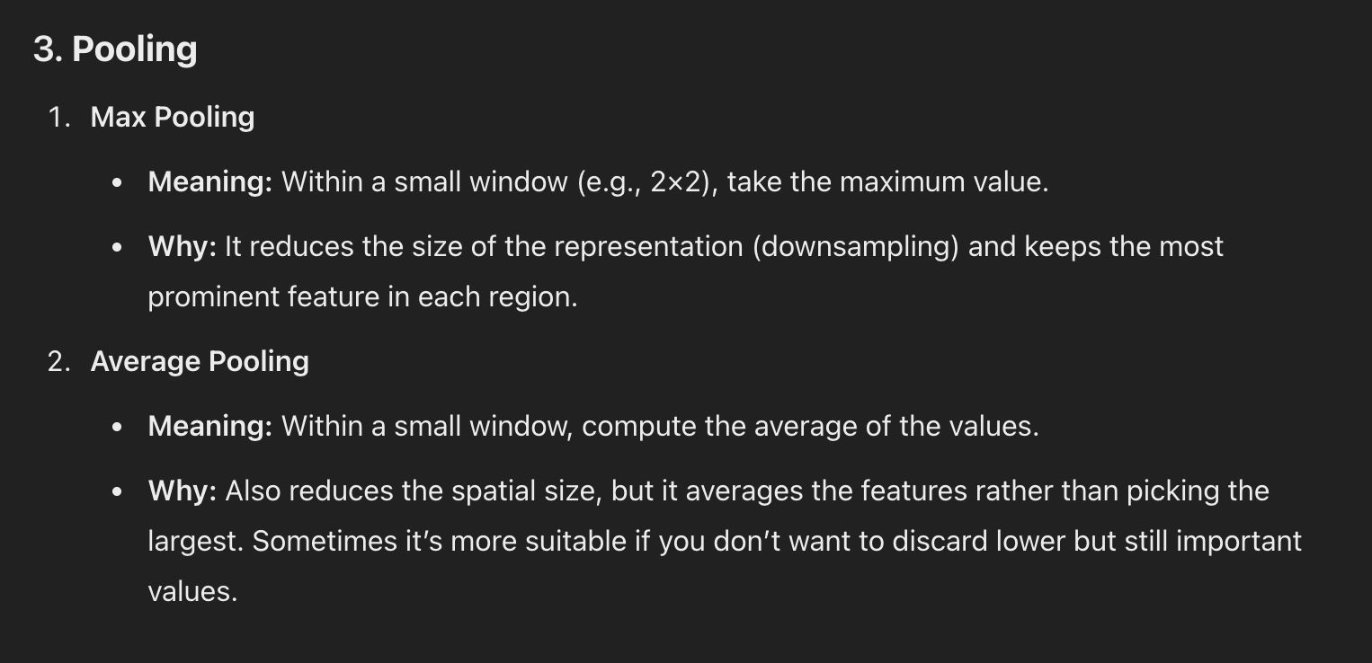

Slide 12
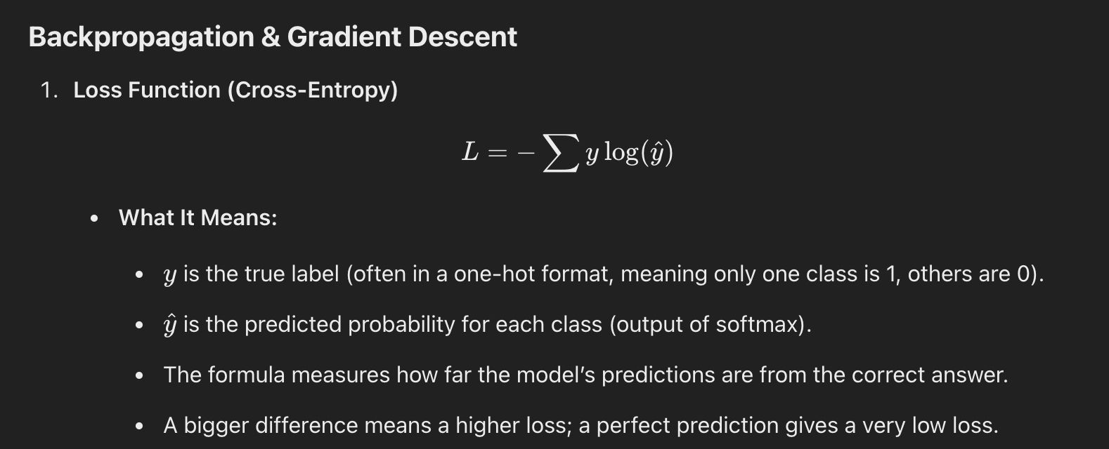

Slide 13
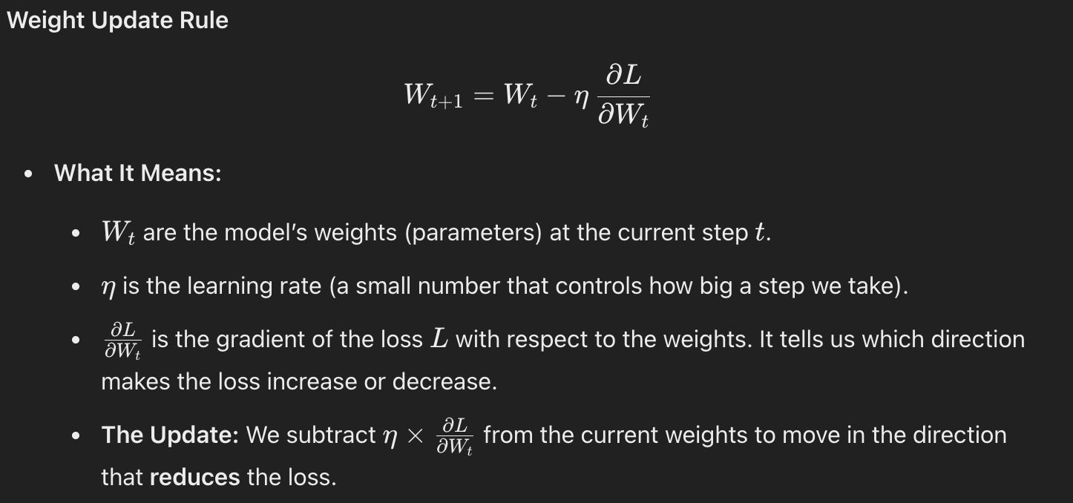
It tells us how to adjust the model's weights in small steps so that the error (loss) is reduced during training.

Slide 14


KEY COMPONENETS OF CNN
Convolutional Layers: Extract features (edges, textures) by sliding a filter over the image.
Activation Function (ReLU) : Introduces non-linearity for complex pattern learning.
Pooling Layers (Max Pooling) : Reduces feature map size, retaining essential information.
Fully Connected Layers: Process extracted features for final decision-making.
Softmax/Sigmoid Output Layer: Produces the probability distribution for classification.

Slide 15
WHY CNN FOR IMAGE ENCRYPTION?
CNNs can learn to encrypt and decrypt images while preserving important details, reducing data loss and noise during the process.

Slide 16
HOW CNN CAN BE IMPLEMENTED
Image Encryption: A CNN model learns to transform original images into encrypted versions by extracting features and mapping them to a secure format.
Image Decryption: A second CNN model reverses the encryption, recovering the original image by minimizing the loss between the decrypted and original image.
Comparison with AES: Unlike AES (which encrypts images block-wise), CNN encryption learns a direct transformation, preserving more image details.
Training & Evaluation: The CIFAR-10 dataset is used for training, and encryption quality is measured using PSNR and SSIM to compare CNN and AES performance.

Slide 17
WHAT IS AES ?
AES is a symmetric encryption algorithm that encrypts data in fixed-size blocks (e.g., 128 bits) using a secret key.
CBC mode enhances security by:
XORing each plaintext block with the previous ciphertext block before encryption.
Using an Initialization Vector (IV) for randomness in the first block.
This ensures that identical plaintext blocks produce different ciphertexts.

Slide 18
IMPLEMENTATION OF AES FOR COMPARISON WITH CNN
Encryption Using AES-CBC:
Encrypt each block using AES with a secret key and IV.
Combine encrypted blocks to form the final encrypted image.
Decryption Using AES-CBC:
Split the encrypted image into blocks.
Decrypt each block using AES key and IV.
Reassemble blocks to reconstruct the original image.
Comparison with CNN-Based Encryption:
AES encrypts block-by-block, while CNN learns an end-to-end encryption process.
AES may cause data loss, while CNN preserves more image details.
Evaluation using PSNR and SSIM to compare image quality after decryption.
This comparison helps determine which method is more secure and retains better image quality.

Slide 19
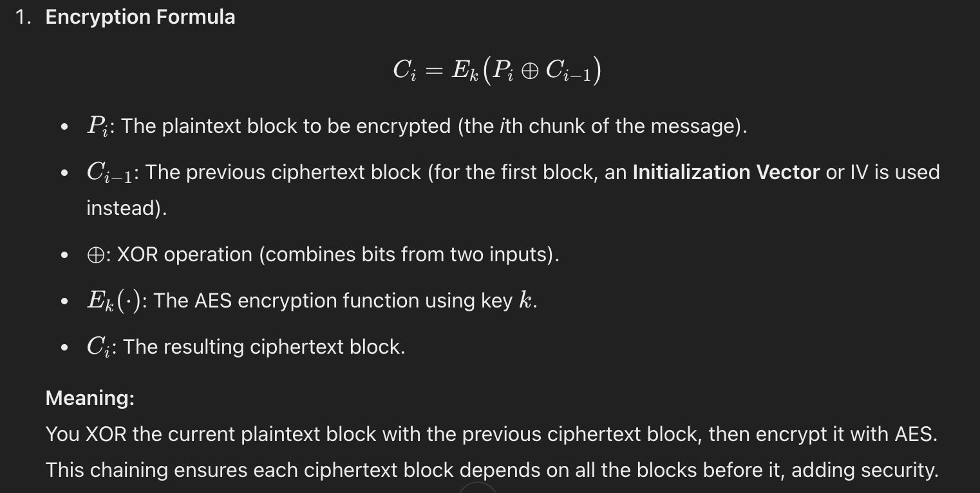

Slide 20
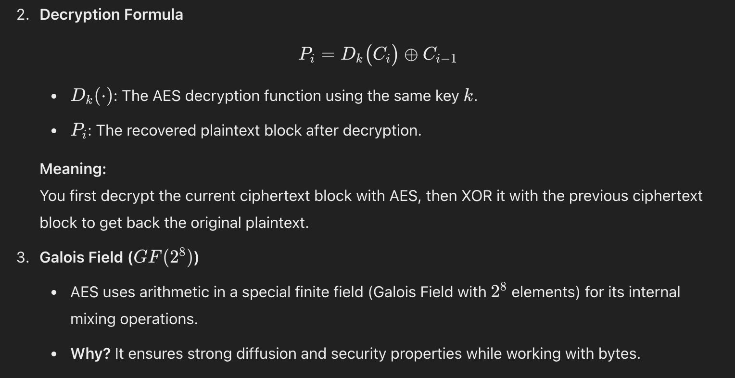

Slide 21
DATASET DETAILS
CIFAR-10 Dataset:
Overview: The CIFAR-10 dataset consists of 60,000 32x32 pixel color images in 10 classes (airplane, automobile, bird, cat, deer, dog, frog, horse, ship, truck).
Size: 6,000 images per class, with a total of 50,000 training images and 10,000 test images.
Usage: The CIFAR-10 dataset will be used to train and test both the CNN-based encryption model and the AES CBC encryption method.

Slide 22
APPLICATIONS
Digital Communication: Secure transmission of encrypted images over the internet (e.g., emails, messaging platforms).
Medical Imaging: Encrypting sensitive patient data (such as medical scans) to prevent unauthorized access.
E-Commerce: Protecting product images in online catalogs, ensuring that they are encrypted during transmission.
Cloud Storage: Securing images stored in cloud services to prevent data breaches or theft.

Slide 23
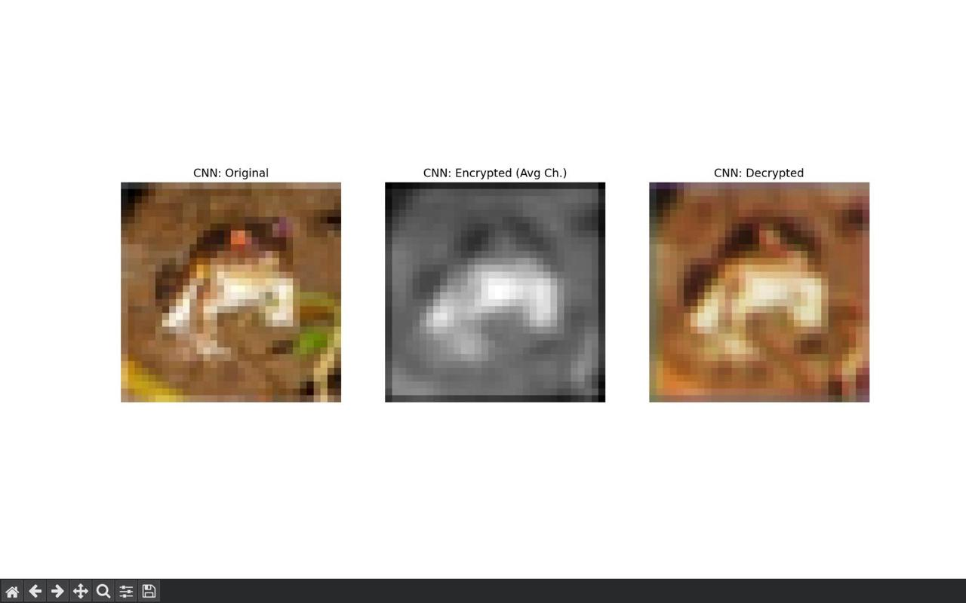
CNN OUTPUT

Slide 24
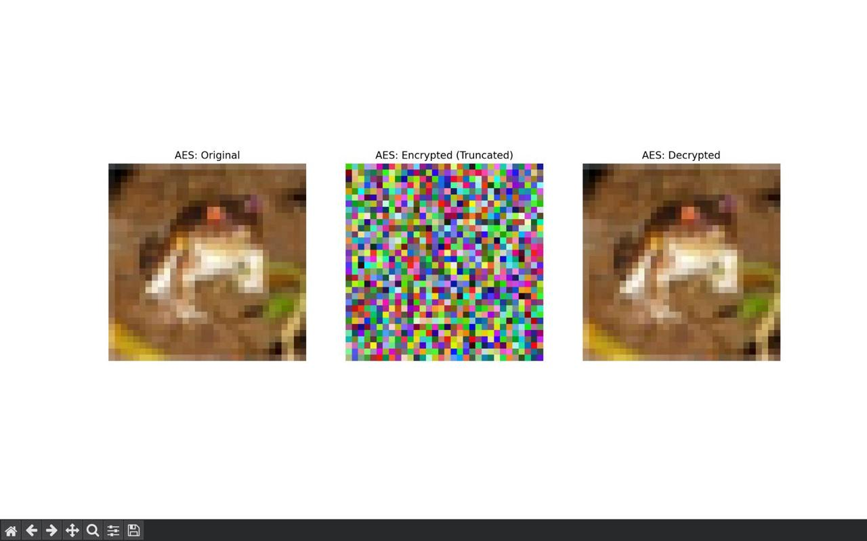
AES OUTPUT

Slide 25
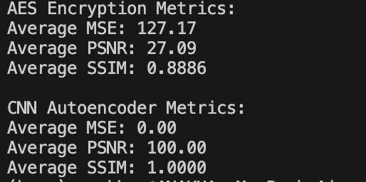
METRICS OUTPUT

Slide 26
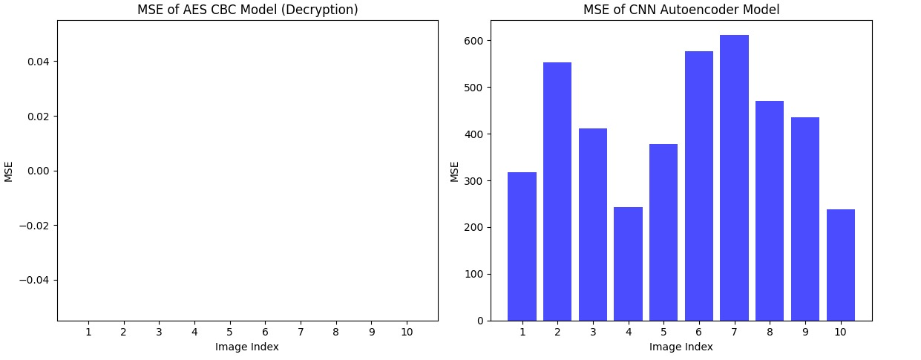

Slide 27
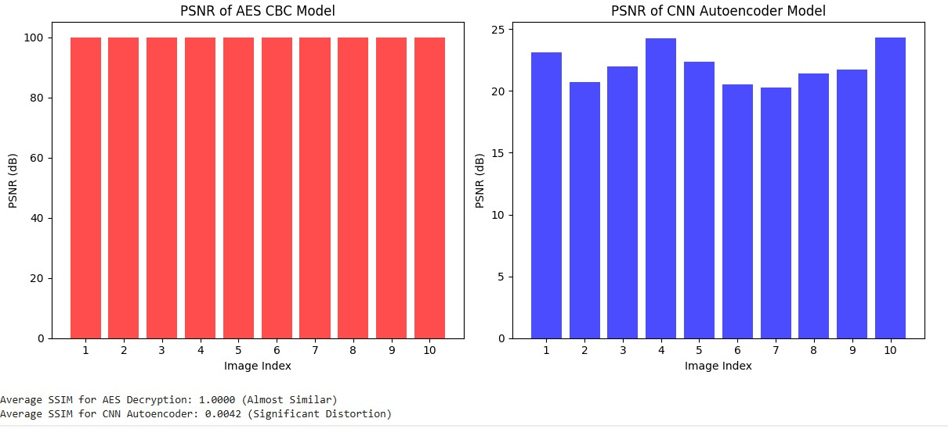

Slide 28
PROPOSED TIMELINE
Week 1-2: Literature review and dataset selection (CIFAR-10).
Week 3-4: Implementation of AES encryption and decryption in Python.
Week 5-6: Implementation of CNN-based cryptography using TensorFlow.
Week 7: Testing and evaluation of both models.
Week 8: Comparison, accuracy assessment, and final report preparation

Slide 29
THANK YOU!

