Slide 1



StoreDashboard(kratika)
View in Power BI
Last data refresh:
5/12/2023 8:45:58 AM UTC
Downloaded at:
7/17/2023 10:13:16 AM UTC

Slide 2
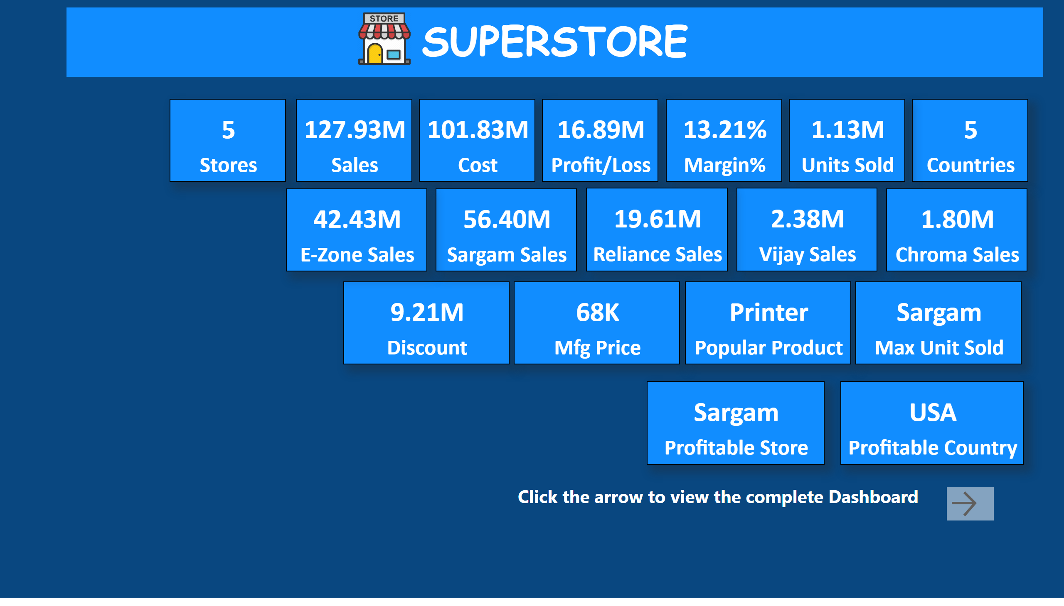
Index
Notes:
textbox
No alt text provided
card
No alt text provided
card
No alt text provided
card
No alt text provided
card
No alt text provided
card
No alt text provided
card
No alt text provided
card
No alt text provided
card
No alt text provided
actionButton
No alt text provided
textbox
No alt text provided
image
No alt text provided
card
No alt text provided
card
No alt text provided
card
No alt text provided
card
No alt text provided
card
No alt text provided
card
No alt text provided
card
No alt text provided
card
No alt text provided
card
No alt text provided
card
No alt text provided

Slide 3
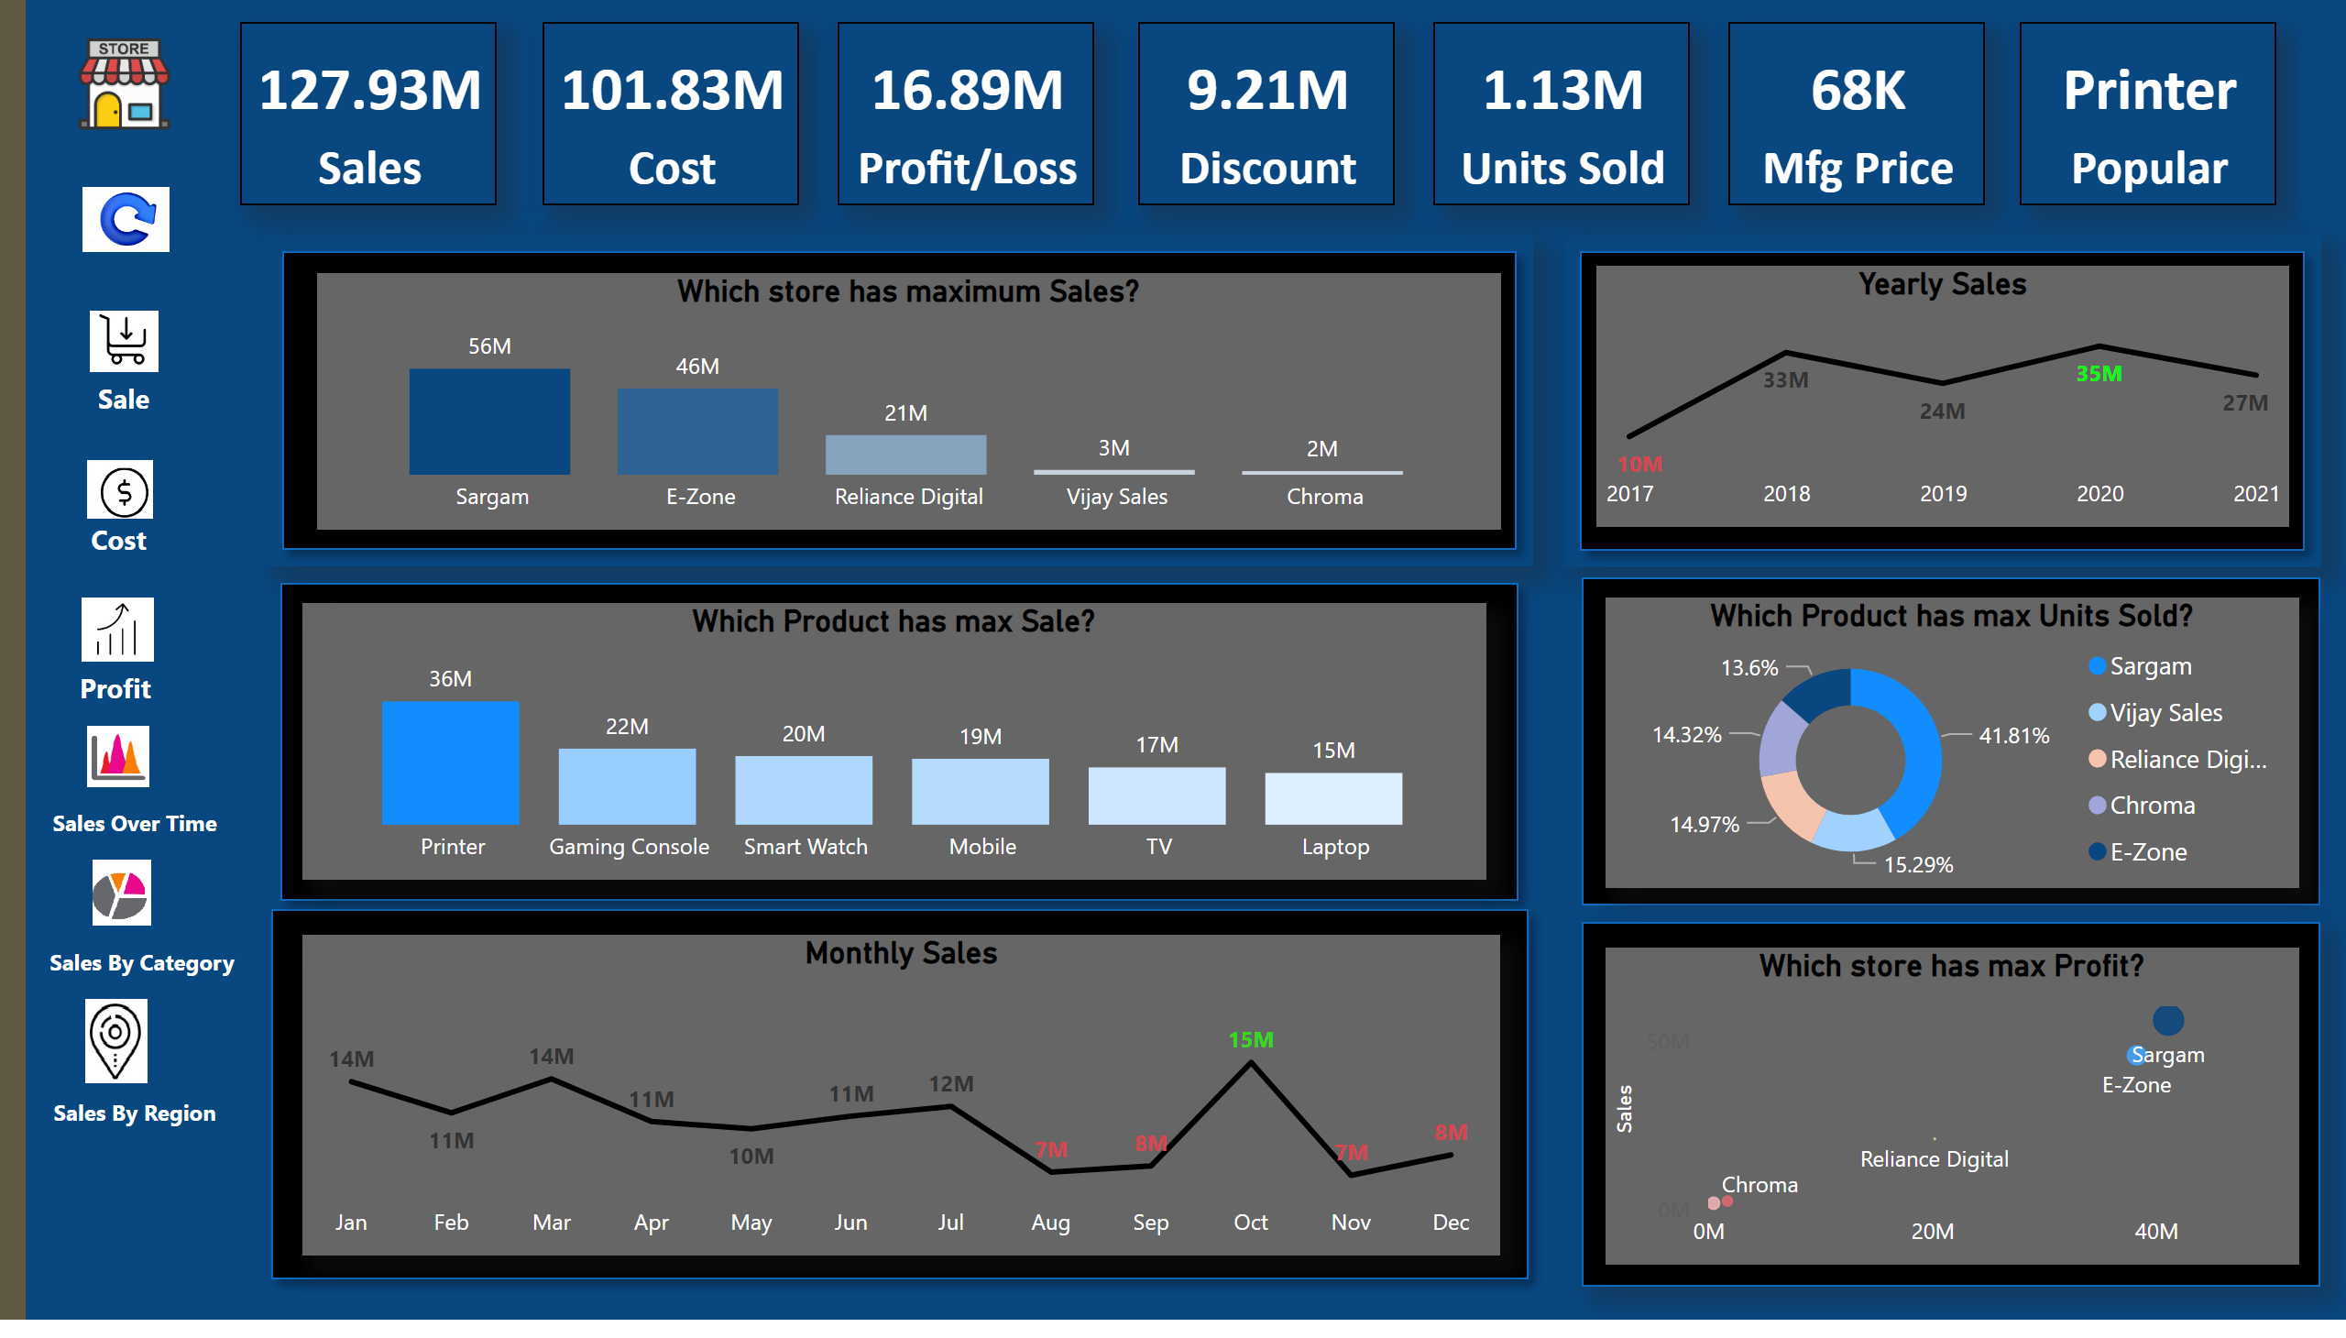
Dashboard
Notes:
card
No alt text provided
card
No alt text provided
card
No alt text provided
card
No alt text provided
card
No alt text provided
card
No alt text provided
card
No alt text provided
shape
No alt text provided
image
No alt text provided
image
No alt text provided
image
No alt text provided
image
No alt text provided
image
No alt text provided
textbox
No alt text provided
textbox
No alt text provided
textbox
No alt text provided
textbox
No alt text provided
textbox
No alt text provided
shape
No alt text provided
shape
No alt text provided
shape
No alt text provided
shape
No alt text provided
image
No alt text provided
textbox
No alt text provided
Which Product has max Units Sold?
No alt text provided
Which store has maximum Sales?
No alt text provided
Monthly Sales
No alt text provided
Yearly Sales
No alt text provided
shape
No alt text provided
Which store has max Profit?
No alt text provided
image
No alt text provided
image
No alt text provided
shape
No alt text provided
Which Product has max Sale?
No alt text provided

