Slide 1



American_Bank_Dashboard(Kratika)
View in Power BI
Last data refresh:
7/15/2023 5:31:01 AM UTC
Downloaded at:
7/17/2023 10:17:34 AM UTC

Slide 2
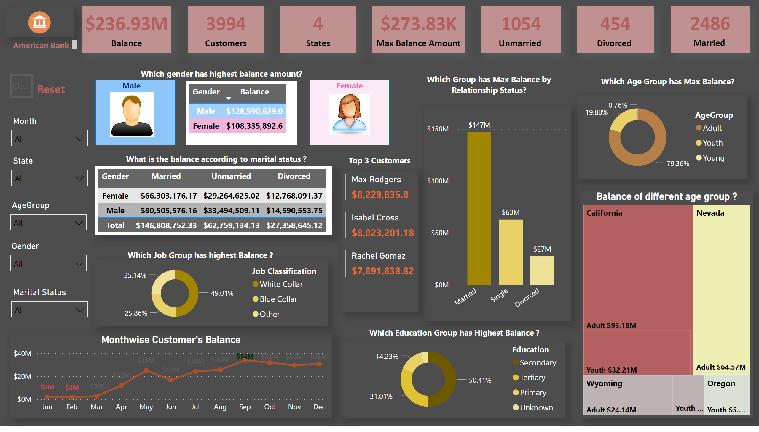
Dashboard
Notes:
card
No alt text provided
card
No alt text provided
card
No alt text provided
card
No alt text provided
image
No alt text provided
slicer
No alt text provided
slicer
No alt text provided
slicer
No alt text provided
slicer
No alt text provided
image
No alt text provided
shape
No alt text provided
image
No alt text provided
shape
No alt text provided
shape
No alt text provided
Which Age Group has highest balance ?
No alt text provided
tableEx
No alt text provided
shape
No alt text provided
Which Age Group has highest balance ?
No alt text provided
Monthwise Customer's Balance
No alt text provided
Balance of different age group ?
No alt text provided
shape
No alt text provided
slicer
No alt text provided
actionButton
No alt text provided
textbox
No alt text provided
textbox
No alt text provided
tableEx
No alt text provided
Which Age Group has highest balance ?
No alt text provided
shape
No alt text provided
Which Age Group has highest balance ?
No alt text provided
Which Age Group has highest balance ?
No alt text provided
shape
No alt text provided
shape
No alt text provided
card
No alt text provided
card
No alt text provided
card
No alt text provided
shape
No alt text provided

