Slide 1

®
bellabeat
Health-focused smart products for women
Smart Device
Usage Analysis
Insights to drive Bellabeat's marketing strategy
Data Source: FitBit Fitness Tracker Data (Kaggle / Möbius) Dataset: 35 users · 1,388 records · March–May 2016 Prepared by: Junior Data Analyst –Iktedar Ahmed, Bellabeat Marketing Team
Confidential — Bellabeat Marketing Analytics · 2026

Slide 2
Agenda
01
02
03
Business Task
Data Overview
Key Findings
What are we solving and why it matters
Source, scope, and preparation methodology
Activity, sleep, calories, intensity patterns
04
05
Correlations
Recommendations
How metrics relate to each other
Marketing strategy actions for Bellabeat

Slide 3
Business Task
The Challenge
Q1
What are the trends in smart device usage?
Bellabeat is a fast-growing wellness tech company for women. To compete in the global smart device market, the executive team needs data-driven insights into how consumers use smart fitness devices. The goal is to analyze FitBit user data to identify behavioral trends that can inform and strengthen Bellabeat's marketing strategy.
Q2
How do these trends apply to Bellabeat customers?
Focus Product: Bellabeat Leaf — the classic wellness tracker worn as bracelet, necklace, or clip.
Q3
How can these trends inform marketing strategy?

Slide 4
Data Overview
35
1,388
2
3
Users
Records
Months
CSV Files
📂 Data Sources Used
🧹 Data Preparation
dailyActivity_merged
Mar 12 – Apr 11, 2016 (FitBit export) dailyActivity_merged
Apr 12 – May 11, 2016 (FitBit export) sleepDay_merged
Apr 12 – May 11, 2016 (FitBit export)
Tool: Google Sheets ✔ Merged all three files into one dataset ✔ Removed 3 duplicate rows ✔ Removed 9 rows with zero-calorie records ✔ Validated: data types, ranges, regex, cross-field etc. ✔ Final: 1,388 clean records across 35 users

Slide 5




Activity Overview — Key Averages Per Day
7,328
2,281
5.25
6.99
steps
kcal
miles
hrs
Avg. Daily Steps
Avg. Daily Calories
Avg. Daily Distance
Avg. Daily Sleep

Slide 6
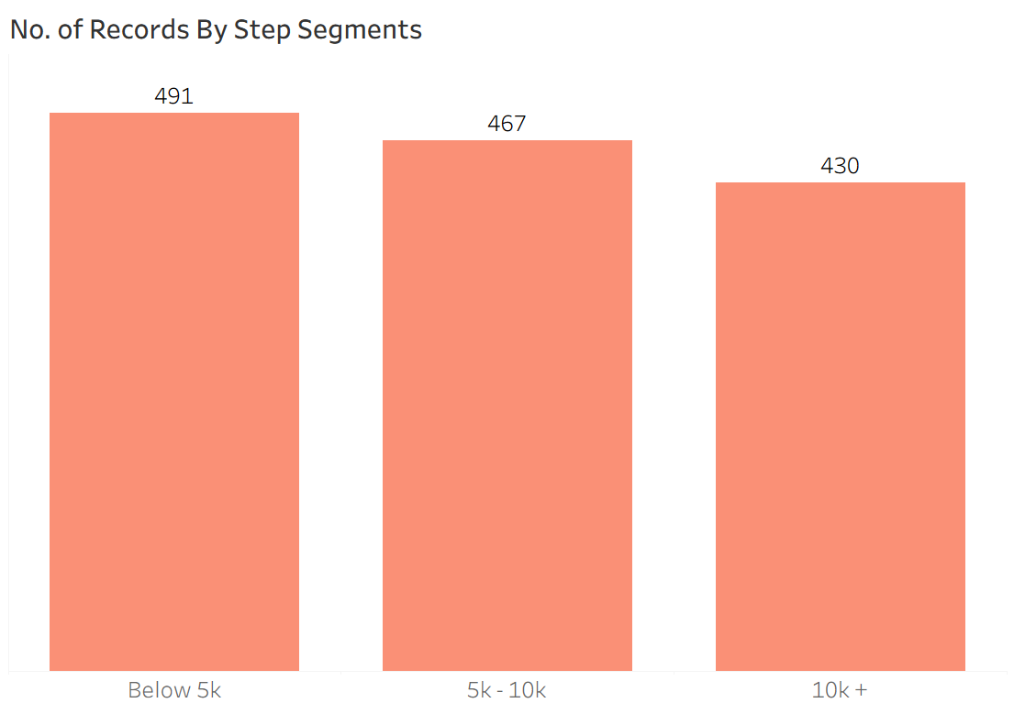
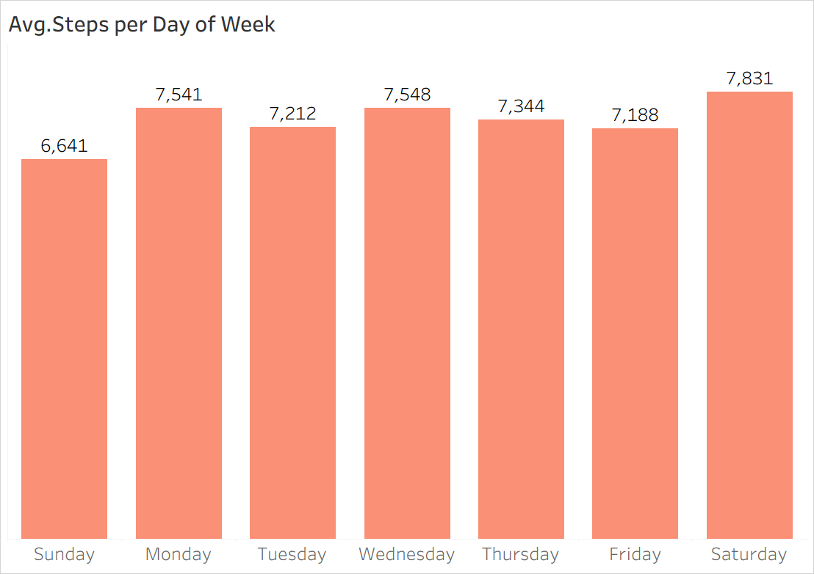
Step Activity — Patterns & Distribution
7,328
7,055
36,019
10.17M
Avg Steps
Median
Max Steps
Total
💡 Avg steps (7,328) fall below the recommended 10,000/day goal — engagement opportunity!

Slide 7
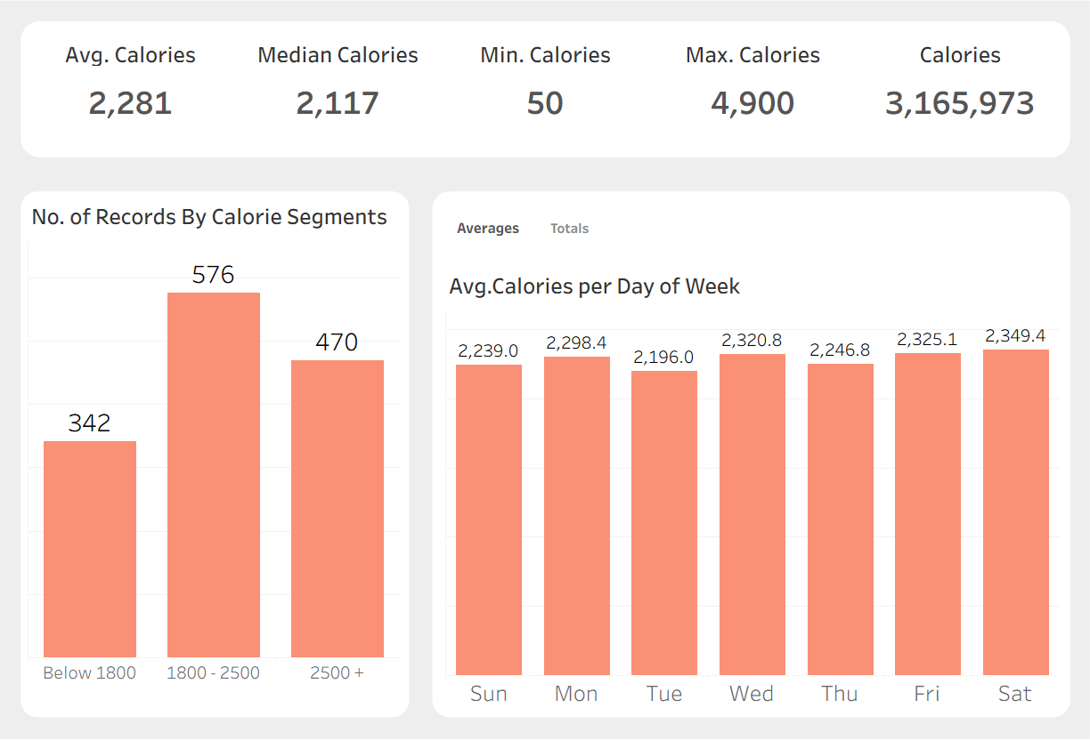
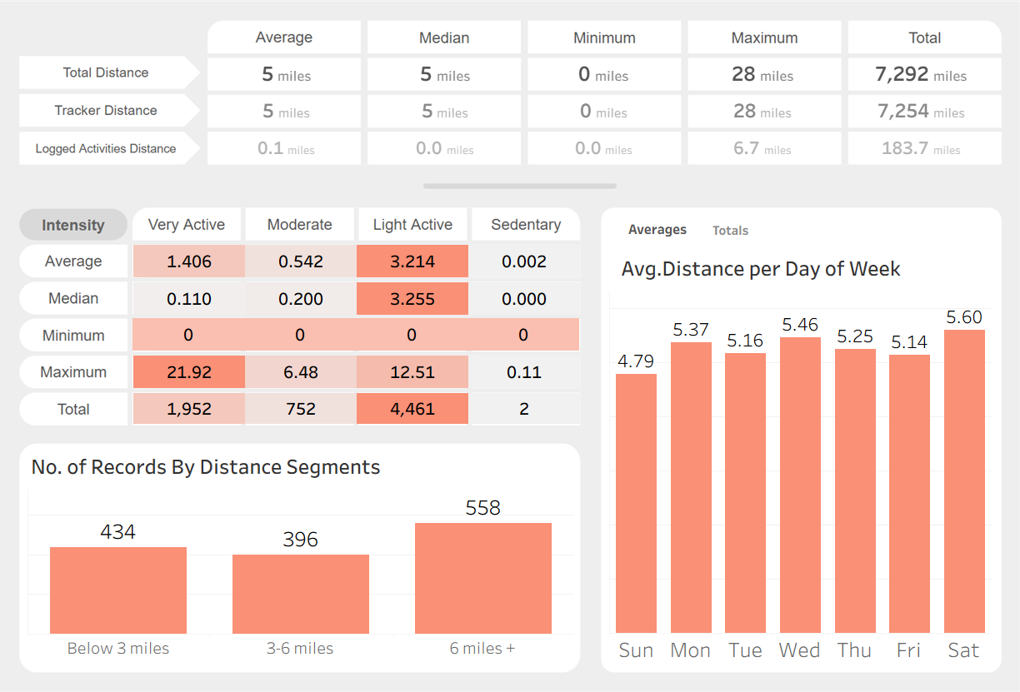
Calories Burned & Distance Covered
Calories Analysis
Distance Analysis
Calories: Most users burn 1,800–2,500 kcal/day · Peak day: Saturday
Distance: Majority covers 6+ miles daily · Light Active Distance (4,461 mi) dominates over Very Active (1,952 mi)

Slide 8
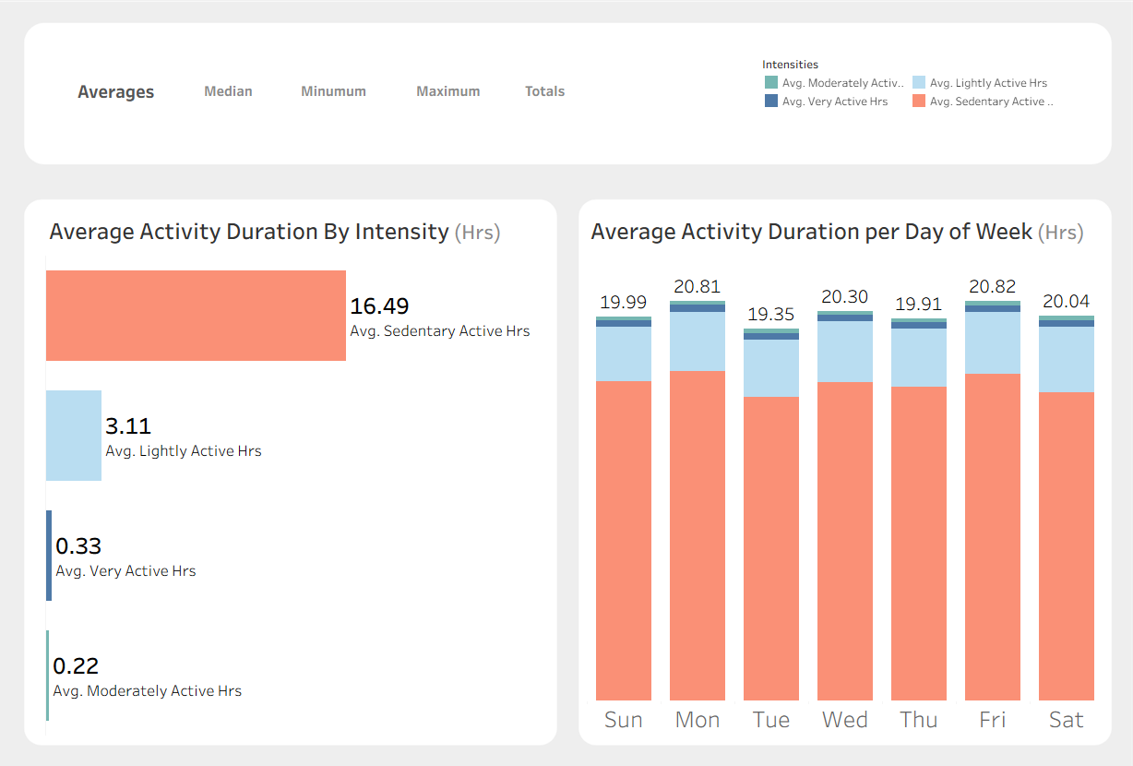
Activity Duration & Intensity Breakdown
16.49 hrs
Sedentary
3.11 hrs
Lightly Active
0.33 hrs
Very Active
0.22 hrs
Moderate
Tableau Dashboard — Duration

Slide 9
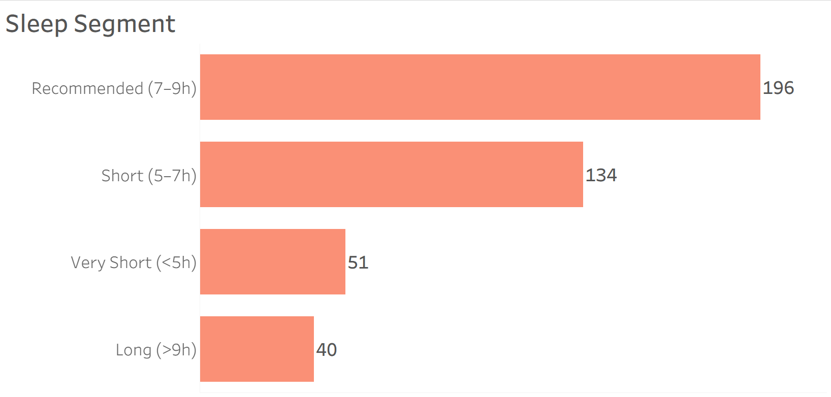
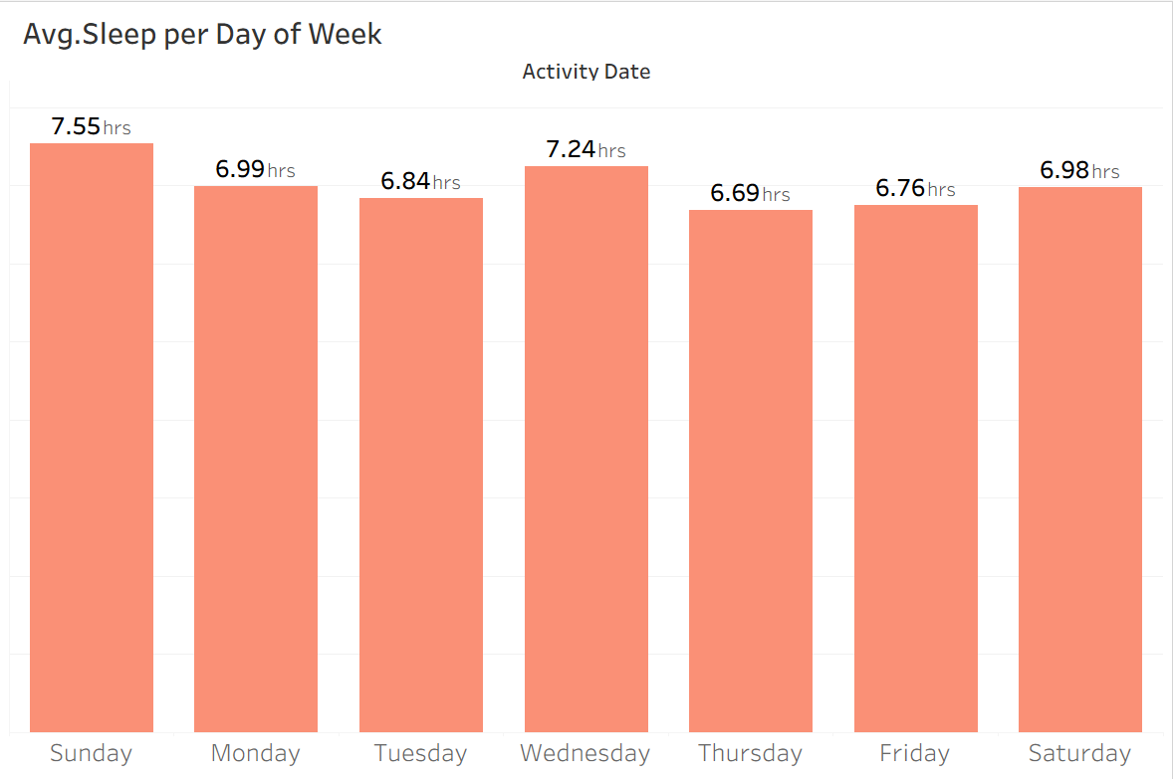
Sleep Patterns & Quality
7 hrs
7 hrs
13 hrs
30.3%
Avg Sleep
Median
Max Sleep
Tracked Sleep
⚠️ Only 30.3% (421 out of 1388) of records include sleep data — a major tracking gap to address.

Slide 10
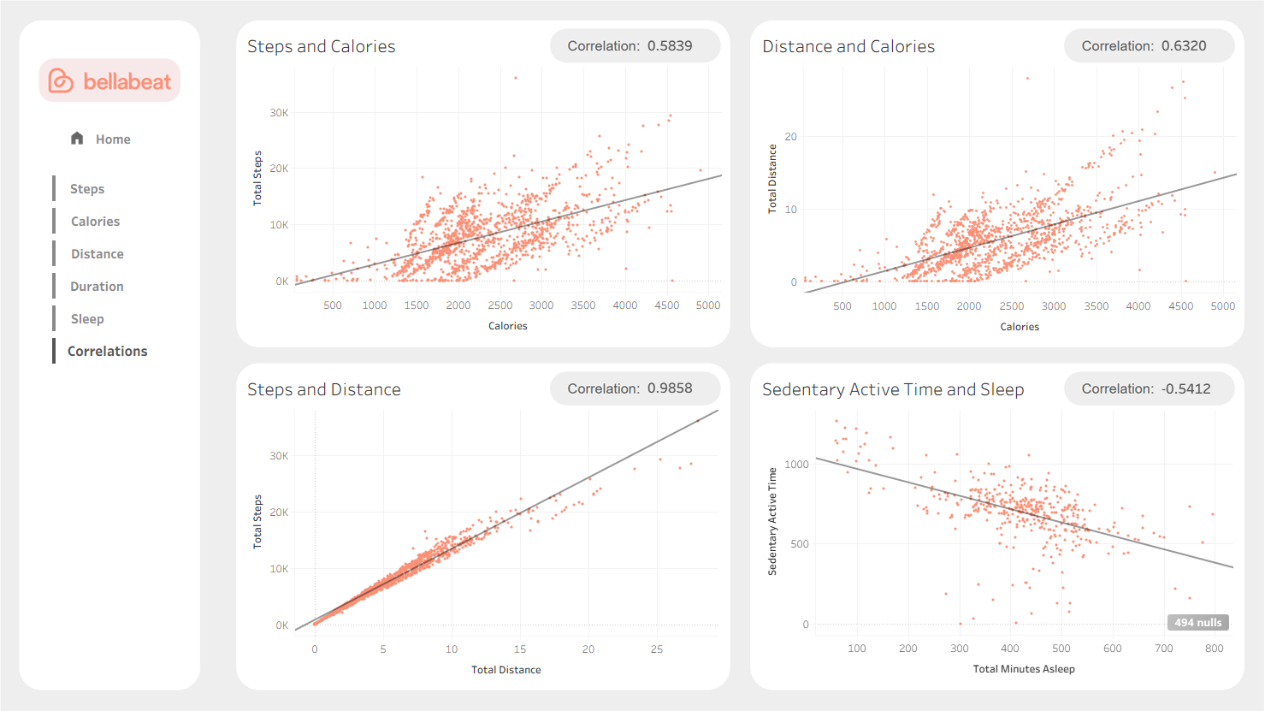
Key Correlations Between Metrics
r = 0.58
Steps ↔ Calories
Moderate positive link
r = 0.63
Distance ↔ Calories
Strong positive link
r = 0.99
Steps ↔ Distance
Nearly perfect correlation
r = −0.54
Sedentary ↔ Sleep
More sitting = less sleep
There's a negative link (r=−0.54) between sitting and sleep quality
Tableau Dashboard — Correlations

Slide 11
Marketing Recommendations
Step Challenge Campaigns
01
Users average only 7,328 steps/day vs. the 10,000 recommended. Market the Leaf as a motivational coach through in-app step challenges, weekly goals, and push notifications. Partner with fitness influencers to drive the "10K challenge" social campaign.
Sleep Tracking Feature Push
02
Only 30.3% of records capture sleep data, and ~44% (185 out of 421 tracked sleep data) users sleep less than the recommended 7–9 hours. Promote sleep as a key differentiator for the Leaf tracker. Launch a 'Better Sleep' educational campaign with reminders and guided wind-down routines through the Bellabeat app.
Reduce Sedentary Time Messaging
03
Users spend ~16.5 hrs/day sedentary on average, and there's a clear negative link (r=−0.54) between sitting and sleep quality. Position the Leaf as a sedentary-break reminder tool. Use Monday and Friday activity peaks to time push notifications and social ads for maximum engagement.

Slide 12
bellabeat
Thank You
Summary of Key Findings
→ Users walk 7,328 steps/day avg — below 10k target → Most of time is sedentary (16.49 hrs/day) → Sleep data captured only 30.3% of the time → More sedentary time correlates with poorer sleep (r=−0.54)
Bellabeat Marketing Analytics · Data: FitBit Fitness Tracker (Kaggle/Möbius, CC0) · Prepared March 2026

