Slide 1

https://github.com/Analyst-In-The-Wild/dna_prediction_perinatal
Using Data to Address Barriers in Perinatal Mental Health Care
Lori Edwards Suarez
Principal Mental Health Transformation Analyst
Nottinghamshire Healthcare NHS Foundation Trust
11/10/2023

Slide 2
Perinatal Mental Health History
Will see women who are 32 weeks pregnant up to 12 months post birth
Perinatal are commissioned to assess 10% of new Mothers
Referrals are at 11-12%
The target however, has never been met
Historically DNA rate has been ~ 30% for initial assessment
With this DNA rate they would need nearly 15% of new mothers referred

Slide 3

DNA Regression Historically
Initially done for Outpatient Liaison
We had several file types
SQL Code
Multiple excel outputs
Some basic R code to try fix it
Multiple SPSS files
This totalled 41 files at the end of the project
When we refreshed the data several hours of work was needed
Which when we tried to replicate it all fell apart

Slide 4
Starting afresh in R
The SQL extraction was done within R using a combination of our bespoke package (nottshcData) and normal routes
Created 2 R files to keep things together (and help with future reproducible)
Grouping_variable.R allows us to make variables from 27 options in some cases to meaningful group
Fact_data.R is calling some of the warehouse we use less frequently
There were 2 Markdown files created
Perinatal_extraction.Rmd
Dna_monitoring_perinatal.Rmd

Slide 5
Data Quality
As with any analysis data quality is a challenge
We wanted to include the following but couldn’t due to missing info
Baby Age
Number of children (poor recording)
Disability status
Accommodation Status
Relationship Status
Notes:
Find a tasteful way to say we don’t see people with dead babies. Second service for trauma and bereavement – need to be admittable to MBU continuing pregnancy or a live birth

Slide 6
Definitions
Initial Appointment
You cannot have a follow up appointment till you have been seen
DNA -> Cancelled -> Seen would all be initial
Time to First Booked
How long before the patient was offered an appointment
IMD
English vs Local
Appt Location
Grouped into Clinic, Virtual, Patient’s Home or Other

Slide 7
Perinatal Extraction Rmd
This is where regression modelling was applied, and calculations made
Variables Used (as in code lots has to be left behind):
Referrer
Ethnicity
Nottinghamshire District
IMD Decile
IMD Education
IMD Barriers
IMD Health & Deprivation
IMD Living Environment
Age at Referral
Previous MH History
HCP Role
Appointment Day
Appointment Location
Time to First Booked Appointment

Slide 8
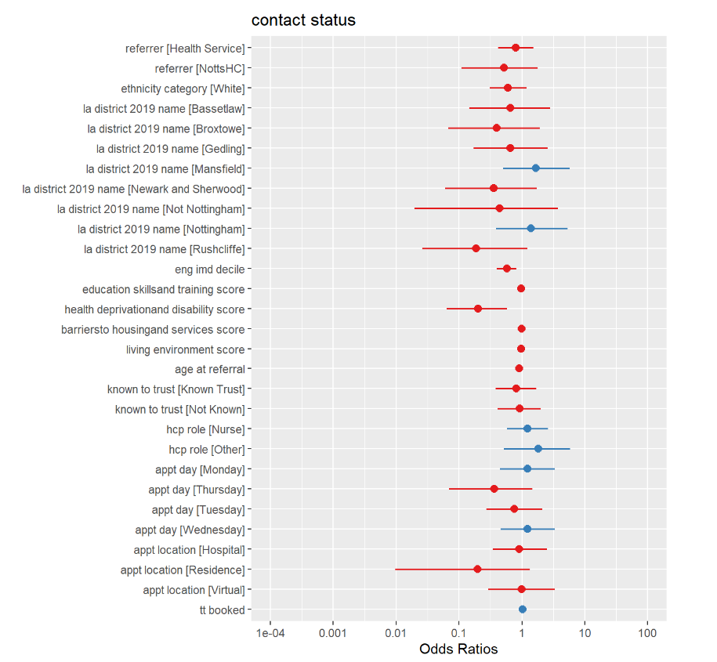
Perinatal Extraction Rmd
Once run had to make is more readable
Using gt package for table
Broom::tidy() for the extraction
sjPlot::plot_model() to create the visual

Slide 9
Taking The Results
We had key variables of significance
IMD – more deprived women have poorer attendance
Age at Referral – older women attend better
Appointment Location (at time of analysis) – home visits preferred
Time to First Booked Appt – longer people wait poorer attendance
Rushcliffe had slight significance but would be related to IMD (as is the 3rd least deprived area in England)
Appointment Location showed Home Visits were best attended

Slide 10
Implementation
Appointment Location couldn’t be “predicted” but could be the solution to poor attendance
So we needed to identify who faced the most barriers to attendances
The service had support workers to help reach out to mothers
Policy currently said repeated non-attenders or people whom asked were offered a home visit.
This was changed to being offered to those with multiple risk factors

Slide 11
Monitoring
We tracked DNA rate over time for initial vs follow up DNA
We made a list of those who were on the waiting list and their risk scores to make decisions
The team had an interest in ethnicity, so we also highlighted who was missing
They also wanted to see the breakdowns of some key demographics
Redacted Demo

