Slide 1
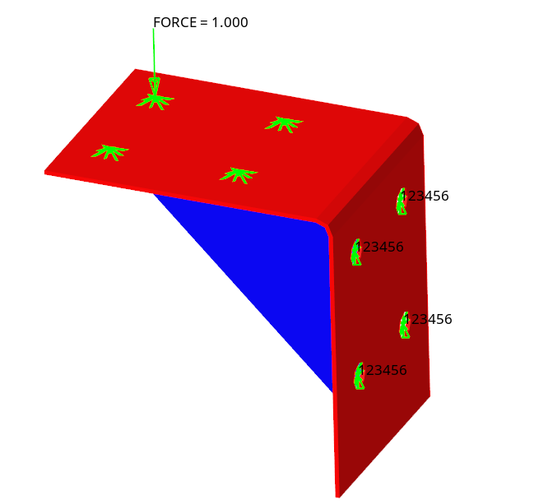
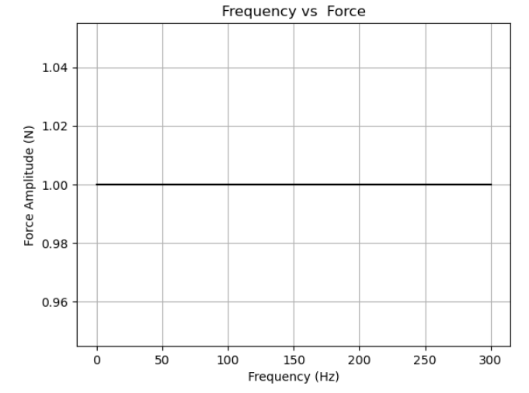
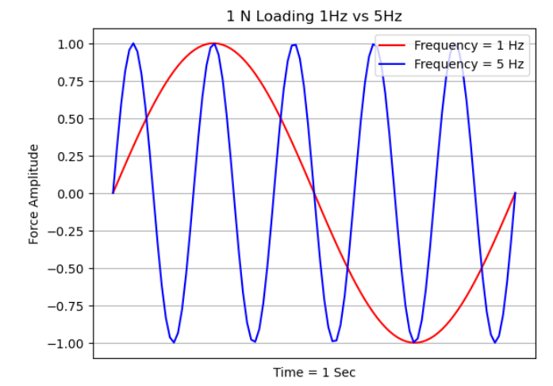
Figure1
Simulation Details
Loc1
Loc3
FRF for simple plate is carried out using Msc Nastran
Plate is constrained at 4 bolt locations (refer figure 1)
1 N Sinusoidal Load is applied for frequencies ranging from 1 to 300 Hz at 4 locations in X, Y and Z directions (refer table 1)
Responses are extracted at same location
Loc2
Loc4
Loads and Constraints
Subcase | Location | Direction | Responses to extract
1 | Loc1 | X | Displacement, Velocity and Acceleration in respective directions
2 | Loc1 | Y
3 | Loc1 | Z
4 | Loc2 | X
5 | Loc2 | Y
6 | Loc2 | Z
7 | Loc3 | X
8 | Loc3 | Y
9 | Loc3 | Z
10 | Loc4 | X
11 | Loc4 | Y
12 | Loc4 | Z
Figure 3: 1 N Load w.r.t. Time for 1 Hz vs 5 Hz
Figure2
1 N Load for all frequencies

Slide 2
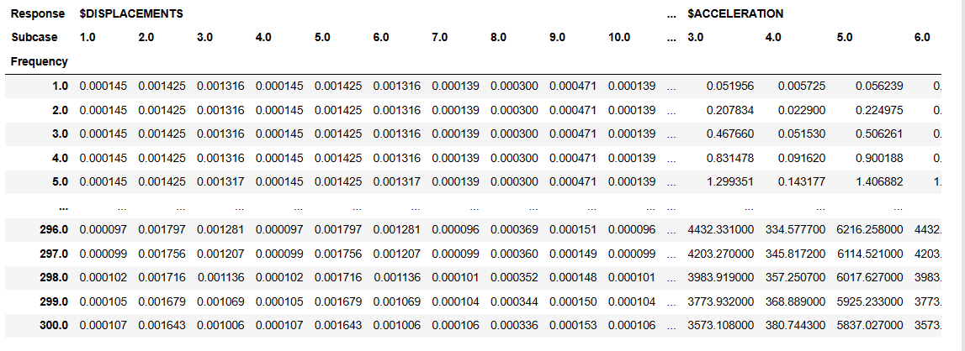
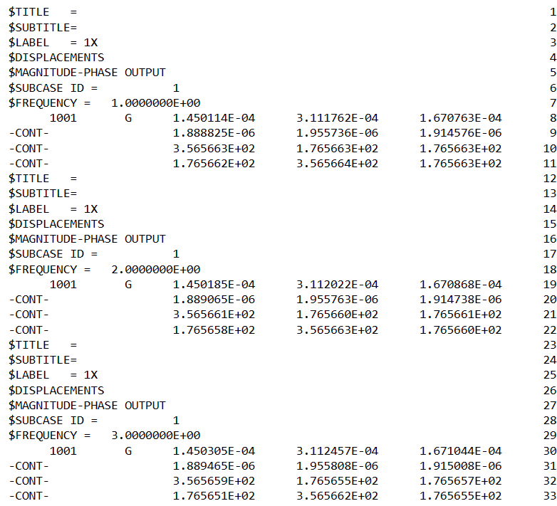
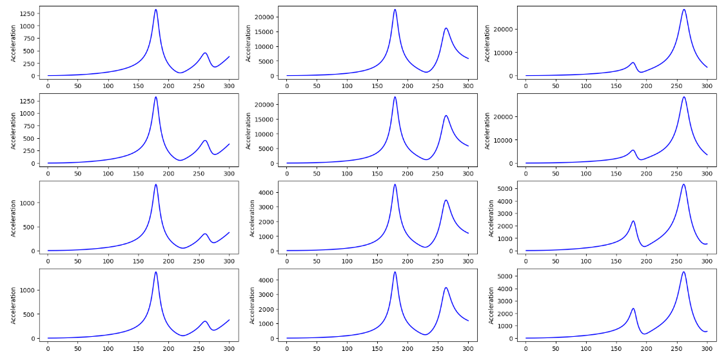
Simulation Results
Data Extraction
Data Visualization
Response Type (Displacement / Velocity / Acceleration )
Subcase ID (1-12)
Frequency (1-300 Hz)
Response (X, Y and Z directions)
File Structure

