Slide 1

STUDY CUSTOMER CHURN ANALYTICS FOR THE BANKING INDUSTRY
BY MANISHA BISWAS

Slide 2
AGENDA
Introduction
Customer churn
Average Credit Score and balance.
Summary Statistics.
Insights.
Metrics to understand Customer Churn.
The top metrics that will help us best understand the churn pattern.
Identify the Churned/Non-churned Customers.
Top 5 customer.
Top 5 customer based on credit score.
Top 10 customer based on credit score.
Top 3 customer based on credit score.
Top Three Focus Areas.
Conclusion

Slide 3
INTRODUCTION
Average Credit Score indicates creditworthiness.
Average Balance reflects typical financial position.
Consider further investigating the accounts with zero balance to understand their nature and impact on the analysis. Monitor accounts with extreme values (outliers) for potential influence on overall trends.
Explore strategies to enhance credit scores for customers below the average, contributing to improved financial health.

Slide 4
CUSTOMER CHURN
Customer churn is the percentage of customers that stopped using your company’s product or service over a time period. This will help a banking company understand what makes a customer leave and how to combat it. To get started, we will explore the data and metrics that help you understand what are the driving factors behind customer churn.
The Dataset link is as follows:-https://drive.google.com/file/d/18G6PwZm0kakfGqb2p7YqtMR_oy_o7pkT/view?usp=sharing

Slide 5
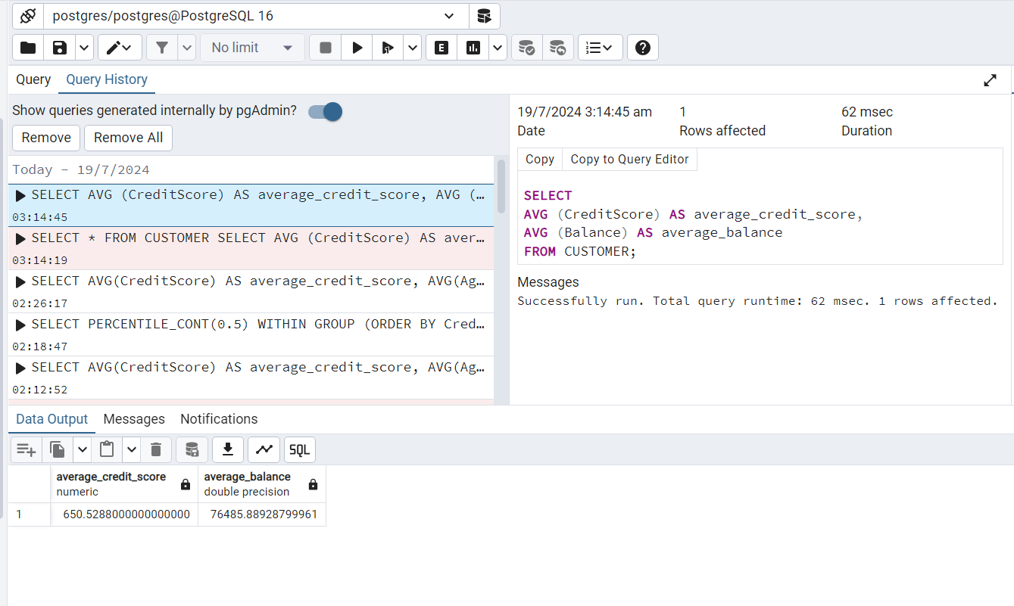
AVERAGE CREDIT SCORE AND BALANCE
Average credit score | Average Balance
650.53 | 76485.89
Insights
Averages provide a snapshot of customer financial health.
Average Credit Score indicates creditworthiness.
Average Balance reflects typical financial position.

Slide 6
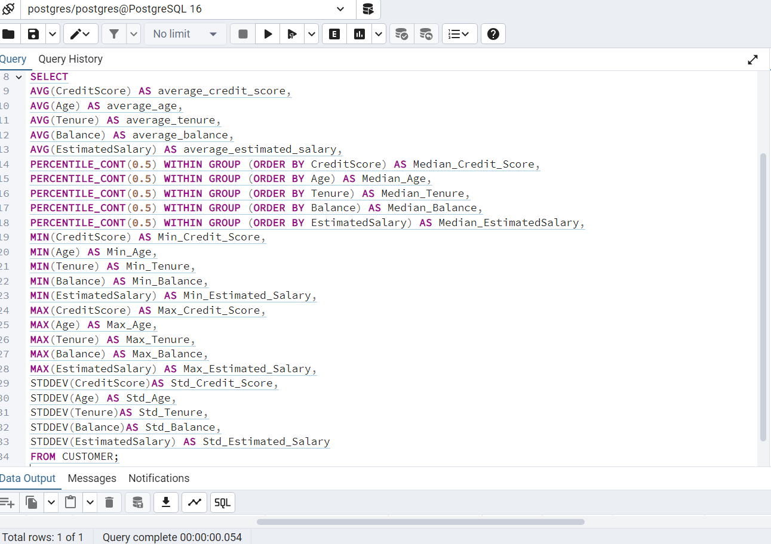
SUMMARY STATISTICS
Metric | Credit Score | Age | Tenure | Balance | EstimatedSalary
Mean | 650.53 | 38.92 | 5.01 | 76485.89 | 100090.24
Median | 652 | 37 | 5 | 97198.54 | 100193.92
Min | 350 | 18 | 0 | 0 | 11.58
Max | 850 | 92 | 10 | 250898.09 | 199992.48
STDDEV | 96.65 | 10.49 | 2.89 | 62397.41 | 57510.49
This table appears to represent descriptive statistics for several variables, likely from a dataset related to credit scoring or financial information. this table provides a comprehensive overview of the central tendency, variability, and range of each variable in the dataset. It offers insights into the distribution of credit scores, ages, tenures, balances, and estimated salaries among the individuals in the dataset.

Slide 7
STACKED BAR CHART FOR SUMMARY STATISTICS

Slide 8
INSIGHTS
There is considerable variability in credit scores, ages, tenure, account balances, and estimated salaries within the dataset.
Account balances show a right-skewed distribution, with some individuals having high balances.
The distribution of age is slightly right-skewed, indicating a higher concentration of younger individuals.
The distribution of tenure is relatively spread out, with some individuals having shorter tenures.
Estimated salary has a relatively symmetric distribution with a moderate spread.

Slide 9
METRICS TO UNDERSTAND CUSTOMER CHURN
Credit Score: Credit score may impact a customer's financial stability and likelihood to churn. Lower credit scores might indicate financial struggles, affecting their decision to continue with a service.
Age: Age can be a significant factor in churn analysis. Younger customers may be more tech-savvy and open to switching services, while older customers might prefer stability. Analyzing age groups can reveal patterns in customer behavior.
Tenure: The length of time a customer has been with the company (tenure) is crucial. Longer tenure generally indicates loyalty. Analyzing tenure in relation to churn can provide insights into whether newer customers are more prone to leaving.
Balance: Customer balances can reflect their financial engagement. Higher balances might indicate financial commitment, while low or negative balances may suggest financial strain, influencing the decision to churn.
Number of Products: The number of products a customer uses can indicate their level of engagement with the company. Customers with multiple products are usually more deeply integrated into the ecosystem, making them less likely to churn.
Is Active Member: Active membership status indicates customer engagement. Inactive members might be more prone to churn. Analyzing the behavior of active vs. inactive members provides insights into the correlation and churn.
Estimated Salary: Customer salary can influence their spending behavior and financial decisions. Analyzing salary in relation to churn can reveal patterns related to customers with higher or lower incomes.
Geography: The geographical location of customers may impact their behavior. Cultural, economic, or regional factors can contribute to churn patterns. Analyzing churn across different geographies can uncover location-specific trends.
Gender: Gender-based analysis can provide insights into whether there are differences in churn behavior between male and female customers.
Has Credit Card: Whether a customer has a credit card with the company may influence their commitment. Customers with credit cards may have a higher level of financial integration, affecting their likelihood to churn.

Slide 10
THE TOP METRICS THAT WILL HELP US BEST UNDERSTAND THE CHURN PATTERN.
Credit Score: Credit score may impact a customer's financial stability and likelihood to churn. Lower credit scores might indicate financial struggles, affecting their decision to continue with a service.
Age: Age can be a significant factor in churn analysis. Younger customers may be more tech-savvy and open to switching services, while older customers might prefer stability. Analyzing age groups can reveal patterns in customer behavior.
Tenure: The length of time a customer has been with the company (tenure) is crucial. Longer tenure generally indicates loyalty. Analyzing tenure in relation to churn can provide insights into whether newer customers are more prone to leaving.
Balance: Customer balances can reflect their financial engagement. Higher balances might indicate financial commitment, while low or negative balances may suggest financial strain, influencing the decision to churn.
Estimated Salary: Customer salary can influence their spending behavior and financial decisions. Analyzing salary in relation to churn can reveal patterns related to customers with higher or lower incomes.

Slide 11
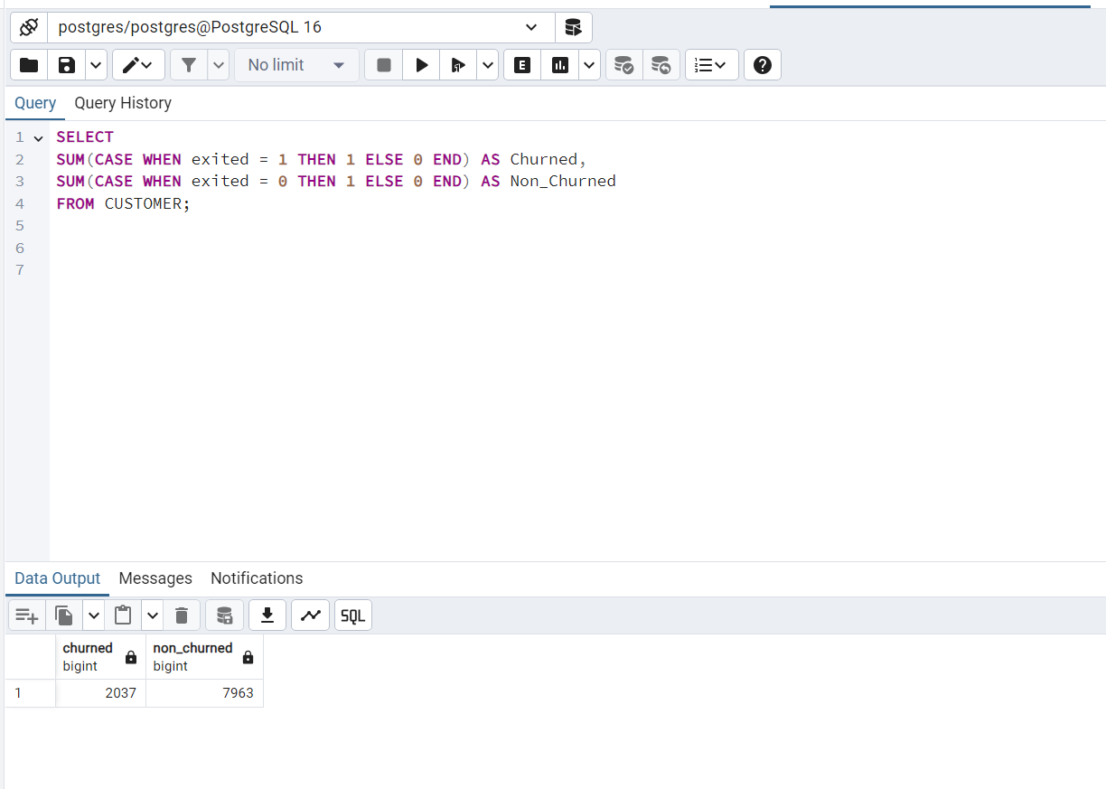
IDENTIFY THE CHURNED/NON-CHURNED CUSTOMERS
CHURNED | NON_CHURNED
2037 | 7963
The table you provided seems to be a summary of customer churn status, categorizing customers into two groups: "Churned" and "Non-Churned."

Slide 12
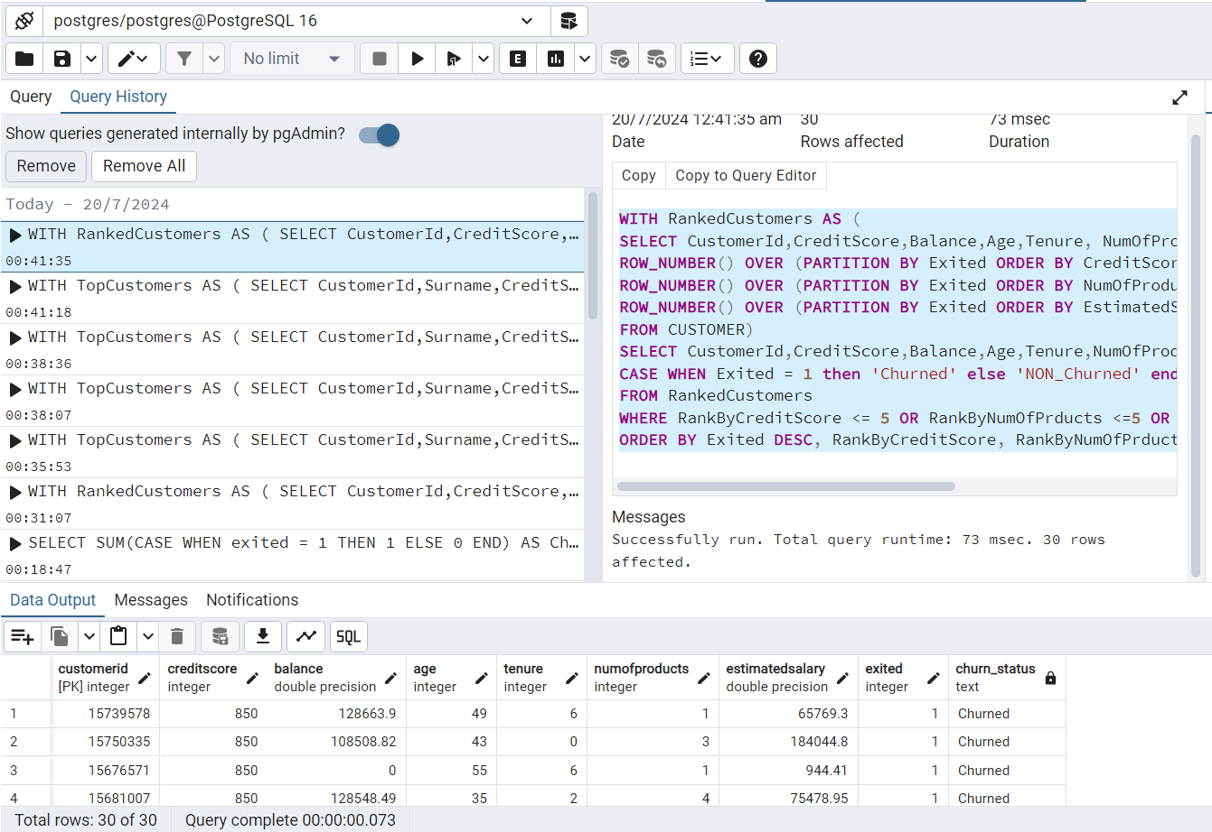
TOP 5 CUSTOMER BASED ON CREDITSCORE,BALANCE, AGE, TENURE, NUMOFPRODUCTS, ESTIMATEDSALARY
Query Explanation:
This query aims to rank customers based on different criteria (credit score, number of products, estimated salary) within their exit status (churned or non-churned). It then selects the top 5 customers for each criterion and presents information about these customers along with their churn status. The ordering in the final result allows for a quick comparison of churned and non-churned customers based on the specified criteria.

Slide 13
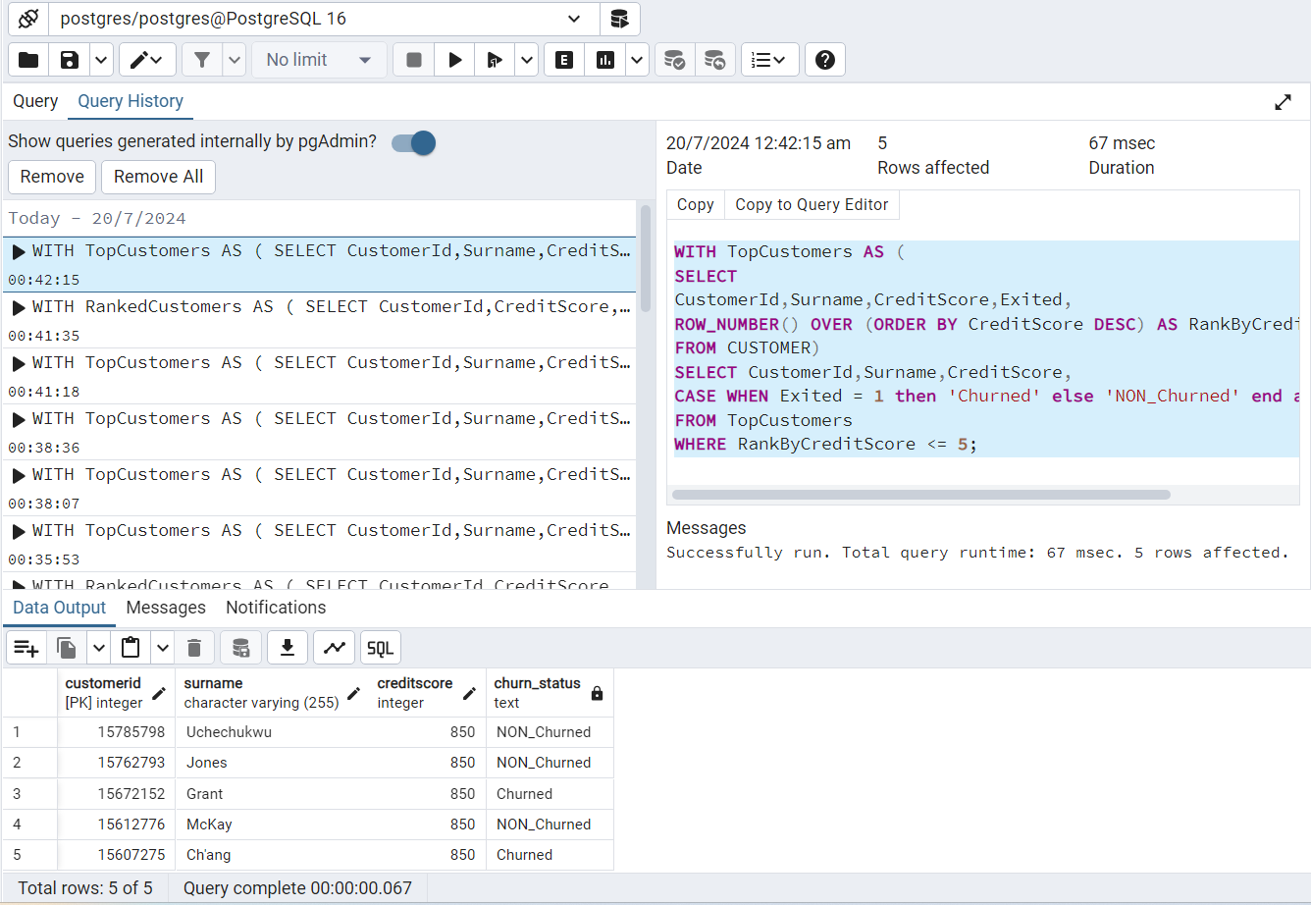
TOP 5 CUSTOMER BASED ON CREDIT SCORE
customerid | surname | creditscore | churn_status
15785798 | Uchechukwu | 850 | NON_Churned
15762793 | Jones | 850 | NON_Churned
15672152 | Grant | 850 | Churned
15612776 | McKay | 850 | NON_Churned
15607275 | Ch'ang | 850 | Churned
This table is a concise representation of key customer attributes, focusing on credit scores and churn status for each customer.

Slide 14
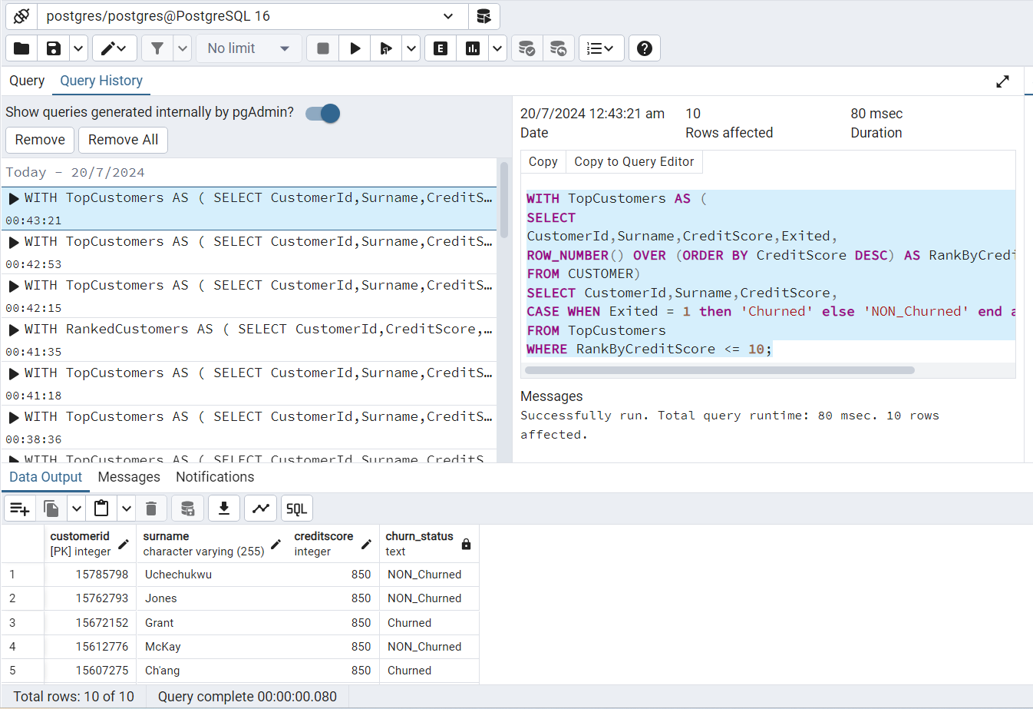
TOP 10 CUSTOMER BASED ON CREDIT SCORE

Slide 15
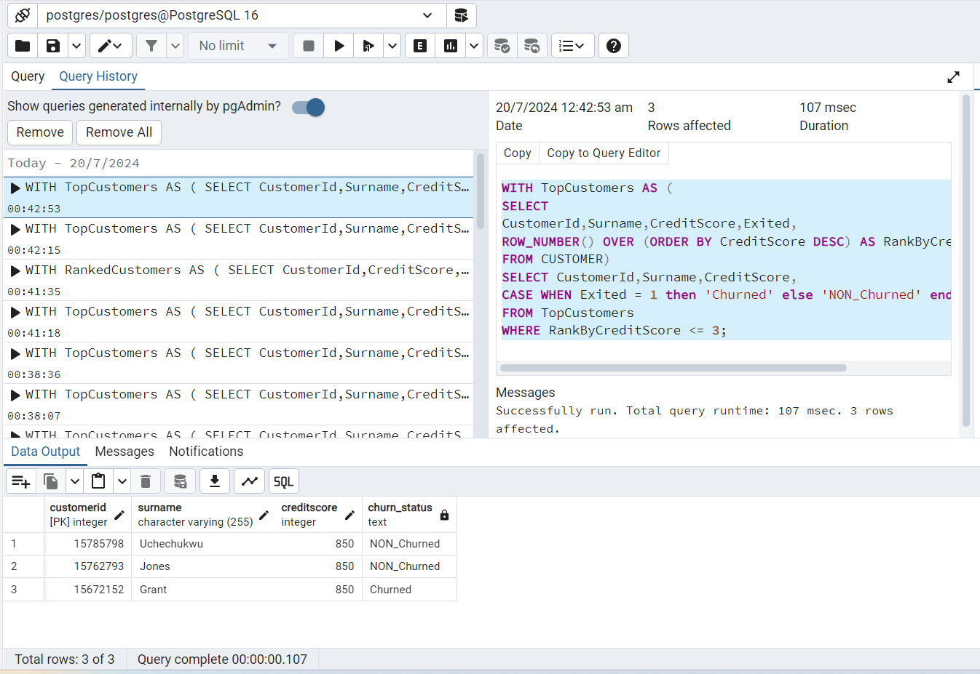
TOP 3 CUSTOMER BASED ON CREDIT SCORE

Slide 16
IDENTIFY TOP THREE FOCUS AREAS
Credit Score: (Customer Satisfaction and Loyalty)
Identify and implement strategies to enhance satisfaction for customers with lower credit scores. Provide targeted promotions or services to improve the creditworthiness of these customers. Establish personalized credit management plans for customers with varying credit scores.
Tenure: (Enhanced Customer Retention)
Develop strategies to reward and retain customers with longer tenures. Introduce loyalty programs or exclusive benefits for customers who have been with the institution for an extended period. Implement targeted communication to express appreciation for customers' long-term commitment.
Num Of Products: (Promotion of Multiple Products)
Encourage customers to explore and utilize additional financial products.
Design promotions or bundled offerings to incentivize the adoption of multiple products. Provide personalized recommendations based on the customer's financial needs and preferences to increase the number of products they use.

Slide 17
CONCLUSION
Understanding the interplay between credit scores, age, tenure, balance, and estimated salary is crucial for developing targeted strategies to mitigate churn. Analyzing these factors in tandem allows for a comprehensive approach to customer retention, tailoring efforts to address the unique challenges and preferences of different customer segments. Companies can use these insights to refine their services, enhance customer satisfaction, and implement retention initiatives that align with the financial dynamics of their customer base.
These focus areas specifically target aspects related to CreditScore, Tenure, and NumOfProducts to enhance customer satisfaction, increase loyalty, and promote the utilization of multiple financial products. The success of these strategies can be measured through metrics such as customer retention rates, increased product adoption, and overall customer satisfaction scores.

