Slide 1

Profiler Application using Sentiment Analysis
Soheil Novinfard

Slide 2
Social Media
Continues emission of posts on Twitter, Facebook, Instagram, …
350,000 tweets sent per minute ¹
Unstructured Data
Could we find some different meanings behind these chain of words?
1. Internet Live Stats. Twitter Usage Statistics. http://www.internetlivestats.com/twitter-statistics/ (accessed 10 August 2018)

Slide 3
Personality Detection
Personality:
“The combination of characteristics or qualities that form an individual's distinctive character.”
Why do one need to find out their personality?
Get an objective view of themselves
Find their strengths and weaknesses
A better decision on their career path
How to define and classify it?
Big Five Factor model ²
Extroversion, Neuroticism, Agreeableness, Conscientiousness, and Openness
2. McCrae RR, Costa Jr PT. Personality trait structure as a human universal. Am Psychol. 1997;52(5):509.

Slide 4
How to Detect the Personality?
Traditional method
Using questionnaire
Many questions
Take up a lot of time
Direct questions may be misleading
Our proposed model
Indirect + quicker
Auto detection of the personality
Examining real data: our activity on social networks

Slide 5
Personality detection mobile application
Includes three aspects
Detection model
User Interface
Mobile application on platform
integration of the model and the interface

Slide 6
Detection Model: Personality Auto Detection by Sentiment Analysis
Dataset for learning and automation
2,465 stream-of-consciousness essays ³
Based on Big Five Factor personality traits
Training our model in 3 steps
Pre-processing
Feature Extraction
Tokenization the document (n-grams)
“Term-frequency” times “inverse document-frequency” (TF-IDF)
Classification
Support Vector Machine
Naive Bayes classifier
3. Pennebaker JW, King LA. Linguistic styles: Language use as an individual difference. J Pers Soc Psychol. 1999;77(6):1296.

Slide 7
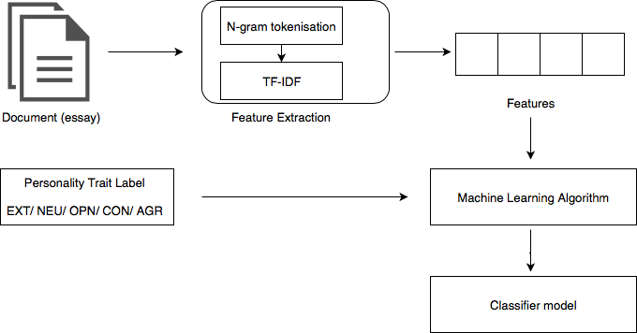
Detection Model: Training process

Slide 8
User Interface
3 Iterations to design the interface
From Low-fidelity to high-fidelity design
Evaluation using different techniques:
Iteration 1: Expert evaluation
Iteration 2: User-based quick and dirty evaluation
2 Users involved
Iteration 3: Rigorous expert heuristic evaluation
Based on 10 usability principles of Nielsen ⁴
3 Experts involved
4. Nielsen J. 10 usability heuristics for user interface design. Nielsen Norman Gr. 1995;1(1).

Slide 9
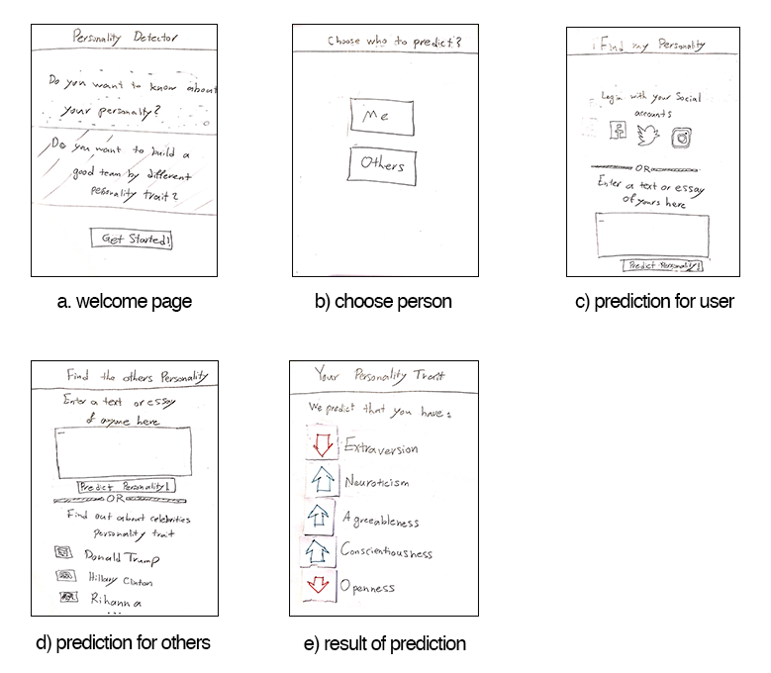
User Interface: First low-fidelity prototype

Slide 10
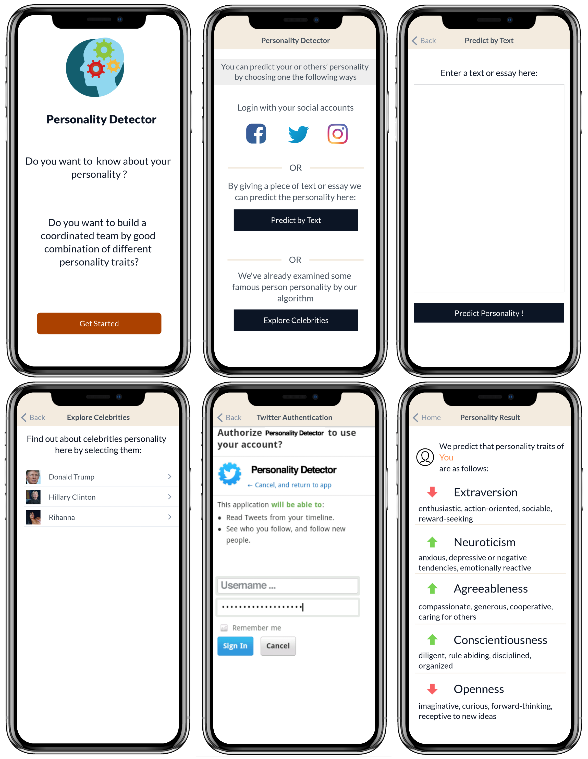
User Interface: Final high-fidelity prototype

Slide 11
Mobile Application
Made on iOS platform
Target is iOS version 10 or later
Covers 95 percent of the platform devices ⁵
Consists of three components
Interface
Input data
Machine learning engine
5. Apple. App Store - Support [Internet]. 2018 [cited 2018 Aug 5]. Available from: https://developer.apple.com/support/app-store/

Slide 12
Mobile Application: Input Data
Social network activity of the user
Twitter, Facebook, Instagram, …
The user is signed in
The latest posts (tweets) of the user is fetched
A document suitable for testing in detection model is generated
What if the user does not have any activity in social networks?
The user can put a simple essay or text of themselves

Slide 13
Mobile Application: Machine learning engine
Two ways of ML engine implementation
Embed the model inside the device
No need to use network (Internet) connectivity
Protecting user’s privacy
Basic models supported in platforms
High energy (battery) consumption
Deploy model in an external service provider
Deploy in HTTP server, Cloud services, ..
Get the ML prediction result with request and response method
Easy to update the model (no need to update the application)
Can use reinforcement models
Need to maintain the service
extra cost as no. users growing

Slide 14
Detection Model: Test & Evaluation
Prediction accuracy result Using 10-fold cross Validation
 |  | EXT | NEU | AGR | CON | OPN
Our models | SVM | 58.33 | 56.79 | 54.20 | 55.86 | 62.95
 | Naive Bayes | 57.24 | 56.71 | 54.08 | 55.13 | 63.11
Other works | First State-of-the-art model (CNN) ⁶ | 55.07 | 59.38 | 55.08 | 55.14 | 60.51
 | Second State-of-the-art model ⁷ | 55.45 | 58.33 | 56.03 | 56.73 | 60.68
6. Majumder N, Poria S, Gelbukh A, Cambria E. Deep learning-based document modeling for personality detection from text. IEEE Intell Syst. 2017;32(2):74–9.
7. Mohammad SM, Kiritchenko S. Using hashtags to capture fine emotion categories from tweets. Comput Intell. 2015;31(2):301–26.

Slide 15
Detection Model: Test & Evaluation – Special Cases
The model’s results for Donald Trump
 | Our Assumption | SVM model | NB model | SVM score | NB score
EXT | positive | negative | positive | 39.18 | 63.83
NEU | positive | negative | negative | 0.71 | 34.93
AGR | negative | negative | negative | 21.78 | 38.32
CON | negative | positive | negative | 97.07 | 42.70
OPN | negative | negative | negative | 0.83 | 29.21

Slide 16
Conclusion
We created a mobile application for predicting the personality traits of users by applying two different classifiers
Machine learning model
suitable performance in terms of predicting accuracy
Analyse the architecture of the mobile application
Data input
Machine learning deployment methods
Interface design
Made an interface based on interactive design principles
3 iterations from low-fidelity to high-fidelity prototype
Assessed by three different evaluation methods
Minimum error for the final interface

Slide 17
Future work
Machine Learning model
Other languages
Deep learning models
Adding emotion detection
Mobile Application
Implement ML models inside device
Develop Android version
User Interface
Evaluate the design with more users
Design an optimised interface for tablet devices

Slide 18
End of slides.
Now It’s time for demonstration ☺

