Slide 1

Prediction of Term Deposit Subscription
Presented by Team 4:
Keerthi Kamarthi
Mumtaz Bano
Shruti Vyas
Sowjanya Vanga
Tejaswi Yadala

Slide 2

Bank Marketing
Banking is a personalized service-oriented industry that provides services according to the customers’ needs.
Banks conducts Marketing campaigns to reach out to customers to promote the banking services.
Common mediums - social media, customer service, digital media and strategic partnerships

Slide 3
Customer Classification
Customer classification improves marketing efficiency. ​
Service promotion conducted for the potential customers.​
Classification based on the customer data and previous marketing data​

Slide 4

Predict if the customers will subscribe a term deposit
Analyze previous marketing campaign data.
Classify the clients based on the data.
Identify clients with higher chance to subscribe for a term deposit.
Focus marketing effort on such clients.
Notes:
In our project we are focusing on specific banking service – term deposits. The main objective of our application is to identify the potential customers that might subscribe term deposit. The data we are using is related with direct marketing campaigns (phone calls) of a Portuguese banking institution. Our application analyses customer features, such as demographics and transaction history, the bank will be able to predict customer saving behaviors and identify which type of customers is more likely to make term deposits. The bank can then focus its marketing efforts on those customers. This will not only allow the bank to secure deposits more effectively but also increase customer satisfaction by reducing undesirable advertisements for certain customers. It also prevents some clients from receiving undesirable advertisements, raising customer satisfaction.

Slide 5
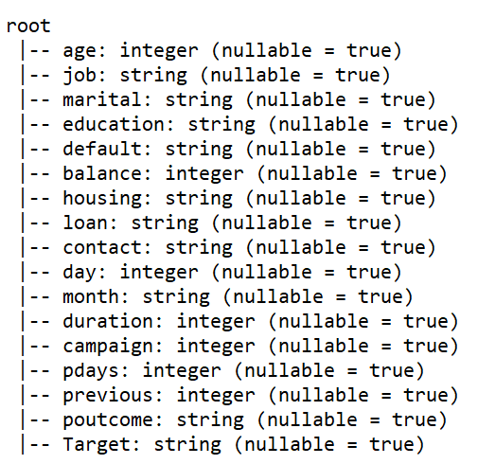
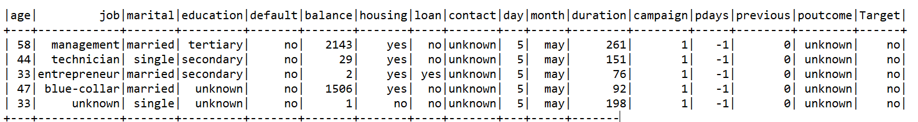
About Data
Data Source Information
Categories of Data : Consumer Data, Campaign Activities & Outcome

Slide 6
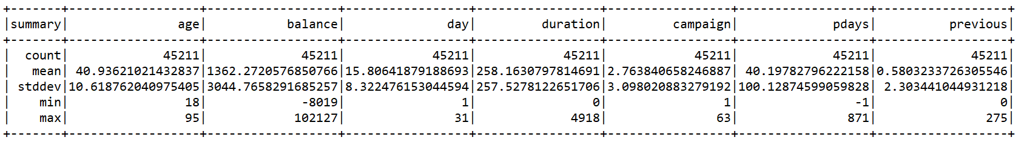
Data Description

Slide 7
Exploratory Data Analysis

Slide 8
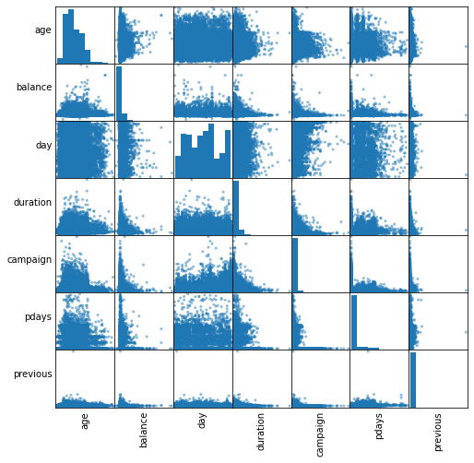
﻿PAIR PLOTS

Slide 9
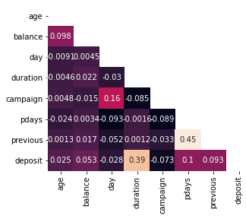
Correlation heat map

Slide 10
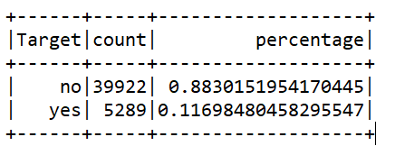
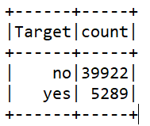
﻿
﻿Count of respondents
88.3% refused to subscribe to term deposits while 11.6% accepted to subscribe term deposits. Our labels are sort of equally distributed.
Down sampling is performed to tackle Imbalanced data.

Slide 11
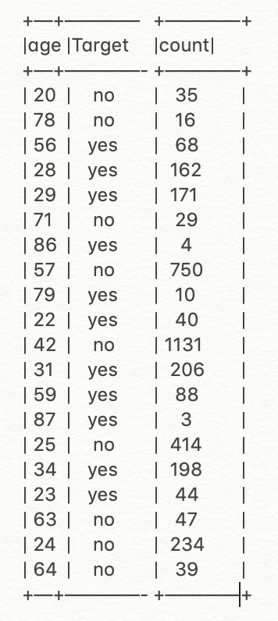
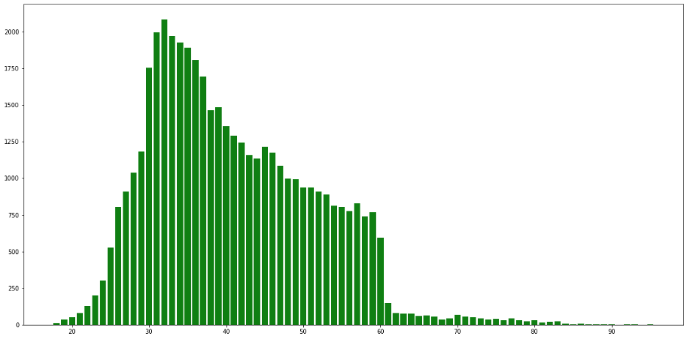
﻿
﻿Number of respondents by Age Categories
Age group 30 to 40 years had more respondents and 80 to 90 years showed less.

Slide 12
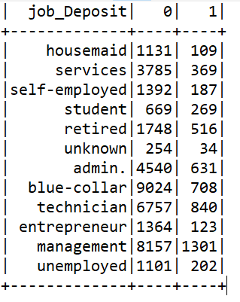
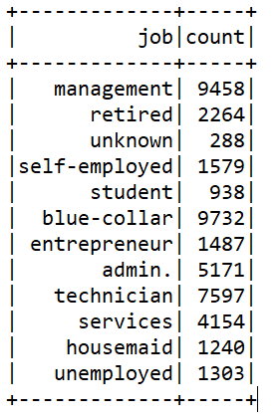
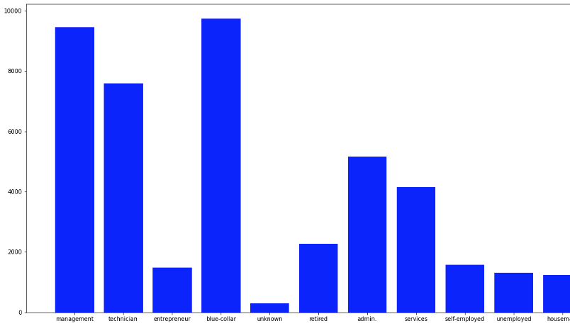
﻿Number of respondents by Job Type
Blue Collar job status had significantly higher number of respondents.
Management job status had high amount of subscribed term deposits

Slide 13
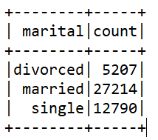
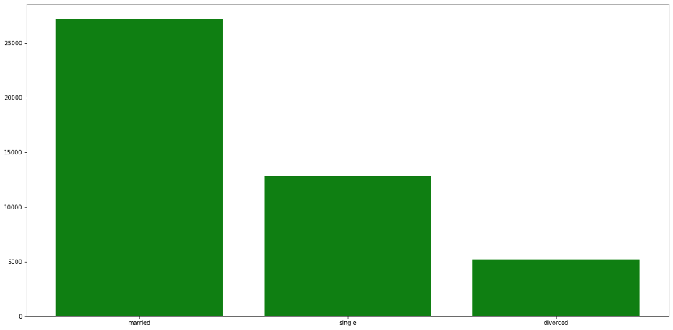
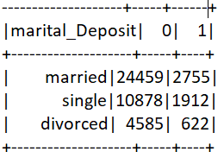
﻿﻿Number of respondents by marital status
Married marital status has highest respondents and subscribed term deposits.

Slide 14
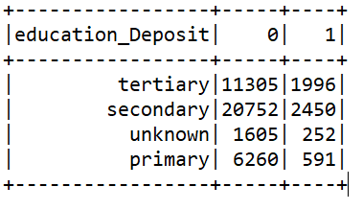
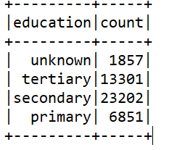
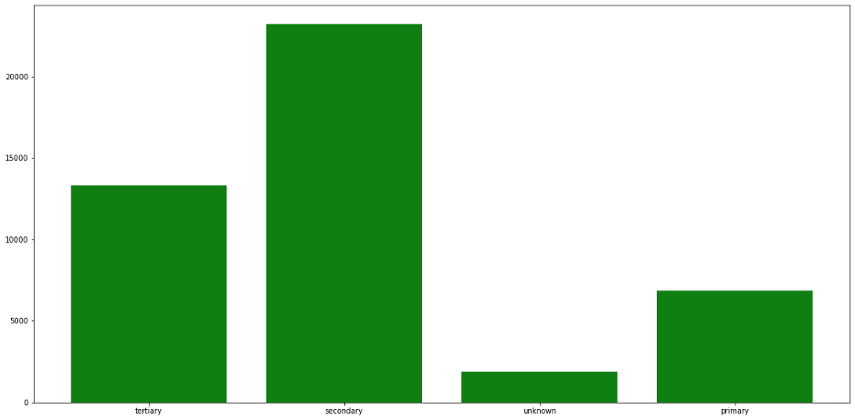
﻿Number of respondents by level of education
Row Labels | Count of y | Percent
primary | 6851 | 15%
secondary | 23202 | 51%
tertiary | 13301 | 29%
unknown | 1857 | 4%
Grand Total | 45211
Highest respondents and subscribed term deposits are from secondary

Slide 15
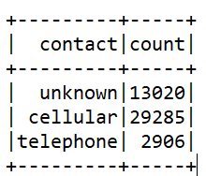
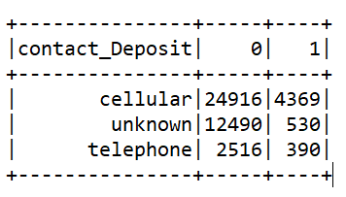
﻿﻿Number of respondents by the type of contact
Cellular is having highest count of respondents

Slide 16
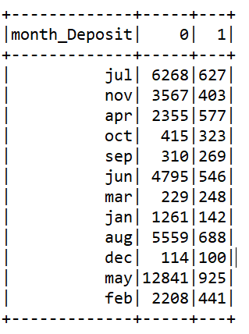
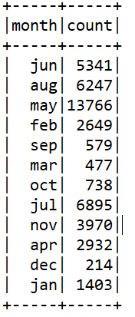
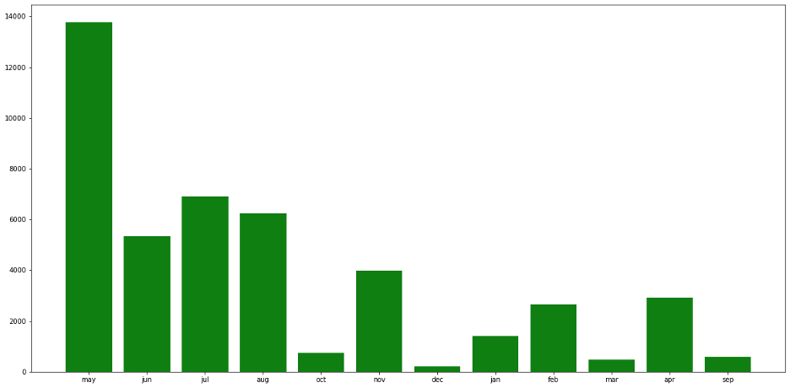
﻿Number of respondents by month
In May marketing department had the highest amount of offers to potential clients
In December the lowest level of offers made from the marketing department.

Slide 17
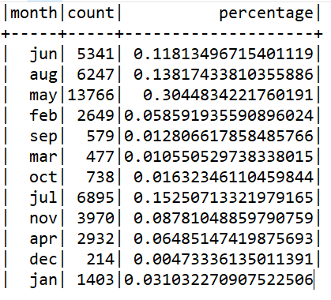
May was the month of highest marketing activity (30.4%), while December was the month of lowest marketing activity (0.47%)

Slide 18
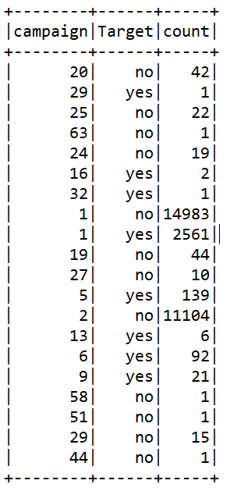
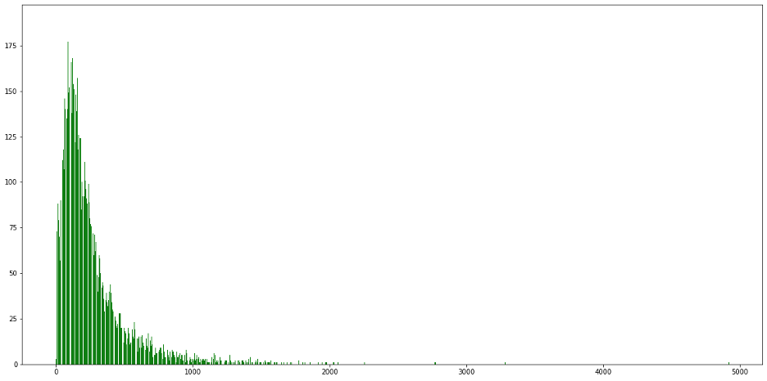
﻿Number of respondents by Campaign
Number of respondents is high in 1st call

Slide 19
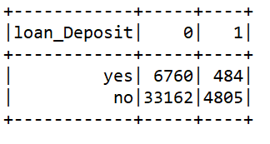
Bivariate Analysis
People who didn’t take the loan have applied for term deposits.

Slide 20
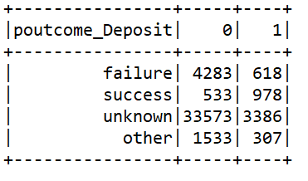
The successful outcome of a previous marketing campaign has more chance of going for a term deposit.

Slide 21
﻿Next Steps
Data preparation for model building
Apply different ML models like Random forest classifier, Logistic regression
Make prediction for the customers subscribing to the term deposit or not
Evaluate the performance of different ML models and finding the best one

Slide 22

Thank You

Slide 23
Links
Data Source:
https://data.world/uci/bank-marketing
https://archive.ics.uci.edu/ml/datasets/Bank+Marketing

