Slide 1
Inventory_Forecasting
File created on: 6/30/2025 11:41:32 AM

Slide 2
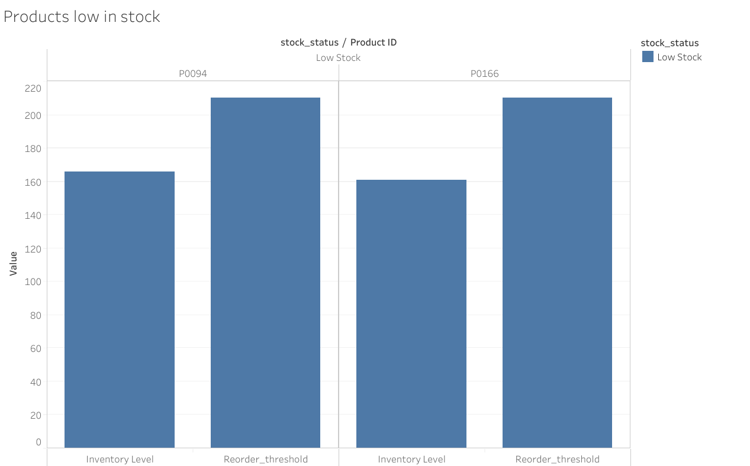

Slide 3


Slide 4
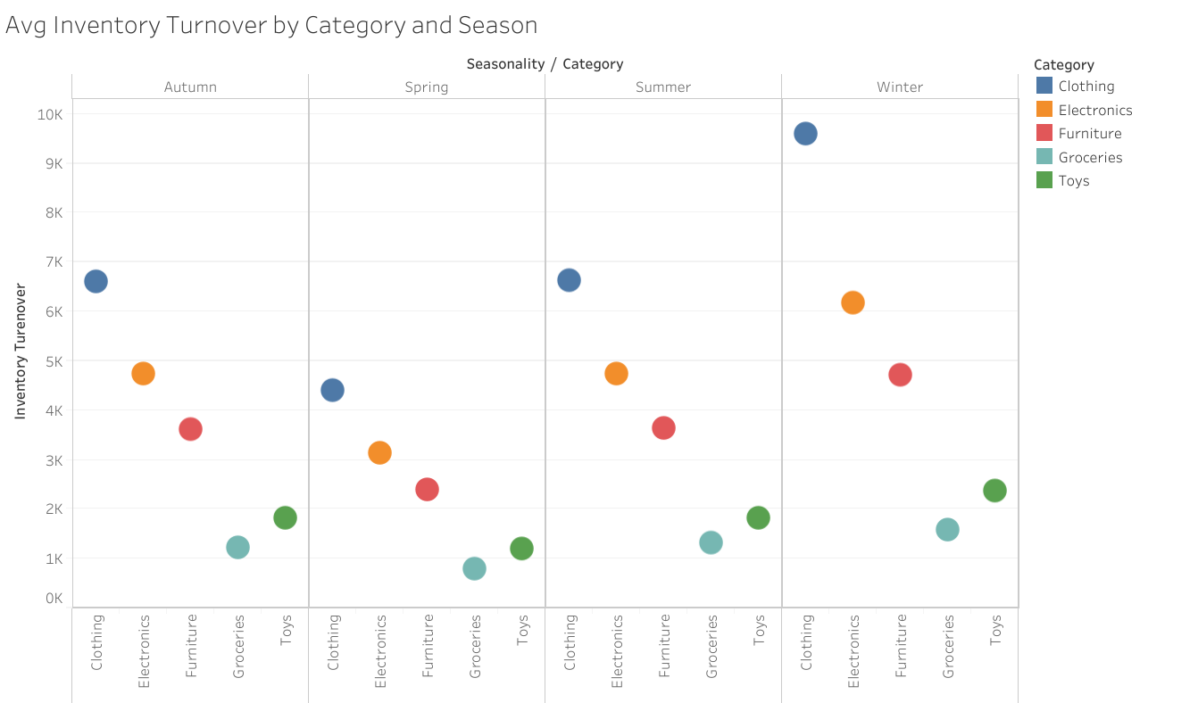

Slide 5
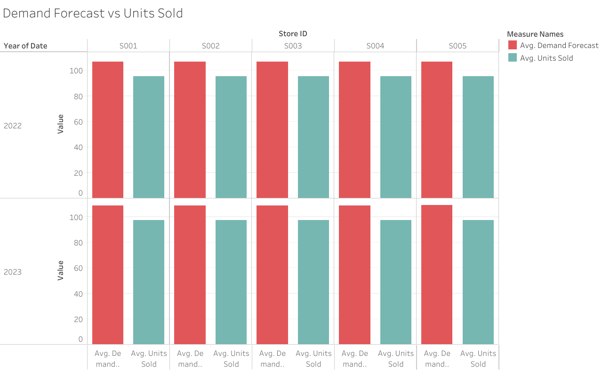

Slide 6
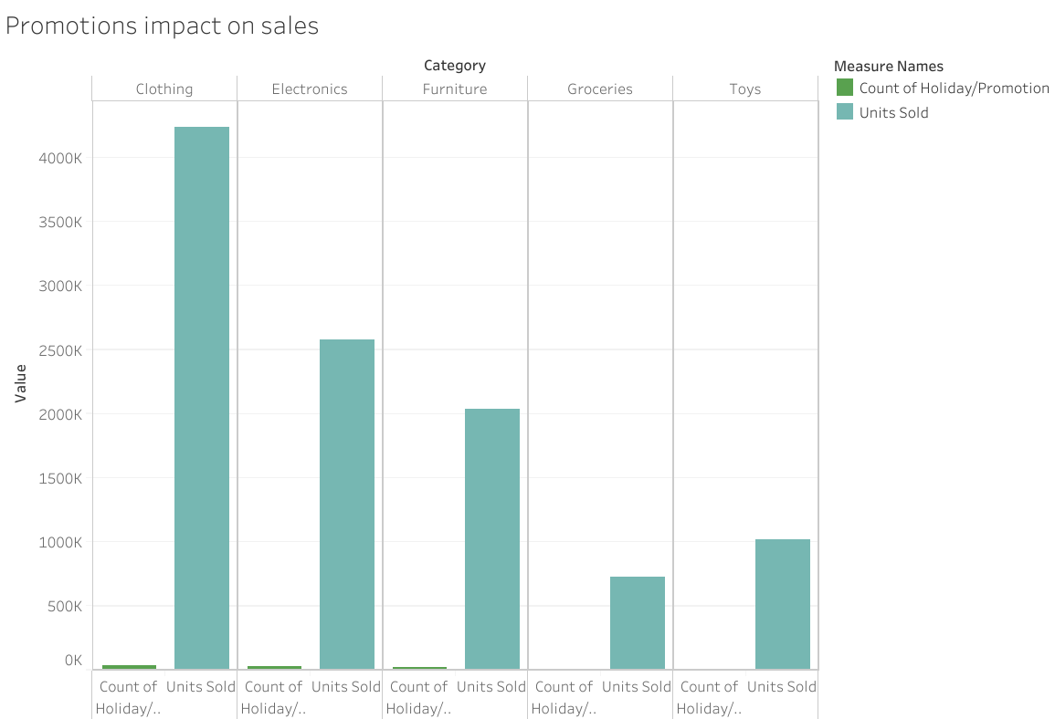

Slide 7
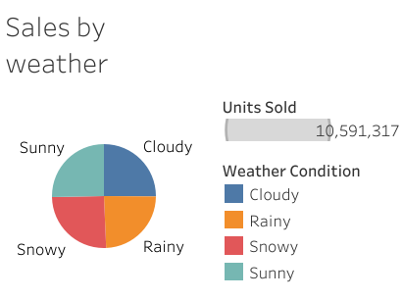

Slide 8
