Slide 1
Applying the method to Parkinson’s Disease
21st June 2018

Slide 2
Whistle-stop tour around Parkinson’s Disease!
~150,00 individuals in the UK
Higher prevalence in men than women (1.5 times more likely)
Symptoms include stiff and slow movement, stooped posture, and tremors
Neuronal death of dopaminergic neurons predominantly in the substantia nigra
Evidence of cell death in brainstem areas
Other brain tissues show dysfunction despite no cell death (SN neurons hypothesised to be particularly vulnerable)
Associated genes include SNCA, LRRK2, GBA, PRKN, PINK1, PARK7, VPS35, EIF4G1, DNAJC13 and CHCHD2.

Slide 3

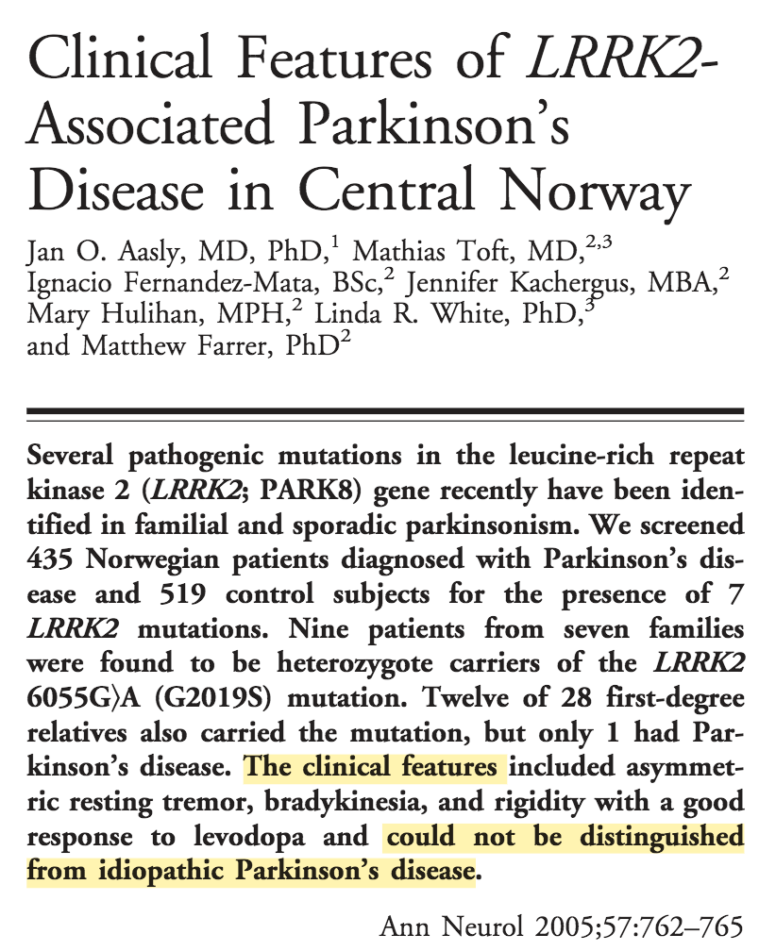

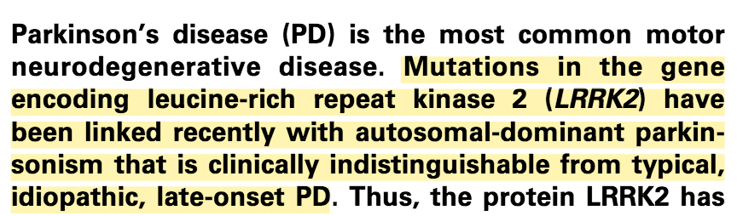
What common phenotype this time?
neuro-lab@sheffield.ac.uk

Slide 4
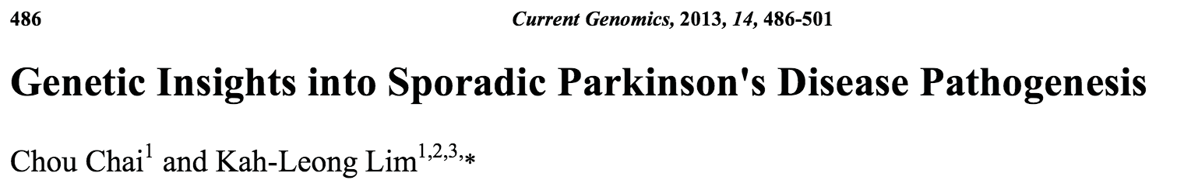
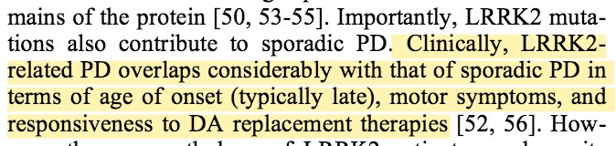
LRRK2 and Sporadic Parkinson’s Disease
Questions:
Why do LRRK2 familial and sporadic patients have such a similar phenotype?
What signature might they share?
Could this signature represent their late-onset/slow progressive nature?
If so, could that help us slow the progression of more aggressive PD cases?
Notes:
The

Slide 5
Datasets
CodeID | Tissue/Cell type | Variant | Samples | Type of array | GEO Ref
DIJ | Substantia Nigra | not specified | 15 disease, 8 control | Affymetrix Human Genome U133 Plus 2.0 Array | GSE49036
FFR | Substantia Nigra | not specified | 9 replicates for the controls and 16 replicates for the Parkinson’s disease patients | Affymetrix Human Genome U133 Plus 2.0 Array | GSE7621
MOR.SN | Substantia nigra, split into medial and lateral portions | sporadic | 15 samples of medial parkinsonian SN, 9 samples of lateral parkinsonian SN (24), 8 medial nigra control samples and 7 lateral nigra control samples(15) | Affymetrix Human Genome U133A Array | GSE8397
MID1 | Substantia Nigra pars compacta | not specified | 10 PD brain samples and 8 control | Affymetrix Human Genome U133 Plus 2.0 Array | GSE20141
MID2 | Whole substantia nigra | not specified | 18 controls, 11 patients | Affymetrix Human Genome U133A Array | GSE20292
DUM | Cortex (BA9) | not specified | 29 PD, 44 neurologically normal controls | Illumina HiSeq 2000 | GSE68719
MOR.FC | Frontal cortex | sporadic | 3 Controls 5 Patients | Affymetrix Human Genome U133A Array | GSE8397
LEW | Dorsal Nucleus of the Vagus Nerve | not specified | 6 PD samples and 4 controls | Affymetrix Human Genome U133A 2.0 Array | GSE19587
MID3 | Prefrontal cortex | not specified | 15 controls 14 patients | Affymetrix Human Genome U133A Array | GSE20168
MID4 | Putamen | not specified | 20 controls and 15 patients | Affymetrix Human Genome U133A Array | GSE20291
BOT1 | Locus Coeruleus | LRRK2 | 4 controls and 2 patients | Affymetrix Human Exon 1.0 ST Array | GSE34516
BOT2 | Putamen | LRRK2 | 5 controls and 3 patients | Affymetrix Human Exon 1.0 ST Array | GSE23290

Slide 6
Common DEGs
Started with ~364 genes
Filtered out gene overlap with
Familial blood signature (PARKIN, ATP13A2, and PINK1)
Sporadic blood signature (2 datasets)
ALS signature (5 datasets)
Finished with 210 genes (100 up, 110 down)
Genes of note include
PD – SNCA, MSX1, CYCS, SPR, ALDH1A1, UCHL1
Mitochondrial complex I deficiency – NDUFV2, NDUFS1, NDUFS3, TMEM126B
AD – RTN4, MAP1B, CASP7
ALS – CHMP2B, SERTAD3, PAWR, MRPS22, TUBA4A
Maple Syrup Urine Disease – BCAT2

