Slide 1
Common Coexpression
20/10/2017

Slide 2
What am I trying to do?
I have found genes that are commonly dysregulated (283 genes)
I used these genes as a seed to identify protein-protein interactions (3536 proteins)
Using the PPI genes list as a seed, is there a core of coexpression relationships that persist throughout each dataset?
If so, does this map onto protein-protein interactions?

Slide 3
Generating coexpression matrices
Subsetted each normalised expression matrix for rows corresponding to PPI network nodes
Some genes lost due to insufficient gene name compatibility (2572 genes, 27% loss)
Conducted spearman rank correlation on these 2572 genes for each of the 6 datasets (just over 3,306,307 relationships)
Filtered to include rho values which are > 0.5 or < -0.5

Slide 4
Coexpression networks
Dataset | Platform | Number of Edges after filtering
C9orf72 ALS | Microarray | 749,485
sALS | Microarray | 1,738,947
sFTLD + GRN FTLD | Microarray | 875,269
VCP | Microarray | 1,924,014
C9orf72 ALS + sALS | RNA-Seq | 907,927
C9orf72 ALS | RNA-Seq | 591,875
Overlap each network in Cytoscape to find edge intersection

Slide 5
But wait…
This isn’t an average.
No one knows what this is.
 | EdgeVal | C9 | sALS | FTLD | VCP | PET | RAV
AAAS : AGTPBP1 | -0.60000 | -0.65869 | -0.71429 | -0.56765 | -0.60000 | -0.80637 | -0.57143
ACAT2 : TUBA1A | 0.84314 | 0.54762 | 0.64286 | 0.76471 | 1.00000 | 0.84314 | 0.64835
ANK2 : TIMP2 | -0.55495 | 0.68313 | 0.67857 | -0.53529 | 0.80000 | 0.68382 | -0.55495
ANKMY2 : VPS45 | 0.82418 | 0.94612 | 0.96429 | -0.64118 | -0.60000 | 0.67157 | 0.82418
ARMC1 : UBE2V2 | -0.60000 | 0.75632 | 0.96429 | 0.96765 | -0.60000 | 0.79902 | 0.70330

Slide 6
Common coexpression directionality
Subset rows where coexpression direction is the same
Before subsetting | 191 nodes | 261 edges
After subsetting | 108 nodes | 119 edges

Slide 10
Random Permutation Test
Randomly sampled genes same size as PPI (2550)
From that randomly sampled 104 “module” genes
Looked for overlap
Repeated 100,000 times
p = 0.00033

Slide 12
ALS/FTLD gene
Serine/threonine kinase that plays an essential role in regulating inflammatory responses to foreign agents
Component of the 26S proteasome, a multiprotein complex involved in the ATP-dependent degradation of ubiquitinated proteins. This complex plays a key role in the maintenance of protein homeostasis by removing misfolded or damaged proteins
Data from studies of human brain tissue and experimental animal models of neuropathological conditions support the hypothesis that the Bcl-2 family regulates cell death in the mature nervous system
Acts as component of the retromer cargo-selective complex (CSC). The CSC is…acting to prevent missorting of selected transmembrane cargo proteins into the lysosomal degradation pathway
Tubulin is the major constituent of microtubules. Tubulin is degraded by parkin in PD leading to misfolded protein. May be toxic.
Involved in developmentally regulated apoptosis and programmed necrosis. Dysfunction of this gene is implicated in several neurological disorders, including Alzheimer's disease

Slide 13
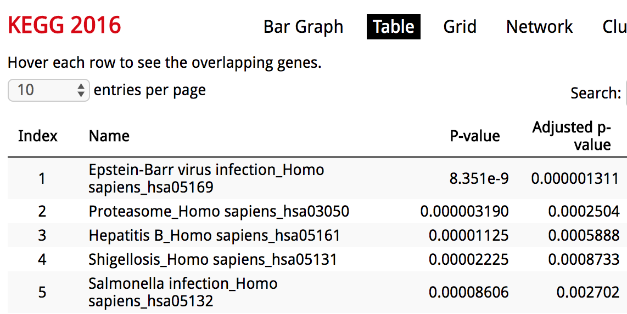
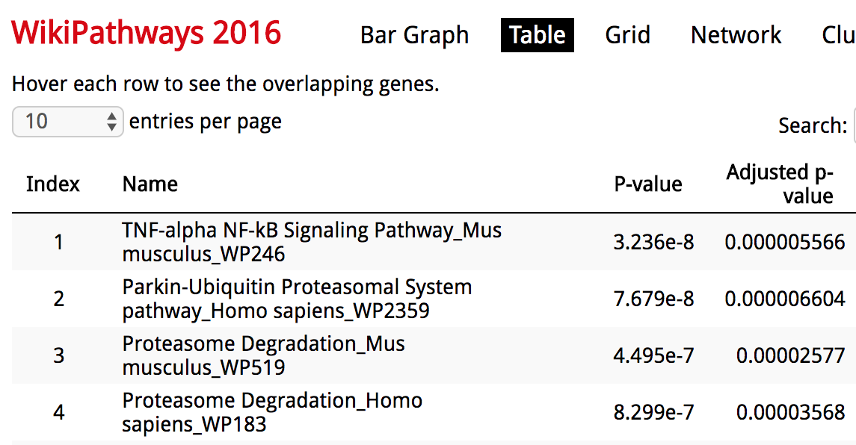
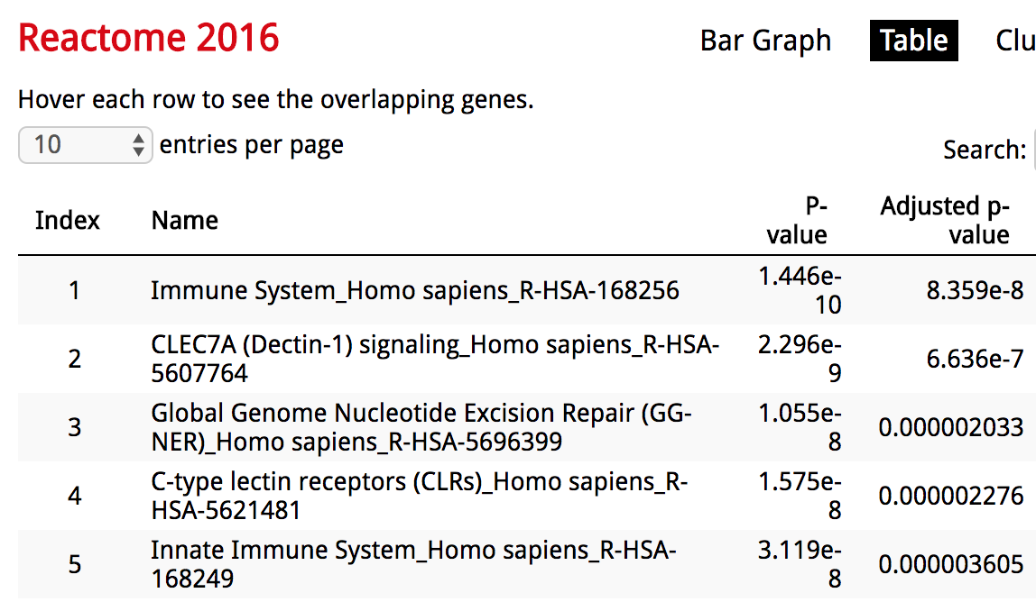
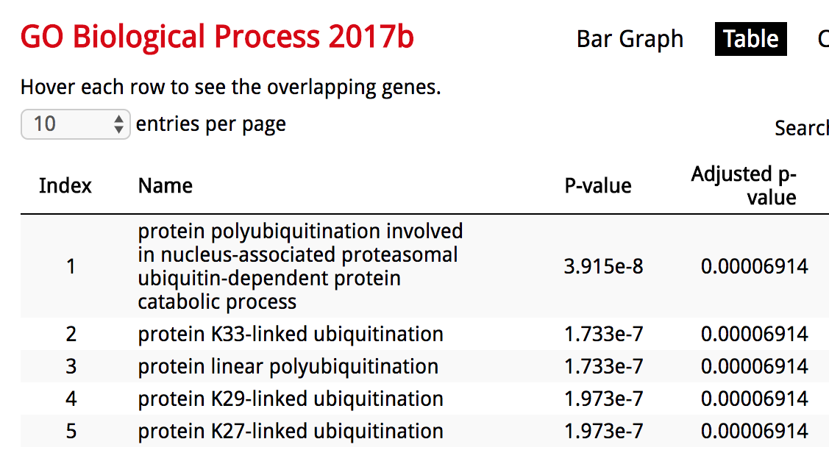
Functional Enrichment

Slide 14
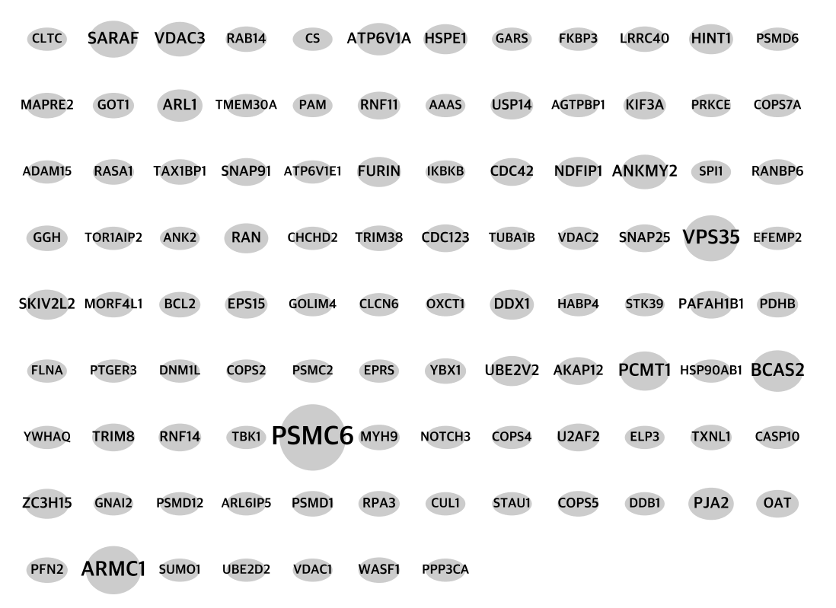
Overlap with PPI network

Slide 15
Union of PPI network and module

Slide 16
What next… ?

