Slide 1
Eddie Lee Data Analysis

Slide 2
The Data
C9orf72 ALS frontal cortex
2 samples per patient, 7 patients
One sample contains fractioned nuclei with TDP-43, the other nuclei without
Only nuclear transcriptome

Slide 3
What they have reported
5576 DEGs
Change in auto-regulation of TARDBP

Slide 4
My methodology
Count matrix was provided ("Count_Matrix_Genes.rda”)
TDP- and TDP+ samples compared using DESeq2
Thresholds of adjusted pvalue of <0.05 and log2FC of <-1 or >1 applied

Slide 5
What I have found
645 DEGs (4811 if adj p value only)
176 upregulated (1 overlap with my DEGs)
469 downregulated (3 overlap with my DEGs)
Does not include TARDBP unless FC threshold not included
Upregulated enriches for and RNA polymerase binding & glucagon-type ligand receptors.
Downregulated enriches for endochondral ossification, phosphatidylinositol 3-kinase signaling, cAMP metabolic process.

Slide 6
If only adj pvalue…
Upregulated enriches for long term potentiation, adherens junction, oxytocin signalling, glutamatergic synapse cannabinoid signalling, dopaminergic synapse, BDNF signaling, mRNA processing, insulin signaling MAPK signalling, EGF/EGFR signaling, golgi transport, synaptic transmission
Downregulated enriches for pathways in cancer, protein-protein interactions in the podocyte, endochondrial ossification, Rho GTPase cycle, collagen biosynthesis, axon guidance, neuronal system, GABA synthesis, muscle contraction, transmission across chemical synapses

Slide 7
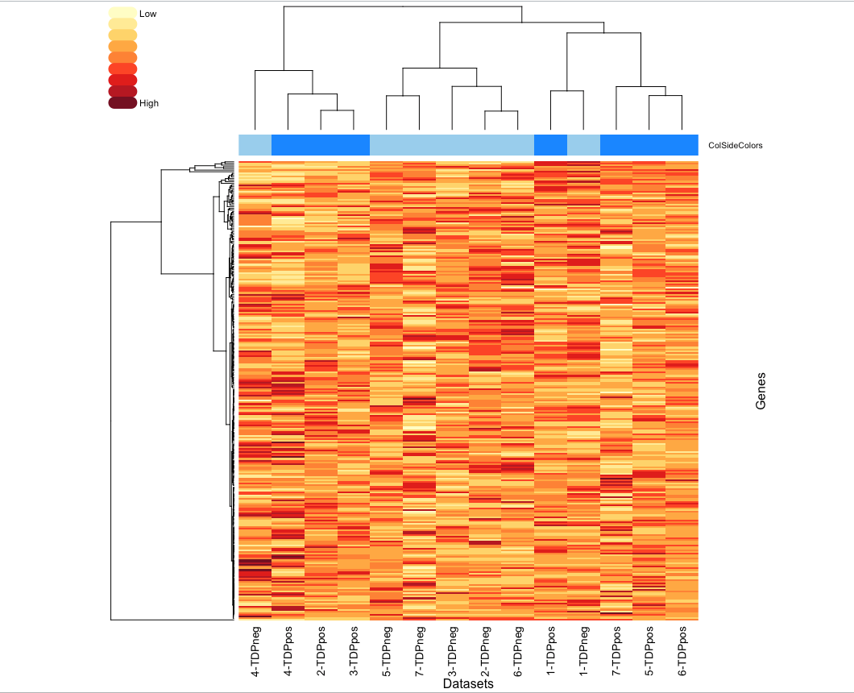
Can my DEGs separate TDP+ and TDP- nuclei?
Normalised expression value
+ Nuclear TDP
- Nuclear TDP

Slide 8
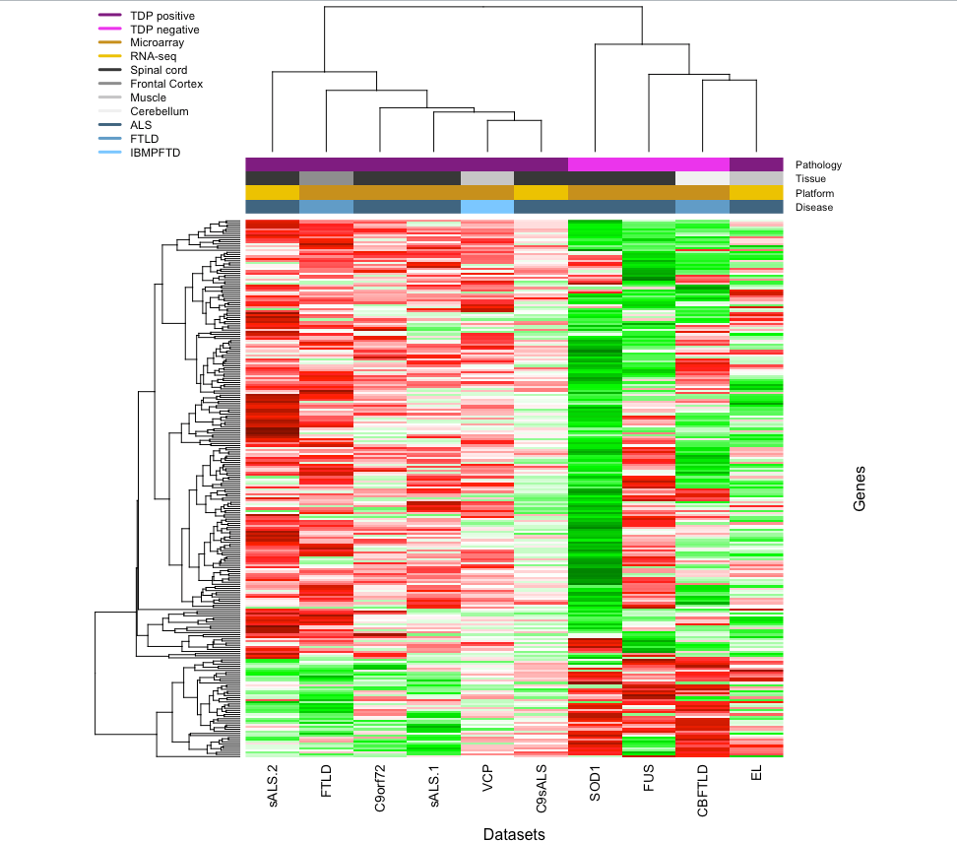
Can my DEGs put TDP- nuclei with my pathology datasets?
Log 2Fold change

Slide 9
What’s going on?
Possibilities:
My genes aren’t representing nuclear loss of TDP-43
There are issues related to the data
Sample size?
Sampling from the same patient?
Nucleosome vs whole transcriptome?

