Slide 1
Do top DEGs from each mutation appear in Complement and coagulation cascades pathway?
Took DEGs with p value of < .05 (or top 2000 for VCP as none qualified)
Mapped onto CCC pathway map

Slide 2
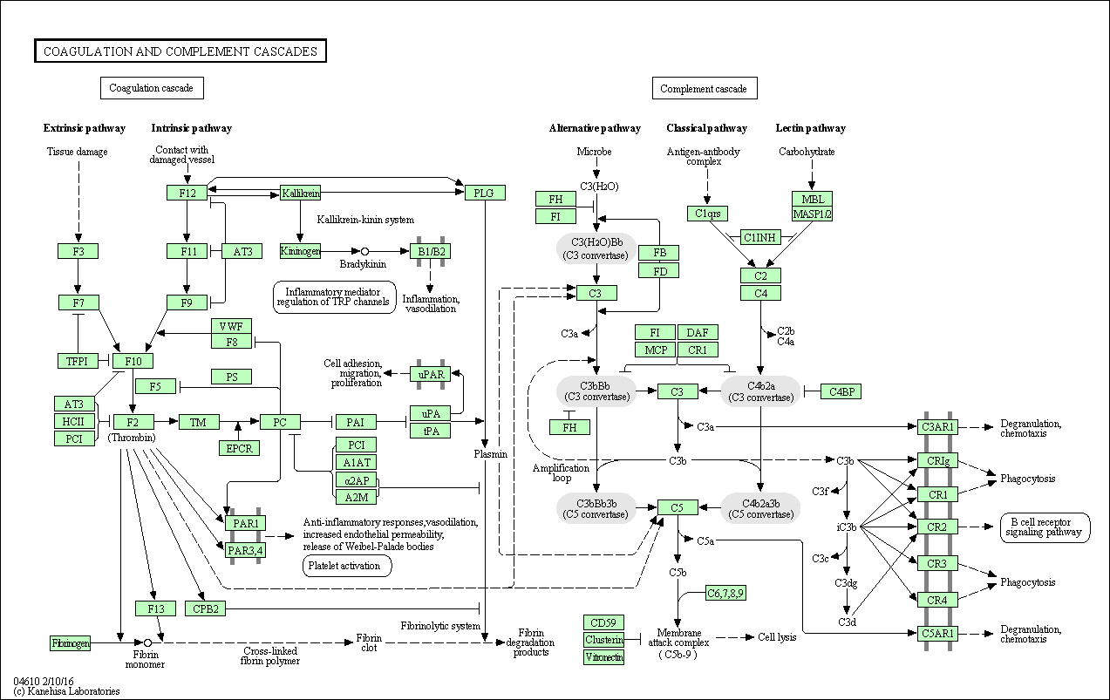
DEGs pValue < .05
GRN
CHMP2B
C9orf72
Top 2000 DEGs
VCP

Slide 3
VCP

Slide 4
C9orf72

Slide 5
CHMP2B

Slide 6
GRN

Slide 7
How can we directly relate the CCC pathway to TDP-43 dysfunction?

Slide 8
How can we directly relate the CCC pathway to TDP-43?
Look for enrichment of genes coding for proteins that physically interact with TDP-43 in CCC pathway
No luck
Use PCxN to identify 10 most correlated pathways, then look for enrichment of TDP-43 PPI genes in those pathways
Still nothing
Put CCC genes and TARDBP into genemania
Add 200 directly interacting genes
Identify what proteins link TARDBP to CCC

Slide 9
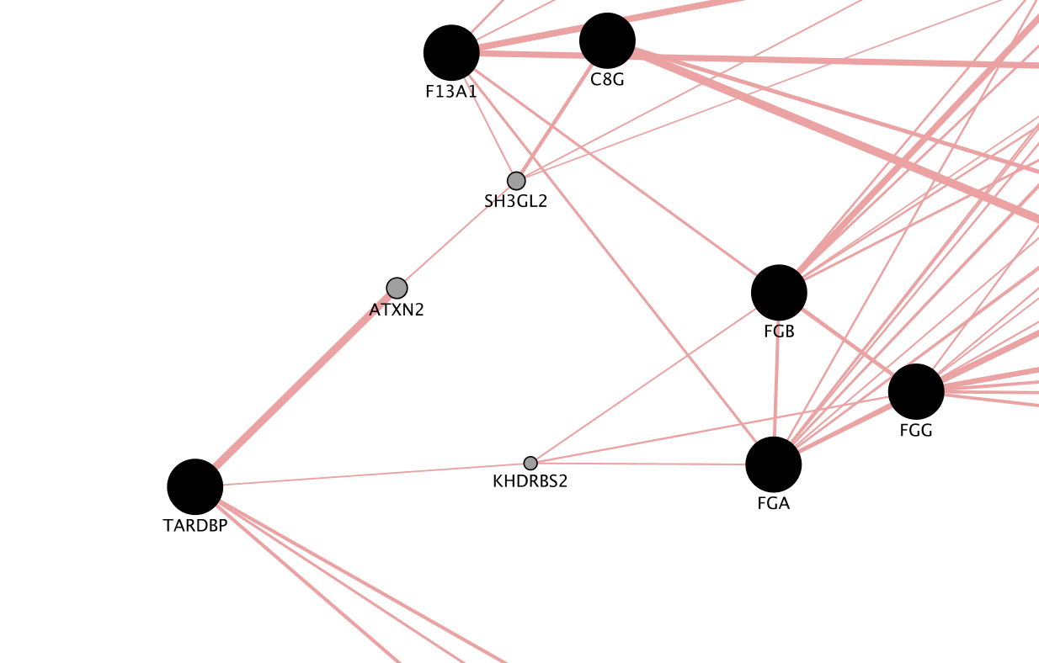

Slide 10
TDP-43 Interactions

