Slide 1

Walmart Sales DROP Root Cause Analysis – Executive Insights

Slide 2
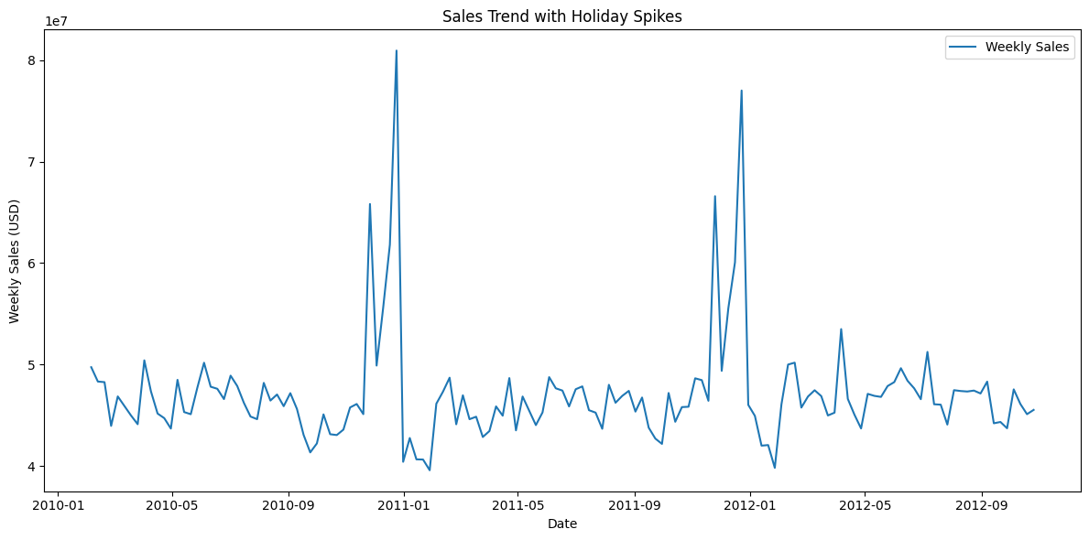
Sales Trend with Holiday Spikes
Sales are steady at around $40–50M per week.
Sharp spikes during the Super Bowl, Thanksgiving, and Christmas.
Q2 (Apr–Jun) looks flat, but promo cuts & CPI shifts are hidden drivers.

Slide 3
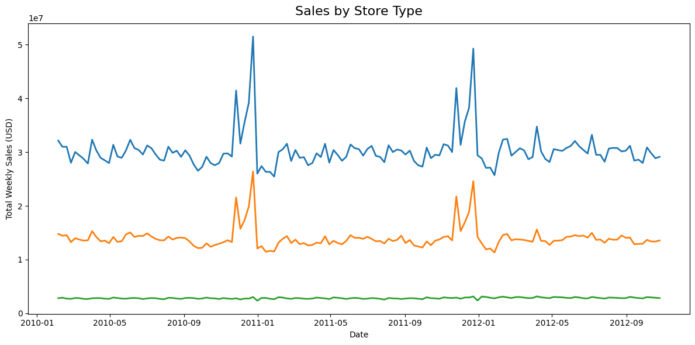
Store Type Performance
Type A (Supercentres) dominate sales and remain relatively stable.
Type B stores show sharper declines during Q2.
Type C stores contribute the least but are also sensitive to dips.
Smaller formats are more vulnerable when promotions are reduced.

Slide 4
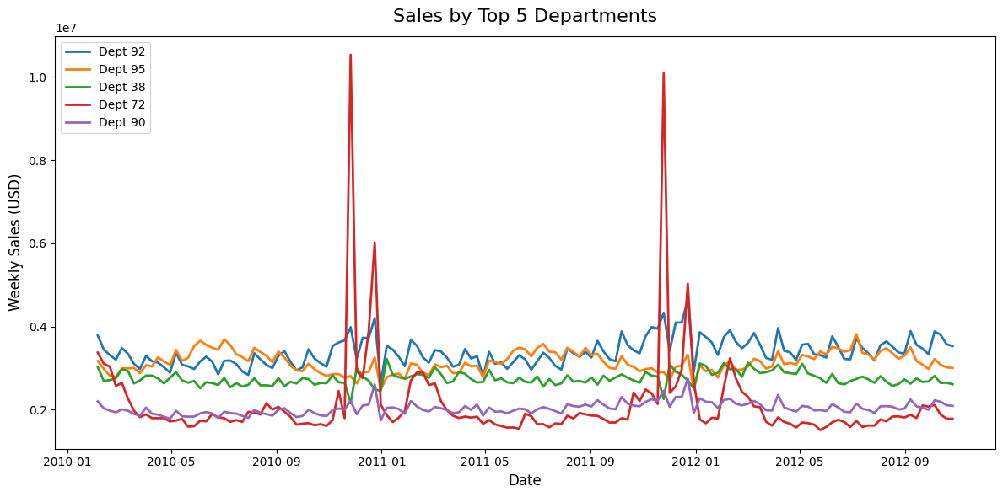
Department Performance
Dept 72 shows sharp spikes during holiday periods (seasonal goods).
Other top departments (92, 95, 38, 90) are steadier but soften in Q2.
Reliance on holiday peaks suggests vulnerability in non-holiday periods.

Slide 5
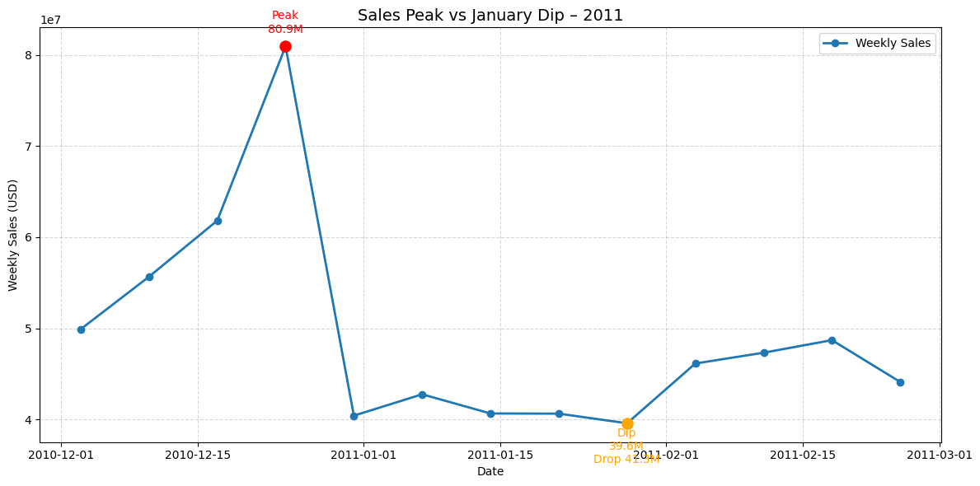
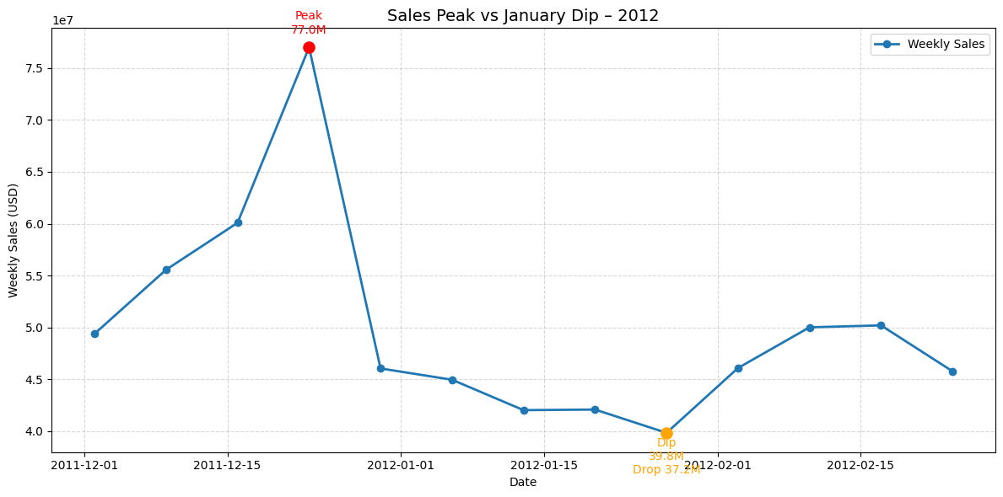
Holiday Peaks vs January Dips – 2011 & 2012
Both years show massive holiday spikes (Christmas week) followed by sharp January drops.
Sales dropped by –41.3M in 2012 and –37.2M in 2022.
The dip is consistent year-on-year, confirming a structural post-holiday pattern.
Revenue quickly resets to baseline (~$40M/week) once the holiday uplift ends.

Slide 6
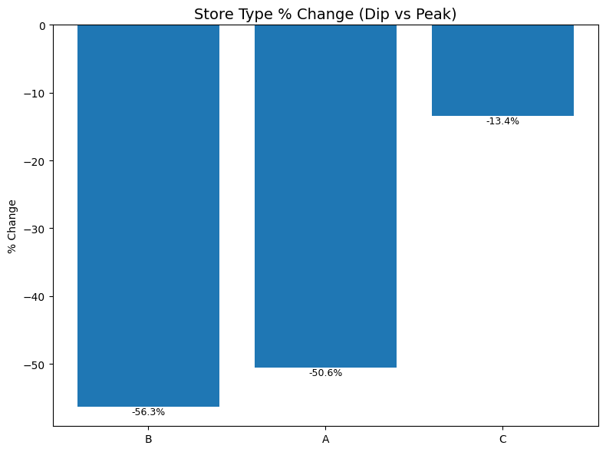
Store Type % Change in Sales (Peak vs. Dip)
Type B stores faced the sharpest decline (–56.3%), showing highest vulnerability post-peak.
Type A stores also dropped significantly (–50.6%), despite being large-format.
Type C stores were relatively resilient with a smaller dip (–13.4%).
The dip impact is not uniform across formats, highlighting the need for tailored post-holiday strategies.

Slide 7
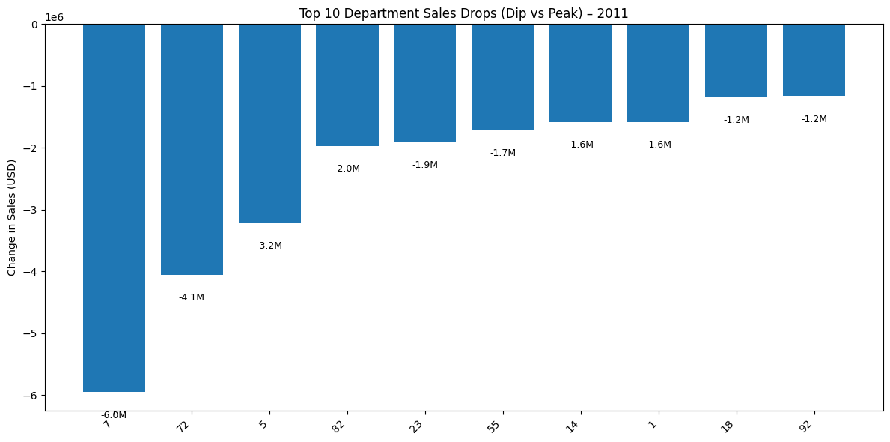
Top Departments Driving Post-Holiday Sales Decline
Dept 1 (–6.0M) saw the largest post-holiday decline, showing high reliance on seasonal demand.
Dept 72 (–4.1M) and Dept 5 (–3.2M) were also heavily impacted, driven by apparel and discretionary goods.
Mid-tier drops (–1.6M to –2.0M) were observed in departments like 82, 23, and 55.
Everyday essential categories are largely absent from top declines, highlighting the stability of grocery/household sales vs discretionary.

Slide 8
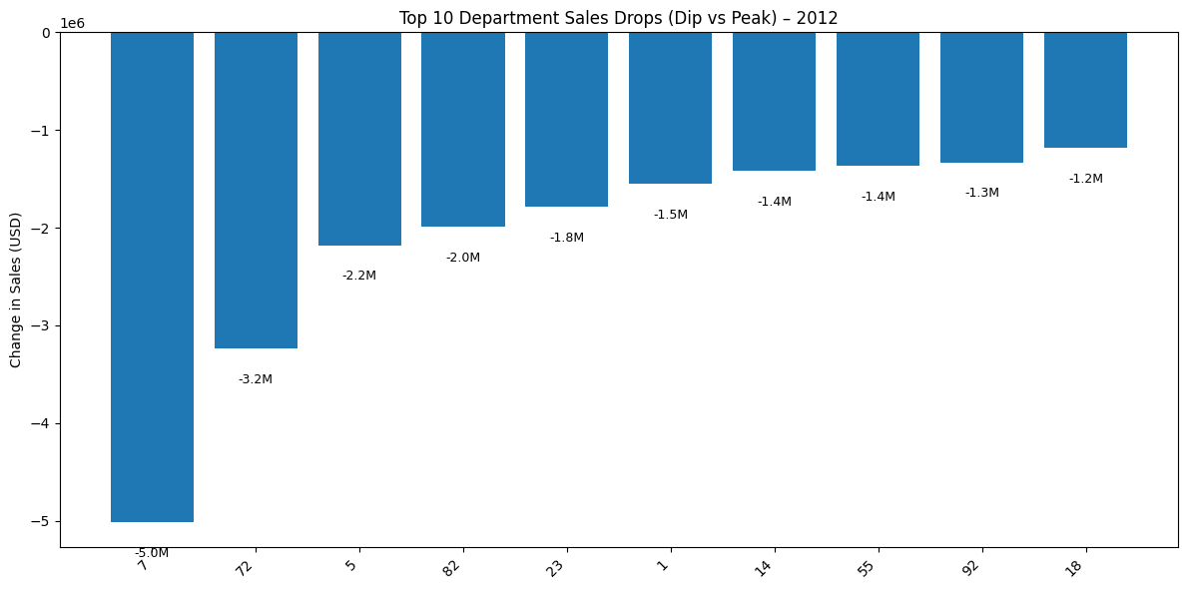
Top Departments Driving Post-Holiday Sales Decline
Dept 1 (–5.0M) had the largest post-holiday decline, again proving heavy reliance on toys/seasonal.
Dept 72 (–3.2M) and Dept 5 (–2.2M) followed, continuing the apparel and discretionary weakness trend.
Several other departments (82, 23, 55, 14, 18, 92) also saw moderate drops between –1.2M and –2.0M.
The pattern is consistent with 2011, confirming that the January dip is structural and category-driven, not a one-off.

Slide 9
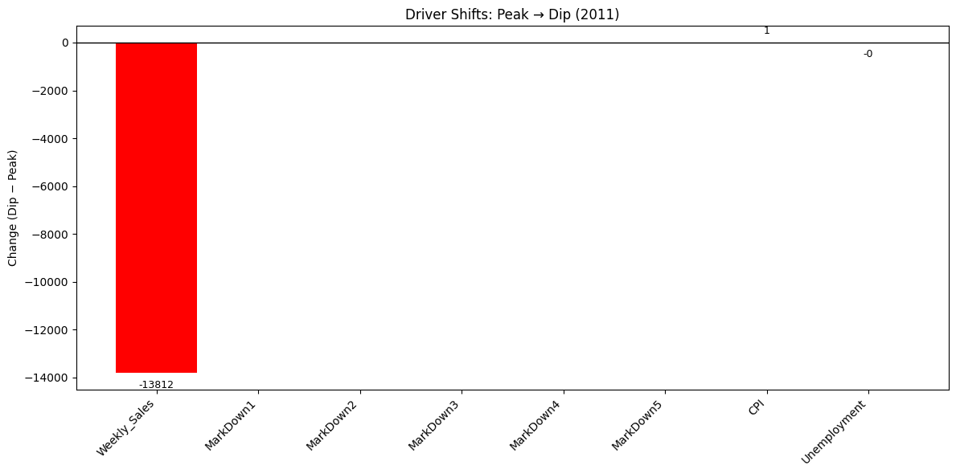
Drivers Behind Sales Drop – Peak vs. Dip
Weekly Sales collapsed (–13.8K units in average weekly sales) → main driver.
Markdowns (1–5) = 0 → no promotional support during dip weeks.
CPI ↑ slightly, Unemployment ↓ → macro not significant.
Confirms dip is seasonal + promotional withdrawal → not structural weakness.

Slide 10
Actions to Manage Post-Holiday Sales Dips
Smooth Promotions
Maintain baseline markdowns in high-elasticity categories.
Achieve a softer landing after peaks, reducing reliance on spikes.
2. Diversify Beyond Seasonal
Push grocery, household, and everyday essentials in January.
Balance sales mix, decrease volatility.
3. Target Store Types B & C
Implement tailored promotions for smaller-format stores.
Retain traffic in vulnerable geographies.
4. Value Messaging
Strengthen bundles, own-label, price packs, loyalty points.
Protect basket size and fight CPI squeeze.
5. Dashboard Monitoring
Use Power BI to track Sales, Promotions, and CPI.
Set early-warning alerts for sharper-than-normal dips.

