Slide 1

Walmart Q2 Sales Root Cause Analysis – Executive Insights

Slide 2
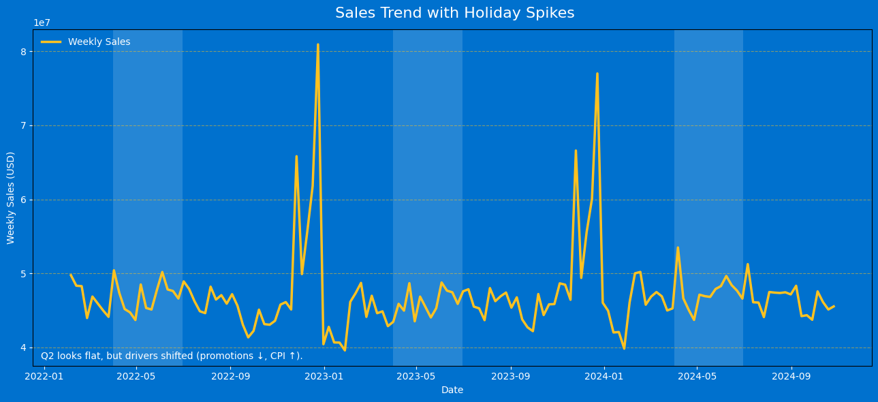
Sales Trend with Holiday Spikes
Sales are steady at around $40–50M per week.
Sharp spikes during the Super Bowl, Thanksgiving, and Christmas.
Q2 (Apr–Jun) looks flat, but promo cuts & CPI shifts are hidden drivers.

Slide 3
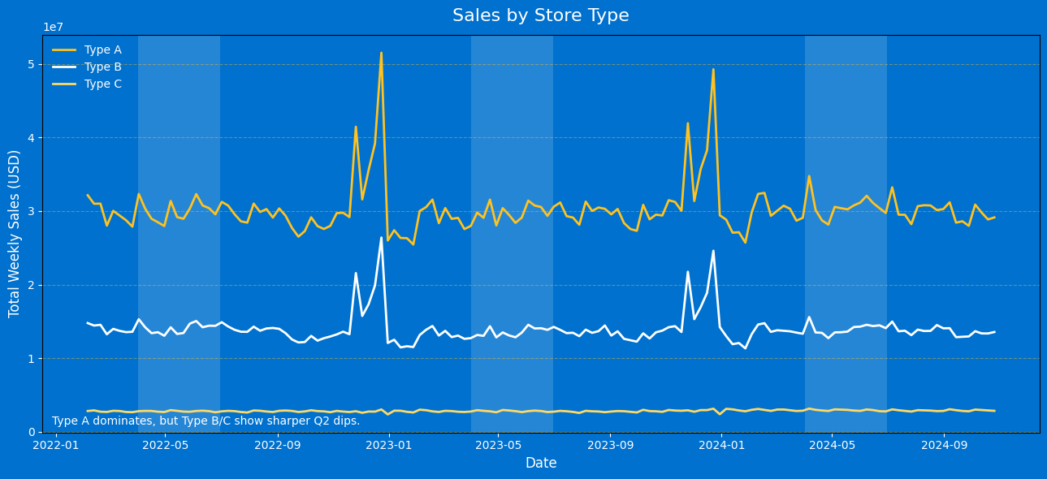
Store Type Performance
Type A (Supercentres) dominate sales and remain relatively stable.
Type B stores show sharper declines during Q2.
Type C stores contribute the least but are also sensitive to dips.
Smaller formats are more vulnerable when promotions are reduced.

Slide 4
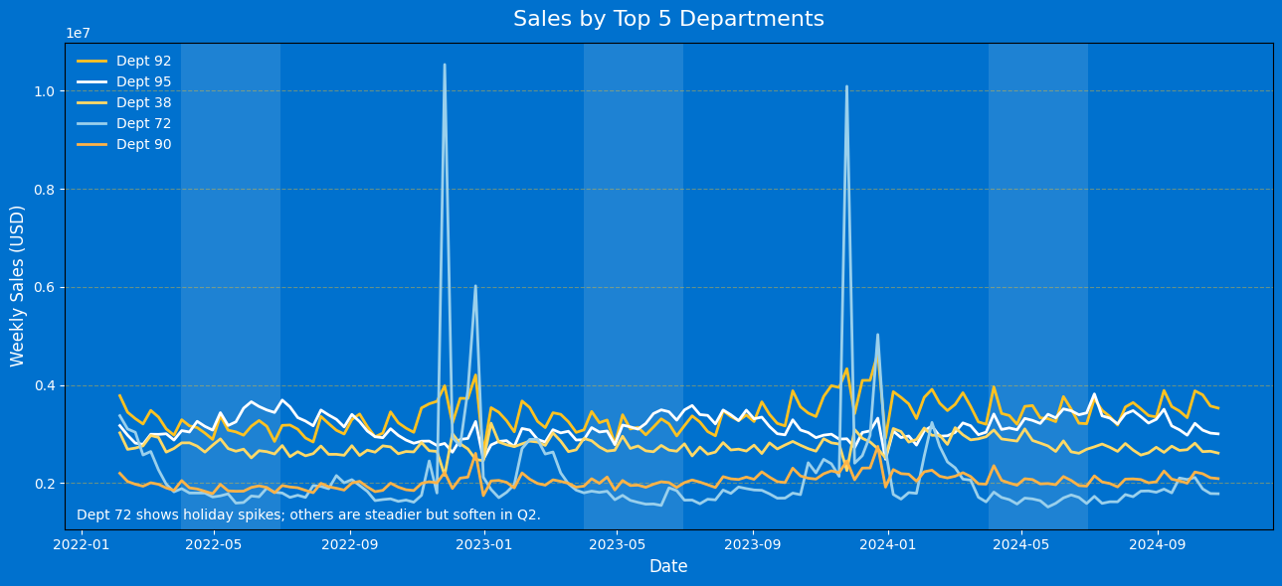
Department Performance
Dept 72 shows sharp spikes during holiday periods (seasonal goods).
Other top departments (92, 95, 38, 90) are steadier but soften in Q2.
Reliance on holiday peaks suggests vulnerability in non-holiday periods.

Slide 5
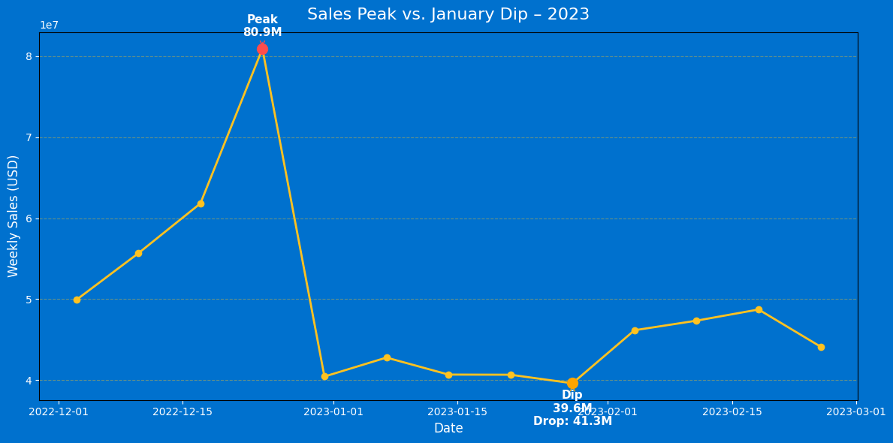
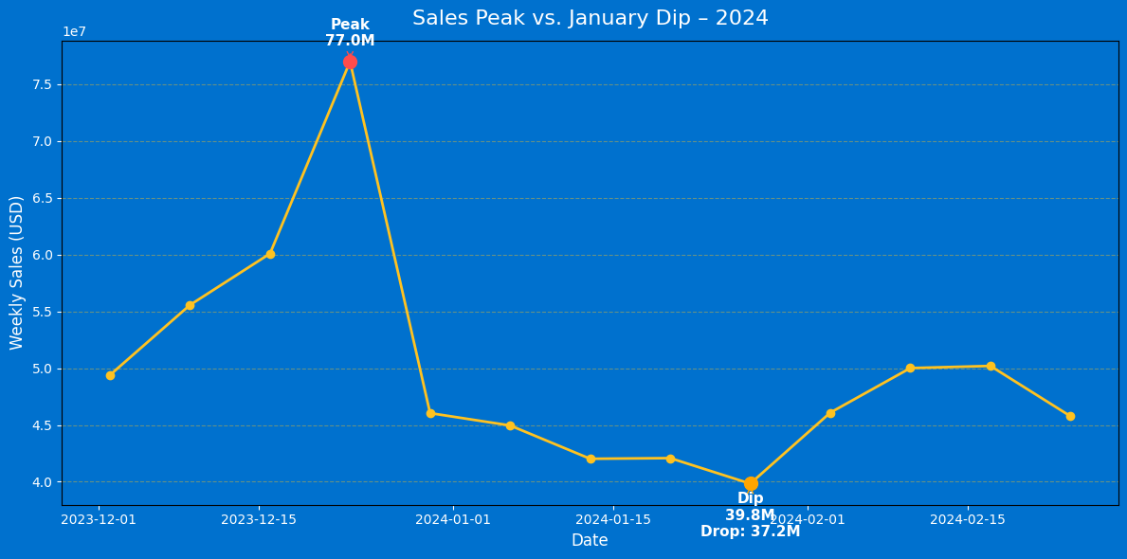
Holiday Peaks vs January Dips – 2023 & 2024
Both years show massive holiday spikes (Christmas week) followed by sharp January drops.
Sales dropped by –41.3M in 2023 and –37.2M in 2024.
The dip is consistent year-on-year, confirming a structural post-holiday pattern.
Revenue quickly resets to baseline (~$40M/week) once the holiday uplift ends.

Slide 6
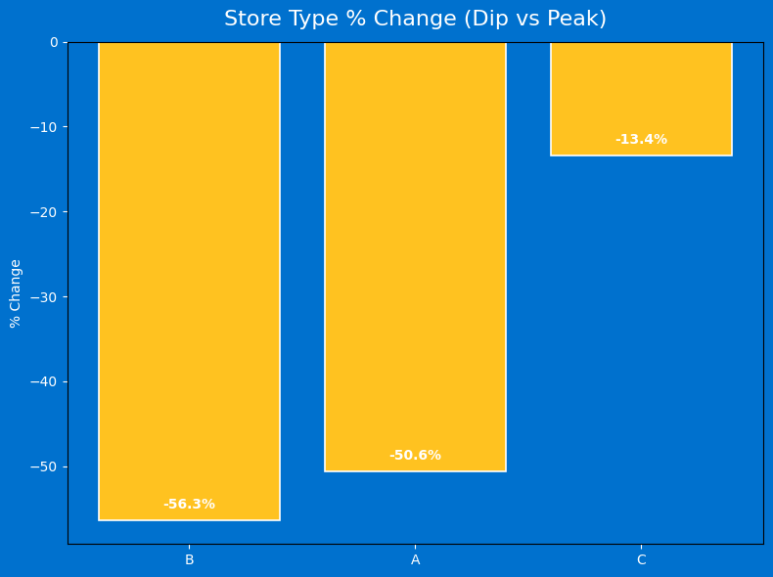
Store Type % Change in Sales (Peak vs. Dip)
Promotions collapsed →
MD1 ↓ –30%, MD2 ↓ –85%, MD4 ↓ –70%, MD5 ↓ –6%
CPI ↑ slightly → added inflation pressure.
Unemployment ↓ → not a negative factor.
Holiday uplift small (~7%) → limited impact outside seasonal peaks.

Slide 7
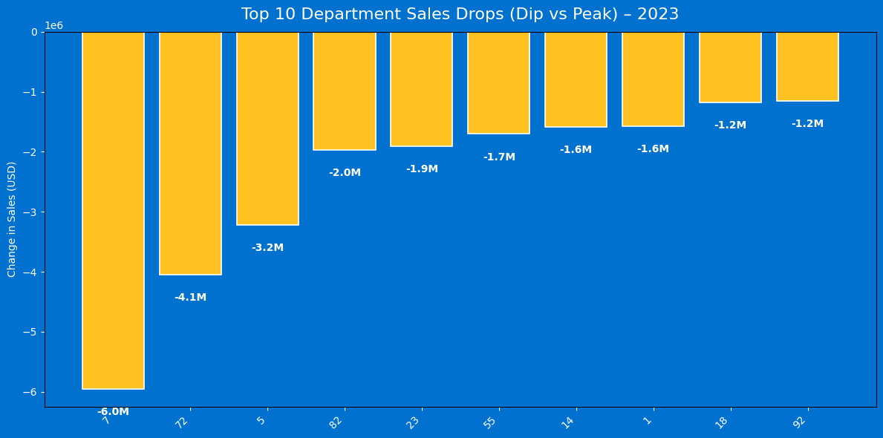
Top Departments Driving Post-Holiday Sales Decline
Promotions collapsed →
MD1 ↓ –30%, MD2 ↓ –85%, MD4 ↓ –70%, MD5 ↓ –6%
CPI ↑ slightly → added inflation pressure.
Unemployment ↓ → not a negative factor.
Holiday uplift small (~7%) → limited impact outside seasonal peaks.

Slide 8
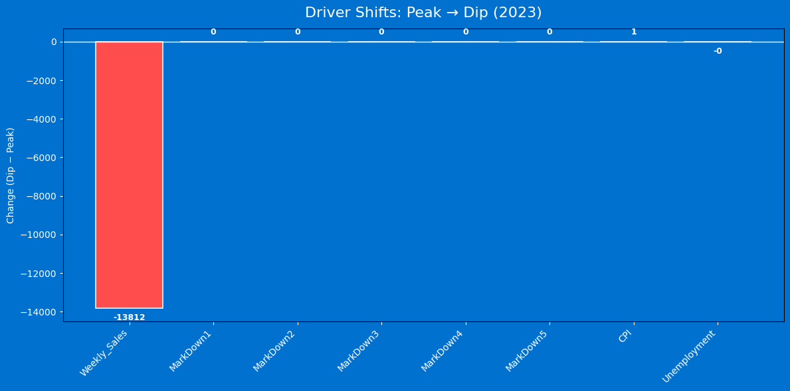
Drivers Behind Sales Drop – Peak vs. Dip
Weekly Sales collapsed (–13.8K units in average weekly sales) → main driver.
Markdowns (1–5) = 0 → no promotional support during dip weeks.
CPI ↑ slightly, Unemployment ↓ → macro not significant.
Confirms dip is seasonal + promotional withdrawal → not structural weakness.

Slide 9
Actions to Manage Post-Holiday Sales Dips
Smooth Promotions
Maintain baseline markdowns in high-elasticity categories.
Achieve a softer landing after peaks, reducing reliance on spikes.
2. Diversify Beyond Seasonal
Push grocery, household, and everyday essentials in January.
Balance sales mix, decrease volatility.
3. Target Store Types B & C
Implement tailored promotions for smaller-format stores.
Retain traffic in vulnerable geographies.
4. Value Messaging
Strengthen bundles, own-label, price packs, loyalty points.
Protect basket size and fight CPI squeeze.
5. Dashboard Monitoring
Use Power BI to track Sales, Promotions, and CPI.
Set early-warning alerts for sharper-than-normal dips.

