Slide 1


Data Mining (Minería de Datos)
Ensembles: Gradient Boosting
Sixto Herrera
Grupo de Meteorología
Univ. de Cantabria – CSIC
MACC / IFCA
Ensembles: Gradient Boosting
Notes:
1

Slide 2
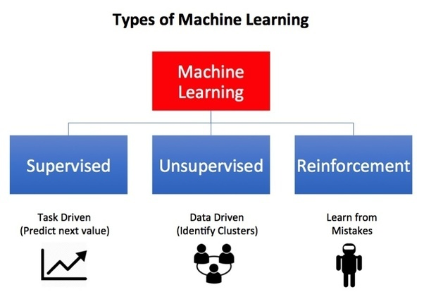
Oct | 29 | Aplazada (sesión de refuezo)
 | 31 | Presentación, introducción y perspectiva histórica
Nov | 5 | Paradigmas, problemas canonicos y data challenges
 | 7 | Reglas de asociación
 | 12 | Práctica: Reglas de asociación
 | 14 | Evaluación, sobrejuste y crossvalidacion
 | 19 | Práctica: Cross-validación
 | 21 | Árboles de clasificacion y decision
 | 26 | Practica: Árboles de clasificación
 |  | T01. Datos discretos
 | 28 | Técnicas de vecinos cercano (k-NN)
Dic | 3 | Práctica: Vecinos cercanos
 | 5 | Reducción de dimensión no lineal
 | 10 | Práctica: Reducción de dimensión no lineal
 |  | T02. Clasificación
 | 12 | Árboles de clasificación y regresion (CART)
 | 17 | Práctica: Árboles de clasificación y regresion (CART)
 | 19 | Ensembles: Bagging and Boosting
Ene | 7 | Práctica Random Forests
 | 9 | Práctica Gradient boosting
 |  | T03. Prediccion
 | 14 | Técnicas de agrupamiento
 | 16 | Practica: Técnicas de agrupamiento
 | 21a | Practica: El paquete CARET
 | 21b | Examen
NOTA: Las líneas de código de R en esta presentación se muestran sobre un fondo gris
Calendar
1
1
Notes:
1

Slide 3
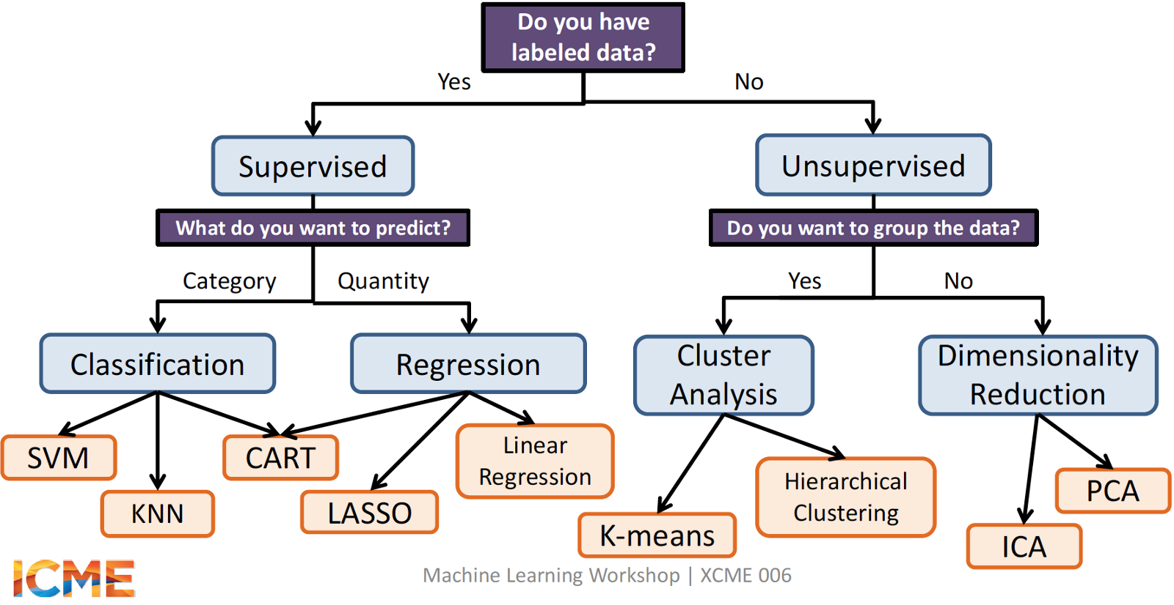
Target variable
Learning paradigms
1
Notes:
1

Slide 4
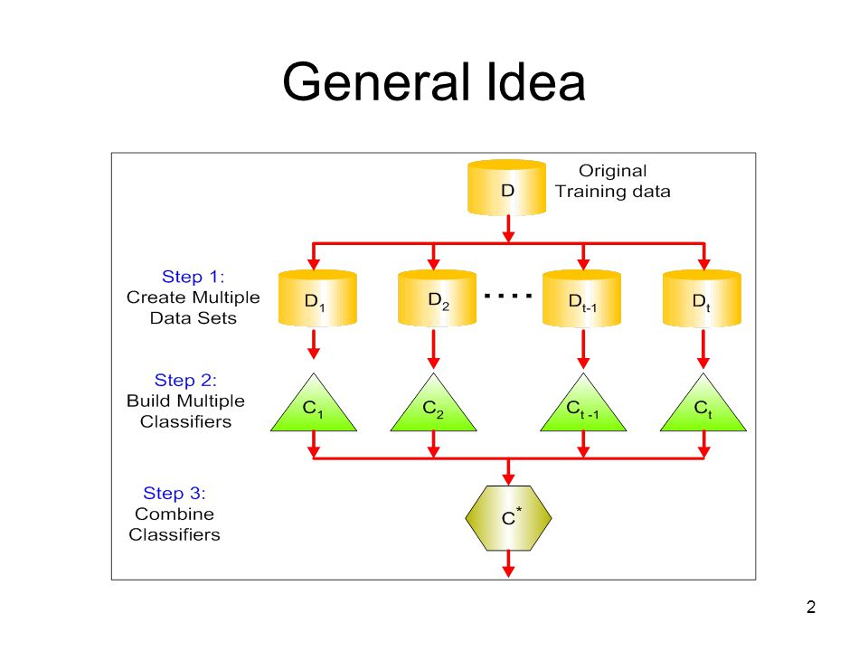

Ensemble learning
Ensemble learning is a supervised approach in which the basic idea is to generate multiple weak models on a training dataset and combining them to generate a strong model which improves the stability and the performance of the individual models.
The wisdom of the crowd
Fable of blind men and elephant
https://en.wikipedia.org/wiki/Blind_men_and_an_elephant
Introduction
1
Notes:
1

Slide 5
Ensemble learning
Ensemble approaches are typically used with CART.
Pros
Trees are very easy to explain (even easier than linear regression)
Trees can be plotted graphically, and are easily interpreted
Trees can easily handle qualitative predictors
They work fine on both classification and regression problems
Cons
Poor prediction accuracy (compared with other approaches)
Instability when changing the train/test partition (cross-validation is key)
By aggregating many trees, the instability of the trees can be reduced and their predictive performance substantially improved.
Introduction
1
Notes:
1

Slide 6
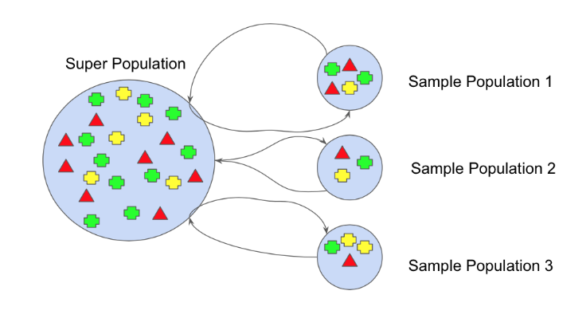
Ensemble learning
Ensemble approaches are typically used with CART.
Pros
Trees are very easy to explain (even easier than linear regression)
Trees can be plotted graphically, and are easily interpreted
Trees can easily handle qualitative predictors
They work fine on both classification and regression problems
Cons
Poor prediction accuracy (compared with other approaches)
Instability when changing the train/test partition (cross-validation is key)
By aggregating many trees, the instability of the trees can be reduced and their performance
improved.
bootstrapping
Mean (prediction)
Majority voting (classification)
Introduction
1
Notes:
1

Slide 7
Ensemble learning
Ensemble approaches are typically used with CART.
Pros
Trees are very easy to explain (even easier than linear regression)
Trees can be plotted graphically, and are easily interpreted
Trees can easily handle qualitative predictors
They work fine on both classification and regression problems
Cons
Poor prediction accuracy (compared with other approaches)
Instability when changing the train/test partition (cross-validation is key)
By aggregating many trees, the instability of the trees can be reduced and their performance
improved.
Weak learners
Low bias and high variance
bootstrapping
High degree of freedom models
e.g. fully developed trees
Mean (prediction)
Majority voting (classification)
Introduction
1
Notes:
1

Slide 8
Ensemble learning
Ensemble approaches are typically used with CART.
Pros
Trees are very easy to explain (even easier than linear regression)
Trees can be plotted graphically, and are easily interpreted
Trees can easily handle qualitative predictors
They work fine on both classification and regression problems
Cons
Poor prediction accuracy (compared with other approaches)
Instability when changing the train/test partition (cross-validation is key)
By aggregating many trees, the instability of the trees can be reduced and their performance
improved.
Weak learners
High bias and low variance
bootstrapping
Low degree if freedom models
e.g. low depth trees
Mean (prediction)
Majority voting (classification)
Introduction
1
Notes:
1

Slide 9
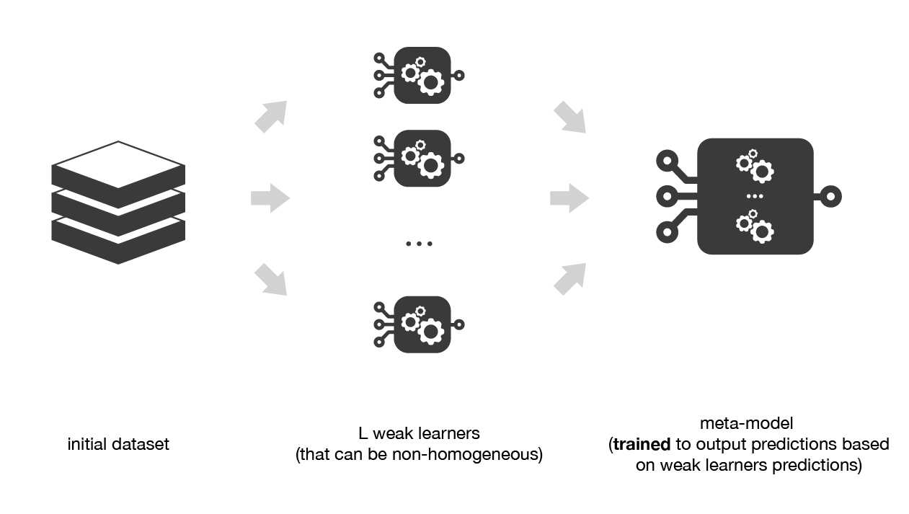
Ensemble learning
Ensemble approaches are typically used with CART.
Pros
Trees are very easy to explain (even easier than linear regression)
Trees can be plotted graphically, and are easily interpreted
Trees can easily handle qualitative predictors
They work fine on both classification and regression problems
Cons
Poor prediction accuracy (compared with other approaches)
Instability when changing the train/test partition (cross-validation is key)
By aggregating many trees, the instability of the trees can be reduced and their performance
improved.
Heterogenous Weak Learners
Stacking considers heterogeneous weak learners, learns them in parallel and combines them by training a meta-model to output a prediction based on the different weak models predictions.
https://stats.stackexchange.com/questions/290701/how-to-stack-machine-learning-models-in-r
https://towardsdatascience.com/ensemble-methods-bagging-boosting-and-stacking-c9214a10a205
Introduction
1
Notes:
1

Slide 10
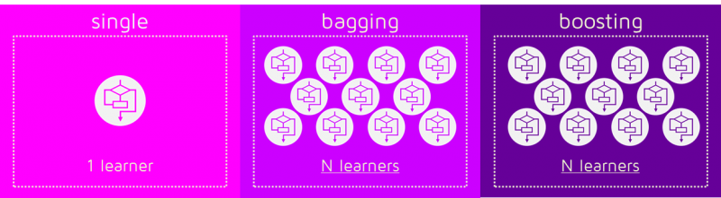
Ensemble learning
Ensemble approaches are typically used with CART.
Pros
Trees are very easy to explain (even easier than linear regression)
Trees can be plotted graphically, and are easily interpreted
Trees can easily handle qualitative predictors
They work fine on both classification and regression problems
Cons
Poor prediction accuracy (compared with other approaches)
Instability when changing the train/test partition (cross-validation is key)
By aggregating many trees, the instability of the trees can be reduced and their performance
improved.
Homogenous Weak Learners
Bagging and Boosting
Introduction
1
Notes:
1

Slide 11
Ensemble learning
Ensemble approaches are typically used with CART.
Pros
Trees are very easy to explain (even easier than linear regression)
Trees can be plotted graphically, and are easily interpreted
Trees can easily handle qualitative predictors
They work fine on both classification and regression problems
Cons
Poor prediction accuracy (compared with other approaches)
Instability when changing the train/test partition (cross-validation is key)
By aggregating many trees, the instability of the trees can be reduced and their performance
improved.
Homogenous Weak Learners
Low bias and high variance
High degree of freedom models
e.g. fully developed trees
Random Forests
Introduction
1
Notes:
1

Slide 12
Ensemble learning
Ensemble approaches are typically used with CART.
Pros
Trees are very easy to explain (even easier than linear regression)
Trees can be plotted graphically, and are easily interpreted
Trees can easily handle qualitative predictors
They work fine on both classification and regression problems
Cons
Poor prediction accuracy (compared with other approaches)
Instability when changing the train/test partition (cross-validation is key)
By aggregating many trees, the instability of the trees can be reduced and their performance
improved.
Homogenous Weak Learners
High bias and low variance
Low degree if freedom models
e.g. low depth trees
AdaBoost: Adaptive Boosting
Introduction
1
Notes:
1

Slide 13
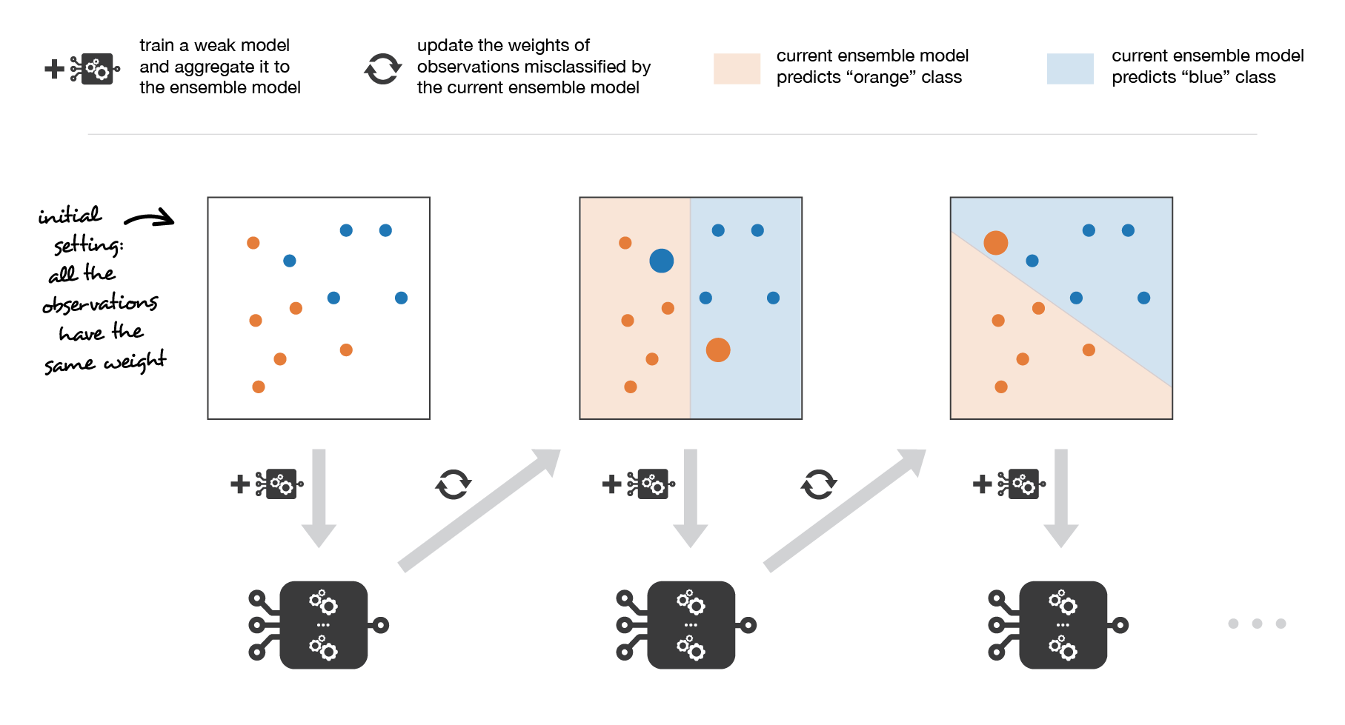
Ensemble: Boosting Methods
Adaptative Boosting
(AdaBoost)
Step 1: All the observations have the same weights
Introduction
1
Notes:
1

Slide 14
Ensemble: Boosting Methods
Adaptative Boosting
(AdaBoost)
Step 1: All the observations have the same weights
a) Fit the weak model considering the observations weights.
b) Evaluate the weak learner to obtain its coefficient.
c) Update the strong learner adding the weak learner.
d) Update the obervations weights
Introduction
1
Notes:
1

Slide 15
Ensemble: Boosting Methods
Adaptative Boosting
(AdaBoost)
Step 1: All the observations have the same weights
Repeat (1:L):
a) Fit the weak model considering the observations weights.
b) Evaluate the weak learner to obtain its coefficient.
c) Update the strong learner adding the weak learner.
d) Update the obervations weights
Result: A strong learner is obtained as a simple linear combination of weak learners weighted by coefficients expressing the performance of each learner. Variants of this algorithm could be obtained by modifying the loss function (e.g. logit for classification or L2 for regression).
Introduction
1
Notes:
1

Slide 16
Ensemble learning
Ensemble approaches are typically used with CART.
Pros
Trees are very easy to explain (even easier than linear regression)
Trees can be plotted graphically, and are easily interpreted
Trees can easily handle qualitative predictors
They work fine on both classification and regression problems
Cons
Poor prediction accuracy (compared with other approaches)
Instability when changing the train/test partition (cross-validation is key)
By aggregating many trees, the instability of the trees can be reduced and their performance
improved.
Homogenous Weak Learners
High bias and low variance
Low degree if freedom models
e.g. low depth trees
Gradient Descent Boosting
Introduction
1
Notes:
1

Slide 17
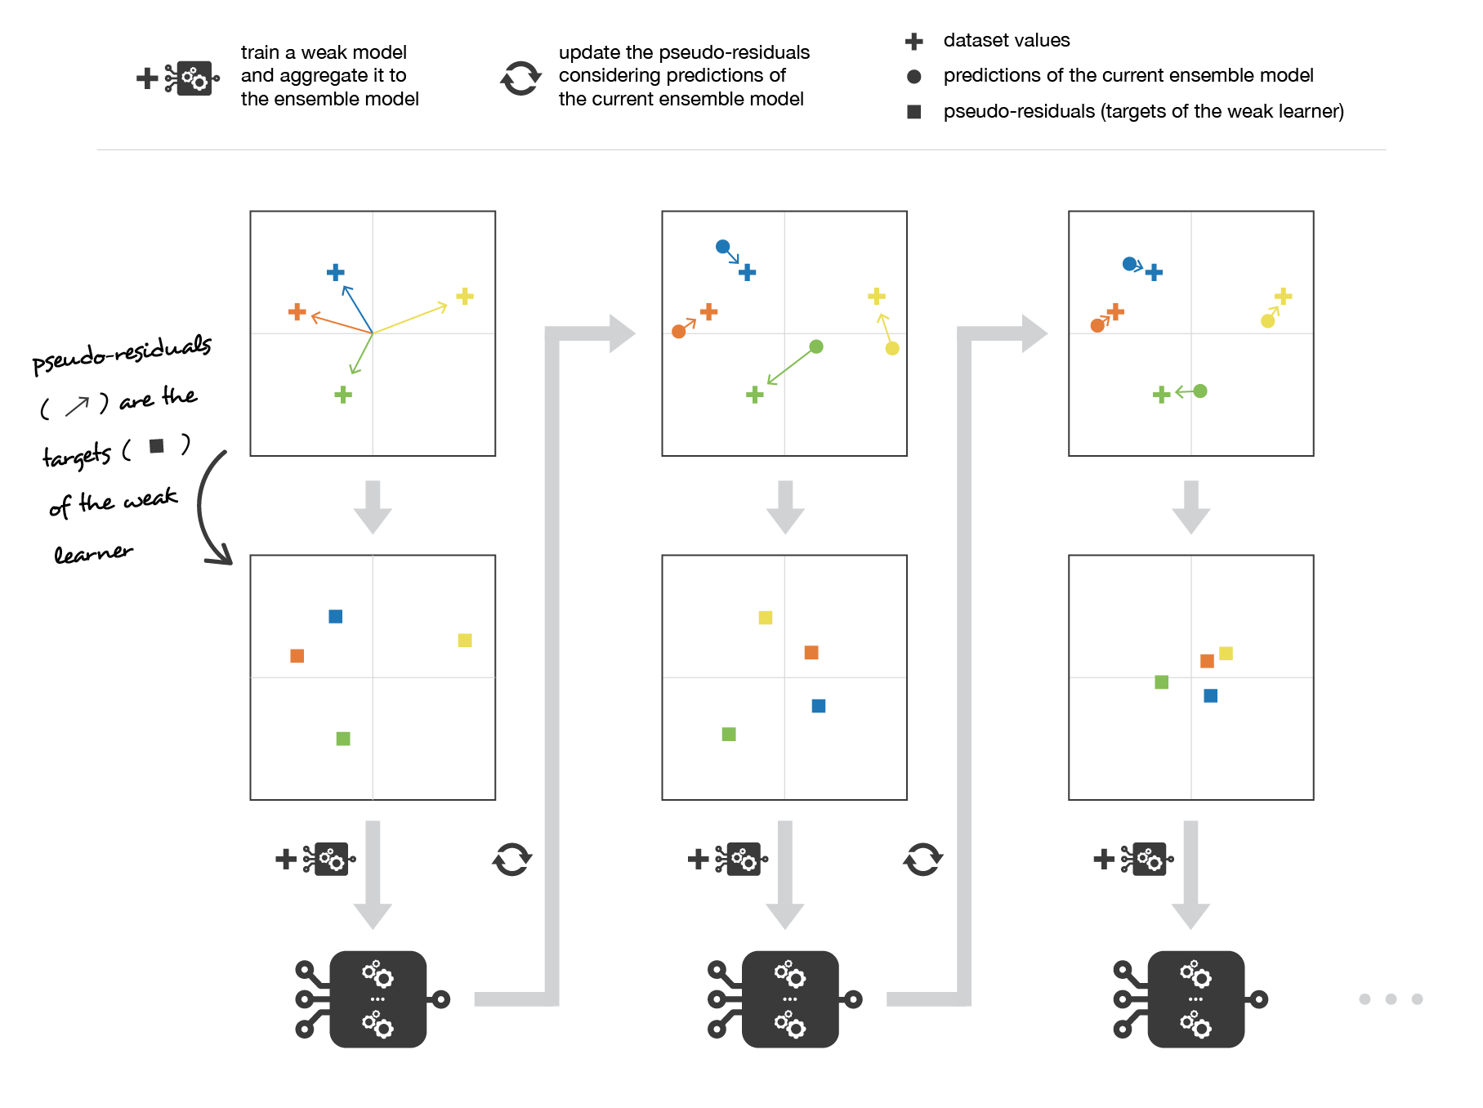

Ensemble: Boosting Methods
Gradient Boosting
Gradient boosting casts the problem into a gradient descent one: at each iteration we fit a weak learner to the opposite of the gradient of the current fitting error with respect to the current ensemble model.
Pseudo-residuals:
Introduction
1
Notes:
1

Slide 18
Ensemble: Boosting Methods
Gradient Boosting
Gradient boosting casts the problem into a gradient descent one: at each iteration we fit a weak learner to the opposite of the gradient of the current fitting error with respect to the current ensemble model.
Pseudo-residuals:
Step size: how much we update the ensemble model in the direction of the new weak learner
Introduction
1
Notes:
1

Slide 19
Ensemble: Boosting Methods
Gradient Boosting
Step 1: The pseudo-residuals are set equal to the observations
Introduction
1
Notes:
1

Slide 20
Ensemble: Boosting Methods
Gradient Boosting
Step 1: The pseudo-residuals are set equal to the observations
a) Fit the weak learner to pseudo-residuals.
b) Compute the optimal step size of the weak learner.
c) Update the strong learner adding the weak learner.
d) Update the pseudo-residuals
Introduction
1
Notes:
1

Slide 21
Ensemble: Boosting Methods
Gradient Boosting
Step 1: The pseudo-residuals are set equal to the observations
Repeat (1:L):
a) Fit the weak learner to pseudo-residuals.
b) Compute the optimal step size of the weak learner.
c) Update the strong learner adding the weak learner.
d) Update the pseudo-residuals
https://www.kdnuggets.com/2018/07/intuitive-ensemble-learning-guide-gradient-boosting.html
Introduction
1
Notes:
1

Slide 22
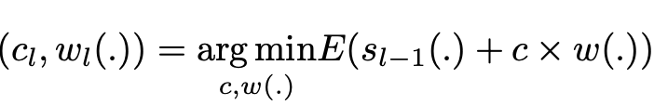
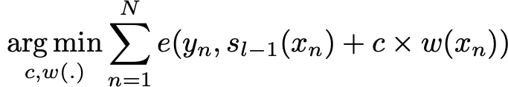
Ensemble: Boosting Methods
Adaptative vs Gradient Descent Boosting Approaches
Adaptative Boosting
(AdaBoost)
Gradient Boosting
Gradient boosting casts the problem into a gradient descent one: at each iteration we fit a weak learner to the opposite of the gradient of the current fitting error with respect to the current ensemble model.
Pseudo-residuals:
Step 1: All the observations have the same weights
Repeat (1:L):
a) Fit the weak model considering the observations weights.
b) Evaluate the weak learner to obtain its coefficient.
c) Update the strong learner adding the weak learner.
d) Update the obervations weights
Step 1: The pseudo-residuals are set equal to the observations
Repeat (1:L):
a) Fit the weak learner to pseudo-residuals.
b) Compute the optimal step size of the weak learner.
c) Update the strong learner adding the weak learner.
d) Update the pseudo-residuals
Introduction
1
Notes:
1

Slide 23
Ensemble: Boosting Methods
Adaptative vs Gradient Descent Boosting Approaches
Adaptative Boosting
(AdaBoost)
Gradient Boosting
Gradient boosting casts the problem into a gradient descent one: at each iteration we fit a weak learner to the opposite of the gradient of the current fitting error with respect to the current ensemble model.
Pseudo-residuals:
Step 1: All the observations have the same weights
Repeat (1:L):
a) Fit the weak model considering the observations weights.
b) Evaluate the weak learner to obtain its coefficient.
c) Update the strong learner adding the weak learner.
d) Update the obervations weights
Step 1: The pseudo-residuals are set equal to the observations
Repeat (1:L):
a) Fit the weak learner to pseudo-residuals.
b) Compute the optimal step size of the weak learner.
c) Update the strong learner adding the weak learner.
d) Update the pseudo-residuals
Notice that, while adaptative boosting tries to solve at each iteration exactly the “local” optimisation problem (find the best weak learner and its coefficient to add to the strong model), gradient boosting uses instead a gradient descent approach and can more easily be adapted to large number of loss functions. Thus, gradient boosting can be considered as a generalization of adaboost to arbitrary differentiable loss functions.
Introduction
1
Notes:
1

Slide 24

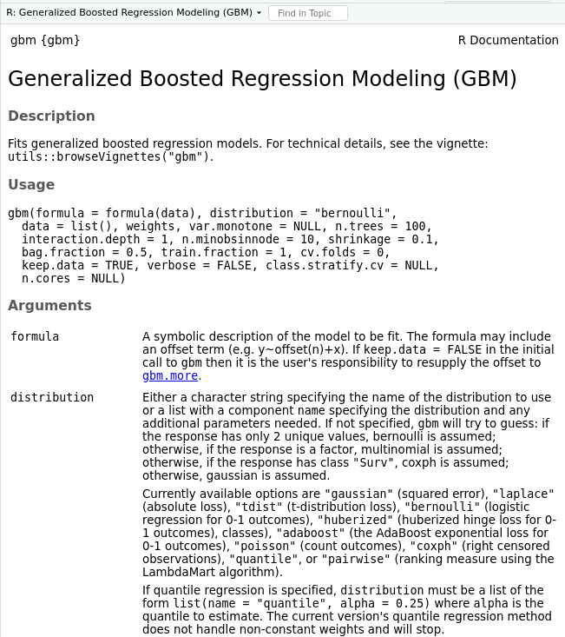
Ensemble: Boosting Methods
Adaptative vs Gradient Descent Boosting Approaches
Adaptative Boosting
(AdaBoost)
Gradient Boosting
Gradient boosting casts the problem into a gradient descent one: at each iteration we fit a weak learner to the opposite of the gradient of the current fitting error with respect to the current ensemble model.
Pseudo-residuals:
Step 1: All the observations have the same weights
Repeat (1:L):
a) Fit the weak model considering the observations weights.
b) Evaluate the weak learner to obtain its coefficient.
c) Update the strong learner adding the weak learner.
d) Update the obervations weights
Step 1: The pseudo-residuals are set equal to the observations
Repeat (1:L):
a) Fit the weak learner to pseudo-residuals.
b) Compute the optimal step size of the weak learner.
c) Update the strong learner adding the weak learner.
d) Update the pseudo-residuals
Notice that, while adaptative boosting tries to solve at each iteration exactly the “local” optimisation problem (find the best weak learner and its coefficient to add to the strong model), gradient boosting uses instead a gradient descent approach and can more easily be adapted to large number of loss functions. Thus, gradient boosting can be considered as a generalization of adaboost to arbitrary differentiable loss functions.
Introduction
1
Notes:
1

Slide 25


Ensemble: Boosting Methods
Extensions of Gradient Descent Boosting Approache
Gradient Boosting
Gradient boosting casts the problem into a gradient descent one: at each iteration we fit a weak learner to the opposite of the gradient of the current fitting error with respect to the current ensemble model.
Pseudo-residuals:
Extreme Gradient Boosting
https://arxiv.org/pdf/1603.02754.pdf
Step 1: The pseudo-residuals are set equal to the observations
https://github.com/dmlc/xgboost
https://xgboost.readthedocs.io/en/latest/parameter.html
Repeat (1:L):
a) Fit the weak learner to pseudo-residuals.
b) Compute the optimal step size of the weak learner.
c) Update the strong learner adding the weak learner.
d) Update the pseudo-residuals
Introduction
1
Notes:
1

Slide 26
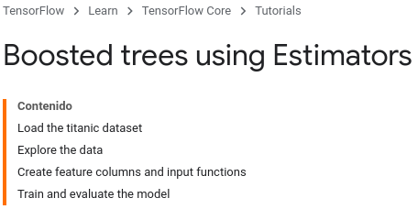
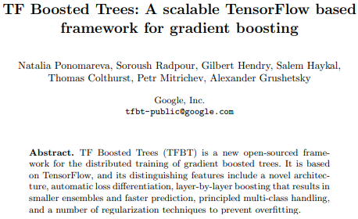
Ensemble: Boosting Methods
Extensions of Gradient Descent Boosting Approache
Gradient Boosting
Gradient boosting casts the problem into a gradient descent one: at each iteration we fit a weak learner to the opposite of the gradient of the current fitting error with respect to the current ensemble model.
Pseudo-residuals:
https://www.tensorflow.org/tutorials/estimator/boosted_trees
Step 1: The pseudo-residuals are set equal to the observations
https://arxiv.org/pdf/1710.11555.pdf
Repeat (1:L):
a) Fit the weak learner to pseudo-residuals.
b) Compute the optimal step size of the weak learner.
c) Update the strong learner adding the weak learner.
d) Update the pseudo-residuals
Introduction
1
Notes:
1

Slide 27
Ensemble Methods in R Classification problem (iris) ## R-Packages: rm(list = ls()) install.packages("tree") install.packages("randomForest") install.packages("adabag") install.packages("gbm") ## Loading R-Packages: library(tree) library(randomForest) library(adabag) library(gbm) library(caret) library(MASS) ## Train/Test partition: set.seed(23) n <- nrow(iris) indtrain <- sample(1:n, round(0.75*n)) # indices for train indtest <- setdiff(1:n, indtrain) # indices for test ## Single Tree: t <- tree(Species ~., iris, subset = indtrain, control = tree.control(length(indtrain), mincut = 1, minsize = 2, mindev = 0)) ## Prediction for test pred.t.test <- predict(t, iris[indtest, ], type = "class") ## Prediction for train pred.t.train <- predict(t, iris[indtrain, ], type = "class")
## Accuracy (Trees):
print(sum(diag(table(pred.t.test, iris$Species[indtest]))) / length(indtest))
print(sum(diag(table(pred.t.train, iris$Species[indtrain]))) / length(indtrain))
Bagging: Random forest
1

Slide 28
Ensemble Methods in R Classification problem (iris) ## R-Packages: rm(list = ls()) install.packages("tree") install.packages("randomForest") install.packages("adabag") install.packages("gbm") ## Loading R-Packages: library(tree) library(randomForest) library(adabag) library(gbm) library(caret) library(MASS) ## Train/Test partition: set.seed(23) n <- nrow(iris) indtrain <- sample(1:n, round(0.75*n)) # indices for train indtest <- setdiff(1:n, indtrain) # indices for test ## Bagging: Random Forests rf <- randomForest(Species ~., iris , subset = indtrain, ntree = 500) ## Prediction for test pred.rf.test <- predict(rf, iris[indtest, ]) ## Prediction for train pred.rf.train <- predict(rf, iris[indtrain, ])
## Accuracy (Trees):
print(sum(diag(table(pred.t.test, iris$Species[indtest]))) / length(indtest))
print(sum(diag(table(pred.t.train, iris$Species[indtrain]))) / length(indtrain))
## Accuracy (Random Forests):
print(sum(diag(table(pred.rf.test, iris$Species[indtest]))) / length(indtest))
print(sum(diag(table(pred.rf.train, iris$Species[indtrain]))) / length(indtrain))
Bagging: Random forest
1

Slide 29
Ensemble Methods in R Classification problem (iris) ## R-Packages: rm(list = ls()) install.packages("tree") install.packages("randomForest") install.packages("adabag") install.packages("gbm") ## Loading R-Packages: library(tree) library(randomForest) library(adabag) library(gbm) library(caret) library(MASS) ## Train/Test partition: set.seed(23) n <- nrow(iris) indtrain <- sample(1:n, round(0.75*n)) # indices for train indtest <- setdiff(1:n, indtrain) # indices for test ## Boosting: Adaptive Boosting (AdaBoost) ab <- boosting(Species ~., iris[indtrain, ], mfinal = 20, control=rpart.control(minsplit = 2, minbucket = 1, cp = 0.01)) ## Prediction for test pred.ab.test <- predict(ab, iris[indtest, ]) ## Prediction for train pred.ab.train <- predict(ab, iris[indtrain, ])
## Accuracy (Trees):
print(sum(diag(table(pred.t.test, iris$Species[indtest]))) / length(indtest))
print(sum(diag(table(pred.t.train, iris$Species[indtrain]))) / length(indtrain))
## Accuracy (Random Forests):
print(sum(diag(table(pred.rf.test, iris$Species[indtest]))) / length(indtest))
print(sum(diag(table(pred.rf.train, iris$Species[indtrain]))) / length(indtrain))
## Accuracy (AdaBoost):
print(sum(diag(table(pred.ab.test$class, iris$Species[indtest])))/length(indtest))
print(sum(diag(table(pred.ab.train$class, iris$Species[indtrain])))/length(indtrain))
Bagging: Random forest
1

Slide 30
Ensemble Methods in R Classification problem (iris) ## R-Packages: rm(list = ls()) install.packages("tree") install.packages("randomForest") install.packages("adabag") install.packages("gbm") ## Loading R-Packages: library(tree) library(randomForest) library(adabag) library(gbm) library(caret) library(MASS) ## Boosting: Gradient Boosting gb <- gbm(Species~., data=iris[indtrain, ], n.trees=1000, interaction.depth=20, shrinkage = 0.01) ## Prediction for test pred.gb.test <- predict(object = gb, newdata = iris[indtest, ], n.trees = 1000, type = "response") ## Prediction for train pred.gb.train <- predict(object = gb, newdata = iris[indtrain, ], n.trees = 1000, type = "response")
## Accuracy (Trees):
print(sum(diag(table(pred.t.test, iris$Species[indtest]))) / length(indtest))
print(sum(diag(table(pred.t.train, iris$Species[indtrain]))) / length(indtrain))
## Accuracy (Random Forests):
print(sum(diag(table(pred.rf.test, iris$Species[indtest]))) / length(indtest))
print(sum(diag(table(pred.rf.train, iris$Species[indtrain]))) / length(indtrain))
## Accuracy (AdaBoost):
print(sum(diag(table(pred.ab.test$class, iris$Species[indtest])))/length(indtest))
print(sum(diag(table(pred.ab.train$class, iris$Species[indtrain])))/length(indtrain))
## Accuracy (Gradient Boosting):
print(sum(diag(table(attributes(pred.gb.test)$dimnames[[2]][apply(pred.gb.test, FUN = which.max, MARGIN = 1)], iris$Species[indtest]))) / length(indtest))
print(sum(diag(table(attributes(pred.gb.test)$dimnames[[2]][apply(pred.gb.train, FUN = which.max, MARGIN = 1)], iris$Species[indtrain]))) / length(indtrain))
Bagging: Random forest
1

Slide 31
Ensemble Methods in R Classification problem (iris) ## R-Packages: rm(list = ls()) install.packages("tree") install.packages("randomForest") install.packages("adabag") install.packages("gbm") ## Loading R-Packages: library(tree) library(randomForest) library(adabag) library(gbm) library(caret) library(MASS) ## Boosting: Gradient Boosting – Tuning the parameters gb.cv <- gbm(Species~., data=iris[indtrain, ], n.trees=1000, interaction.depth=20, shrinkage = 0.01, cv.folds = 4) ntree_opt_cv <- gbm.perf(gb.cv, method = "cv") ntree_opt_oob <- gbm.perf(gb.cv, method = "OOB") print(c(ntree_opt_cv,ntree_opt_oob))
## Accuracy (Trees):
print(sum(diag(table(pred.t.test, iris$Species[indtest]))) / length(indtest))
print(sum(diag(table(pred.t.train, iris$Species[indtrain]))) / length(indtrain))
## Accuracy (Random Forests):
print(sum(diag(table(pred.rf.test, iris$Species[indtest]))) / length(indtest))
print(sum(diag(table(pred.rf.train, iris$Species[indtrain]))) / length(indtrain))
## Accuracy (AdaBoost):
print(sum(diag(table(pred.ab.test$class, iris$Species[indtest])))/length(indtest))
print(sum(diag(table(pred.ab.train$class, iris$Species[indtrain])))/length(indtrain))
## Accuracy (Gradient Boosting):
print(sum(diag(table(attributes(pred.gb.test)$dimnames[[2]][apply(pred.gb.test, FUN = which.max, MARGIN = 1)], iris$Species[indtest]))) / length(indtest))
print(sum(diag(table(attributes(pred.gb.test)$dimnames[[2]][apply(pred.gb.train, FUN = which.max, MARGIN = 1)], iris$Species[indtrain]))) / length(indtrain))
Bagging: Random forest
1

Slide 32
Ensemble Methods in R Classification problem (iris) ## R-Packages: rm(list = ls()) install.packages("tree") install.packages("randomForest") install.packages("adabag") install.packages("gbm") ## Loading R-Packages: library(tree) library(randomForest) library(adabag) library(gbm) library(caret) library(MASS) ## Boosting: Gradient Boosting gb <- gbm(Species~., data=iris[indtrain, ], n.trees=ntree_opt_cv, interaction.depth=20, shrinkage = 0.01) print(gb) summary(gb) ## Prediction for test pred.gb.test <- predict(object = gb, newdata = iris[indtest, ], n.trees = ntree_opt_cv, type = "response") ## Prediction for train pred.gb.train <- predict(object = gb, newdata = iris[indtrain, ], n.trees = ntree_opt_cv, type = "response")
## Accuracy (Trees):
print(sum(diag(table(pred.t.test, iris$Species[indtest]))) / length(indtest))
print(sum(diag(table(pred.t.train, iris$Species[indtrain]))) / length(indtrain))
## Accuracy (Random Forests):
print(sum(diag(table(pred.rf.test, iris$Species[indtest]))) / length(indtest))
print(sum(diag(table(pred.rf.train, iris$Species[indtrain]))) / length(indtrain))
## Accuracy (AdaBoost):
print(sum(diag(table(pred.ab.test$class, iris$Species[indtest])))/length(indtest))
print(sum(diag(table(pred.ab.train$class, iris$Species[indtrain])))/length(indtrain))
## Accuracy (Gradient Boosting):
print(sum(diag(table(attributes(pred.gb.test)$dimnames[[2]][apply(pred.gb.test, FUN = which.max, MARGIN = 1)], iris$Species[indtest]))) / length(indtest))
print(sum(diag(table(attributes(pred.gb.test)$dimnames[[2]][apply(pred.gb.train, FUN = which.max, MARGIN = 1)], iris$Species[indtrain]))) / length(indtrain))
Bagging: Random forest
1

Slide 33
Ensemble: Boosting Methods
Adaptative vs Gradient Descent Boosting Approaches
https://www.kdnuggets.com/2019/09/ensemble-methods-machine-learning-adaboost.html
https://www.kdnuggets.com/2018/07/intuitive-ensemble-learning-guide-gradient-boosting.html
https://towardsdatascience.com/decision-tree-ensembles-bagging-and-boosting-266a8ba60fd9
https://towardsdatascience.com/ensemble-methods-bagging-boosting-and-stacking-c9214a10a205
https://towardsdatascience.com/understanding-gradient-boosting-machines-9be756fe76ab
https://www.kdnuggets.com/2018/01/gradient-boosting-tensorflow-vs-xgboost.html
https://github.com/dmlc/xgboost
https://xgboost.readthedocs.io/en/latest/R-package/index.html
https://www.kdnuggets.com/2018/01/gradient-boosting-tensorflow-vs-xgboost.html
https://arxiv.org/pdf/1710.11555.pdf
https://xgboost.readthedocs.io/en/latest/tutorials/model.html
https://arxiv.org/pdf/1603.02754.pdf
https://becominghuman.ai/ensemble-learning-bagging-and-boosting-d20f38be9b1e
https://stats.stackexchange.com/questions/290701/how-to-stack-machine-learning-models-in-r
https://towardsdatascience.com/understanding-gradient-boosting-machines-9be756fe76ab
Introduction
1
Notes:
1

Slide 34
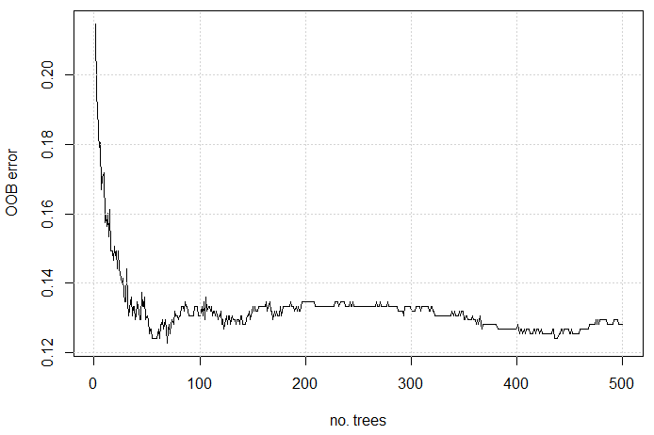
Random forest in R Classification problem (rain/no rain) load(“…/meteo.RData") # keeping only 1000 days for this example n = 1000 y = y[1:n] x = x[1:n, ] # train/test partition indtrain = sample(1:n, round(0.75*n)) # indices for train indtest = setdiff(1:n, indtrain) # indices for test # binary occurrence (1/0) occ = y occ[which(y < 1)] = 0 occ[which(y >= 1)] = 1 # dataframe for occurrence df.occ = data.frame(y.occ = as.factor(occ), predictors = x) # RF rf = randomForest(y.occ ~., df.occ, subset = indtrain) # RF configuration: no. of trees? no. of predictors considered at each node? rf # OOB error? plot(rf$err.rate[, 1], type = "l", xlab = "no. trees", ylab = "OOB error") grid() | # test error? pred = predict(rf, df.occ[indtest, ]) 1 - sum(diag(table(pred, df.occ$y.occ[indtest]))) / length(indtest) # error (1-accuracy)
Bagging: Random forest
1

Slide 35
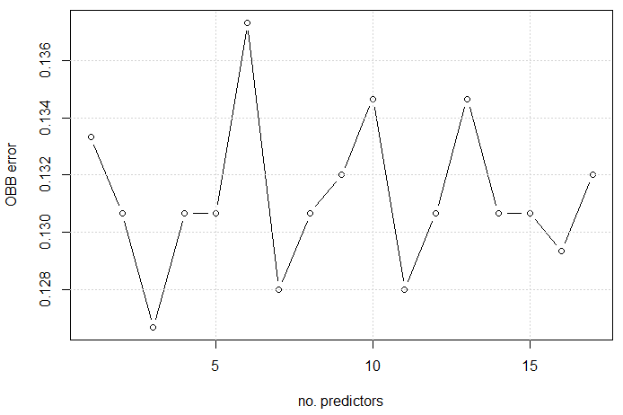
Random forest in R Classification problem (rain/no rain) ## fitting the optimum number of predictors considered at each node (mtry) ntree = which(rf$err.rate[,1] == min(rf$err.rate[,1])) # OOB error? err.oob = c() for (mtry in 1:17) { rf.mtry = randomForest(y.occ ~., df.occ, subset = indtrain, ntree = ntree, mtry = mtry) err.oob[mtry] = rf.mtry$err.rate[ntree, 1] } plot(err.oob, type = "b", xlab = "no. predictors", ylab = "OBB error") grid() | ## results for optimum RF mtry = 3 # optimum value rf.opt = randomForest(y.occ ~., df.occ, subset = indtrain, ntree = ntree, mtry = mtry) # OOB error for optimum RF? rf.opt # test error for optimum RF? pred = predict(rf.opt, df.occ[indtest, ]) 1 - sum(diag(table(pred, df.occ$y.occ[indtest]))) / length(indtest)
Bagging: Random forest
1

Slide 36
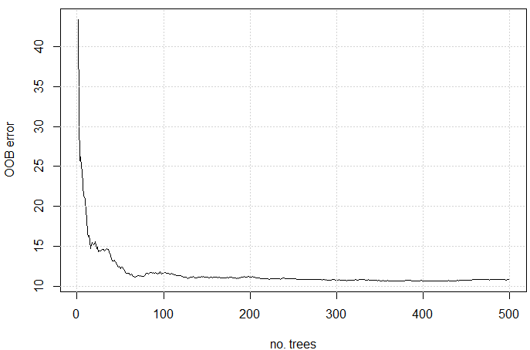
Random forest in R Prediction problem (Boston) library(MASS) n = nrow(Boston) # train/test partition indtrain = sample(1:n, round(0.75*n)) # indices for train indtest = setdiff(1:n, indtrain) # indices for test # RF rf = randomForest(medv ~., Boston , subset = indtrain) # RF configuration? # OOB error? plot(rf$mse, type = "l", xlab = "no. trees", ylab = "OOB error"); grid() | ## fitting mtry ntree = which(rf$mse == min(rf$mse)) # OOB error? err.oob = c() for (mtry in 1:13) { rf.mtry = randomForest(medv ~., Boston, subset = indtrain, ntree = ntree, mtry = mtry) err.oob[mtry] = rf.mtry$mse[ntree] } # test error? err.test = c() for (mtry in 1:13) { rf.mtry = randomForest(medv ~., Boston, subset = indtrain, ntree = ntree, mtry = mtry) pred.mtry = predict(rf.mtry, Boston[indtest, ]) err.test[mtry] = mean((pred.mtry - Boston$medv[indtest])^2) }
Bagging: Random forest
1
Notes:
1

Slide 37
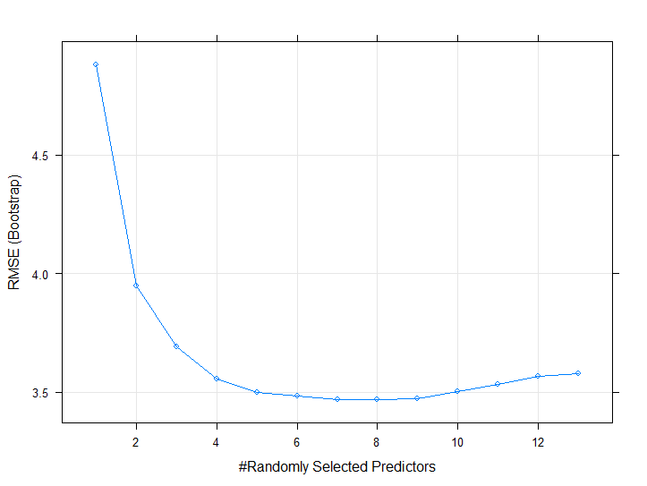
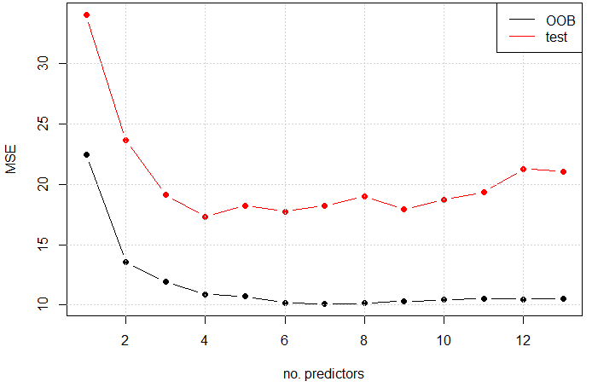
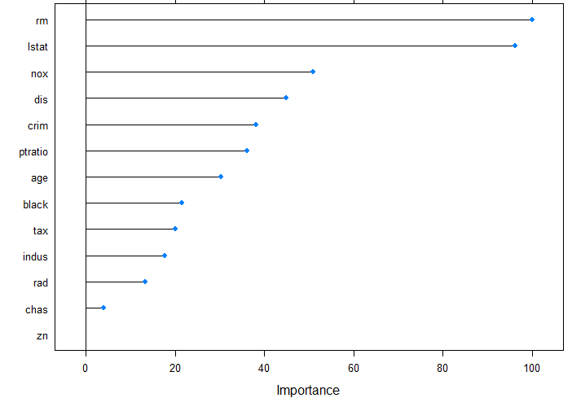
Random forest in R Prediction problem (Boston) # OOB vs. test errors matplot(1:13 , cbind(err.oob, err.test), type = "b", pch = 19 , lty = 1, col = c("black", "red"), ylab = "MSE", xlab = "no. predictors") grid() legend("topright", c("OOB", "test"), lty = 1, col = c("black", "red")) | ## fitting mtry with caret library(caret) rf.caret = train(medv ~., Boston, subset = indtrain, method = "rf", ntree = ntree, tuneGrid = expand.grid(mtry = 1:13)) plot(rf.caret) ## predictors' importance rf.opt = train(medv ~., Boston, subset = indtrain, method = "rf", ntree = ntree, tuneGrid = expand.grid(mtry = 6), importance = T) plot(varImp(rf.opt))
Bagging: Random forest
1
Notes:
1

Slide 38
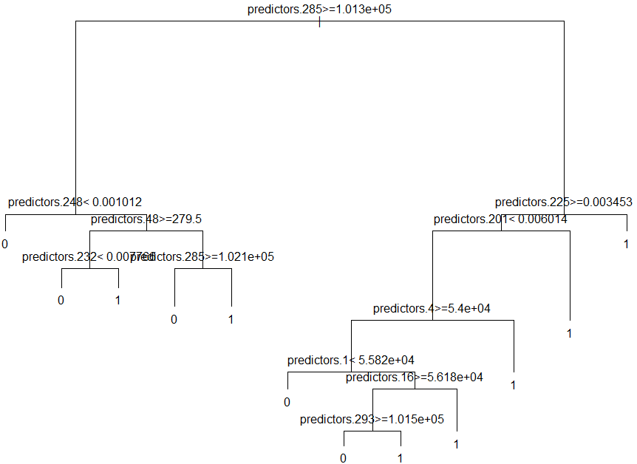
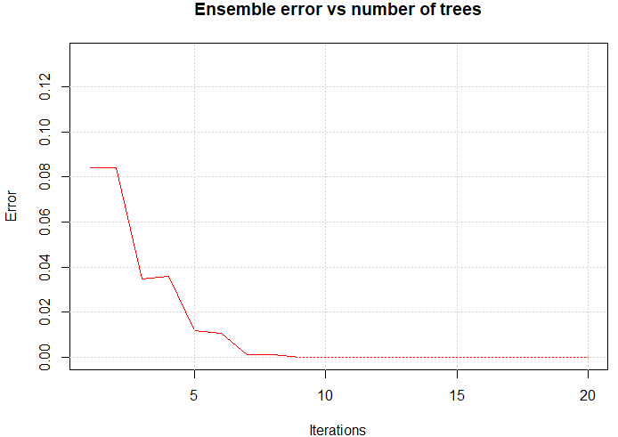
Boosting (AdaBoost) in R Classification problem (rain/no rain) install.packages("adabag") library(adabag) # AdaBoost with 20 trees (mfinal) ab = boosting(y.occ ~., df.occ[indtrain, ], mfinal = 20) # train errors as a function of number of trees plot(errorevol(ab, df.occ[indtrain, ])) grid() | # we can pick and draw individual trees plot(ab$trees[[1]]) text(ab$trees[[1]], pretty = F) ## prediction for test pred.ab = predict(ab, df.occ[indtest, ]) # test error 1 - sum(diag(table(pred.ab$class, df.occ$y.occ[indtest]))) / length(indtest)
Boosting
1
Notes:
1

