Slide 1


Data Mining (Minería de Datos)
Classification Trees
Rodrigo Manzanas
rodrigo.manzanas@unican.es
Grupo de Meteorología
Univ. de Cantabria – CSIC
MACC / IFCA

Slide 2
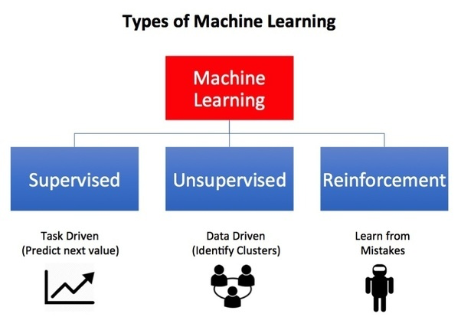
Oct | 30 | Aplazada (sesión de refuezo)
Nov | 6 | Presentación, introducción y perspectiva histórica
 | 8 | Paradigmas, problemas canónicos y data challenges
 | 13 | Reglas de asociación
 | 15 | Práctica: Reglas de asociación
 | 20 | Evaluación, sobreajuste y cross-validación
 | 22 | Práctica: Cross-validación
 | 27 | Árboles de clasificación
 | 29 | Práctica: Árboles de clasificación
 |  | T01. Datos discretos
Dic | 4 | Técnicas de vecinos cercano (k-NN)
 | 11 | Práctica: Vecinos cercanos
 | 13 | Reducción de dimensión lineal
 | 18 | Práctica: LDA y PCA
 | 20 | Reducción no lineal
 |  | T02. Clasificación
Ene | 8 | Árboles de clasificación y regresión (CART)
 | 10 | Práctica: CART
 | 15 | Ensembles: Bagging and Boosting
 | 17 | Práctica: Random forests
 |  | T03. Predicción
 | 22 | Práctica: Gradient boosting
 | 24a | Técnicas de agrupamiento
 | 24b | Práctica: Técnicas de agrupamiento
 | 29a | Práctica: El paquete CARET
 | 29b | Examen
NOTA: Las líneas de código de R en esta presentación se muestran sobre un fondo gris
Calendar
2

Slide 3
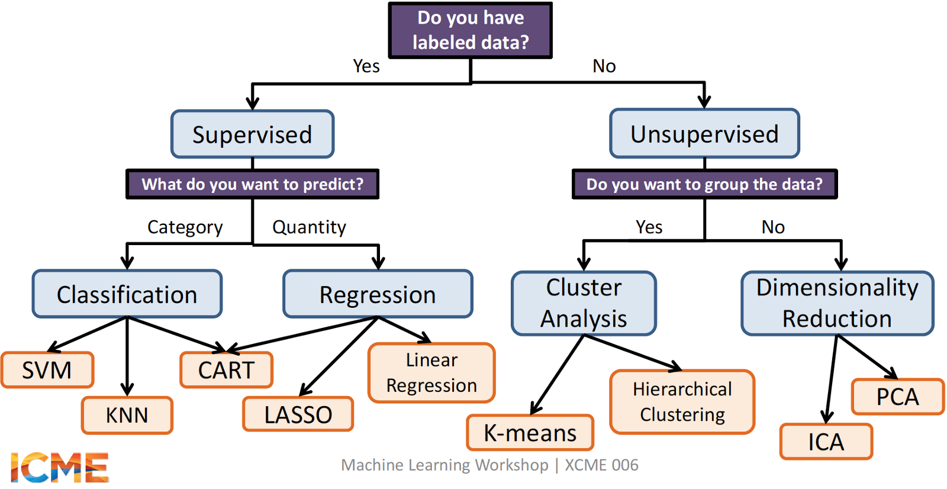
Target variable
Learning paradigms
3

Slide 4
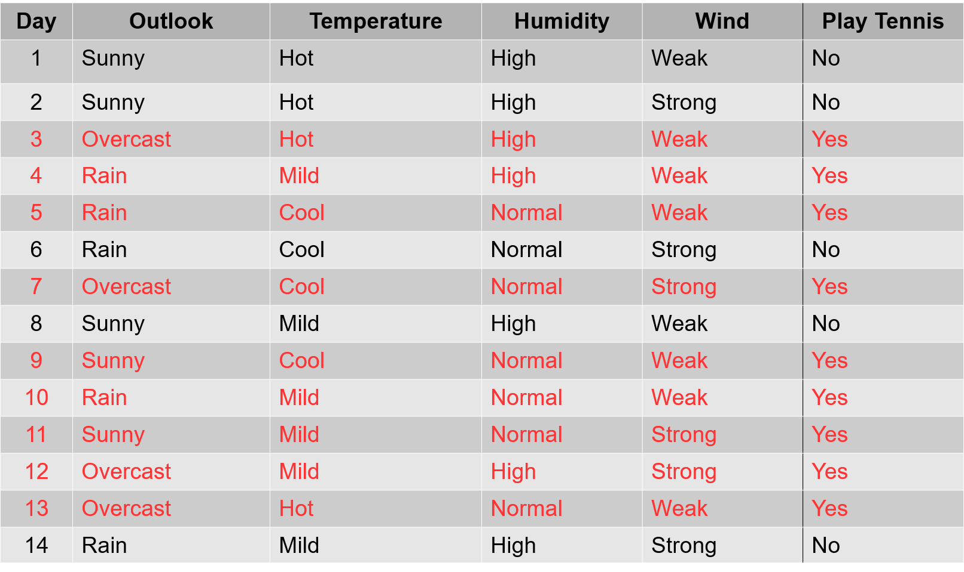
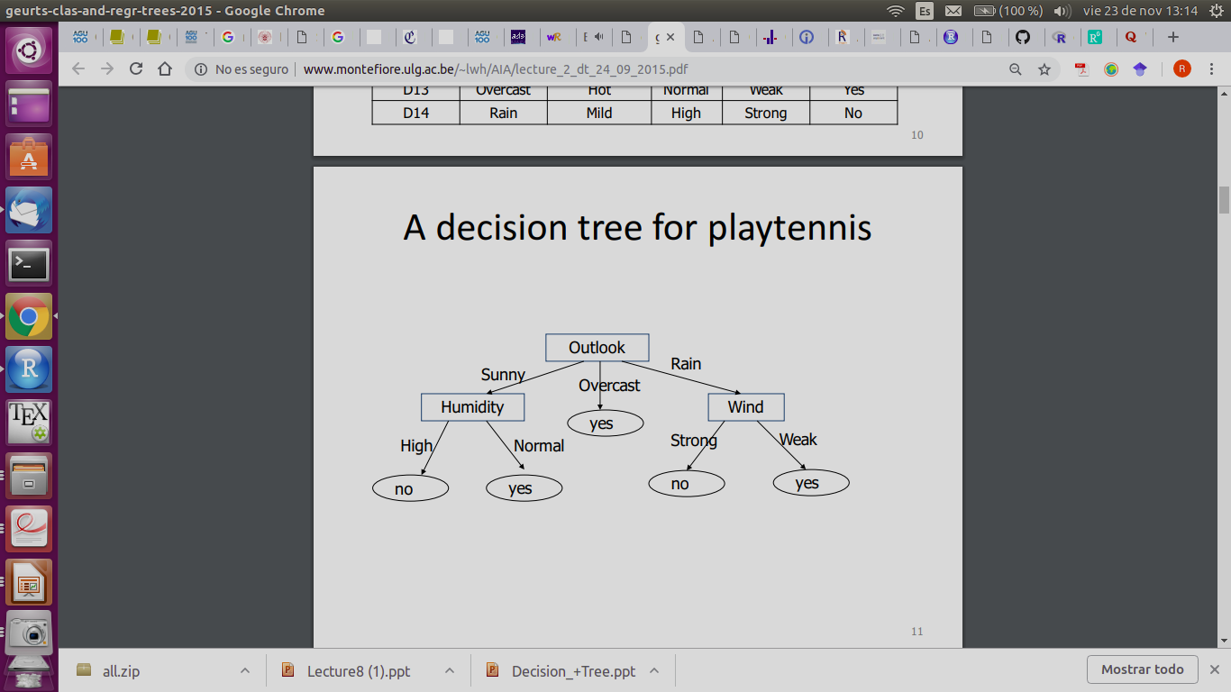
PlayTennis dataset:
https://github.com/sjwhitworth/golearn/blob/master/examples/datasets/tennis.csv
Classification trees
Aim:
To classify a categorical target
variable (R factor) based on a set of
categorical or continuous predictors
Structure:
Each node corresponds to a test
on an attribute
Each branch corresponds to an
attribute value
Each leaf (terminal node)
represents a final class
Each path is a conjunction of
attribute values
Key points:
Due to their intuitive representation,
they are easy to assimilate by humans
They can be constructed relatively fast
as compared to other methods
In general, they provide as good results
as other more complex methods
Introduction

Slide 5
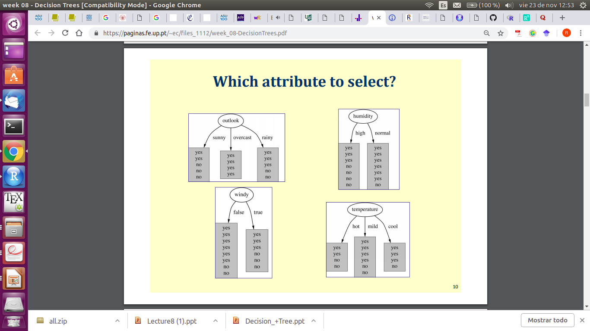
Tree construction
There are several algorithms to build up the tree. However, the idea of all of them is the same: evaluate attribute according to its power of separation.
Many variants for attribute selection:
from machine learning: ID3 (Iterative Dichotomizer), C4.5 and C5.0 (Quinlan 86, 93)
from statistics: CART (Classification And Regression Trees) (Breiman et al. 84)
from pattern recognition: CHAID (CHi-squared Automated Interaction Detection) (Magidson 94)
Their main difference is the criterion followed to perform the division of the node (splitting)
Best discriminating
attribute
Tree construction

Slide 6
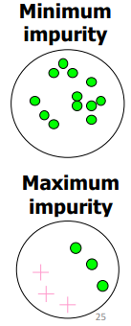
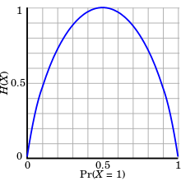
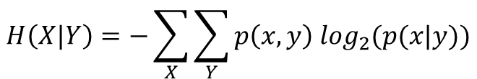
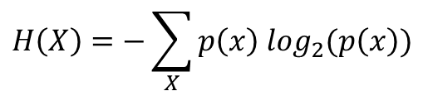



ID3 (the core algorithm)
ID3 relies on the information gain (IG) to grow the tree. IG measures how important a given attribute is. The goal is to maximize the predictive power of the tree by reducing the uncertainty in the classified data (or entropy, H). H can be seen as a measure of the purity of a node.
$$IG(X|Y)=H\left(X\right)−H(X|Y)$$
$$H\left(X\right)=−\sum_{X}{p\left(x\right) \log_{2}(p\left(x\right))}$$
$$H\left(X|Y\right)=−\sum_{X}{\sum_{Y}{p\left(x,y\right) \log_{2}(p(x|y))}}$$
$$H\left(X\right)=0$$
$$H\left(X\right)=0.5$$
The ID3 algorithm

Slide 7
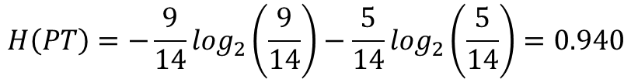
Day | Outlook | Temperature | Humidity | Wind | Play Tennis
1 | Sunny | Hot | High | Weak | No
2 | Sunny | Hot | High | Strong | No
3 | Overcast | Hot | High | Weak | Yes
4 | Rain | Mild | High | Weak | Yes
5 | Rain | Cool | Normal | Weak | Yes
6 | Rain | Cool | Normal | Strong | No
7 | Overcast | Cool | Normal | Strong | Yes
8 | Sunny | Mild | High | Weak | No
9 | Sunny | Cool | Normal | Weak | Yes
10 | Rain | Mild | Normal | Weak | Yes
11 | Sunny | Mild | Normal | Strong | Yes
12 | Overcast | Mild | High | Strong | Yes
13 | Overcast | Hot | Normal | Weak | Yes
14 | Rain | Mild | High | Strong | No
$$H\left(PT\right)=−\frac{9}{14}\log_{2}\left(\frac{9}{14}\right)−\frac{5}{14}\log_{2}\left(\frac{5}{14}\right)=0.940$$
The ID3 algorithm

Slide 8
Day | Outlook | Temperature | Humidity | Wind | Play Tennis
1 | Sunny | Hot | High | Weak | No
2 | Sunny | Hot | High | Strong | No
3 | Overcast | Hot | High | Weak | Yes
4 | Rain | Mild | High | Weak | Yes
5 | Rain | Cool | Normal | Weak | Yes
6 | Rain | Cool | Normal | Strong | No
7 | Overcast | Cool | Normal | Strong | Yes
8 | Sunny | Mild | High | Weak | No
9 | Sunny | Cool | Normal | Weak | Yes
10 | Rain | Mild | Normal | Weak | Yes
11 | Sunny | Mild | Normal | Strong | Yes
12 | Overcast | Mild | High | Strong | Yes
13 | Overcast | Hot | Normal | Weak | Yes
14 | Rain | Mild | High | Strong | No
$$H\left(PT|Wind\right)=−p\left(Yes,Strong\right)\log_{2}\left(p\left(Yes|Strong\right)\right)−p\left(No,Strong\right)\log_{2}\left(p\left(No|Strong\right)\right)$$
$$−p\left(Yes,Weak\right)\log_{2}(p\left(Yes|Weak\right))−p\left(No,Weak\right)\log_{2}(p\left(No|Weak\right))$$
The ID3 algorithm

Slide 9
Day | Outlook | Temperature | Humidity | Wind | Play Tennis
1 | Sunny | Hot | High | Weak | No
2 | Sunny | Hot | High | Strong | No
3 | Overcast | Hot | High | Weak | Yes
4 | Rain | Mild | High | Weak | Yes
5 | Rain | Cool | Normal | Weak | Yes
6 | Rain | Cool | Normal | Strong | No
7 | Overcast | Cool | Normal | Strong | Yes
8 | Sunny | Mild | High | Weak | No
9 | Sunny | Cool | Normal | Weak | Yes
10 | Rain | Mild | Normal | Weak | Yes
11 | Sunny | Mild | Normal | Strong | Yes
12 | Overcast | Mild | High | Strong | Yes
13 | Overcast | Hot | Normal | Weak | Yes
14 | Rain | Mild | High | Strong | No
$$H\left(PT|Wind\right)=−\frac{3}{14}\log_{2}\left(\frac{3}{6}\right)−\frac{3}{14}\log_{2}\left(\frac{3}{6}\right)−\frac{6}{14}\log_{2}\left(\frac{6}{8}\right)−\frac{2}{14}\log_{2}\left(\frac{2}{8}\right)=0.892$$
The ID3 algorithm

Slide 10
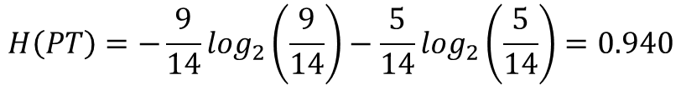



$$H\left(PT\right)=−\frac{9}{14}\log_{2}\left(\frac{9}{14}\right)−\frac{5}{14}\log_{2}\left(\frac{5}{14}\right)=0.940$$
$$H\left(PT|Wind\right)=−\frac{3}{14}\log_{2}\left(\frac{3}{6}\right)−\frac{3}{14}\log_{2}\left(\frac{3}{14}\right)−\frac{6}{14}\log_{2}\left(\frac{6}{8}\right)−\frac{2}{14}\log_{2}\left(\frac{2}{14}\right)=0.892$$
$$IG\left(PT|Wind\right)=0.940−0.892=0.048$$
$$IG\left(PT|Humidity\right)=0.151$$
$$IG\left(PT|Outlook\right)=0.246$$
Root node
$$IG\left(PT|Temperature\right)=0.029$$
Outlook
Sunny
Rain
Overcast
2 yes, 3 no
4 yes, 0 no
3 yes, 2 no
The ID3 algorithm

Slide 11
$$H\left(PT\right)=−\frac{9}{14}\log_{2}\left(\frac{9}{14}\right)−\frac{5}{14}\log_{2}\left(\frac{5}{14}\right)=0.940$$
$$H\left(PT|Wind\right)=−\frac{3}{14}\log_{2}\left(\frac{3}{6}\right)−\frac{3}{14}\log_{2}\left(\frac{3}{14}\right)−\frac{6}{14}\log_{2}\left(\frac{6}{8}\right)−\frac{2}{14}\log_{2}\left(\frac{2}{14}\right)=0.892$$
$$IG\left(PT|Wind\right)=0.940−0.892=0.048$$
$$IG\left(PT|Humidity\right)=0.151$$
$$IG\left(PT|Outlook\right)=0.246$$
Root node
$$IG\left(PT|Temperature\right)=0.029$$
Outlook
Sunny
Rain
Overcast
2 yes, 3 no
4 yes, 0 no
3 yes, 2 no
leaf
The ID3 algorithm

Slide 12
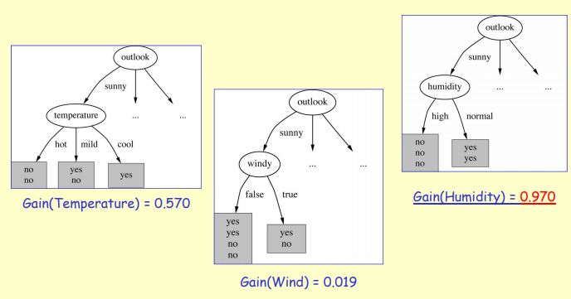
… continue to split…
ID3 performs a greedy search in which the algorithm never backtracks to reconsider earlier choices. This type of search is likely not to be a globally optimum solution, but generally works well
next attribute chosen:
Humidity
Partitioning up the predictor space
Outlook
Sunny
Overcast
Rain
Humidity
yes
Wind
Normal
Strong
Weak
No
Yes
No
Yes

Slide 13
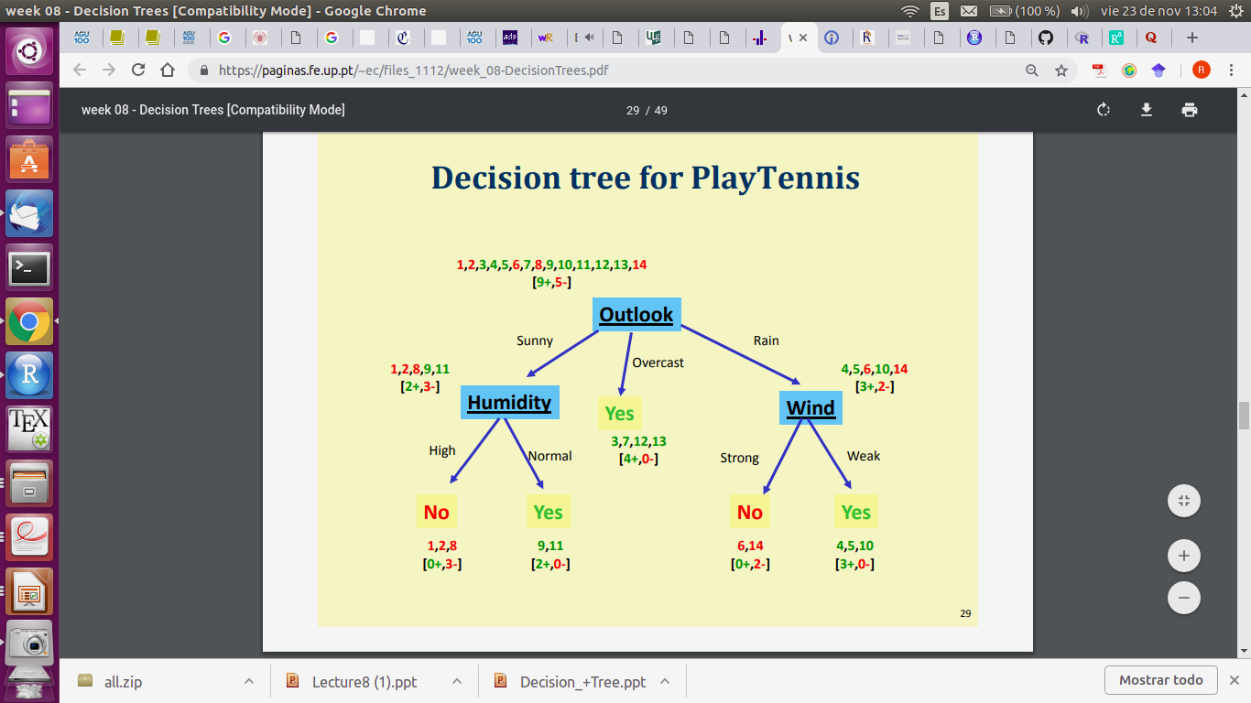
… final tree!
If some attributes are not useful for classification, they will not be selected to grow the tree. For this reason, decision trees often used as a pre-processing for other learning algorithms which suffers from the presence of irrelevant information
For a sufficiently complex (i.e. large) tree, all instances can be correctly classified. However, this can lead to overfitting (we will see this later)
Partitioning up the predictor space

Slide 14



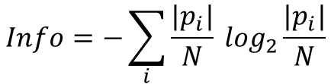

The C4.5 algorithm
The information gain is a measure that tends to prefer attributes with large number of possible values. To solve this, the successor of ID3, C4.5 (Quinlan 93), uses the gain ratio as partitioning criterion. In addition, this new algorithm was improved to handle with missing data and continuous attributes (which are splitted into categories).
Gain ratio (GR): Takes into account the number and sizes of branches when choosing an attribute, penalizing those with many values and instances uniformly distributed.
C5.0 is just a more efficient implementation of C4.5 (faster computing times).
Most of the algorithms that have been developed for learning classification trees are variations of ID3 and its successors C4.5 and C5.0.
$$GR=−\frac{IG}{Info}$$
$$Info=−\sum_{i}{\frac{|p_{i}|}{N}} \log_{2}\frac{|p_{i}|}{N}$$
$${Info}_{Outlook}=−\frac{5}{14}\log_{2}\left(\frac{5}{14}\right)−\frac{5}{14}\log_{2}\left(\frac{5}{14}\right)−\frac{4}{14}\log_{2}\left(\frac{4}{14}\right)=1.577$$
$${GR}_{Outlook}=−\frac{{IG}_{Outlook}}{{Info}_{Outlook}}=\frac{0.246}{1.577}=0.157$$
attribute chosen
$${GR}_{Humidity}=0.152$$
$${GR}_{Wind}=0.049$$
The C4.5 algorithm

Slide 15
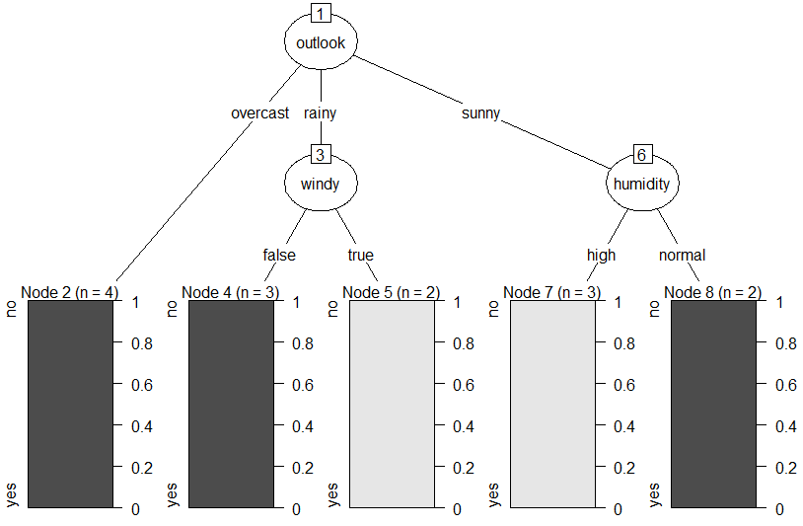
Tree construction in R
There are many packages in R to build classification tress: tree, rpart, rpart2, C5.0, etc.
Use of C5.0 (based on GR):
Example for playTennis (categorical attributes)
## read dataset
tennis = read.csv(“…/tennis.csv")
## grow the tree
library(C50)
t = C5.0(formula = play ~ .,
data = tennis)
## plot the tree
plot(t)
summary(t)
## percentage of training samples that
fall into all the terminal nodes after the split
C5imp(t)
Overall
outlook 100.00
humidity 35.71
windy 35.71
temp 0.00
Examples in R

Slide 16
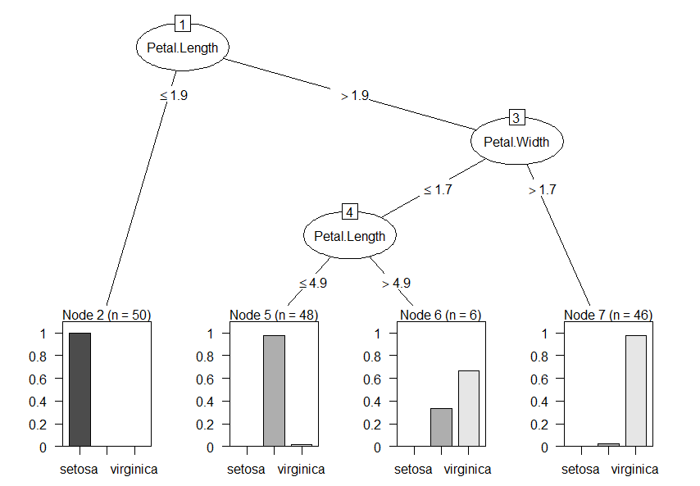
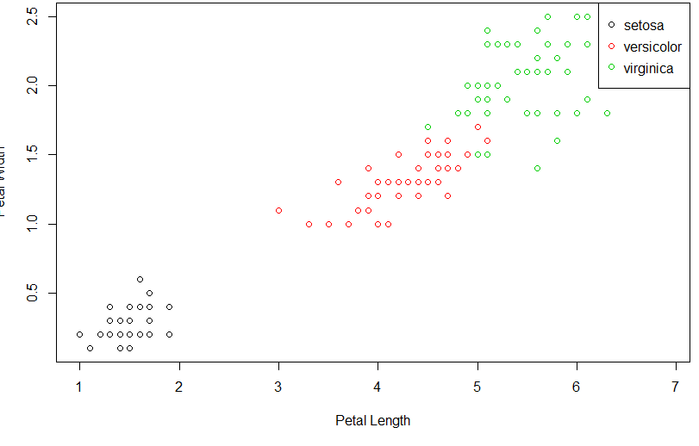
Example for iris (continuous attributes)
## continuous attributes are splitted into
categories based on thresholds
t = C5.0(formula = Species ~ ., data = iris)
plot(t)
summary(t)
## there are only two relevant predictors
t = C5.0(formula = Species ~ Petal.Length + Petal.Width, data = iris)
plot(t)
summary(t)
## the total space is partitioned according to the
thresholds determined by the tree
with(iris, plot(Petal.Length, Petal.Width, col = Species,
xlab = "Petal Length", ylab = "Petal Width"))
legend("topright", levels(iris$Species), col = 1:length(levels(iris$Species)), pch = 1)
Examples in R

Slide 17
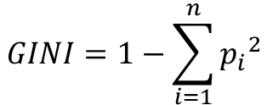
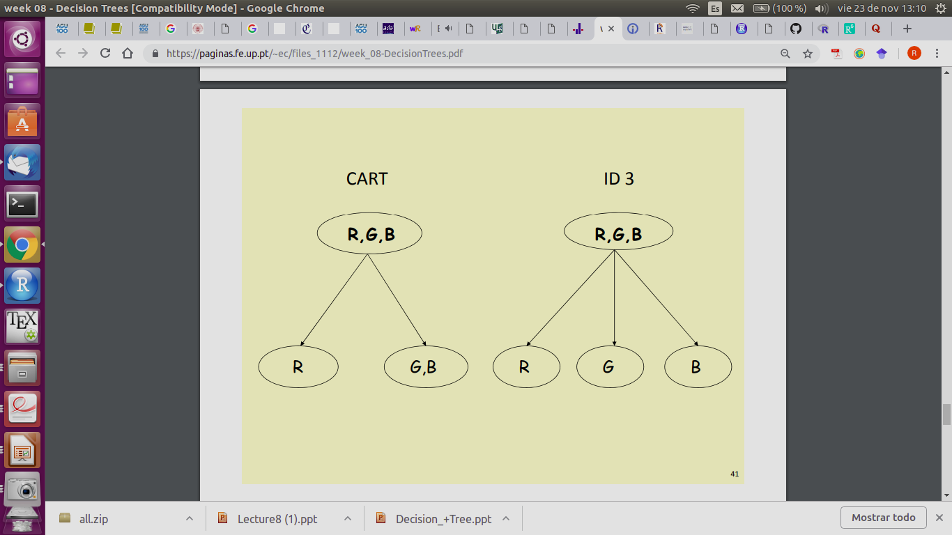
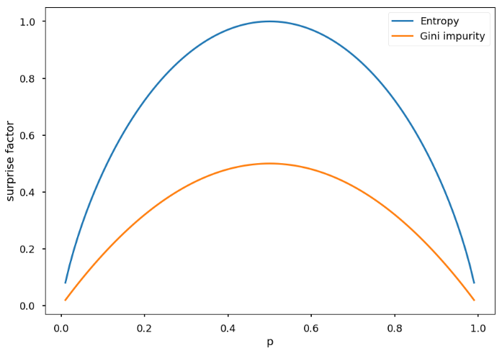
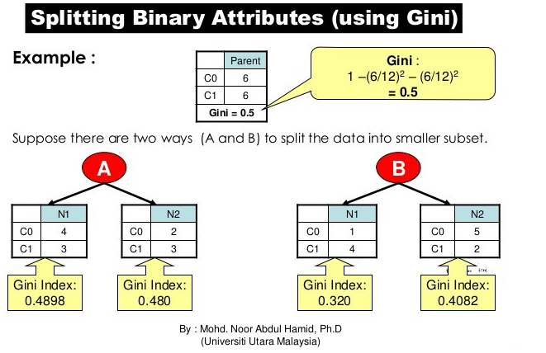
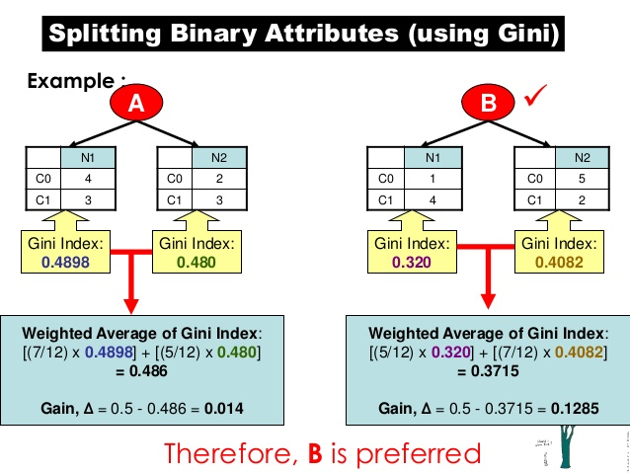

CART (Classification And Regression Trees)
Splitting of binary attributes, based on the Gini index (another measure of the purity of the node). Lower Gini values are preferred (perfect index = 0).
CART

Slide 18
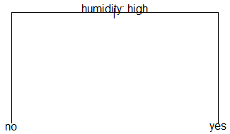
Tree construction in R
There are many packages in R to build classification tress: tree, rpart, rpart2, C5.0, etc.
Use of tree and rpart (CART; based on the Gini index):
Example for playTennis (categorical attributes)
## tree package
library(tree)
# default parameters
t = tree(formula = play ~ ., data = tennis)
plot(t)
text(t, pretty = F)
Examples in R

Slide 19
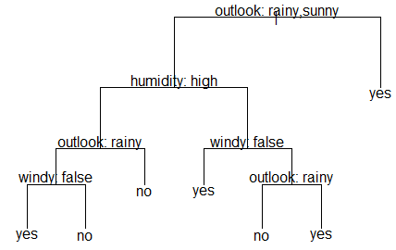
Tree construction in R
There are many packages in R to build classification tress: tree, rpart, rpart2, C5.0, etc.
Use of tree and rpart (CART; based on the Gini index):
Example for playTennis (categorical attributes)
## tree package
library(tree)
# default parameters
t = tree(formula = play ~ ., data = tennis)
plot(t)
text(t, pretty = F)
# user-defined parameters
t = tree(formula = play ~ ., data = tennis,
minsize = 1)
plot(t)
text(t, pretty = F)
Examples in R

Slide 20
Tree construction in R
There are many packages in R to build classification tress: tree, rpart, rpart2, C5.0, etc.
Use of tree and rpart (CART; based on the Gini index):
Example for playTennis (categorical attributes)
## tree package
library(tree)
# default parameters
t = tree(formula = play ~ ., data = tennis)
plot(t)
text(t, pretty = F)
# user-defined parameters
t = tree(formula = play ~ ., data = tennis,
minsize = 1)
plot(t)
text(t, pretty = F)
Documentation must be carefully read!!
Examples in R

Slide 21
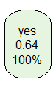
## rpart/rpart.plot packages
library(rpart)
# default parameters
t = rpart(formula = play ~ .,
data = tennis)
library(rpart.plot)
Examples in R

Slide 22
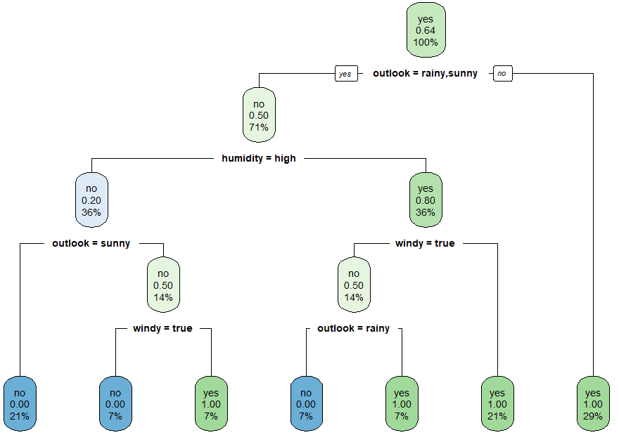
## rpart/rpart.plot packages
library(rpart)
# default parameters
t = rpart(formula = play ~ .,
data = tennis)
library(rpart.plot)
rpart.plot(t)
# user-defined parameters
t = rpart(formula = play ~ .,
data = tennis, minsplit = 2,
minbucket = 1)
rpart.plot(t)
Examples in R

Slide 23
## rpart/rpart.plot packages
library(rpart)
# default parameters
t = rpart(formula = play ~ .,
data = tennis)
library(rpart.plot)
rpart.plot(t)
# user-defined parameters
t = rpart(formula = play ~ .,
data = tennis, minsplit = 2,
minbucket = 1)
rpart.plot(t)
Compare with the result obtained with the C50 package: which are the differences?
Examples in R

Slide 24
## rpart/rpart.plot packages
library(rpart)
# default parameters
t = rpart(formula = play ~ .,
data = tennis)
library(rpart.plot)
rpart.plot(t)
# user-defined parameters
t = rpart(formula = play ~ .,
data = tennis, minsplit = 2,
minbucket = 1)
rpart.plot(t)
Compare with the result obtained with the C50 package: which are the differences?
Documentation must be carefully read!!
Examples in R

Slide 25
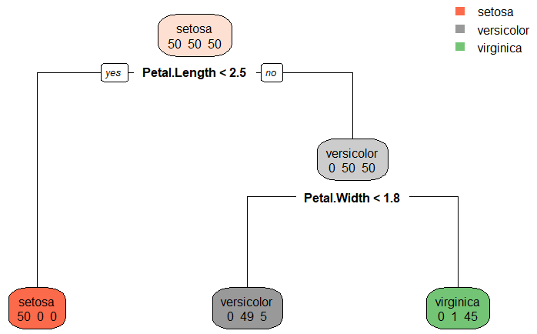
Example for iris (continuous attributes)
# default parameters
t = rpart(formula = Species ~ ., data = iris)
rpart.plot(t, extra = 1)
Examples in R

Slide 26
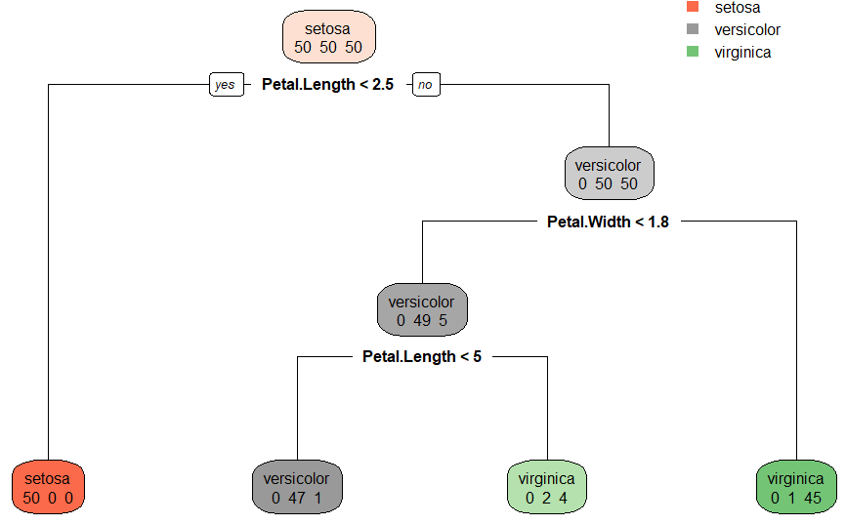
Example for iris (continuous attributes)
# default parameters
t = rpart(formula = Species ~ ., data = iris)
rpart.plot(t, extra = 1)
# user-defined parameters
t = rpart(formula = Species ~ ., data = iris,
minsplit = 2, minbucket = 1)
rpart.plot(t, extra = 1)
Examples in R

Slide 27
Example for iris (continuous attributes)
# default parameters
t = rpart(formula = Species ~ ., data = iris)
rpart.plot(t, extra = 1)
# user-defined parameters
t = rpart(formula = Species ~ ., data = iris,
minsplit = 2, minbucket = 1)
rpart.plot(t, extra = 1)
Compare with the result obtained with the C50 package: which are the differences?
Examples in R

Slide 28
Documentation must be carefully read!!
Example for iris (continuous attributes)
# default parameters
t = rpart(formula = Species ~ ., data = iris)
rpart.plot(t, extra = 1)
# user-defined parameters
t = rpart(formula = Species ~ ., data = iris,
minsplit = 2, minbucket = 1)
rpart.plot(t, extra = 1)
Compare with the result obtained with the C50 package: which are the differences?
Examples in R

Slide 29
summary(t)
Call:
rpart(formula = Species ~ ., data = iris, minsplit = 2, minbucket = 1)
n= 150
CP nsplit rel error xerror xstd
1 0.50 0 1.00 1.22 0.04772141
2 0.44 1 0.50 0.70 0.06110101
3 0.02 2 0.06 0.11 0.03192700
4 0.01 3 0.04 0.10 0.03055050
Variable importance
Petal.Width Petal.Length Sepal.Length Sepal.Width
34 32 20 14
Node number 1: 150 observations, complexity param=0.5
predicted class=setosa expected loss=0.6666667 P(node) =1
class counts: 50 50 50
probabilities: 0.333 0.333 0.333
left son=2 (50 obs) right son=3 (100 obs)
Primary splits:
Petal.Length < 2.45 to the left, improve=50.00000, (0 missing)
Petal.Width < 0.8 to the left, improve=50.00000, (0 missing)
Sepal.Length < 5.45 to the left, improve=34.16405, (0 missing)
Sepal.Width < 3.35 to the right, improve=19.03851, (0 missing)
Surrogate splits:
Petal.Width < 0.8 to the left, agree=1.000, adj=1.00, (0 split)
Sepal.Length < 5.45 to the left, agree=0.920, adj=0.76, (0 split)
Sepal.Width < 3.35 to the right, agree=0.833, adj=0.50, (0 split)
Node number 2: 50 observations
predicted class=setosa expected loss=0 P(node) =0.3333333
class counts: 50 0 0
probabilities: 1.000 0.000 0.000
Node number 3: 100 observations, complexity param=0.44
predicted class=versicolor expected loss=0.5 P(node) =0.6666667
class counts: 0 50 50
probabilities: 0.000 0.500 0.500
left son=6 (54 obs) right son=7 (46 obs)
Primary splits:
Petal.Width < 1.75 to the left, improve=38.969400, (0 missing)
Petal.Length < 4.75 to the left, improve=37.353540, (0 missing)
Sepal.Length < 6.15 to the left, improve=10.686870, (0 missing)
Sepal.Width < 2.45 to the left, improve= 3.555556, (0 missing)
Surrogate splits:
Petal.Length < 4.75 to the left, agree=0.91, adj=0.804, (0 split)
Sepal.Length < 6.15 to the left, agree=0.73, adj=0.413, (0 split)
Sepal.Width < 2.95 to the left, agree=0.67, adj=0.283, (0 split)
Node number 6: 54 observations, complexity param=0.02
predicted class=versicolor expected loss=0.09259259 P(node) =0.36
class counts: 0 49 5
probabilities: 0.000 0.907 0.093
left son=12 (48 obs) right son=13 (6 obs)
Primary splits:
Petal.Length < 4.95 to the left, improve=4.4490740, (0 missing)
Sepal.Length < 7.1 to the left, improve=1.6778480, (0 missing)
Petal.Width < 1.35 to the left, improve=0.9971510, (0 missing)
Sepal.Width < 2.65 to the right, improve=0.2500139, (0 missing)
Node number 7: 46 observations
predicted class=virginica expected loss=0.02173913 P(node) =0.3066667
class counts: 0 1 45
probabilities: 0.000 0.022 0.978
Node number 12: 48 observations
predicted class=versicolor expected loss=0.02083333 P(node) =0.32
class counts: 0 47 1
probabilities: 0.000 0.979 0.021
Node number 13: 6 observations
predicted class=virginica expected loss=0.3333333 P(node) =0.04
class counts: 0 2 4
probabilities: 0.000 0.333 0.667
Examples in R

Slide 30
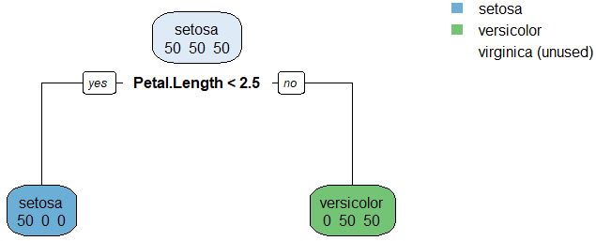
# user-defined parameters: “maxpdepth”
t = rpart(formula = Species ~ ., data = iris,
maxdepth = 1)
rpart.plot(t, extra = 1)
# user-defined parameters: “maxpdepth”
t = rpart(formula = Species ~ ., data = iris,
maxdepth = 2)
rpart.plot(t, extra = 1)
Examples in R

Slide 31
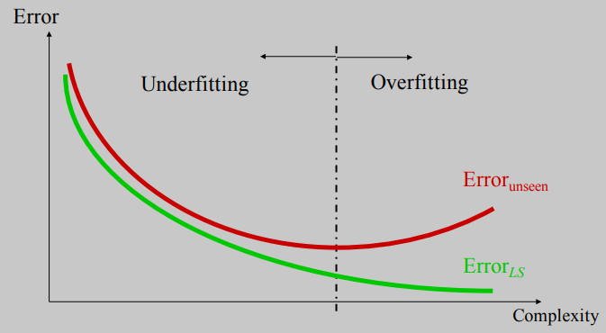
Overfitting
A large tree (i.e. with many terminal nodes) may tend to overfit the training data, leading to poor performance in the test set. Generally, we can improve this behavior by pruning the tree, i.e., cutting off some of the terminal nodes.
test
training
Overfitting: Pruning the tree

Slide 32
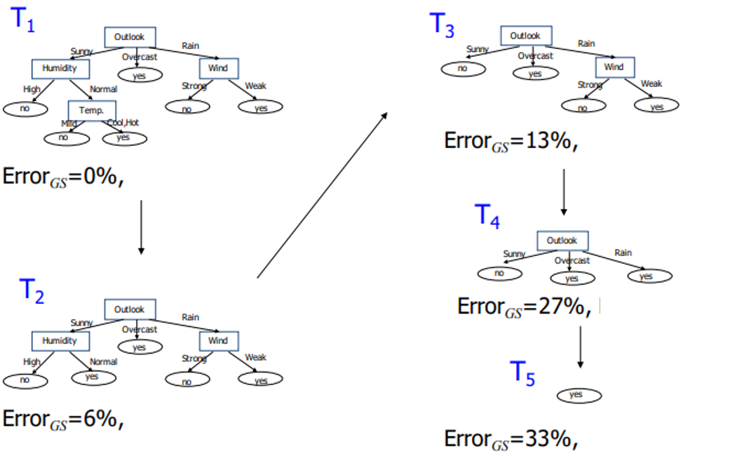
How can we avoid overfitting?
Pre-pruning: stop growing the tree before it reaches the point at which it perfectly classifies
the learning sample. Procedure:
Stop splitting a node if:
The number of objects is too small
The impurity is low enough
This approach leads to small trees but can remove relevant splits
Post-pruning: allow the tree to overfit
and then, one finalized, remove the less
useful nodes. In general, this is
preferred option. Procedure:
Compute a sequence of trees
{T1, T2, …} where T1 is the complete
tree. T2 is obtained by removing from
T1 the node that less increases the
error. Sometimes, this process is guided
based on some cost-complexity
criterion (e.g. in medicine)
The question is: where to stop? In practice,
it is usual to split the learning dataset into
two subsets: a training sample for growing
the tree and a test sample for evaluating
its generalization error (e.g. hold-out
cross-validation).
Overfitting: Pruning the tree

Slide 33
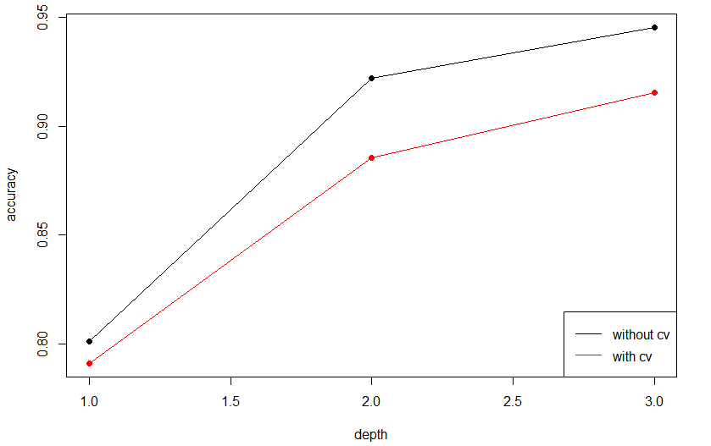
Post-pruning in R
Example for cars (dataset included in the caret package)
## exploring the dataset
library(caret)
data("cars")
summary(cars)
## convert continuous variable "Price" to categorical
cars$Price = as.factor(ifelse(cars$Price >= 22000, "E", "C"))
## 50% of dataset for training and the other 50% for test
n = dim(cars)[1]
set.seed(2)
indtrain = sample(1:n, round(0.5*n))
indtest = setdiff(1:n, indtrain)
dataset.train = cars[indtrain, ]
dataset.test = cars[indtest, ]
## performance without cross-validation, for increasingly complex configurations of the tree
acc.nocv = c()
for (md in 1:3) { # maximum depth allowed for the tree
# learning the tree
t = rpart(formula = Price ~ ., data = dataset.train, maxdepth = md)
# applying learnt tree to predict
pred = predict(t, dataset.train, type = "class")
# performance evaluation
acc.nocv[md] = sum(diag(table(pred, dataset.train$Price))) / length(indtrain)
}
## performance with cross-validation, for increasingly complex configurations of the tree
acc.cv = c()
for (md in 1:3) { # maximum depth allowed for the tree
# learning the tree
t = rpart(formula = Price ~ ., data = dataset.train, maxdepth = md)
# applying learnt tree to predict
pred = predict(t, dataset.test, type = "class”)
# performance evaluation
acc.cv[md] = sum(diag(table(pred, dataset.test$Price))) / length(indtest)
}
## plotting results
matplot(cbind(acc.nocv, acc.cv), type = "o", pch = 19, lty = 1, col = c("black", "red"),
xlab = "depth", ylab = "accuracy")
legend("bottomright", c("without cv", "with cv"), lty = 1, col = c("black", "red"))
grid()
Examples in R

Slide 34
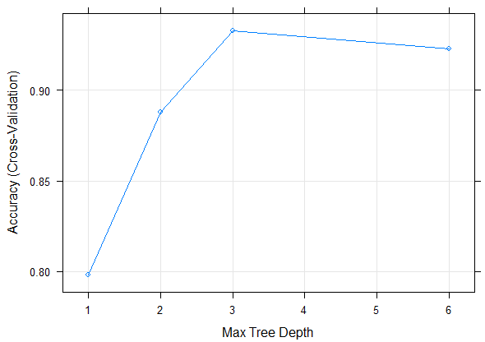
Example for cars (using caret)
Caret tremendously simplifies the model fitting process, allowing for automatized cross-validation
## 50% of the dataset for cross-validation and
## 50% for test
indtrain = createDataPartition(y = cars$Price, p = 0.5,
list = FALSE)
dataset.train = cars[indtrain,]
dataset.test = cars[-indtrain,]
# 10 folds
trctrl = trainControl(method = "cv", number = 10)
## caret automatically tries different values of the
## method parameter (5 in this case, internally selected)
t = train(Price ~ ., data = dataset.train,
method = "rpart2",
trControl = trctrl,
tuneLength = 5)
plot(t)
## prediction
pred = predict(t, newdata = dataset.test)
## evaluation
sum(diag(table(pred, dataset.test$Price))) / dim(dataset.test)[1]
To check the parameters handled by caret:
http://topepo.github.io/caret/index.html
Examples in R

