Slide 1

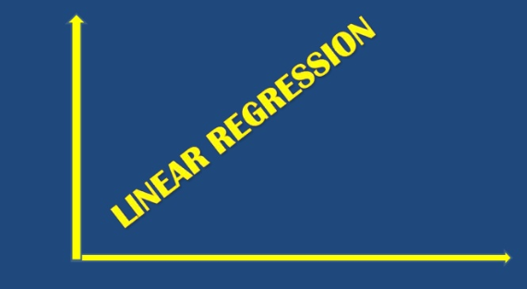
CENTRE FOR CONTINUING EDUCATION “Online course on Basics of Data Analytics” Team-3(Statistics and Linear Regression - Simple & Multiple)
By-
Saqib Akhter
Gourav Pattanaik
Laxmi G Hegde
M S Swaroop

Slide 2
Table of Contents
Introduction
Objectives
Data gathering and preprocessing
Model Development for Simple linear regression
Model Development for Multiple linear regression
Data insights
Conclusion

Slide 3
Introduction:
Linear Regression
Simple Linear Regression
Multiple Linear regression

Slide 4
Objective:
Simple Linear Regression
Regression of one forecast or dependent variable and one explanatory or independent variable
Multiple Linear Regression
Regression of one dependent variable and two independent variable
Linear relationship between x1, x2 and y given by ‘Y=m1x1+m2x2+c’
Governing equation :
Ʃxy = mƩx²+cƩx
Ʃy=mƩx+nc
Linear relationship between x and y given by ‘Y = mx+c’
Governing equation as:
Ʃx1y = m1Ʃx1²+m2Ʃx1x2+cƩx1
Ʃx2y = m1Ʃx1x2+m2Ʃx2²⁺+cƩx2
Ʃy=m1Ʃx1+m2Ʃx2+cƩ1

Slide 5
y-=mx+c
Find the value of m and c and fit a simple regression curve between x(Independent variable) and y(dependent variable)
Y=m1x1+m2x2+c
Find the value of m1, m2 and c and fit a multiple regression curve between x1, x2 (two Independent variable) and y (dependent variable)

Slide 6
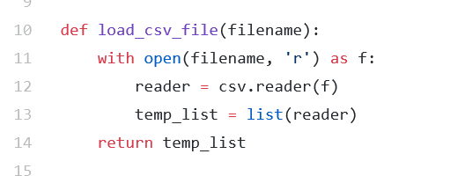
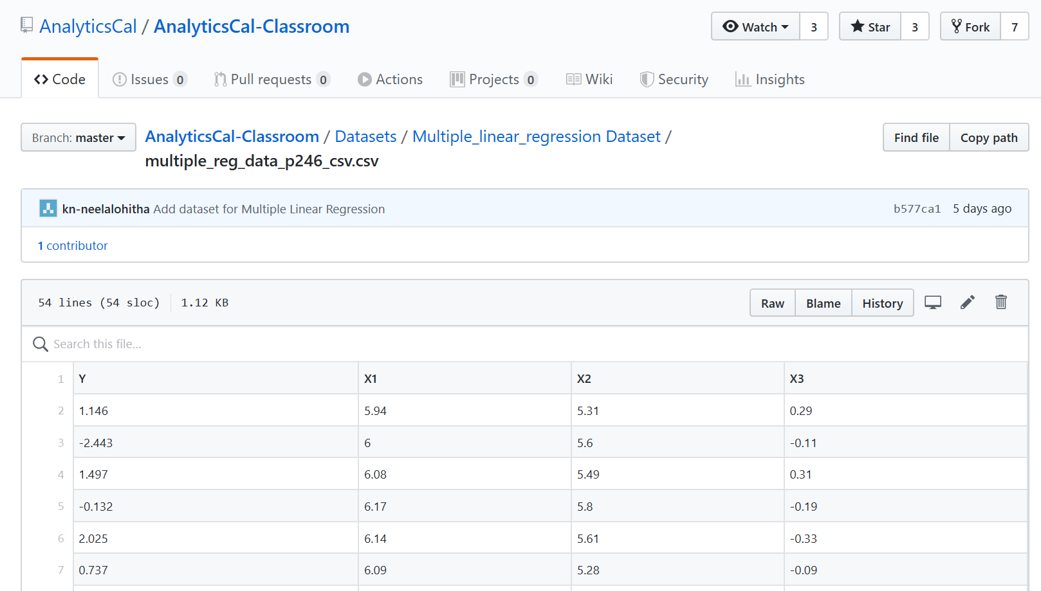
Data gathering & Pre-preprocessing
We in-take in a .csv file containing the dataset as follows, then load it.
Then call in functions based on number of variables (simple or multiple)

Slide 7
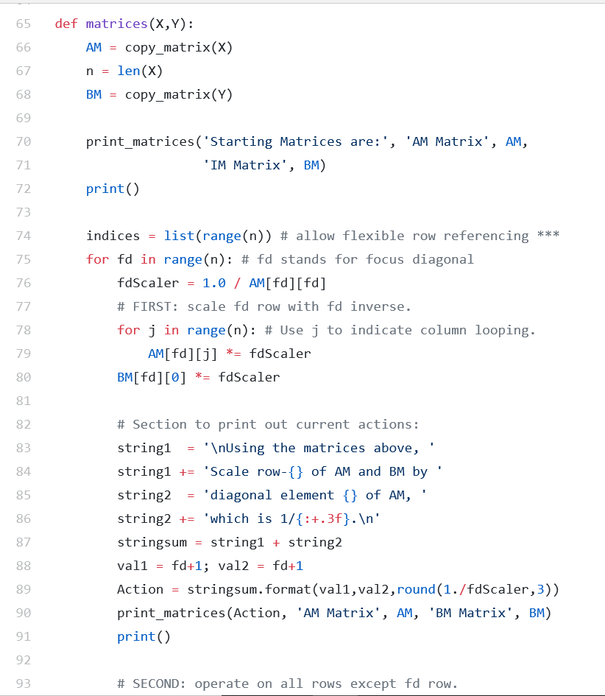
Model Development for Simple linear regression
Following is the code snippet of building simple linear regression model

Slide 8
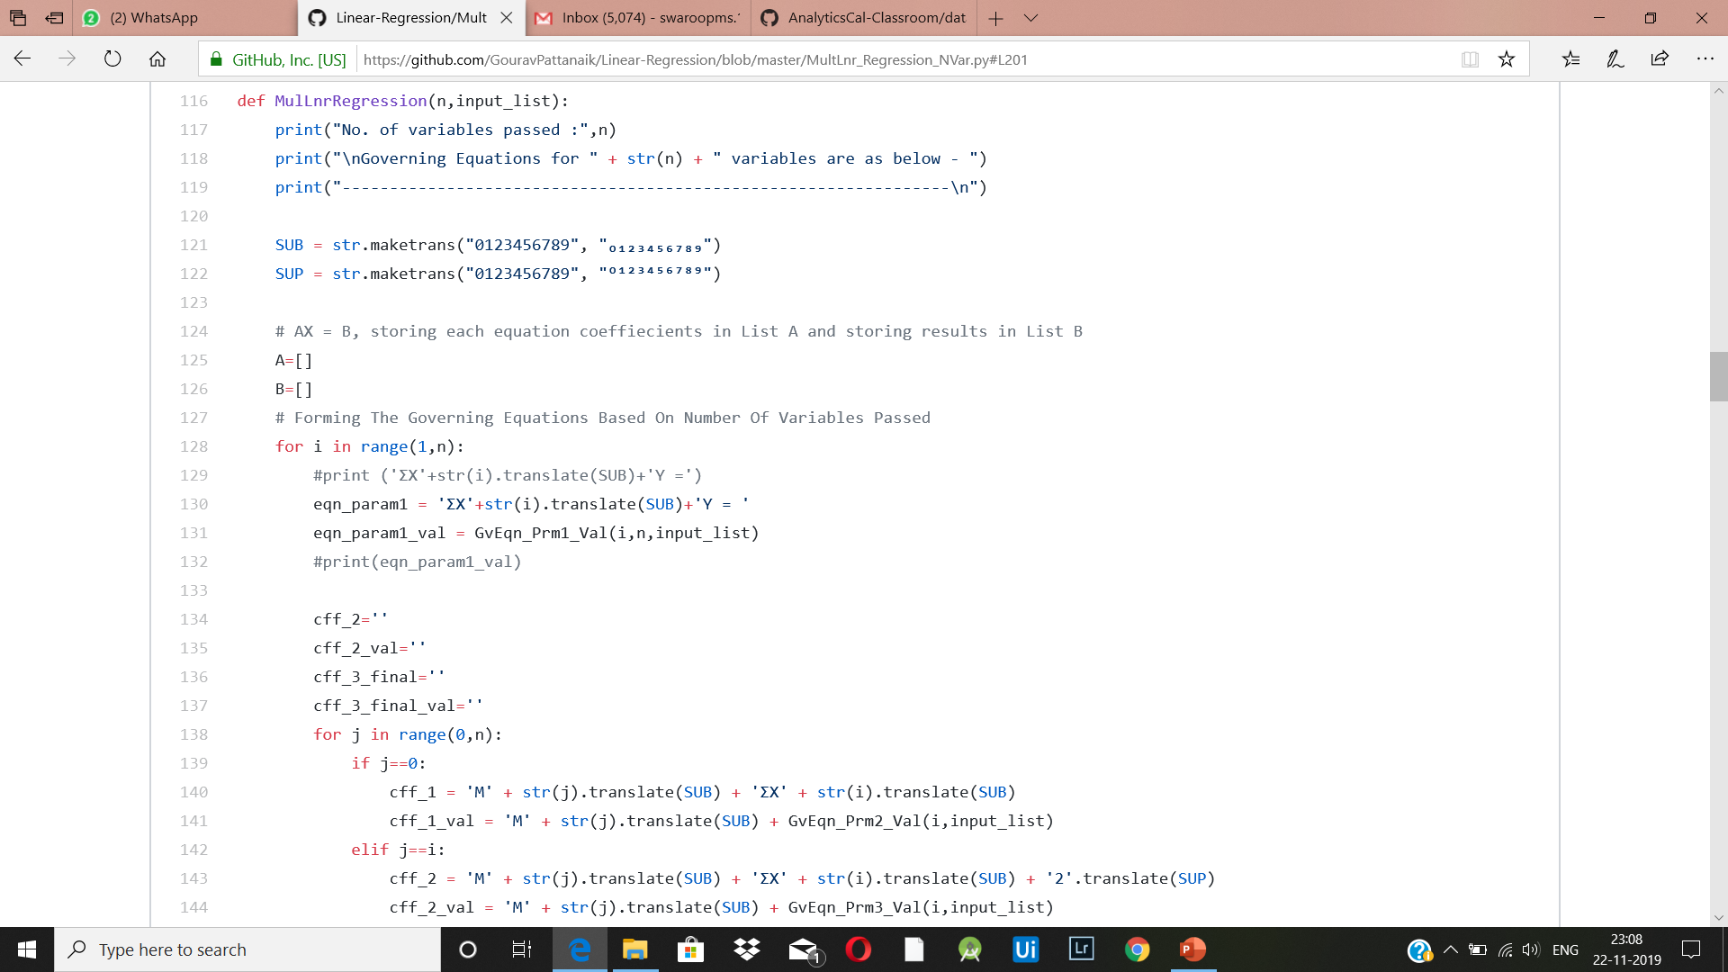
Model Development for Multiple linear regression
Following is the code snippet of building Multiple linear regression model

Slide 9
Results of the code
Basically the output screenshot

Slide 10
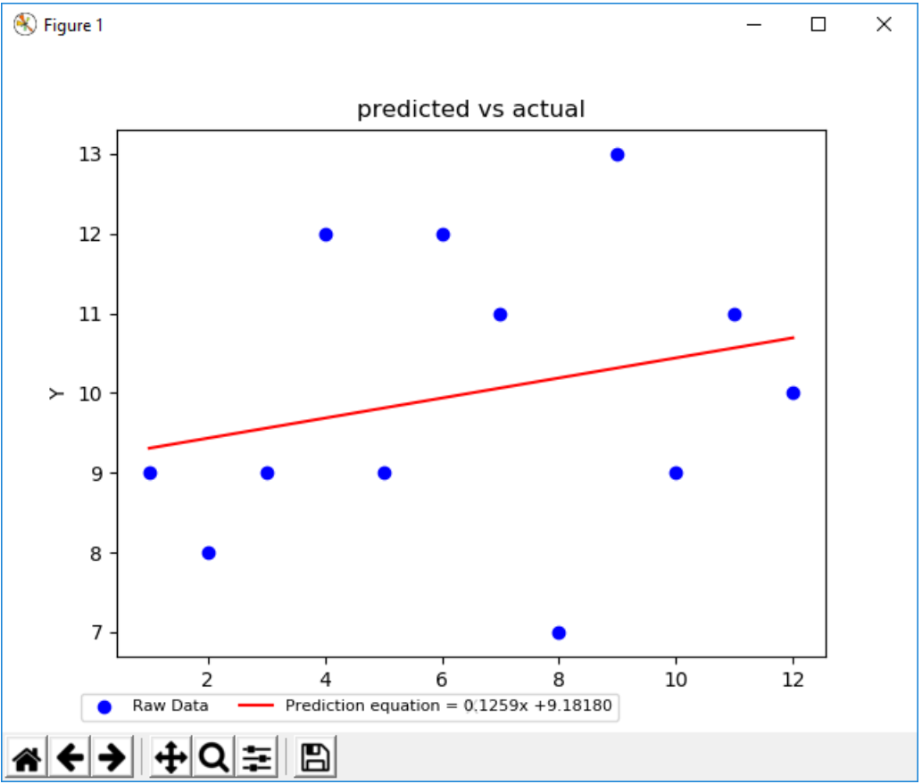
Data Insights
We get the plot of the simple linear
regression model as follows.
From these we study the behaviour of the
Predicted Vs the actual equation.

Slide 11
Next procedures & Conclusions:
Finding out SSR,SSE and observations of F and P-statistic using the anova table.
Forecasting the model and verifying it with the Test data
Finding Out the confidence interval of the model.

Slide 12
THANK YOU
By-
Saqib Akhter
Gourav Pattanaik
Laxmi G Hegde
M S Swaroop

