Slide 1
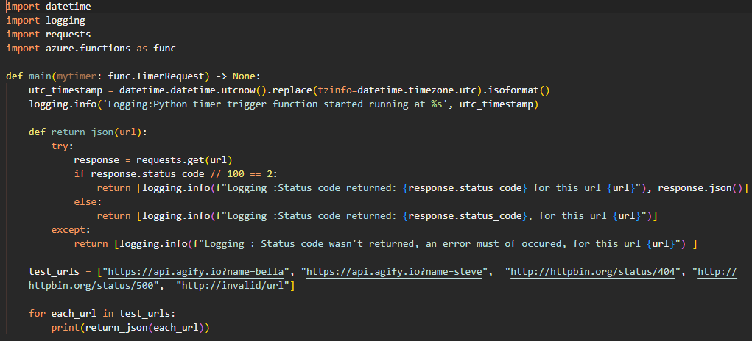
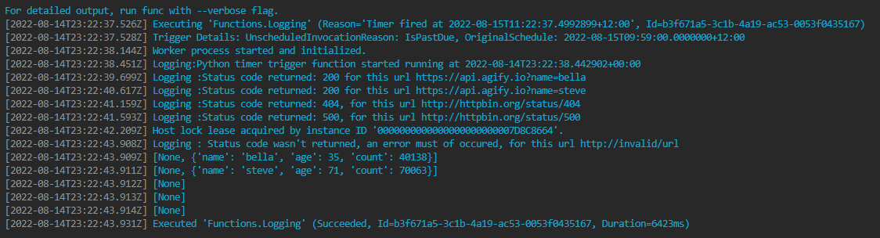
Logging of status code is returned based on response from the 5 URLs. “response.json()” isn’t returned from a logging perspective as it not specified as needing logging. It appears logging is treated a priority over “non-logging” returns, as the response.json() isn’t returned at this stage
The return statement generates a “None” from the first item in the list (i.e. logging), as no meaningful information is returned. For the 200 series responses, the json response is returned.

