Slide 1
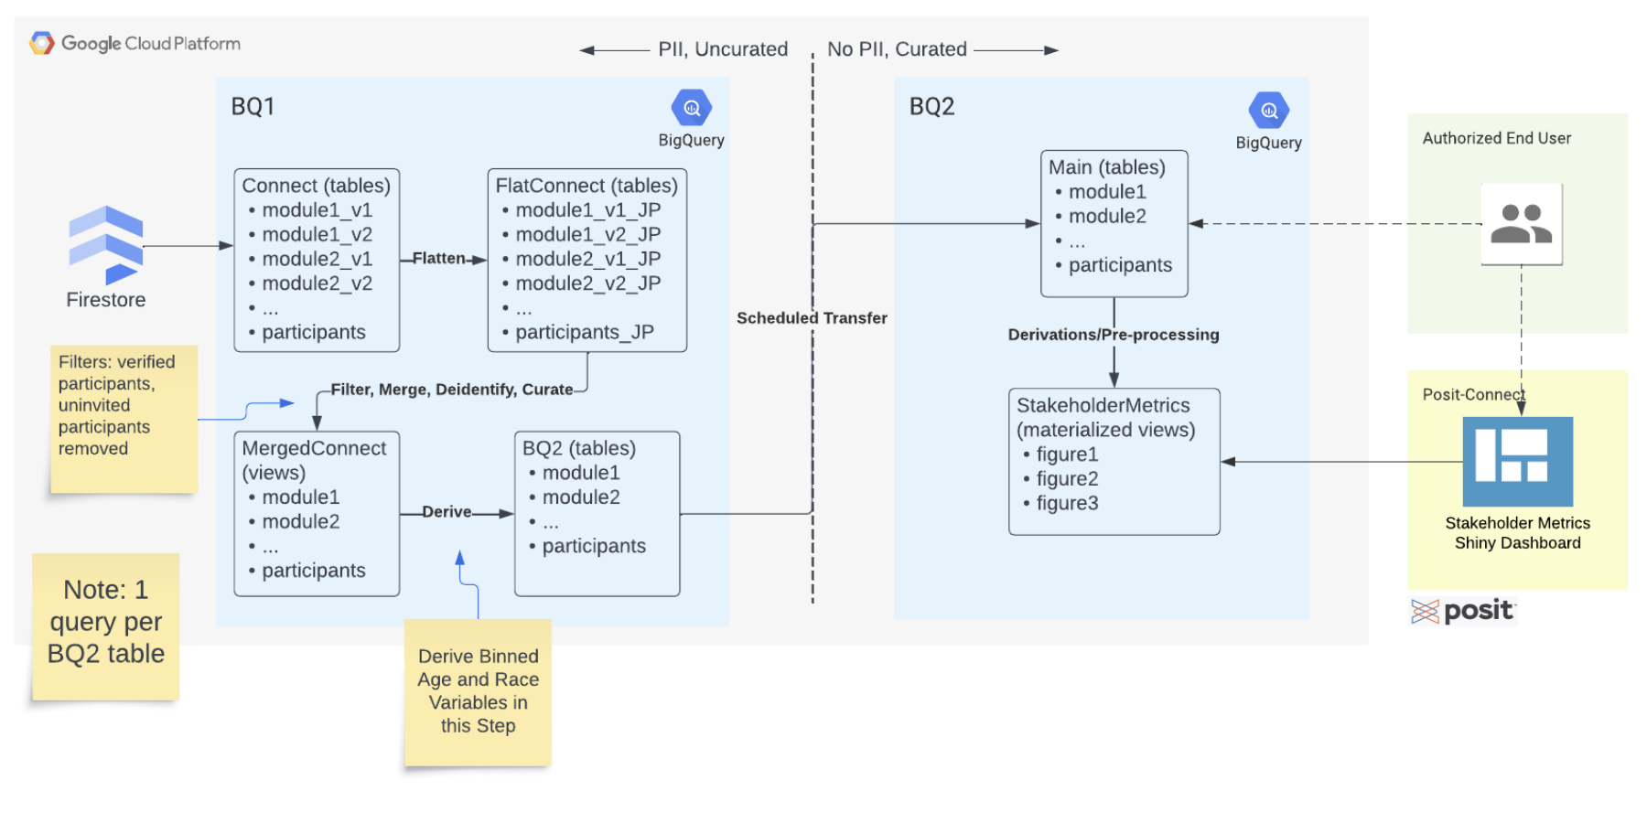
De-identify & de-PII BQ1 data, QC data using DD in R
Generate SQL query with step 1 fixes in R
OR submit these changes to source table
Execute SQL queries in GCP or R

Slide 2
Reasons to care
Once we agree on all of these details, we can break the work up into pieces, perhaps by table and even sub-process within a table
Ensure nobody is working on the same piece of the project
Easily track progress

Slide 3
Moving functions (get DD, schema) into the custom R functions folder
Ensure queries are consistent in formatting style
Would love to have functions written by jing that address variable issues in the data that implement her fixes
Status update on which tables are “done”?– none? Module 1 is actively undergoing QC for variable names and data quality, Module 2 is undergoing
Steps:
1. r function to id exceptions
Sql fun to handle the exceptions
R script to build query using 1 and 2 (generate_module1_query.qmd)

Slide 4
Steps within the ”filter” step
1. Deidentify, de-PII, QC the current BQ data in R
Input: BQ1 data
Output: SQL query text? Or corrected source tables?
2. Execute SQL queries in GCP/R
Goals:
Explicitly define procedure in step 1
Define the file structure of BQ2 build
Define how each file will contribute to the output and what should/shouldn’t be included in each file
Define source data updating paradigm we should use: update source data? or patch new data
Progress communication structure in github?

Slide 5
Step1: De-identify, de-PII and QC Data
Input: BQ1 Data + DD
Output: Correct table schemas to be used in step #2/SQL code?
File Structure: 1 file per table
This procedure must be completed for each table, lets define the procedure explicitly.
Define the procedures to loop through for each table
Not all tables are the same, we must manually curate each table

Slide 6
Tables
Are any of these tables completed and ready for BQ2?
Biosurvey
Biospecimen
Clinicalbiosurvey
Covid19survey
Menstrualsurvey
Module1_v1
Module1_v2
Module2_v2
Module2_v1
Module3
Module4
notifications
participants

Slide 7
Retrieve DD
For each table listed previously:
Retrieve schema from GCP
Complete QC checks on the variable names, i.e. comparing the names found in the table to the DD
QC the data, i.e. match the data format from the DD to the data from GCP
Document any problem variables by either:
Change issue in source table– maybe not able to do since this required multiple levels of coordination across dev ops team
Also makes sense to NOT do these fixes in the flattening procedure as well. we want a correct image of what are in firestore.
Write a fix in R to implement in the SQL query in the next step (i.e. coalesce statement each time we want to update the BQ2 table?
5. Using DD remove variables defined as PII
6. Compile correct schema for table (i.e. if variables were renamed, combined etc.)
7. Output the correct sql query string into a .sql file to be executed in R/GCP?
Agree on this structure?

Slide 8
How to track progress
Assign individuals tables to complete?
Assign individuals subtasks on certain tables?

Slide 9
Step 2: Generate SQL query string
Input: functions generated in step 1
Output: 1 SQL query file for each table that can be executed in GCP or R
File structure: 1 file that sources each table’s file from step 1

Slide 10
Most tables really only need the pii removal and de identification, they don’t need a lot of attention like module ½ need
Jake made a section in the readme file which tracks our progress on the BQ2 table generation
Should we make individual files for each survey ?
Need to fill out the readme that jake started for the

