Slide 1
How does form…
BQ2
SM DB Views
SMDB App
affect function?

Slide 2
SMDB Data Structure Attributes
Data aggregation
Authentication/security
Dashboard output flexibility
Dashboard underlying code
Location of derivation of plot variables
BQ2 tables will be identified at the Connect ID level
1 question need answered: are we planning for 2 separate audiences? E.g. audience 1: site PIs + connect team audience 2: public? Each have different security requirements. Something to keep in mind. Difficult to go from public → site PI rather than site PI level → public

Slide 3
4 Options
Connect_ID level data, user-level auth
The most flexible option in terms of ability to add new features to dashboard and in terms of data filtering (this is my preference)
Connect_ID level data, app-level auth
Extremely flexible connect-id level data, however unsure if Daniel would be ok with this
Public fully aggregated data hosted on GitHub/Box
Fully aggregated data, no security concerns but the least flexible of the options
Per-plot-aggregation
Data that is fully aggregated at the level of what each plot requires (no connect_id level data)

Slide 4
Option 1
Connect ID level data, user-level authentication through GCP
Aggregation: (# Verified Participants x # attributes), Connect ID, 1 table with a unique row of data for each participant
Demographic variables such as race, sex, etc. will be pre-derived
Could look into using “indexes” for filters that the dashboard could use as filters, increasing query speed
Authentication: User will need to have access to BQ2 tables (via Daniel) as well as access to the app (via Rebecca/Jake)
Dashboard Output/Function: Connect ID level data allows maximum flexibility in dashboard filters/graphs/tables. Cross-tab statistics can be generated easily in R

Slide 5
Option 1 Data Structure
Connect_ID | Race | Age | Blood_Survey_Complete | Site
1 | White | 50 | No | HP
2 | Asian | 70 | No | HP
3 | African American | 55 | Yes | HP
Primary Key: Connect ID
Dimension: # Connect IDs X # Attributes
Variable derivations: completed in GCP when table is created (similar to what were already doing for the current SMDB tables in BQ2)
Table can be easily filtered

Slide 6
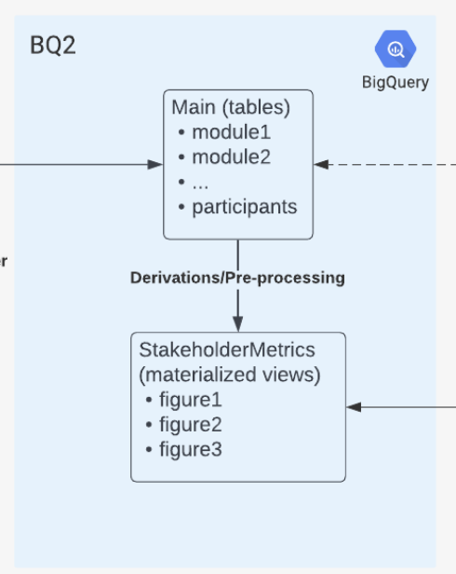
Option 1– Backend GCP
All variables that will be plotted in R must be pre-derived in GCP in order to keep data query cost low (age, race, gender etc.)
These derived variables are sourced from the main tables in bq2

Slide 7
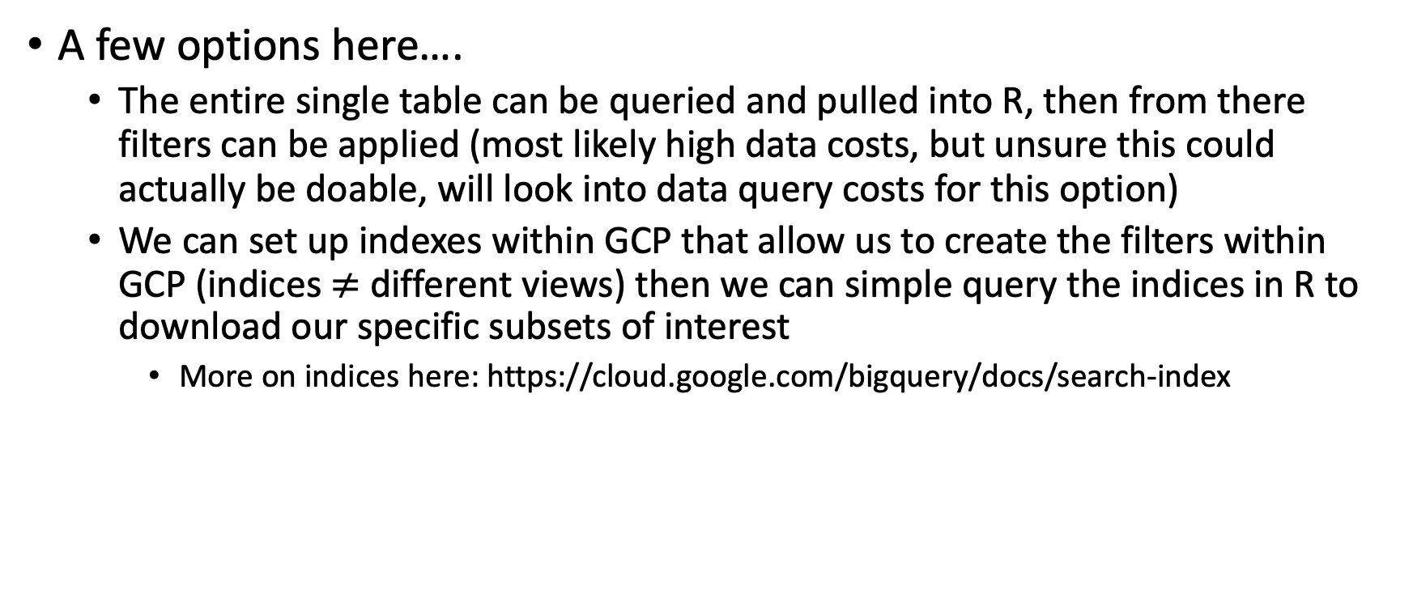
Option 1– Front end R
A few options here….
The entire single table can be queried and pulled into R, then from there filters can be applied (most likely high data costs, but unsure this could actually be doable, will look into data query costs for this option)
We can set up indexes within GCP that allow us to create the filters within GCP (indices $≠$ different views) then we can simple query the indices in R to download our specific subsets of interest
More on indices here: https://cloud.google.com/bigquery/docs/search-index

Slide 8
Pros/Cons of Option 1
Pros:
Extremely flexible in terms of data filters and incorporating new features into the dashboard/table
Possibly very efficient queries from R if indices are set up properly
Table structure extremely simple to understand and straightforward
Cons:
Potentially expensive to download into R
Dual security necessary (GCP + posit app)

Slide 9
Option 2
Option 1 except we bypass user authentication and instead register the app as a service account --> if you have a link to the app, you have access to the plots within the app
I don’t think Daniel will like this option

Slide 10
Option 3, Public Data Only
All data used by the dashboard will be hosted on a public site such as github
Aggregation: Data will be fully aggregated at the level of each chart and completely de-identified
Authentication: Users will need to be granted access to the app, no
Dashboard Output/Function: Fully aggregated, static CSVs on github don’t allow much freedom in output or ease of feature integration

Slide 11
Option 3 Data Structure
Year | Month | Aggregate_Age_45_50 | Aggregate_Blood_Survey | Aggregate_Race_Asian
2021 | January | 40 | 2 | 5
2021 | February | 50 | 5 | 6
Primary Key: None
Dimension: (# Years x 12) X # Attributes
Variable derivations: completed in GCP when table is created (similar to what were already doing for the current SMDB tables in BQ2)
No allowance for on the fly cross-tab calculations

Slide 12
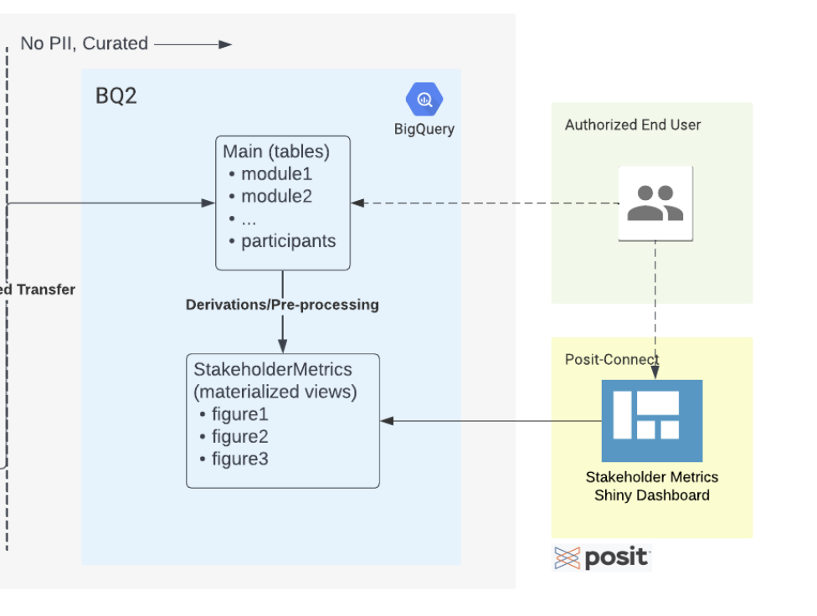
Option 3, Backend GCP
All variables must be pre-derived at the year-month level (or the granularity chosen for the plots, could be year-week)
Adding in an extra step by exporting data and saving it to github/Box
GH

Slide 13
Option 3- Front End R
This leaves the smallest amount of derivation in R, allowing for very fast queries but the scope of the queries is very small
No longer querying from GCP– lower data cost
Essentially the only R code necessary is simple plotly plots since all data is pre-aggregated

Slide 14
Pros/Cons of Option 3
Pros:
Extremely low data query costs
No security due to completely public data
Cons:
Inflexible data structure, difficult to add new features
All cross tab statistics would need to be pre derived in GCP and separate columns will be added to the final product
Adding another step to the data pipeline

Slide 15
Option 4, Pre-Derived by Plot Data
All data used by the dashboard will be organized by plot with separate views/tables in BQ2
Aggregation: Could be connect_id or at the week-year level
Authentication: Users will have access to the specific tables in BQ2 that generate the plots in the dashboard, users will need access to the DB
Dashboard Output/Function: Completely pre-derived variables makes cross-tab statistics/plots annoying to make as each would need its own separate table in BQ2

Slide 16
Option 4, Data Structure
GCP Table: BQ2_PROD.SMDB_Tables.Age_By_Site.Site#1Age
Year | Month | Aggregate_Age_45_55
2021 | January | 5
GCP Table: BQ2_PROD.SMDB_Tables.Age_By_Site.Site#2Age
Year | Month | Aggregate_Age_45_55
2021 | January | 5
Primary Key: None
Dimension: (# Years x 12) X # Attributes
Variable derivations: completed in GCP when table is created (similar to what were already doing for the current SMDB tables in BQ2)
No allowance for on the fly cross-tab calculations
Each plot would correspond to its own view in GCP, this could be A LOT of views

Slide 17
Option 4, Backend GCP
Each plot will correspond to a view in BQ2 in GCP
Each view could be aggregated at different levels, although at the most coarse would make sense (year-week), keep data query costs low

