Slide 1
Why we need a data model

Slide 2
Challenges of the wide, concept_id column headers model
Not self-describing - concept_ids in column names and values without crosswalk in dataset makes it difficult to explore and reason about
Dictionary is a side car document referenced separately, not a first-class feature of the data model
Ever-changing schema - every new answer/option/loop adds columns; pipelines break or need to be explicitly extended to include additional columns (think loop questions, novel SETA responses).
Code against PR2 would potentially be obsolete as soon as new data are released
Not generically "queryable" - every analysis hardcodes column names and relabels them
Version drift - v1/v2 columns reconciled by hand
Ambiguous missingness - blank = not selected? not shown? not taken?
Current approach is to manually reference questionairres and encode in R? Is that right, Kelsey?
What if this was native to the data model? One query pattern or function per skip pattern. Implemented once.
Governance is complicated - requires manual allow list
Notes:
The five pains. Punchline lands after the exhibits. See internal_pitch.md — Why — the problems we all live with.

Slide 3
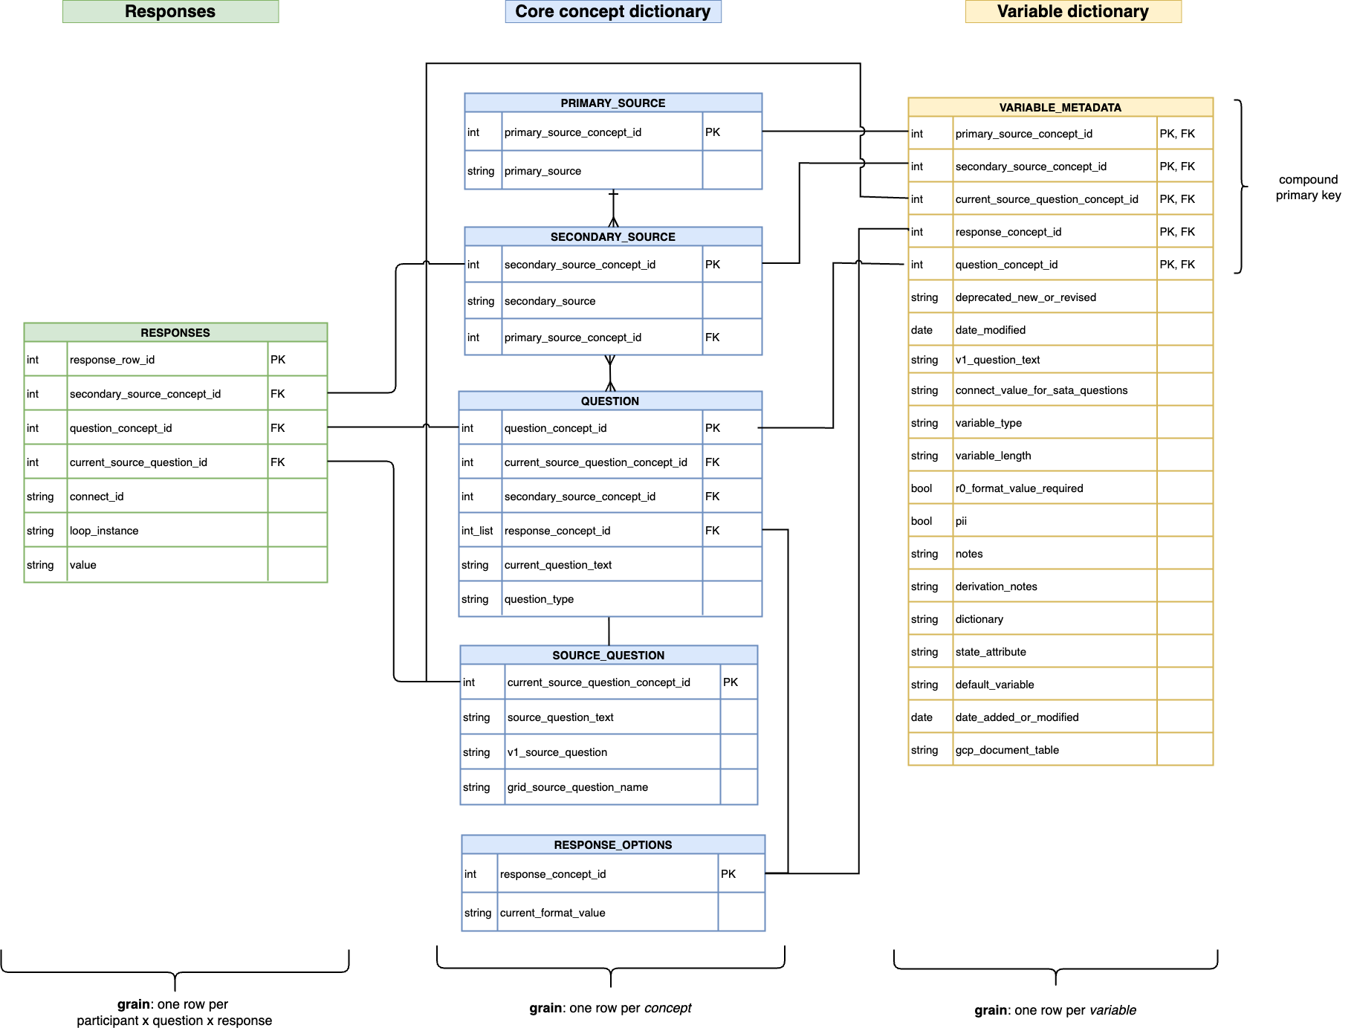

Slide 4
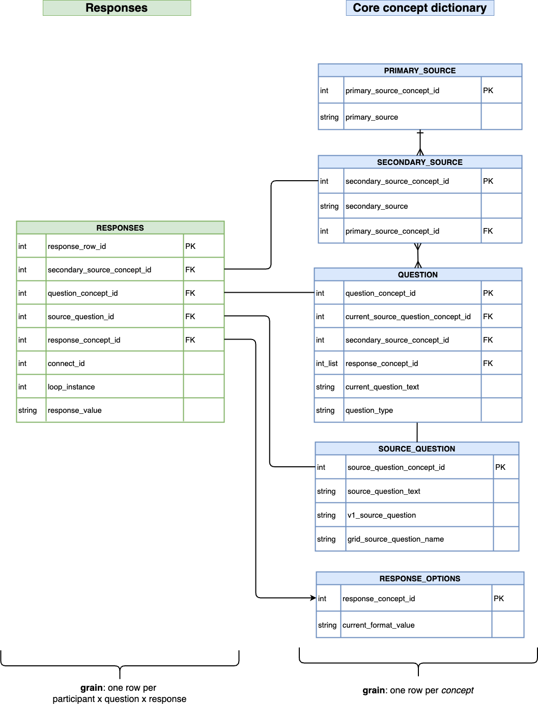

Slide 5
Analyzing long format (1/3): Labels are one join away
Every row says what it means: concept id + human label, side by side
-- one join attaches a label to every answer
SELECT
connect_id,
question_text,
response_concept_id,
response_label,
value
FROM responses
JOIN question USING (question_concept_id)
LEFT JOIN response USING (response_concept_id)
WHERE connect_id = 1001;
question_text | resp. id | response_label | value
Sex | 536341288 | Female
Age |  |  | 47
Smoking Status | 700000002 | Former
Education | 875342283 | Bachelor's Degree
Have you lost…teeth? | 812107266 | Yes, from accident or injury
Have you lost…teeth? | 452438775 | Yes, from tooth decay or disease
no 2,360-column map.. the dictionary travels with the data

Slide 6
Analyzing long format (2/3): Wide is one generic PIVOT away
Pick your tool. One line, and none of them name a single column.
-- SQL: column names come from the DATA, not from you (tested this syntax in DuckDB, not BQ)
PIVOT (
SELECT connect_id, question_text, answer
FROM v_long
WHERE question_type != 'multiselect’
)ON question_text USING any_value(answer);
# Python (pandas)
long.pivot(index='connect_id', columns='question_text', values='answer')
# R (tidyr)
pivot_wider(long, id_cols=connect_id, names_from=question_text, values_from=answer)
connect_id | Age | Education | Sex | Smoking Status
1001 | 47 | Bachelor's Degree | Female | Former
1002 | 62 | High School Graduate or GED | Male | Current
1003 | 55 | Advanced Degree | Female | Never
1004 | 39 | Bachelor's Degree | Male | Never
1005 | 71 | High School Graduate or GED | Female | Former
Column names come from the data, not from you add a question, get a new column. Wrap it once as get_wide(survey) and every team reuses it.
pandas & tidyr discover columns automatically; BigQuery's PIVOT lists the values (or generate them with dynamic SQL). `long` = the single-value answers.

Slide 7
Analyzing long format (3/3): Counts are a simple GROUP BY
-- how many selected each tooth-loss reason?
SELECT response_label, COUNT(*) AS n
FROM v_long
WHERE question_concept_id = 899251483
GROUP BY response_label
ORDER BY n DESC;
tooth_loss_reason | n
Yes, from tooth decay or disease | 2
Yes, from accident or injury | 2
Yes, for some other reason | 1
No, I haven't lost any teeth | 1
In wide, that means summing N ever-changing 0/1 indicator columns; in long it's the same group-by you'd write for any question.
Swap the concept id and the same one-liner counts smoking, education, anything. One pattern for every question.

Slide 8
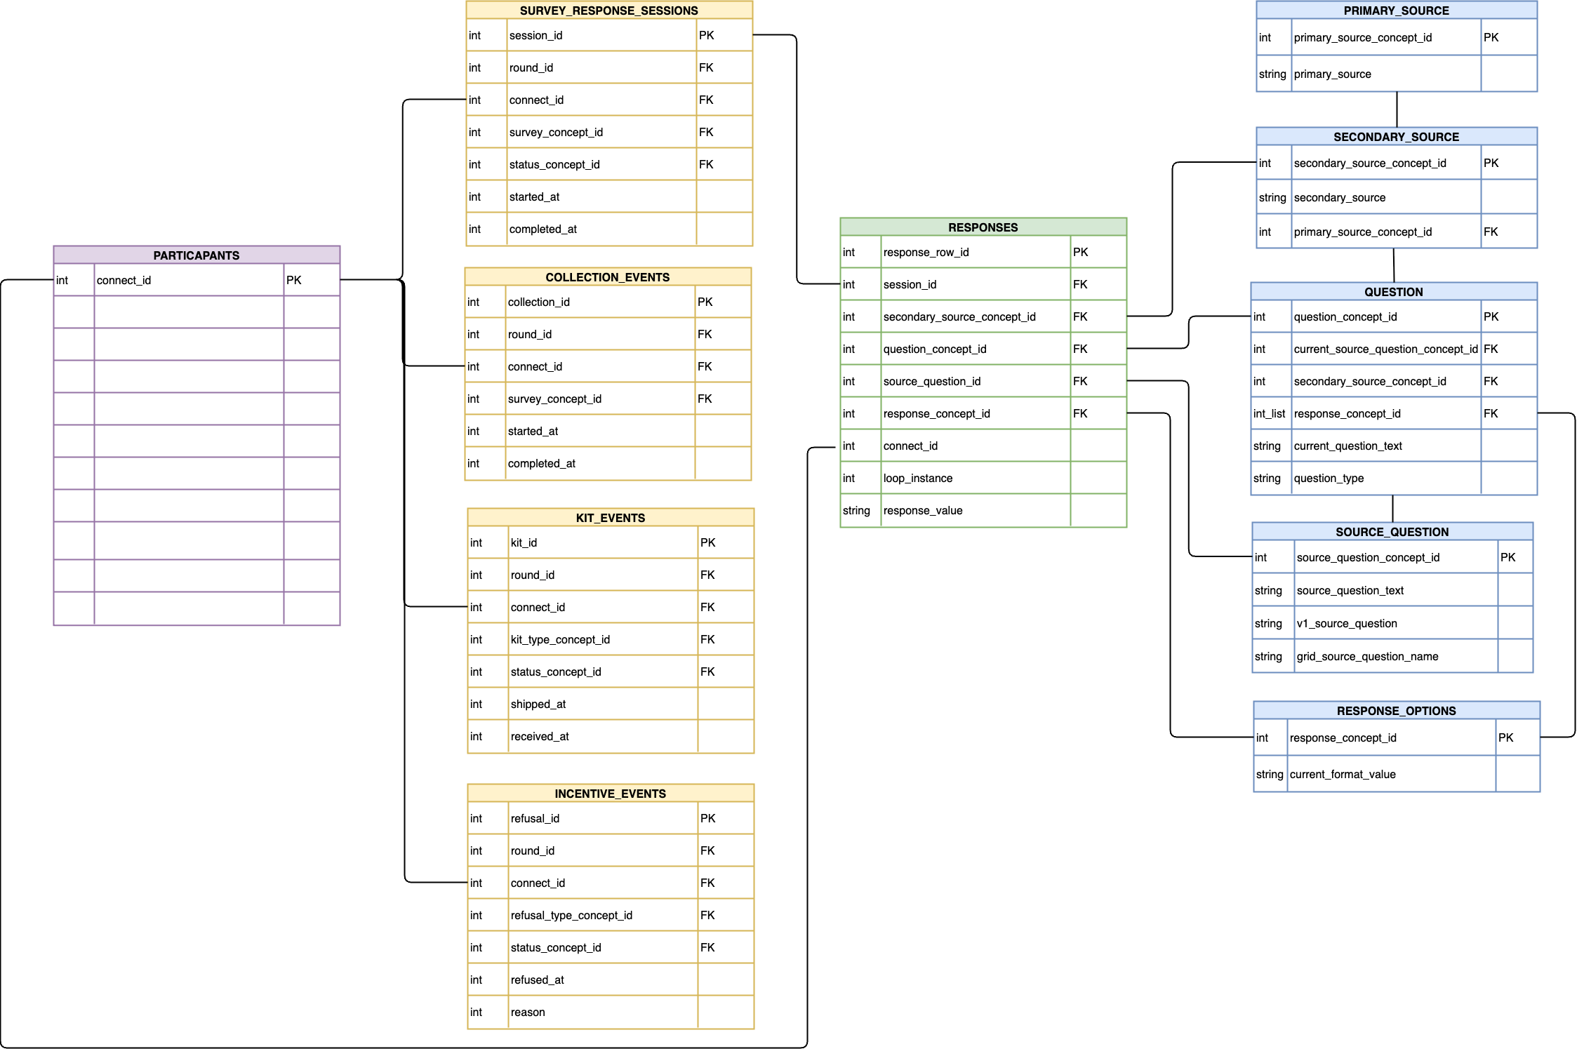
How does the event plane map to our current “survey-centered” data dictionary?
Participant Details
Event plane
Responses
Survey Meta Data (loaded from DD)

Slide 9
2 stage approach
1) Long format responses table linked to meta data
Minimal change to achieve stable schema, self-describing schema
Question type
Loop iteration
2) Modify data model to include
Skip Logic (inspiration from quickQ)
Versioning
Concept relationships (inspiration from OMOP)
Stage 2 benefits
Common abstraction for question types allows same analyses to be applied to any question of the same type
Skip-logic-aware analytics (true missingnessness) without side-care documentation
Version handling – Researchers cannot easily overlook appropriate handling of survey/question versions

