Slide 1
Connect Relational Data Model
Why a data model — the accepted Dictionary-Direct model + its enhancement roadmap for PR2
Team walk-through · detailed notes in internal_pitch.md
Notes:
We already believe in this idea (OMOP) — we just never applied it to our own Connect data. The accepted model is Dictionary-Direct; further capabilities are adopted as incremental enhancements. See internal_pitch.md — The ask.

Slide 2
Why a data model?
Make the data explain itself — so analysis doesn't depend on tribal knowledge or bespoke code
Self-describing
Meaning travels with the data — no decoder ring required.
No tribal knowledge
Labels, structure & valid values live in the data — query it correctly without insider context.
Metadata in the data
Not in side-car spreadsheets or scripts that drift out of sync.
Standardized analyses
The same question is answered the same way by everyone.
A schema contract
Tools built on it keep running when new data arrives.
Shared abstractions
Every select-all handled one way; every loop one way — no per-question code.
Today that knowledge lives in column-name conventions, spreadsheets, and analysts' heads. A data model puts it in the data.
Notes:
The opener: why model at all. Six plain-English value props — self-describing; queryable without tribal knowledge; metadata in the data (not sidecar files); standardized analyses; a schema contract tools can build on (and survive new data); shared abstractions (all select-all handled one way, all loops one way). Sets up the next slide: this is exactly the OMOP lesson. See internal_pitch.md — Why a data model at all?

Slide 3
…and it's the OMOP lesson — applied to our own data
The power isn't the table layout — it's relationships defined as data
Defined relationships between concepts & domains → analytics written once, reused across teams. That is exactly why we adopted OMOP.
What OMOP defines | The same idea in our model
concept — analyze standard concepts, not source codes | concept-ID spine — query concepts, not d_ columns
concept_relationship / concept_ancestor — link & roll up | concept_relationship / question_equivalence (planned)
long event tables + _source_concept_id | long responses fact + retained source columns
standard model → tools reused across 200 sites | stable contract → shared views/tools across teams + PR2
One source, not many — no cross-site network effect; reuse comes from the relationships, across our teams & researchers. OMOP becomes a downstream export.
Notes:
Lead with the OMOP principle the team already accepts. See internal_pitch.md — Why a data model at all?

Slide 4
The problem: we analyze raw source data
Our analysis-ready data is wide tables of opaque concept-ID columns
• Dancing schema — every new answer/option/loop adds columns; pipelines break
• Not generically queryable — every analysis hardcodes column names
• Version drift — v1/v2 columns reconciled by hand
• Ambiguous missingness — blank = not selected? not shown? not taken?
• No built-in governance — PHI/PII is a manual, unenforced allow-list
In OMOP terms, these wide tables are source data — and we're analyzing them raw.
Notes:
The five pains. Punchline lands after the exhibits. See internal_pitch.md — Why — the problems we all live with.

Slide 5
Exhibit 1 — our own Module 1 report
"Merged Module 1 Summary Statistics" · 6,234 lines · scheduled pipeline
~650 lines rebuild the model by hand before the first statistic:
• Hand-rolled v1/v2 merge — re-runs every refresh, column-name dependent
• 150-entry label dictionary typed by hand — with duplicate-key bugs & typos
• Skip logic & loops reimplemented as bespoke functions
• Every missing value → "Skipped this Question" — 3 cases conflated (counts inflated)
→ The model does the merge once (GROUP BY concept), generates labels, and makes skip/loops data.
Notes:
A colleague's flagship report — evidence, not criticism. See internal_pitch.md — This isn't hypothetical.

Slide 6
Exhibit 2 — the QA/QC engine
1,271-line engine + 14 Excel workbooks = 7,025 hand-written rules
The rule checks… | # (all 14 workbooks) | Already in the model as
Cross-variable condition | 3,454 (49%) | skip_logic
Numeric / date / time | 883 (13%) | variable_metadata.variable_type
String length | 792 (11%) | variable_metadata.variable_length
Answer ∈ valid option set | 773 (11%) | response_options
Populated / required | 65 (1%) | skip_logic / is_required
Genuinely custom | 1,058 (15%) | — needs authoring
Most re-state metadata the model centralizes; complex cross-variable logic is authored once — not re-coded in 3 places.
Honest limits: ~35% are pure value/type/length checks; the skip-gated rest needs the richer skip-logic model (~8% complex tail authored once). Module 4 ≈ 50% custom.
Notes:
Recalibrated: ~35% directly generatable (value/type/length); a further ~50% skip-gated -> becomes shared skip-logic data authored ONCE instead of re-coded across 3 repos (simple majority machine-generated, ~8% complex tail like percentDiff preserved as raw expression). ~15% genuinely custom. Contingent on the richer (QuickQ) skip_rule representation. Module 4 ~50% custom is the honest counter-case. See internal_pitch.md — QA/QC engine; CLAUDE.md — Skip-logic complexity & coverage.

Slide 7
Exhibit 3 — geocoding & unharmonized concept IDs
Same field, no relationship linking its variants
• "Street name of a residence" = ~27 unrelated concept IDs (home ×11, seasonal ×10, work, school, childhood…)
• Three separate codebases each rebuild the same address crosswalk
• One even string-matches question labels as join keys (fragile — labels drift)
• No "address" or "street_name" concept generalizes → nothing reusable
Fix: concept_relationship / question_equivalence — author "these are the same field" once, as data.
Notes:
Strongest case for the concept-equivalence enhancement — argues to pull it forward. See internal_pitch.md — geocoding.

Slide 8
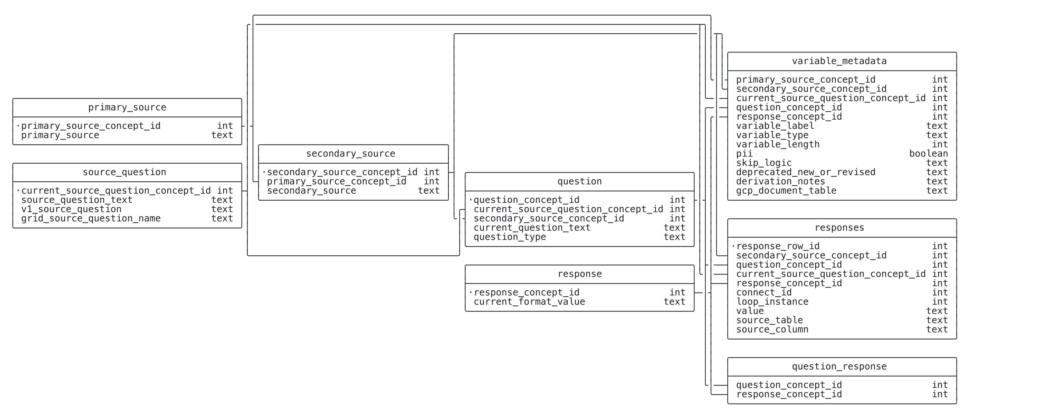
The idea — answers become rows
The model: the dictionary as-is + one long responses table
New answers / options / loops are rows, never new columns. Full model ERD (Dictionary-Direct).
Notes:
The model: CIDTool dictionary as-is + one responses fact. See internal_pitch.md — The model.

Slide 9
A closer look: select-all questions
Same data, a clearer shape — the dictionary stays the source of truth
Today's encoding faithfully mirrors how the data is stored. The model just adds a logical view on top — nothing is lost, the dictionary is unchanged.
Example: "Have you lost any permanent teeth?" | Dictionary today | Model — logical view
The question | shifted into "Source Question" | one question (multi_select)
Each option (e.g. "from accident") | promoted to its own "Question" | a response option
The answer | a synthetic Yes/No per option | one row per option actually selected
Add an option next year | a new column | a new row
Phased & low-risk: the dictionary tables are untouched; this is a view we layer on — adopt it where it helps, keep everything else as-is.
Notes:
EASE-IN framing for a skeptical audience. The current encoding isn't wrong — it faithfully mirrors physical storage (a multi-select really is N 0/1 columns). The model's improvement is logical: an option is an answer choice, not a question, so it belongs in response_options; 'selected' becomes the presence of a row instead of a synthetic Yes/No. Same tooth-loss example as the docs (899251483; options 812107266 accident / 452438775 decay / 886864375 other / 551489317 none; Yes/No = 353358909/104430631). Quest disambiguates select-all [ ] vs single-select ( ) vs grid |grid|. Nothing is thrown away; the dictionary remains the source of truth and this view sits on top. See CLAUDE.md — Source Question is overloaded.

Slide 10
Incremental enhancements — the roadmap
Each a bounded add-on to the accepted model — same responses fact, dictionary stays the source of truth
# | Enhancement | Value
1 | Normalized question-type view | templated per-type SQL across surveys
2 | Typed value columns | numeric analysis; coded answers join labels
3 | Improved version handling | unify V1/V2; offered-vs-not-selected answerable
4 | skip_logic (from Quest) | skip logic queryable; most QA/QC rules generated
5 | response_sessions | true missingness (not-asked vs not-answered)
6 | Concept equivalence (demo built) | harmonize reused fields once, as data
7 | Governance (sensitivity + IAM) | external-release readiness (PHI/PII) for PR2
8 | Analytics marts (dbt) | curated, reproducible derived variables + lineage
9 | Event plane | long-format win for operational/biospecimen data
Adopt one at a time as need pulls it in. Governance (#7) gates external sharing; dbt marts (#8) deliver the most researcher value. See enhancement_backlog.md.
Notes:
The larger redesign was not adopted wholesale; its features are these incremental enhancements on the accepted Dictionary-Direct model. Each attaches to the same responses fact and keeps the dictionary as the source of truth. Honest dependencies (from the backlog): CIDTool maturity for dims, a Quest parser for skip_logic, and governance as an org/IRB effort. See docs/enhancement_backlog.md.

Slide 11
New: events are going long-format too
DevOps is moving follow-ups from nested columns to per-type event tables
• Per-type long tables: activities · collections · kits · surveys · incentives · refusals (+ collectionDetails)
• Shared key on every table: (Connect ID, Round) — Round + activity type = the encounter
• collectionDetails: ~120 nested fields → 14 columns; a new round/specimen = zero schema change
• Risk: human-readable names & values dropped the concept IDs → won't link to Primary/Secondary Source
Keep the long format — re-attach a concept_id to every column & value (one vocab, one ID: Mouthwash = MW = Home Mouthwash).
Notes:
Same long-format thesis as our model, arrived at independently. The one fix: concept IDs, not strings. See CLAUDE.md — Event plane: DevOps long-format proposal; docs/devops_event_tables_memo.md.

Slide 12
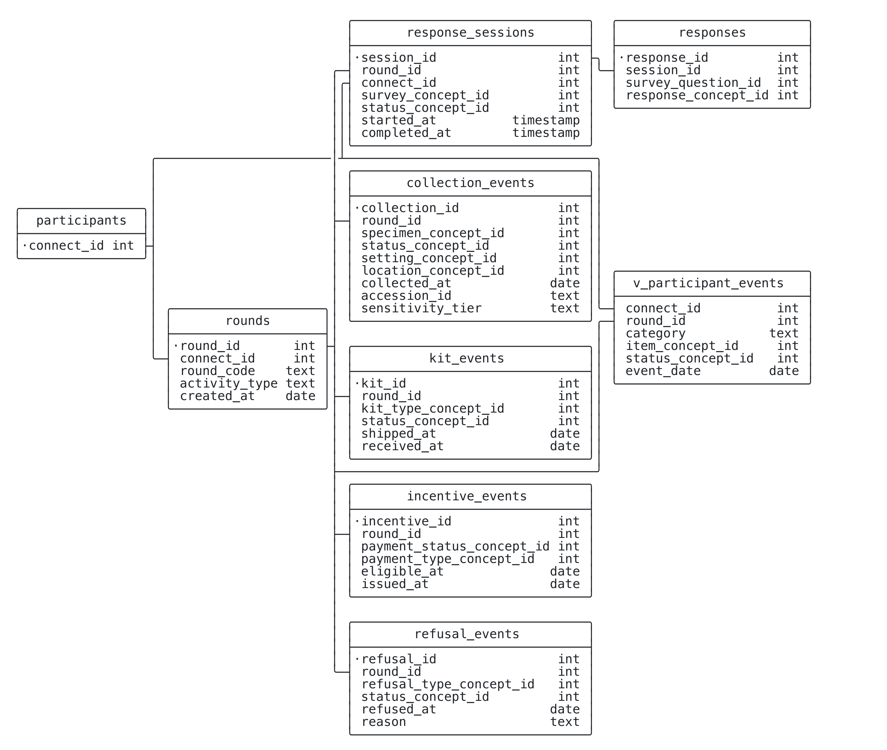
Draft: the reconciled event plane
Round = the encounter; surveys & events share it; concept-typed columns keep dictionary links
Separate per-type event facts + a unified view (the SMDB summary). DRAFT — pending DevOps confirmation of Round-as-encounter.
Notes:
Round hub (~ OMOP visit) off participants; response_sessions = DevOps 'surveys' table; collection/kit/incentive/refusal facts key on (connect_id, round); v_participant_events = SMDB unified view. See dbml/data_model_events.dbml.

Slide 13
Curated derived variables (dbt marts)
Define each research variable once — tested, governed, lineage to source
The payoff of "write analytics once": a canonical pack-years / BMI / risk score every researcher reuses — not re-derived per study.
Group | Example marts | Canonical derived variable
Behavioral | smoking · alcohol · physical_activity · diet | pack-years · MET-hours/week
Anthropometric | anthropometry | BMI (height + weight)
Host | reproductive_history · family_history · genetic_risk | parity · hereditary-risk flag · polygenic risk score
Clinical | medical_history · medications · screening_history | comorbidity index · regular aspirin use · up-to-date-with-screening
Environmental | environmental_exposures | Area Deprivation Index (from geocoded address)
Why dbt: model-level lineage to source · tests = contracts in CI · one-directional layer boundary · sensitivity tiers flow to marts (enforced in IAM).
Honest: derivation is real epi work (owner + sign-off per variable); marts are curated, not the only access — raw responses stay reachable.
Notes:
This is the analytics-marts enhancement (#8), downstream of the model via dbt. Pitch = highest-value case of the OMOP 'write analytics once' thesis: derived variables defined once, canonically, with lineage — vs. re-coded per study (the 3 pain repos). dbt features map to our principles: dbt docs DAG = lineage to source (#12); SQL is the definition (no black box, #12); source()/ref()+access enforce Core→Analytic→Marts (#8); tests move much of the 7,025-rule QC into CI; sensitivity_tier flows via meta, enforced in IAM (#11); model versions/exposures = a derived-variable catalog. Recommend one mart PER construct (grouped), not a wide mega-table. Grain: participant, or participant×wave for longitudinal. Examples map to established cancer-prevention exposure domains (WCRF/AICR). See CLAUDE.md — Derived variables, lineage & dbt / Mart catalog.

Slide 14
Same queries, two ways
From painful/impossible → routine
Standard query | Wide (today) | The model | With an enhancement
Multi-select distribution | unpivot + v1/v2 COALESCE | filtered group-by; versions pool | plain group-by / view
Labeled distribution, any question | bespoke CASE, no reuse | parameterized by concept_id | precomputed mart aggregate
Completion & true missingness | ambiguous | still ambiguous | sessions + skip_logic (#5/#4)
Non-PHI extract (governance) | manual allow-list | manual allow-list | sensitivity tier + IAM (#7)
Harmonized field across surveys | rebuild crosswalk (3 repos) | pool a reused concept | concept equivalence (#6)
The model fixes the loud, everyday pains; enhancements unlock missingness, governance & harmonization.
Notes:
Worked SQL for each row is in internal_pitch.md — Value proposition (Q1–Q5).

Slide 15
Analyzing long format (1/3) — labels are one join away
Every row says what it means: concept id + human label, side by side
-- one join attaches a label to every answer
SELECT connect_id, question_text,
response_concept_id, response_label, value
FROM responses
JOIN question USING (question_concept_id)
LEFT JOIN response USING (response_concept_id)
WHERE connect_id = 1001;
question_text | resp. id | response_label | value
Sex | 536341288 | Female
Age |  |  | 47
Smoking Status | 700000002 | Former
Education | 875342283 | Bachelor's Degree
Have you lost…teeth? | 812107266 | Yes, from accident or injury
Have you lost…teeth? | 452438775 | Yes, from tooth decay or disease
No decoder ring, no 2,360-column map — the dictionary travels with the data.
Notes:
Demo data is synthetic (sql/demo_long_format.sql, runs in DuckDB ~ BigQuery). The labels come from joining the dictionary; analysts never memorize concept ids. v_long packages this join so it's literally SELECT * FROM v_long.

Slide 16
Analyzing long format (2/3) — wide is one generic PIVOT away
Pick your tool — one line, and none of them name a single column
-- SQL (DuckDB) — column names come from the DATA, not from you
PIVOT (FROM v_long SELECT connect_id, question_text, answer
WHERE question_type <> 'multi_select')
ON question_text USING any_value(answer);
# Python (pandas)
long.pivot(index='connect_id', columns='question_text', values='answer')
# R (tidyr)
pivot_wider(long, id_cols=connect_id, names_from=question_text, values_from=answer)
connect_id | Age | Education | Sex | Smoking Status
1001 | 47 | Bachelor's Degree | Female | Former
1002 | 62 | High School Graduate or GED | Male | Current
1003 | 55 | Advanced Degree | Female | Never
1004 | 39 | Bachelor's Degree | Male | Never
1005 | 71 | High School Graduate or GED | Female | Former
Column names come from the data, not from you — add a question, get a new column. Wrap it once as get_wide(survey) and every team reuses it.
pandas & tidyr discover columns automatically; BigQuery's PIVOT lists the values (or generate them with dynamic SQL). `long` = the single-value answers.
Notes:
Reframed: the pivot is GENERIC and metadata-driven — no hardcoded column list (the opposite of a wide-table script). NOTE on completeness: DuckDB's PIVOT implicitly groups by every column not in ON/USING, so you must project to (id, name, value) first — that's the subquery shown; this exact statement runs. The fully-dynamic ON…USING form is DuckDB; BigQuery's PIVOT needs the value list (FOR question_text IN (...)) or dynamic SQL. pandas.pivot and tidyr::pivot_wider are fully dynamic and are what analysts already use. All three verified against sql/demo_long_format.sql (synthetic). Select-all is excluded (multi-valued → belongs in long, next slide). Parameterize by survey → a reusable get_wide() helper (tool built on the contract).

Slide 17
Analyzing long format (3/3) — counts are a simple GROUP BY
And select-all gets *easier*: one group-by, no summing 0/1 columns
-- how many selected each tooth-loss reason?
SELECT response_label, COUNT(*) AS n
FROM v_long
WHERE question_concept_id = 899251483
GROUP BY response_label
ORDER BY n DESC;
tooth_loss_reason | n
Yes, from tooth decay or disease | 2
Yes, from accident or injury | 2
Yes, for some other reason | 1
No, I haven't lost any teeth | 1
In wide, that means summing N ever-changing 0/1 indicator columns; in long it's the same group-by you'd write for any question.
Swap the concept id and the same one-liner counts smoking, education, anything — one pattern for every question.
Notes:
Counts are GROUP BY — often simpler than wide. Select-all is the standout: wide makes you know and sum a changing set of indicator columns; long is one group-by on response_label. Same query shape works for every question by swapping the concept id (e.g. Smoking Status -> Never 2 / Former 2 / Current 1).

Slide 18
Recommendation
• The Dictionary-Direct model is accepted — stand it up (low cost, low risk, immediately useful)
• Adopt enhancements incrementally — prioritize governance (#7, gates external sharing) and dbt analytics marts (#8, most researcher value)
The model is the accepted foundation. Enhancements make it the governed, shareable product PR2 needs.
Notes:
Ask: stand up the accepted model now; adopt enhancements incrementally (esp. governance #7 and dbt marts #8); consider pulling the concept-equivalence enhancement forward (geocoding). See internal_pitch.md — Recommendation.

