Slide 1
Framework for Automated Quality Checks
Leveraging Configurable Parameters and ADF Pipelines for Robust Quality Assurance

Slide 2
Objective
• Create a robust framework for performing automated quality checks on tables.
• Use configurable parameters and ADF pipelines to execute stored procedures based on defined checks.

Slide 3
Framework Overview
• Config Table: Centralized configuration table to define quality checks and stored procedures.
• Stored Procedures (SPs): Modular SPs for different types of quality checks.
• ADF Pipelines: Trigger SPs dynamically based on parameters (e.g., object name, check name).

Slide 4
Config Table Structure
• CheckType: Type of quality check (e.g., column count, comment matching, duplicate checks).
• ProcedureName: Stored procedure to perform the check.
• OptionalParams: Optional parameters for specific checks.
Example Schema:
| CheckType | ProcedureName | OptionalParams |
|--------------------|------------------------|------------------------------|
| Column Count Check | sp_check_column_count | {column_name: 'ID'} |
| Comment Check | sp_check_comment_match | {comment: 'description'} |
| Duplicate Check | sp_check_duplicates | {primary_key: 'ID'} |

Slide 5
Stored Procedures (SPs)
• Column Count Check: Ensures the expected number of columns in a table matches the configuration.
• Comment Match Check: Compares database comments with documented comments.
• Duplicate Check: Validates uniqueness of primary or surrogate keys.

Slide 6
ADF Pipeline Design
• Input Parameters:
- Object Name (mandatory).
- Optional Check Name (e.g., column count, comment match, duplicate check).
• Pipeline Logic:
- Query the config table stored in ADLS.
- Fetch the corresponding stored procedure based on the check name.
- Dynamically execute the selected stored procedure.

Slide 7
Data Flow from ADLS to ADF
• Config Table in ADLS: Stored in structured format (JSON, CSV, or Parquet).
• ADF Pipeline: Reads the Config Table and triggers the respective stored procedure based on parameters.

Slide 8
Benefits of the Framework
• Scalable & Flexible: Add new checks by updating the config table.
• Modular Architecture: Each check is handled by a separate stored procedure.
• Dynamic Execution: ADF pipeline executes SPs dynamically.
• No Code Changes in ADF Pipeline: Add new checks without modifying the pipeline.
• Automation & Efficiency: Reduces manual effort and improves efficiency.
• Consistency Across Teams: Ensures uniform quality checks across departments.

Slide 9
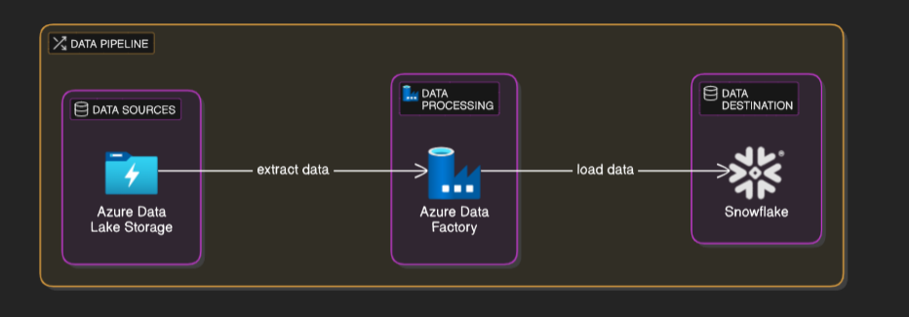
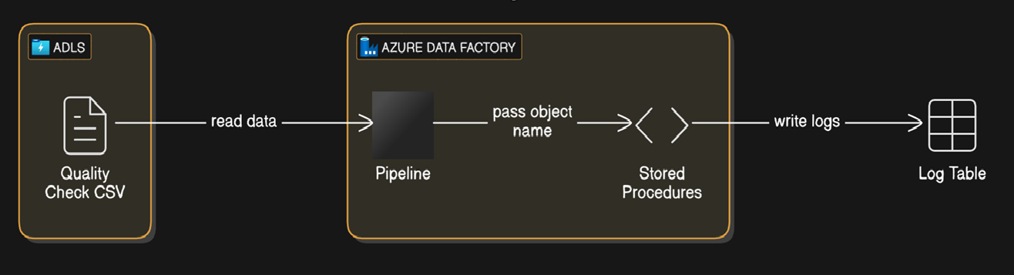
High-Level Diagram

Slide 10
Next Steps
• Develop Stored Procedures: Create and test SPs for various quality checks.
1
• Create Config Table: Define checks and corresponding SPs; store in ADLS.
2
• Implement ADF Pipeline: Set up the pipeline to trigger SPs dynamically.
3
• Testing and Validation: Test the framework with different input scenarios.
4

Slide 11
Conclusion
• The framework enables flexibility, scalability, and automation.
• Centralized configuration and dynamic execution simplify maintenance.
• Effortlessly expand and maintain quality checks without pipeline code changes.

Slide 12
Questions & Answers

