Slide 1

Starbucks Sales Analysis Dashboard
A Data Visualization Project using Microsoft Power BI
Presented by: Mamata Rajaram Sawant
Dashboard Based on Sample Sales Data

Slide 2
Project Objective
Analyze Starbucks sales data using Power BI
Analyze product categories and regional trends
Understand customer preferences and payment trends

Slide 3
Tools & Skills Used
Tools: Power BI, Excel
Skills: Data Cleaning & Transformation using Power Query Editor
Data Source: Starbucks Sales Excel Dataset(approx. 1000 rows)

Slide 4
Dataset Overview
Column Name | Description
Store_ID | Unique ID for each Starbucks store
City | City where store is located
State | State location of the store
Size | Product size (Tall, Grande, etc.)
Category | Product type (Hot, Cold, Blended)
Quantity | Quantity sold
Price | Price per unit
Total_Sales | Total revenue for that record
Payment_Mode | Type of payment (Cash, Card, UPI, etc.)
Date | Transaction date

Slide 5
Data Cleaning & Preparation
Steps Taken in Power Query:
Opened raw dataset in Power Query Editor
Replaced null values in Quantity and Price columns with 0
Changed data types:
Date (column) ➝ Date(data type)
Quantity, Price, Total_Sales ➝ Whole Number / Decimal
Renamed columns for clarity (e.g., Cat ➝ Category, PM ➝ Payment_Mode)
Removed duplicates

Slide 6
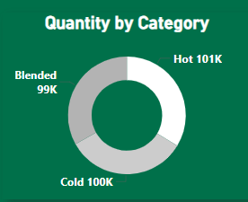
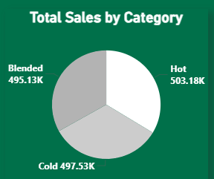
Dashboard Overview – Category Insights
Products are categorized into Blended, Cold, and Hot.
All three categories show equal total sales, suggesting uniform demand.
Donut chart confirms equal quantity distribution, helping with balanced stocking.
This helps Starbucks ensure consistent inventory across categories.

Slide 7
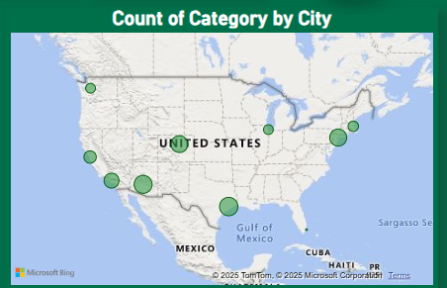
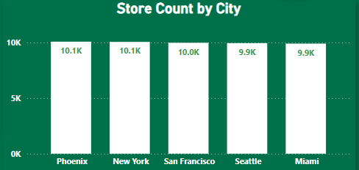
Dashboard – Regional Insights
Phoenix, New York, and San Francisco have the highest store counts.
Geographic distribution shows balanced category spread across major U.S. cities.
Starbucks can use this to evaluate regional growth opportunities.

Slide 8
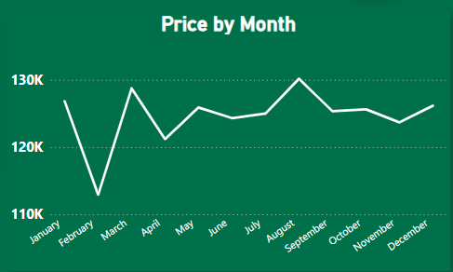
Dashboard – Time & Price Trends
Price peaks in March and August, suggesting potential seasonal demand or pricing strategy.
Relatively steady pricing in the second half indicates pricing stability.

Slide 9
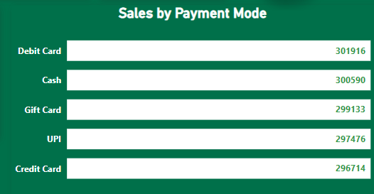
Dashboard – Customer Preferences
Debit Cards are the most used payment method, generating over 301K in sales.
Cash and Gift Cards follow closely, showing strong adoption of both traditional and digital modes.
UPI and Credit Card usage are slightly lower but still comparable, each contributing nearly 300K.
This reflects that Starbucks offers a diverse and flexible payment system, accommodating all customer preferences.

Slide 10
Conclusion & Learnings
Key Insights from the Dashboard:
Sales are balanced across product categories and payment modes.
Phoenix, New York, and San Francisco lead in store presence.
March and August show pricing peaks — hinting at seasonal trends.
What I Learned:
Cleaned and transformed data using Power Query Editor
Created visual reports using Power BI
Designed a user-friendly, branded dashboard
Derived meaningful insights from raw sales data

Slide 11
Thank You
I hope you found the Starbucks Sales Dashboard insightful.
Feel free to connect or ask any questions!
🔗 LinkedIn: linkedin.com/in/mamata-sawant-87330b2a6

Slide 12
