Slide 1
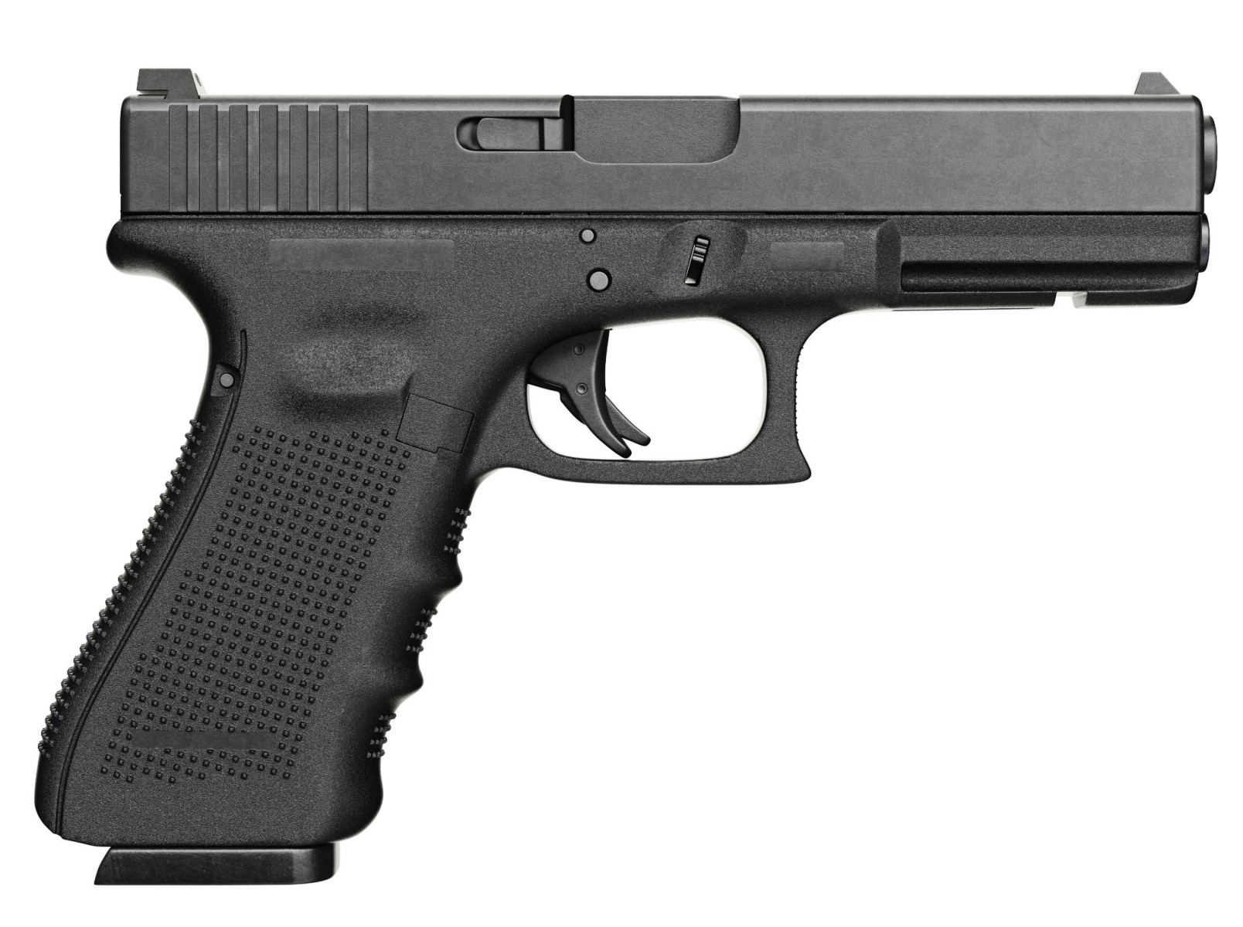
GUN DEATHS in AMERICA
STUDY DONE BY
Eltahir Gotar
Aaron Snytka
Rene Martinez

Slide 2

PROBLEM: Is There A Correlation Between GUN LAWS AND GUN RELATED DEATHS
U.S. STATES INCLUDED FOR STUDY :
TEXAS POPULATION COUNT
1999 - 20558220
2017 - 28304596
CALIFORNIA POPULATION COUNT
1999- 33499204
2017 - 39536653

Slide 3

ANALYSIS: NULL HYPOTHESIS (H₀)
STATES WITH INCREASED GUN LAWS WILL HAVE A DECREASED INCIDENCE OF GUN DEATHS

Slide 4

ANALYSIS: ALTERNATIVE HYPOTHESIS (H₁)
STATES WITH DECREASED GUN LAWS WILL NOT HAVE AN INCREASED INCIDENCE OF GUN DEATHS

Slide 5
WE WANT TO EXAMINE THE ONGOING DEBATE SURROUNDING GUN DEATHS
IS THERE A RELATIONSHIP BETWEEN GUN LAWS AND GUN RELATED DEATHS ?
IS IT NECESSARY TO HAVE ANY GUN LAWS TO CURB THE NUMBER OF GUN RELATED DEATHS ?
THE PURPOSE OF OUR STUDY IS TO DETERMINE IF THERE IS MERIT TO THE IDEA THAT STRICTER GUN LAWS REDUCES GUN DEATHS.
WE USED TEXAS AND CALIFORNIA AS STUDY MODELS DUE TO THEIR LARGE POPULATIONS AS WELL AS THE STATES OBLIGED AND NON-OBLIGED GUN LAWS.

Slide 6
THE RESULTS OF OUR FINDINGS DETERMINED TEXAS WITH NON-OBLIGED GUN LAWS RESULTED IN SLIGHT INCREASED GUN DEATHS THROUGH OUT THE TIME RANGE IN OUR STUDY
THE RESULTS OF OUR FINDINGS DETERMINED CALIFORNIA WITH OBLIGED GUN LAWS RESULTED IN SLIGHT DECREASED GUN DEATHS THROUGH OUT THE TIME RANGE IN OUR STUDY
WE ARE PARTIALLY SATISFIED WITH OUR FINDINGS BECAUSE OUR RESULTS CORROBORATED WITH OUR HYPOTHESIS

Slide 7
FACETS USED WERE POPULATION SIZE AND GUN RELATED DEATHS
STATISICAL DATA OBTAINED FROM THE CDC, CENSUS BUREAU, OPENDATASOFT, KAGGLE, GOOGLE MAPS, http://everytownresearch.org/
DATASETS WERE PROVIDED FROM MULTIPLE SOURCES AS CSV AND API FILES

Slide 8

DATA CLEAN UP
DAILY ONLINE SEARCHES FOR DATASETS AND DATABASES IN CSV AND API
WE USED PYTHON/PANDAS LIBRARIES TO CLEAN UP DATA BY EXTRACTING DATASETS FOR TEXAS AND CALIFORNIA.
OBTAINING API KEYS FROM WEBSITES, FINDING ENOUGH DATA, AND COMBINNG DATA FROM MULTIPLE SOURCES INTO ONE DATASET

Slide 9

ANALYSIS: METHODS
PANDAS
PYTHON
API
CSV
SIMPLE STATS
LINEAR REGESSION
T-TEST
CHISQUARE

Slide 10

ANALYSIS: CONCLUSTIONS

Slide 11
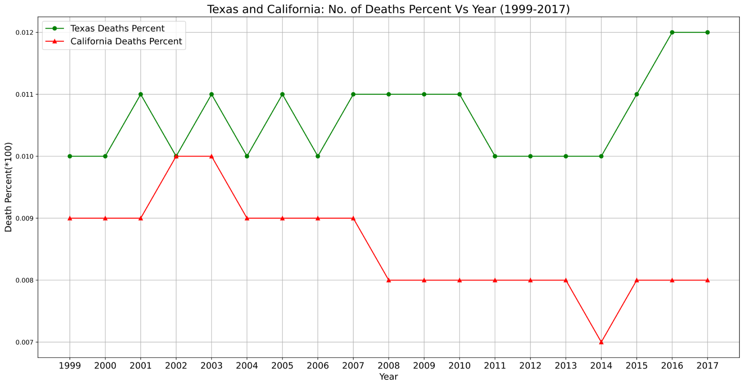
st.ttest_ind(cal_file_df [’Total Gun Laws’], cal_file_df [‘Deaths Percent’], equal_var=False)

Slide 12
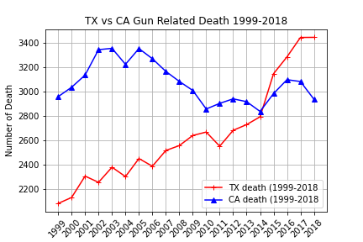
TEXAS vs CALIFORNIA

Slide 13
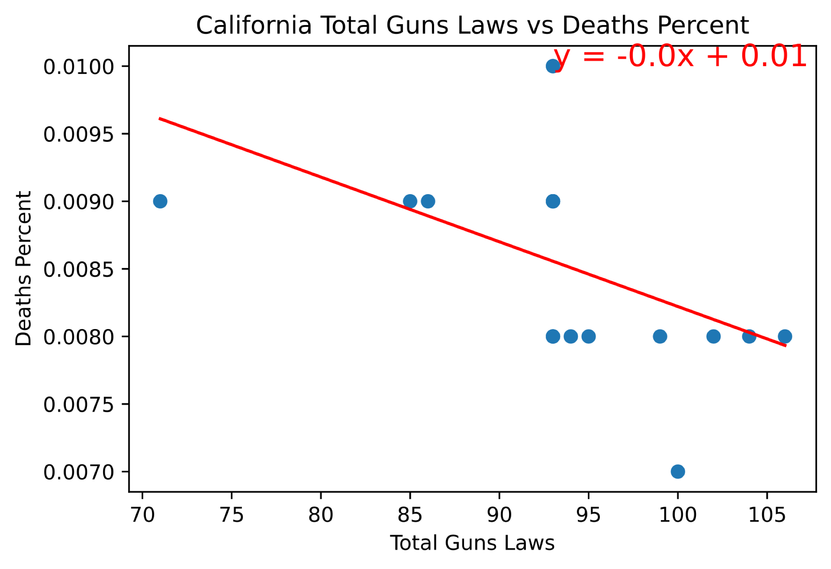
st.ttest_ind(cal_file_df [’Total Gun Laws’], cal_file_df [’Deaths Percent’], equal_var= False) Ttest_indResult(statistic=53.42126153130487, pvalue=2.7766780951025074e-21) st.chisquare(cal_file_df [’Total Gun Laws’], cal_file_df [‘Deaths Percent'], equal_var= False) Power_divergenceResult(statistic=19941605.2572381, pvalue=0.0)

Slide 14
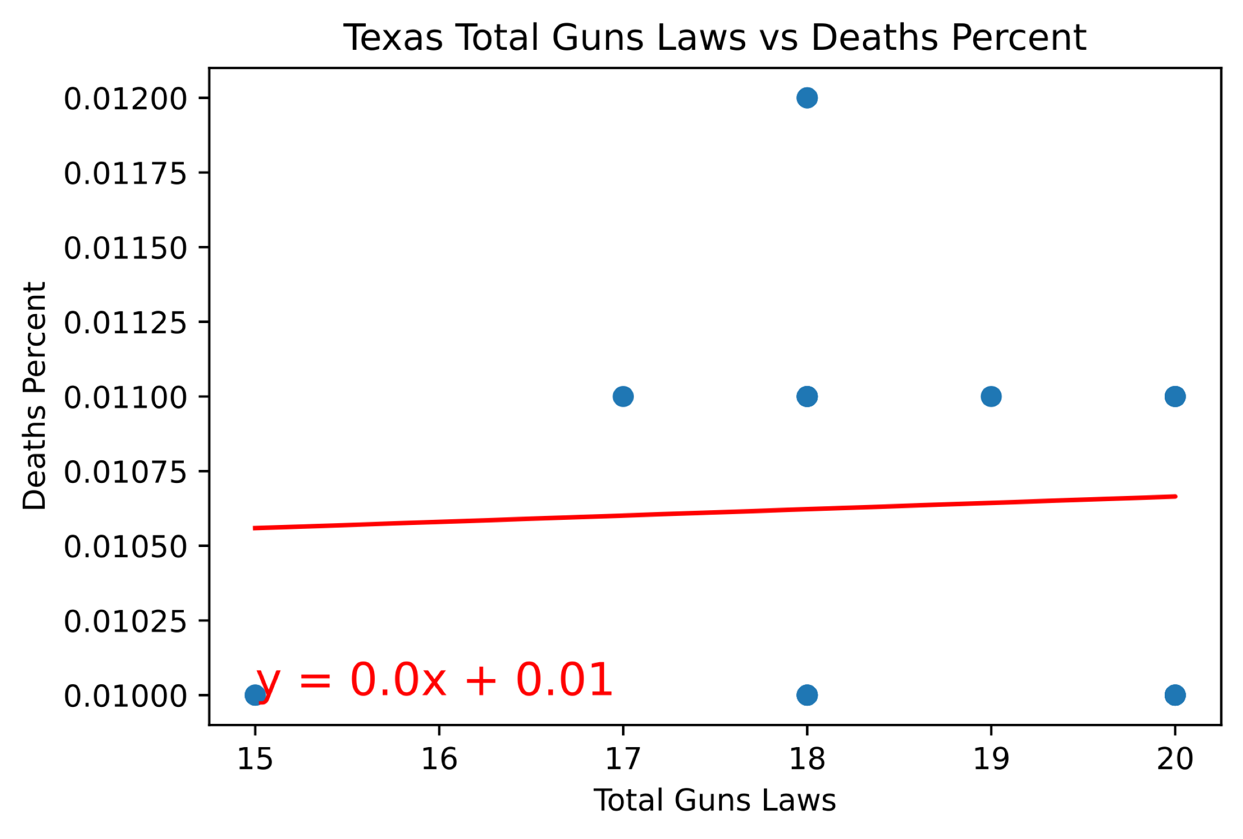
st.ttest_ind(tex_file_df [’Total Gun Laws’], tex_file_df [‘Deaths Percent’], equal_var=False) Ttest_indResult(statistic=50.9630730042901, pvalue=6.448738792320535e-21) st.chisquare(tex_file_df [’Total Gun Laws’], tex_file_df [‘Deaths Percent’], equal_var=False) Power_divergenceResult(statistic=612045.6565454545, pvalue=0.0)

Slide 15
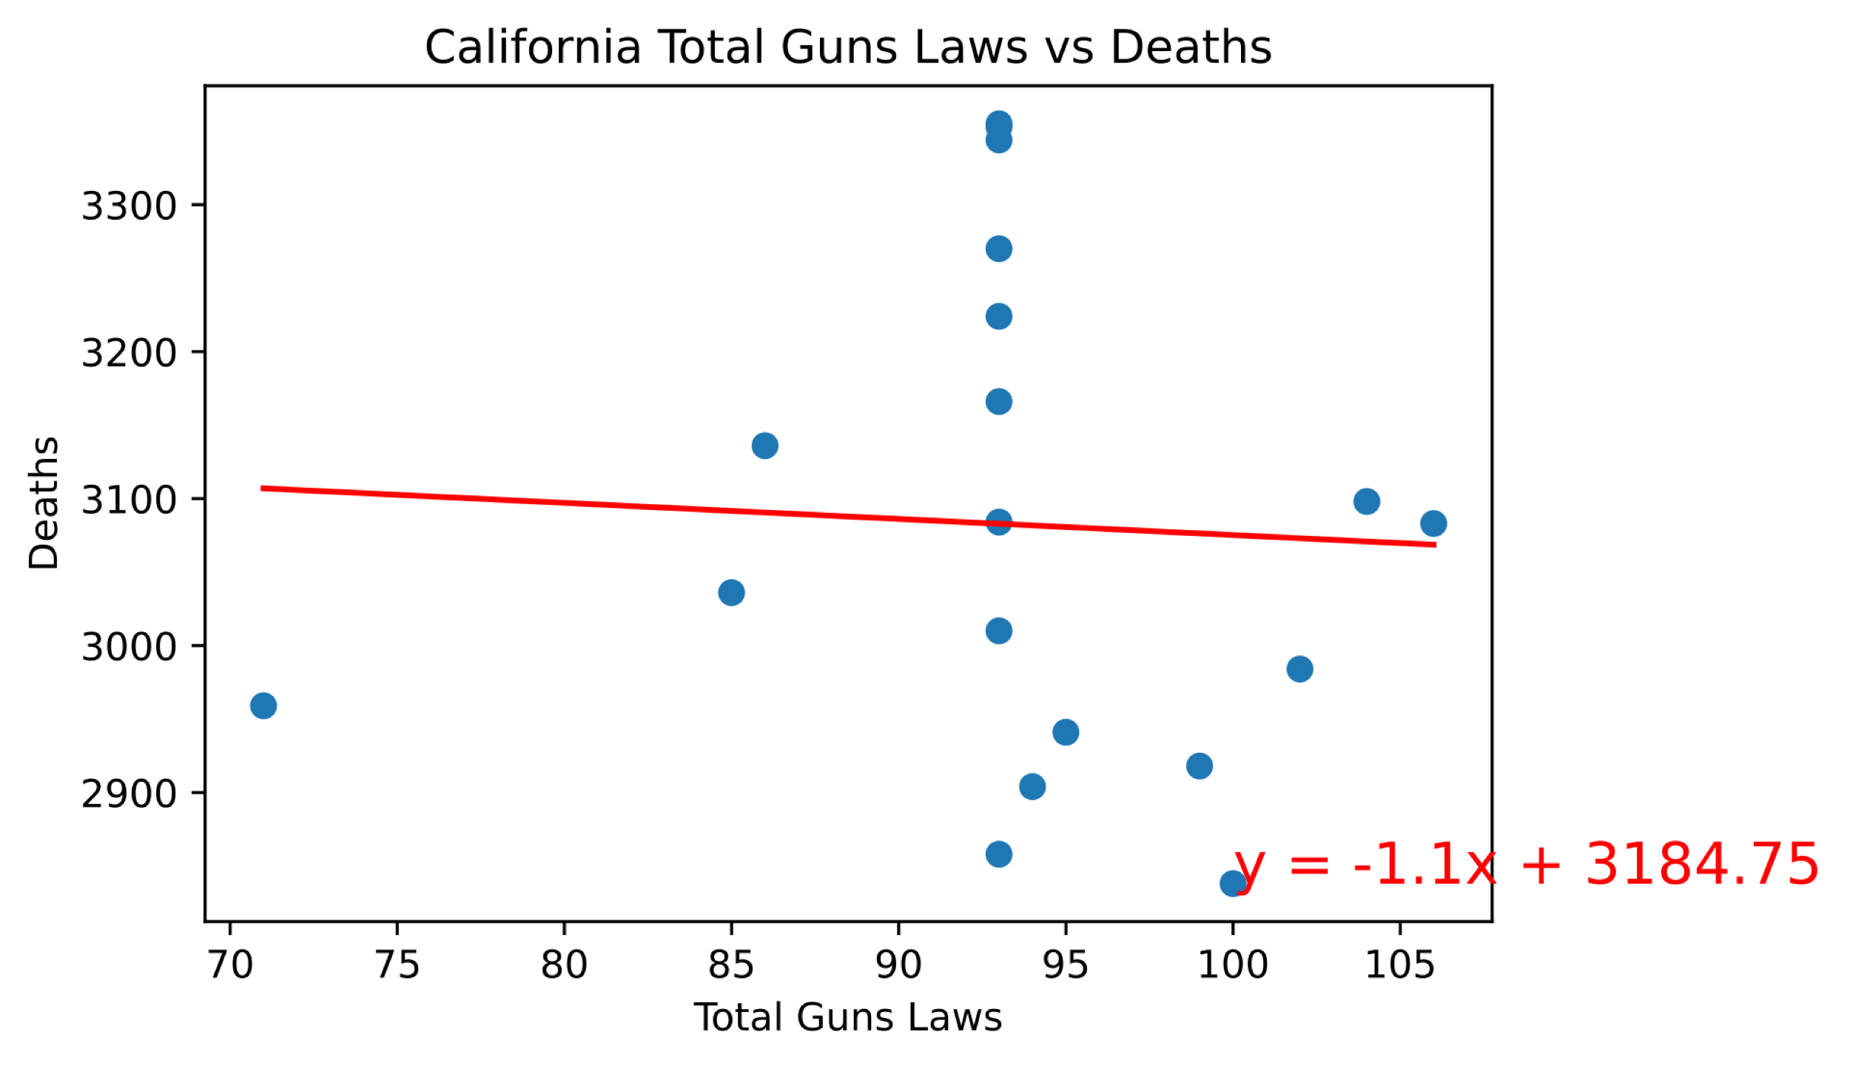
LINEAR REGRESSION

Slide 16
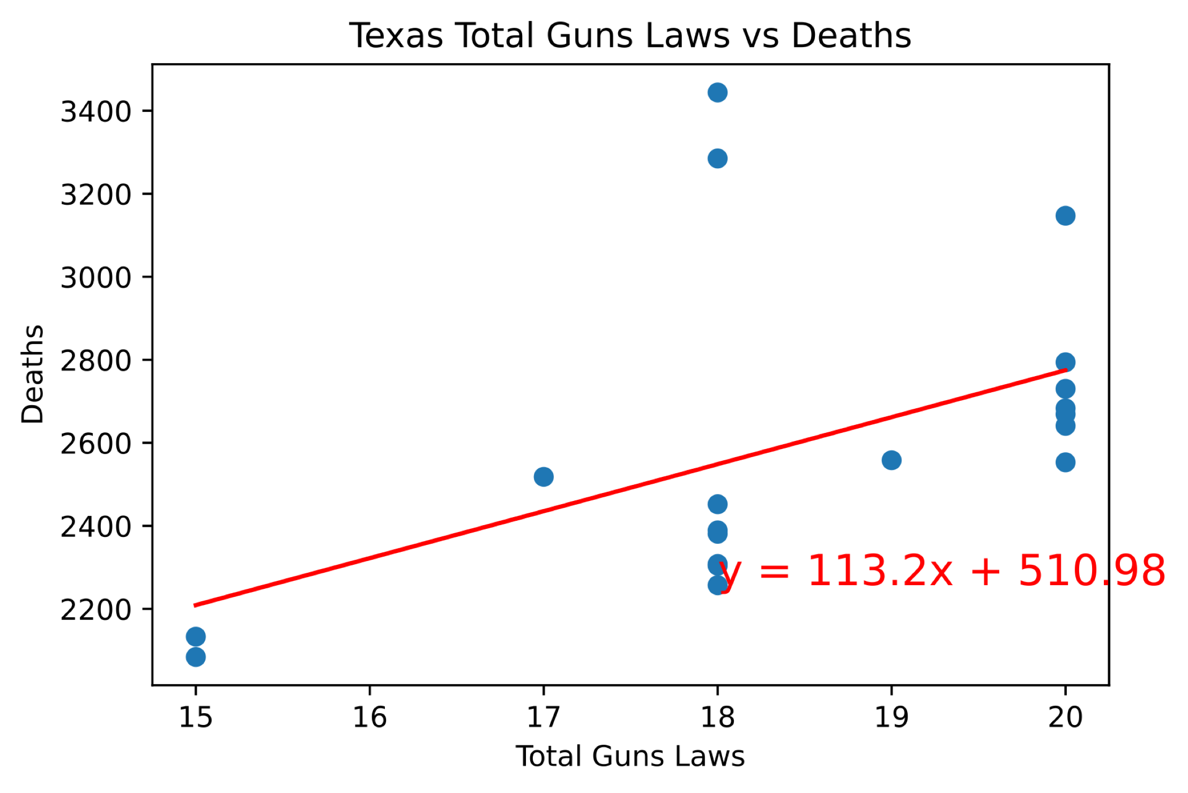
LINEAR REGRESSION

Slide 17
DISCUSSION
OVERALL OUR FINDINGS INDICATED THAT INCREASED GUN LAWS SLIGHTLY CORRELATED WITH DECREASED GUN RELATED DEATHS
TEXAS WITH NON-OBLIGED LAWS
CALIFORNIA OBLIGED LAWS

Slide 18

CHALLENGES
DIFFICULTY LOCATING DATA SETS
WE HAD TO PULL FROM MULTIPLE SOURCES TO GATHER ENOUGH COMPUTABLE INFORMATION
WE HAD DIFFICULTY ABSTRACING DATA DUE TO LIMITS
AQUIRING API KEYS

Slide 19
FURTHER ANALYSIS
FOR CONTINED ANALYIS IF WE HAD MORE TIME, WE WOULD LOOK AT THE ENTIRE U.S. AND USE TEXAS AND CALIFORNIA AS SAMPLE POPULATIONS TO DETERMINE IF THEY ARE REPRESENTATIVE OF THE REMAINING U.S. POPULATION

Slide 20

OPEN FLOOR Q&A

