Slide 1


ChatService
Developing a Real-Time Chat Application
Author: Anamaria Onetiu

Slide 2






ChatService - Developing a Real-Time Chat Application
Project Goal
Demonstration
Solution Strategy
Agenda
SW Architecture
Technologies & Tools
Pros & Cons

Slide 3


ChatService - Developing a Real-Time Chat Application
Goal
receive: Hi!
send: Hello!
receive: Hi!
receive: Hello!
send: Hi!
receive: Hello!

Slide 4




ChatService - Developing a Real-Time Chat Application
Solution Strategy
Requirements analysis
Technology
evaluation
Development
approach
Time & Resource planning
System/SW Architecture
Notes:
“Before diving into code, I took time to understand the scope and constraints, including the time limit, runtime environment, and intended use case. I then evaluated which technologies would offer the best trade-off between control, simplicity, and performance. The final solution follows a modular client-server architecture, balancing robustness, extensibility, and ease of use — all within a manageable time frame.”
1. Initial Requirement Analysis
Interpreted the assessment to extract clear functional and non-functional goals
Identified key system behaviors: connection handling, message flow, real-time updates
Clarified boundaries of scope to keep the solution focused and achievable
2. Resource & Time Constraints Consideration
Considered the 8-hour development window and terminal-based context
Chose a simple, scalable architecture that avoids over-engineering
Selected approaches that require no external dependencies or UI frameworks
3. Technology Evaluation & Decision-Making
Chose C++ for full control over system resources and socket-level communication
Decided on multithreading over multiprocessing for efficient concurrency
Avoided heavyweight frameworks to stay portable and minimize setup
4. System Architecture Planning
Designed a client-server model with the server as the central message broker
Used a thread-per-client strategy for isolation and responsiveness
Shared resources (like the client list) protected by mutexes for safety
5. Development Approach
Built separate modules for client, server, and shared functionality
Used modular utilities for config, timestamping, and signal handling
Prioritized clean shutdown behavior and fault tolerance

Slide 5
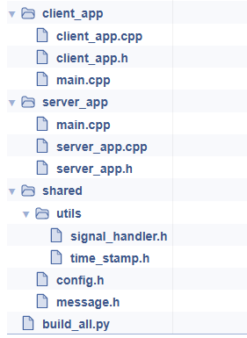

ChatService - Developing a Real-Time Chat Application
SW Architecture – OVERVIEW
server_app
shared utilities
client_app
Notes:
The architecture is cleanly divided into three main components: 🔹 The server_app — which handles all client connections, manages messaging, and ensures communication across multiple clients. 🔹 The client_app — responsible for user interaction, sending messages to the server, and receiving messages from other users via the server. 🔹 The shared utilities — a common module that holds reusable functionality like configuration constants, signal handling logic, and timestamp utilities.
This design reflects a modular approach, which significantly improves maintainability, readability, and testability. Each component has a clear, well-defined responsibility and interacts with the others through simple, predictable interfaces.
This modular separation also allows us to easily extend or enhance parts of the application in the future — for instance, adding encryption, a database layer, or authentication — without disrupting the rest of the system.
On the right-hand side, you can see the physical folder structure of our project. It reflects this logical separation directly in the file organization. Each folder groups related code, and shared components are abstracted into a common shared directory, enabling code reuse and consistency.
This organization and architecture align with software engineering best practices, even for a terminal-based prototype, and it makes our system both robust and scalable.”

Slide 6
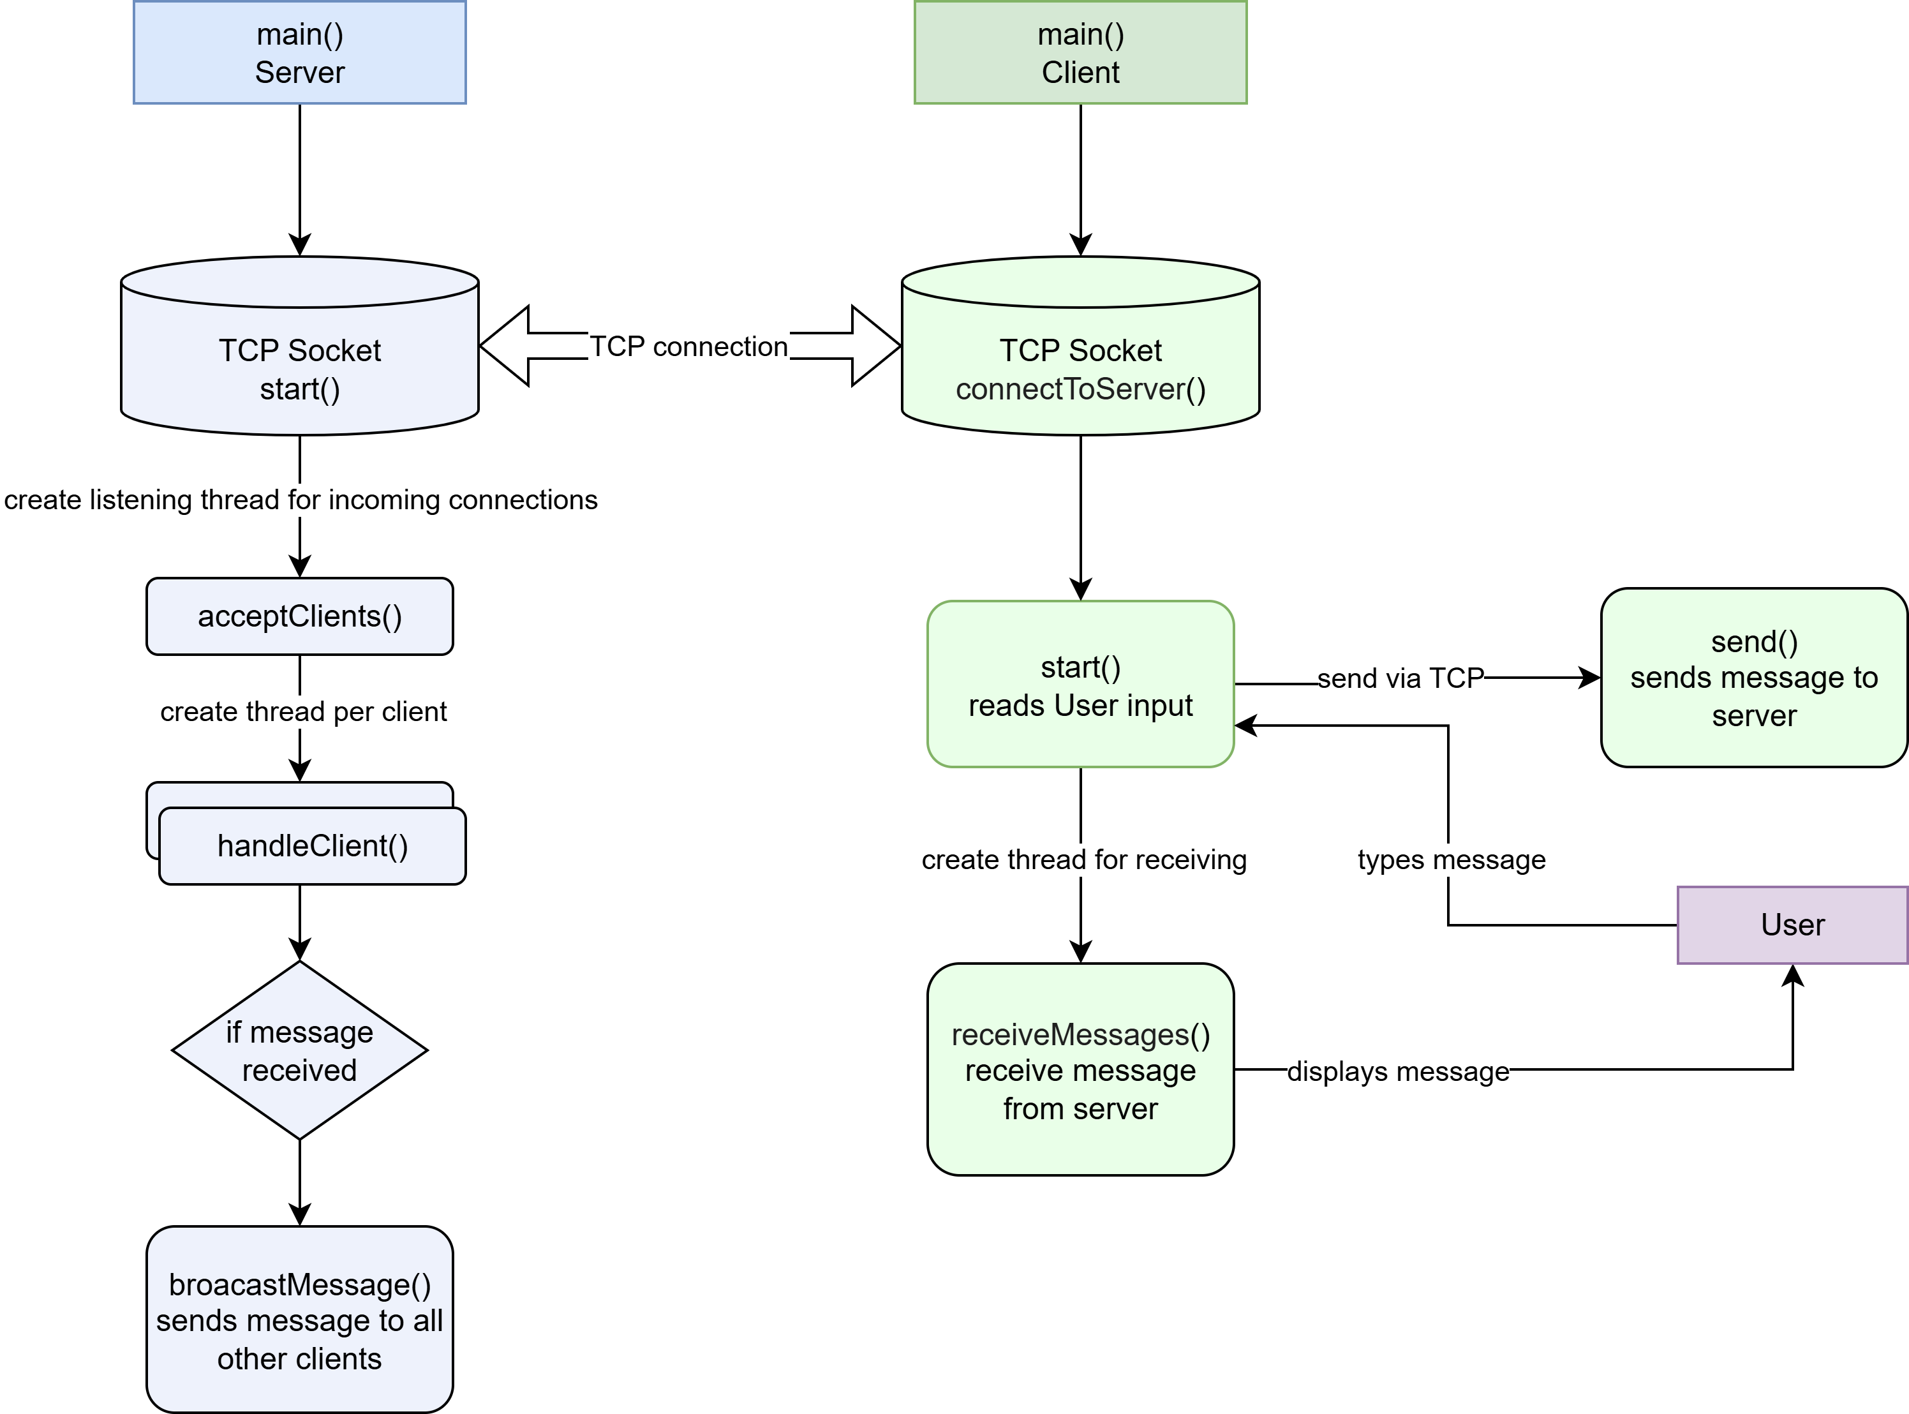
ChatService - Developing a Real-Time Chat Application
SW Architecture – ACTION FLOW
Create listening socket
Bind + listen on port
Start accept thread
Wait for client connections
On new connection:
Add to client list
Launch thread to handle new client
Loop: receive <-> broadcast to others
Admin command thread:
/list → print client list | /exit → stop server
Connect to server (IP + port)
Bind + listen on port
Start receiver thread:
Loop: receive -> print to terminal
Main thread: read user input
/quit -> shutdown
message -> send to server
Notes:
Software Architecture
The system has two standalone C++ programs: server_app and client_app.
Server (server_app)
Creates a TCP socket.
Binds to a port, listens for incoming connections.
Accepts clients using accept().
For every client, starts a new thread.
Each thread reads messages using recv().
Messages are forwarded to all other clients using send().
Messages are handled as raw strings.
No parsing, no object serialization, no Message struct usage.
Maintains a list of client socket file descriptors.
Client (client_app)
Connects to the server using connect().
Starts two threads:
One reads user input from stdin, sends it to the server via send().
One waits for messages from the server via recv() and prints them to stdout.
Messages are displayed exactly as received.
User input and display are handled in the terminal.

Slide 7


ChatService - Developing a Real-Time Chat Application
Advantages and disadvantages
Simple Design
No GUI
Modular Structure
No Authentication
PROS
CONS
Signal handling
No Encryption
Supports command line arguments
No message history
Notes:
"Another benefit is that both the client and server can be configured at runtime using command-line arguments. This makes it flexible to deploy in different environments — whether you're running locally, through a VPN, or on another network."

Slide 8













ChatService - Developing a Real-Time Chat Application
Technologies and Tools
Infrastructure
Programing Languages
Linux VM Ubuntu (headless/no GUI)
Tailscale for network integration and connection
C++ 17/20 – Core development language
Python – Build automation script
Development tools
C++ Core Technologies
VSCode – development environment
CMake – Build system and project management
SSH – Remote development on Linux VM
Git/GtHub – Version control and commits
POSIX Sockets – Network communication(TCP)
std::thread – Multi-threaded server and client loops
std::mutex, std::atomic - for safe thread access
Signal Handling – SIGINT handler for graceful shutdown

Slide 9
ChatService - Developing a Real-Time Chat Application
THALES COLLEAGUE#2
receive: Thank You!
receive: Thank You!
THALES COLLEAGUE #..n
receive: Thank You!
THALES COLLEAGUE#1
send: Thank You!
ANAMARIA

Slide 10
ChatService - Developing a Real-Time Chat Application
Requirements
Terminal based chat service
CLIENT APPLICATION
SERVER APPLICATION
runnable on a computer or laptop
development language of your choice (C++)
client application executed multiple times
server application is executed once and remains running
client must connect automatically or via user input
system should shut down gracefully when interrupted (e.g., Ctrl+C)
code should be modular and maintainable
avoid crashing on unexpected disconnects or errors
Allow users to write and send text messages to the server
Automatically or manually connect to the server
Display messages received from the server
Support the /quit command to disconnect
Accept incoming client connections
Support client disconnection
Receive messages from clients
Broadcast each message to all other connected clients
Handle admin commands like /list (show connected clients) and /exit (shut down)
FUNCTIONAL REQUIREMENTS
NON-FUNCTIONAL REQUIREMENTS
Notes:
Develop a terminal-based chat service consisting of a server and multiple clients, enabling users to exchange real-time text messages over a TCP connection. The system should be platform-independent, written in a programming language of choice (C++ in this case), and suitable for execution on standard desktop or laptop computers.
“The original goal was to develop a simple, platform-independent chat service using a client-server model. I began by extracting the core functional requirements directly from the assessment: real-time messaging, client-server communication, and message broadcasting. Beyond that, I introduced some non-functional improvements — like signal handling and reusable utilities — to increase the reliability and maintainability of the system without changing the fundamental behavior.

