Slide 1
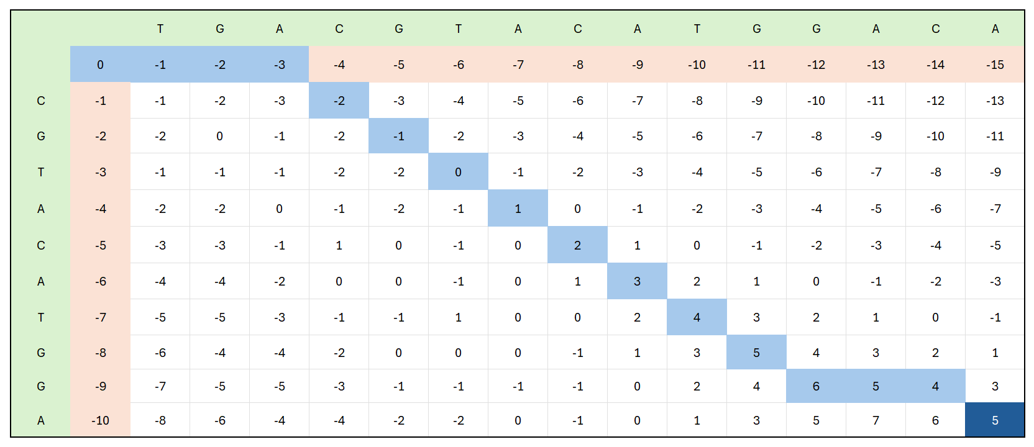

Slide 2
SLJEDEĆI SLAJD JE POLU -GLOBALNO PORAVNANJE m = 2 n = -2 g = -2

Slide 3

 |  | A | C | G | T | A | C | G | A | C
 | 0 | 0 | 0 | 0 | 0 | 0 | 0 | 0 | 0 | 0
T | 0 | -2 | -2 | -2 | 2 | 0 | -2 | -2 | -2 | -2
C | 0 | -2 | 0 | -2 | 0 | 0 | 2 | 0 | -2 | 0
G | 0 | -2 | -2 | 2 | 0 | -2 | 0 | 4 | 2 | 0
T | 0 | -2 | -4 | 0 | 4 | 2 | 0 | 2 | 2 | 0
A | 0 | 2 | 0 | -2 | 2 | 6 | 4 | 2 | 4 | 2
A | 0 | 2 | 0 | -2 | 0 | 4 | 4 | 2 | 4 | 2
G | 0 | 0 | 0 | 2 | 0 | 2 | 2 | 6 | 4 | 2
A | 0 | 2 | 0 | 0 | 0 | 2 | 0 | 4 | 8 | 6

Slide 4
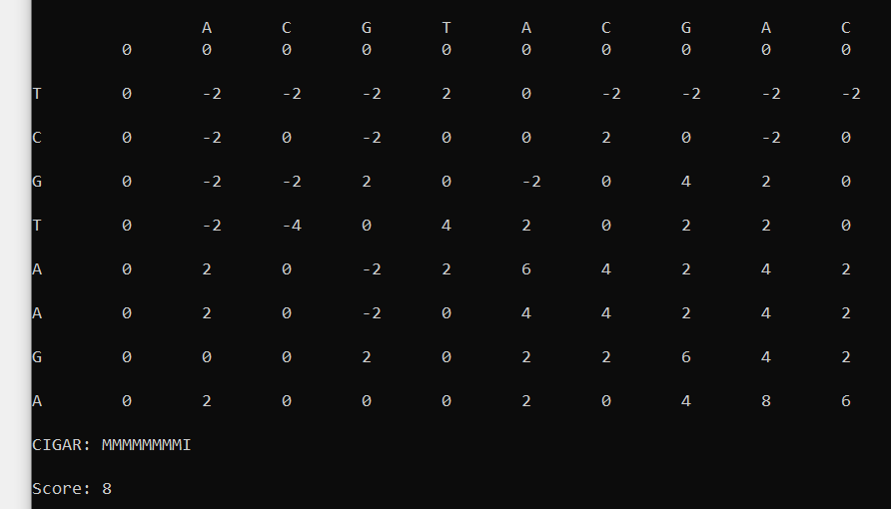
M M M M M M M M I
A C G T A C G A C T C G T A A G A -

Slide 5
SLJEDEĆI SLAJD JE GLOBALNO PORAVNANJE m = 2 n = -2 g = -2

Slide 6
 |  | A | C | G | T | A | C | G | A | C
 | 0 | -2 | -4 | -6 | -8 | -10 | -12 | -14 | -16 | -18
T | -2 | -2 | -4 | -6 | -4 | -6 | -8 | -10 | -12 | -14
A | -4 | 0 | -2 | -4 | -6 | -2 | -4 | -6 | -8 | -10
C | -6 | -2 | 2 | 0 | -2 | -4 | 0 | -2 | -4 | -6
G | -8 | -4 | 0 | 4 | 2 | 0 | -2 | 2 | 0 | -2
A | -10 | -6 | -2 | 2 | 2 | 4 | 2 | 0 | 4 | 2
T | -12 | -8 | -4 | 0 | 4 | 2 | 2 | 0 | 2 | 2
G | -14 | -10 | -6 | -2 | 2 | 2 | 0 | 4 | 2 | 0

Slide 7
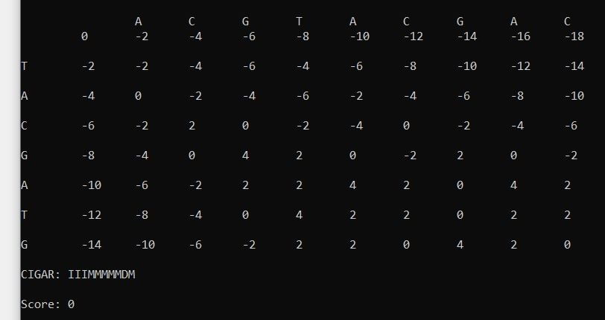
I I I M M M M M D M ACG T A C G A - C - - - T A C G A T G

Slide 8
SLJEDEĆI SLAJD JE LOKALNO PORAVNANJE m = 2 n = -2 g = -2

Slide 9
 |  | A | C | G | T | A | C | G | A | C
 | 0 | 0 | 0 | 0 | 0 | 0 | 0 | 0 | 0 | 0
T | 0 | 0 | 0 | 0 | 2 | 0 | 0 | 0 | 0 | 0
T | 0 | 0 | 0 | 0 | 2 | 0 | 0 | 0 | 0 | 0
A | 0 | 2 | 0 | 0 | 0 | 4 | 2 | 0 | 2 | 0
C | 0 | 0 | 4 | 2 | 0 | 2 | 6 | 4 | 2 | 4
A | 0 | 2 | 2 | 2 | 0 | 2 | 4 | 4 | 6 | 4
C | 0 | 0 | 4 | 2 | 0 | 0 | 4 | 2 | 4 | 8

Slide 10
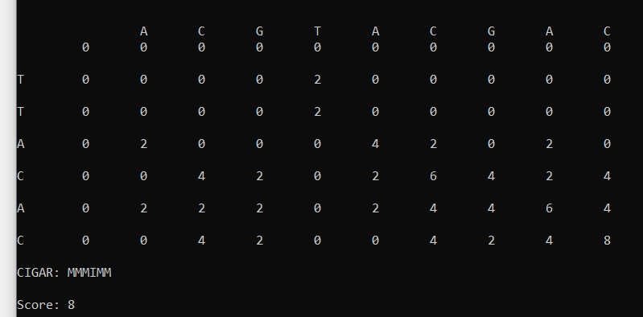
M M M I M M ACG T A C G A C T T A C - A C

