Slide 1

Trivy - security scanner
For identifing vulnerabilities, misconfigurations, secrets, and software licenses in container
A Presentation by
Aditya Pratap Singh – 16010123025
Anamay Narkar – 16010123040
Vraj Soni - 16010122309

Slide 2
Problem Definition
Modern software development relies heavily on third-party libraries, container images, and Infrastructure-as-Code (IaC). This introduces several security risks:
Vulnerability Sprawl: Developers often use outdated or "buggy" dependencies (CVEs) without knowing it.
Misconfigurations: Incorrectly set up Kubernets manifests or Dockerfiles (e.g., running as root) create easy entry points for attackers.
Secret Leaks: Hardcoded API keys, tokens, or passwords accidentally committed to code repositories.
Manual Bottlenecks: Traditional security audits are too slow for fast-paced DevOps cycles.

Slide 3
Introduction of Trivy
Trivy (developed by Aqua Security) is a comprehensive, multi-purpose security scanner.
Core Purpose: To provide a single tool that can scan everything from a local filesystem to a cloud-native Kubernetes cluster.
Philosophy: It is designed to be stateless and easy to use, it doesn’t require a complex database setup or a long installation process.
Ecosystem: It is the default scanner for major platforms like Harbor, GitLab, and Artifact Hub.

Slide 4
Features & Functionalities
Trivy is a "Swiss Army Knife" for security. Its main scanners include:
Vulnerability Scanning: Detects known vulnerabilities (CVEs) in OS packages (Alpine, Ubuntu, etc.) and application dependencies (Python, Go, Java, etc.).
Misconfiguration Scanning (IaC): Scans Terraform, Dockerfile, Kubernetes, and CloudFormation for security best practices.
Secret Scanning: Searches for leaked passwords, AWS keys, and GitHub tokens.
SBOM Generation: Can create a Software Bill of Materials (standard formats like CycloneDX) to document every component in your software.
License Scanning: Identifies software licenses to ensure legal compliance.

Slide 5
Installation & Setup Steps
installed via pacman - package manager
Environment: Implemented on Arch Linux using the pacman package manager.
Installation Command: sudo pacman -S trivy.
Installs the single, lightweight binary (~237 MB).
Verification: trivy –version
Confirms version 0.69.3 is active.
Database Sync: Automatically initialized and updated to March 31, 2026.
Ensures the scanner recognizes the latest "Zero-Day" threats and CVEs.
Key Advantage: Stateless and ready to use immediately after a single command.

Slide 6
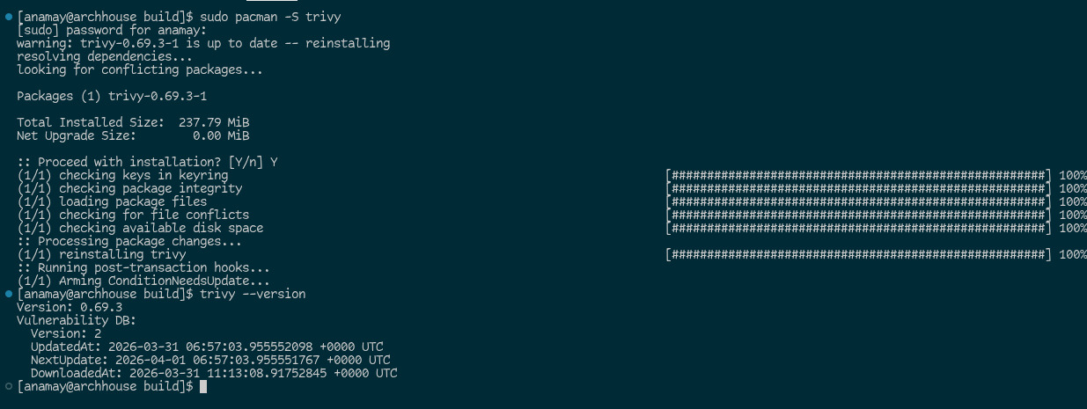
Installation & Setup Steps

Slide 7
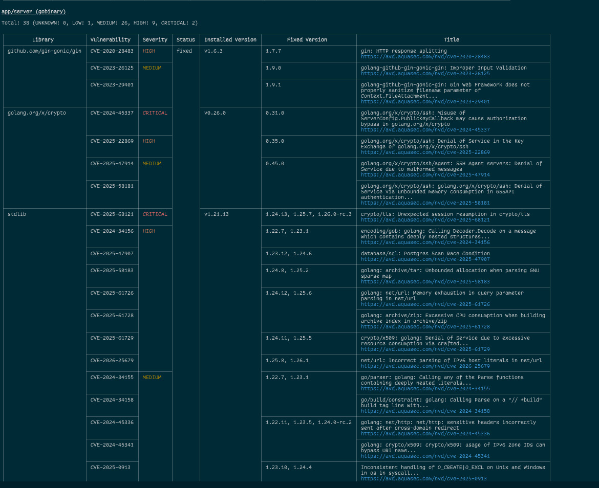
Results

Slide 8
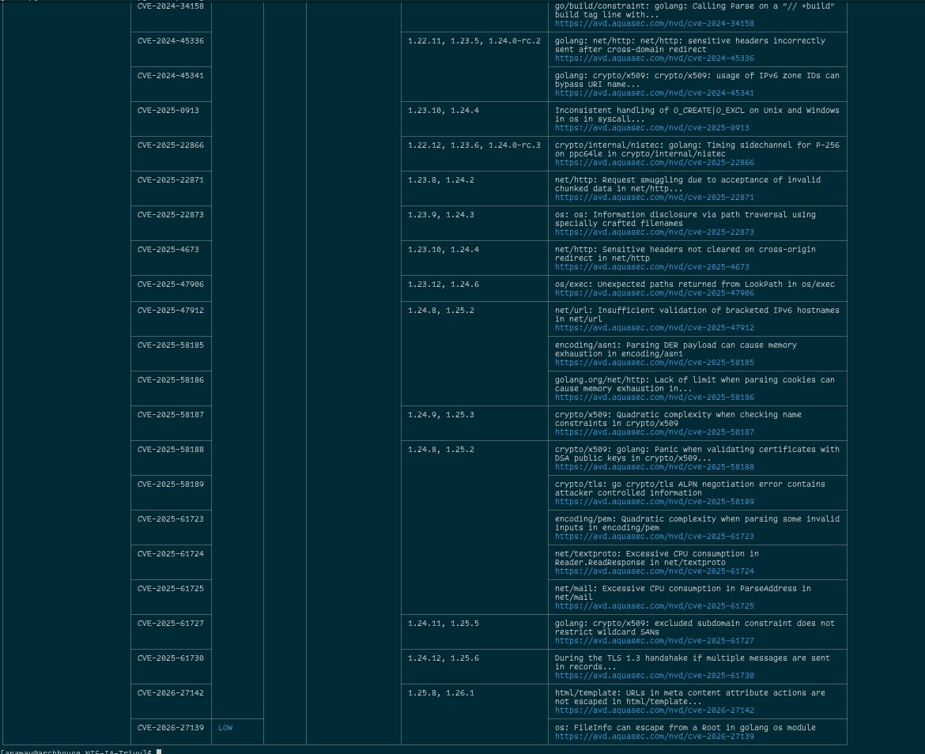
Results

Slide 9
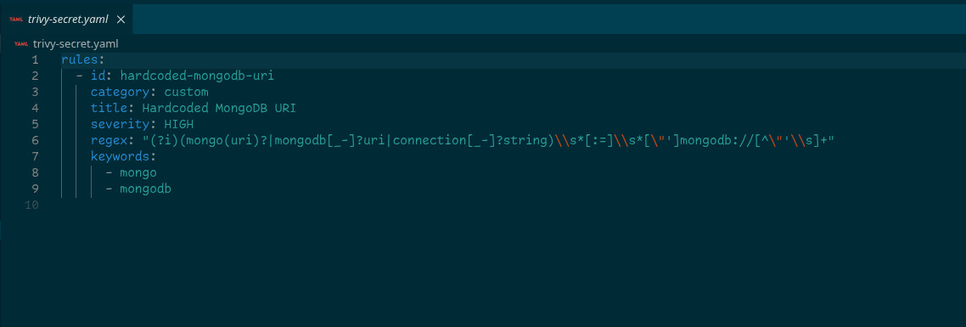
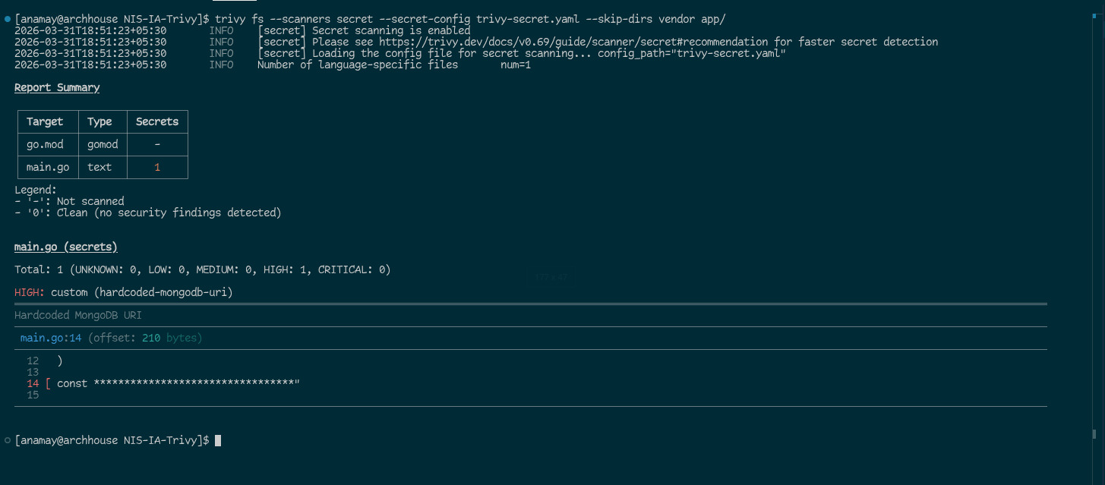
Results

Slide 10
Security Implications
Implementing Trivy has significant impacts on an organization's security posture:
Reduced Attack Surface: By fixing "Critical" vulnerabilities before code is even deployed.
Compliance: Helps meet standards like PCI-DSS or SOC2 by proving that software is regularly scanned.
Shift-Left Security: Moving security checks from the "End" of development to the "Start" (the developer's machine).
Recent Alert (Note for Extra Credit): Be aware that in March 2026, some versions of Trivy images (0.69.4–0.69.6) were briefly compromised in a supply chain attack. This highlights that even security tools must be verified via checksums or pinned to known clean versions (like 0.69.3).

Slide 11
Applications
CI/CD Pipelines: Automatically fail a build if a high-severity vulnerability is found in a GitHub Action or Jenkins pipeline.
Container Registries: Scanning images as soon as they are pushed to a registry.
Kubernetes Clusters: Using the "Trivy Operator" to constantly monitor live pods for new vulnerabilities.
Local Development: Developers scanning their own code before pushing it to the repository.

Slide 12
Conclusion
The implementation and testing of Trivy demonstrate that modern security is no longer a "luxury" but a continuous requirement. By integrating this tool into our workflow, we transition from reactive patching to proactive defense.
Key Takeaways:
Visibility is Security: Our results proved that even "working" code can hide critical vulnerabilities in the underlying Go standard library and third-party frameworks like Gin.
Beyond Vulnerabilities: Trivy's ability to catch a hardcoded MongoDB URI on Line 14 of our source code highlights its value in preventing catastrophic data breaches caused by simple human error.
Operational Efficiency: Because Trivy is stateless and lightning-fast (as seen in our Arch Linux setup), it can be embedded directly into CI/CD pipelines without slowing down the development cycle.

