Slide 1
ML-driven hybrid container and serverless resource management on AWS
CostScale
ML-driven hybrid container and serverless resource management on AWS
• [TO FILL: student names and IDs]
• [TO FILL: programme, institute, course]
• October 2026
Notes:
Introduce the project in one sentence: a resource manager that keeps a cheap base of EC2 sized by a forecast and sends the rest to Lambda. Mention it is a university cloud-computing project, built and measured on AWS in Mumbai, using a real production trace from Azure. Names and IDs are to be filled in.

Slide 2
The problem
Predict workload, then allocate resources
• Containers / VMs: cheap per unit, but slow to provision
• Lambda: instant, pay per use, several times costlier per unit
• Load varies; most functions are idle, a few are very busy
• Goal: lowest cost while serving every request in time
101
heavy Azure functions simulated
(>= $50/month on training days)
28,859
functions present on all 14 days
(of 72k in the trace)
Notes:
Two ways to buy compute: reserved containers or VMs are cheap per unit but need lead time; Lambda is instant and pay per use but costs several times more per unit of work. Traffic varies, so sizing for peak wastes money and reacting late drops or delays requests. The task: predict workload and allocate resources. Rubric items: inputs and features, algorithm and horizon, allocation mechanism, evaluation on accuracy, utilisation, latency, cost and energy, and what happens when the prediction is wrong.

Slide 3
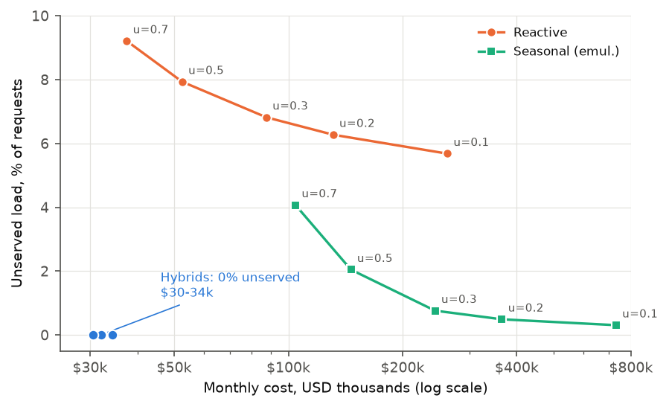
Why plain autoscaling is not enough
Every reactive setting drops load or overpays
• Reactive u=0.7: $37.5k, 9.2% load dropped
• Reactive u=0.3: $87.5k, still 6.8% dropped
• Hybrid-rolling: $32.2k, 0% dropped
• Test days, 101 heavy functions, AWS Mumbai prices
Notes:
Reactive autoscaling sizes capacity from load it saw five minutes ago at a target utilisation u. In the simulation, every u we tried leaves load unserved because there is no fallback: u 0.7 costs $37.5k and drops 9.2 percent; u 0.3 costs $87.5k and still drops 6.8 percent. The hybrid in the bottom-left corner of the chart serves everything for $32.2k. The seasonal line is an emulation of predictive-scaling style capacity from the same hour on previous days, not the AWS algorithm.

Slide 4
The idea: a base plus overflow
Newsvendor: base = q*-quantile of forecast load
• Base: EC2 Auto Scaling Group (cheap, always on)
• Overflow: AWS Lambda (instant, pay per use)
• ALB weighted target groups split the traffic
• Forecast sets instance count (hourly); observed rate sets weights (per minute)
base b* = F⁻¹(q*)
q* = 1 − f / L
f: container $ per unit-minute
L: Lambda $ per unit-minute
0.0013%
gap between the rule and brute-force search (test hours)
Notes:
Keep a base of always-on EC2 capacity. Everything above the base goes to Lambda. The base is the quantile of forecast load whose level is q-star equals one minus f over L, where f is the container cost and L the Lambda cost of the same unit of load for a minute. If L is not above f the base is zero. We checked the rule against brute-force search per function and hour: the difference is -0.0013 percent. Forecasting sets the slow thing, instance count; a per-minute loop sets ALB weights.

Slide 5
Data
Azure Functions 2019 trace, filtered to busy functions
Step | Count
Distinct functions (14 days) | 72,359
On day 1 | 46,412
On all 14 days | 28,859
>= 5 req/min, all 14 days | 2,127
+ duration + memory | 2,066
Heavy (>= $50/mo) | 101
• Load = invocations/min ÷ 60 × duration (concurrency)
• Timer functions excluded (periodic, not diurnal)
• Chronological split: train 1-10, validation 11-12, test 13-14
• Azure traffic priced with AWS prices
Notes:
Azure Functions 2019 trace, CC-BY, from Shahrad et al., USENIX ATC 2020. Fourteen days of per-minute invocations, with durations and memory. Most functions are rarely invoked, the median function on day one gets 32 invocations, so we filter. We keep functions present on all 14 days with at least 5 requests per minute: 2,127, of which 2,066 also have duration and memory. A function is heavy if its cheaper single-platform option costs at least 50 dollars per month on training days. Load is concurrency: invocations per minute over 60 times average duration. Azure traffic is priced with AWS prices. Split is chronological per function: days 1-10 train, 11-12 validation, 13-14 test.

Slide 6
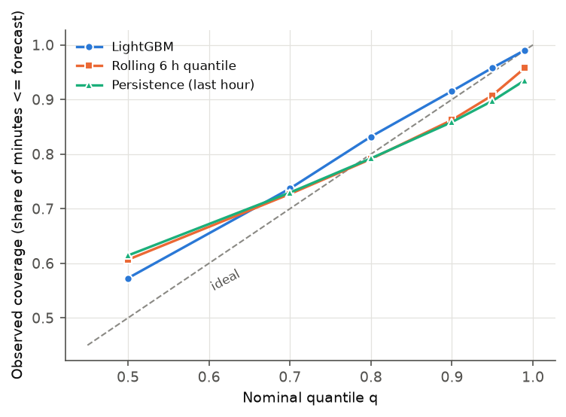
Features and model
LightGBM quantile regression, next-hour horizon
• Targets: q in {0.5, 0.7, 0.8, 0.9, 0.95, 0.99} of next-hour per-minute concurrency
• Features: last 60 / 360 min (mean, max, q90), same hour yesterday, hour of day, trigger, app level
• Margin multiplier chosen on validation by decision cost
• Baselines: persistence, rolling 6 h, seasonal naive, static
Notes:
One global LightGBM model per quantile, objective quantile, trained across all heavy functions with load normalised per function. Horizon: next hour, decided at the start of the hour. Features come only from before the decision time: last hour and last six hours mean, max and 90th percentile; same hour yesterday; hour of day; trigger; and the function's level. The safety margin was chosen on validation by minimising decision cost, and came out as 1.0, so none. Baselines: persistence, rolling six-hour quantile, seasonal naive and static training quantile. Accuracy: LightGBM is best at the upper quantiles and tracks coverage; persistence is better at the median. The decision-cost result is on the next slide.

Slide 7
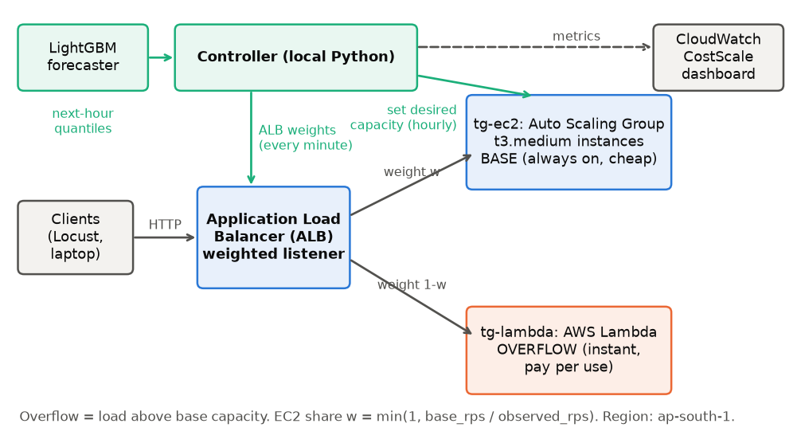
Architecture
Forecast sets instances, observed load sets weights
• ALB weights 0-999, per minute
• ASG desired capacity, per hour
• Lambda 1769 MB (1 vCPU) as overflow
• make up / make down, tagged, verified
Notes:
A local controller does two jobs. Every decision interval it takes the forecast quantile at q-star and sets the ASG desired capacity. Every minute it reads the observed request rate and sets the ALB weights: the EC2 share is the minimum of one and healthy capacity over observed rate, in integer weights from 0 to 999. The ALB splits by percentage, not overflow-only, so the live system leaks relative to the simulator; we measure that. Everything is tagged project equals costscale, default VPC, no NAT gateway, no RDS, and one make down destroys it and verifies with the tagging API.

Slide 8
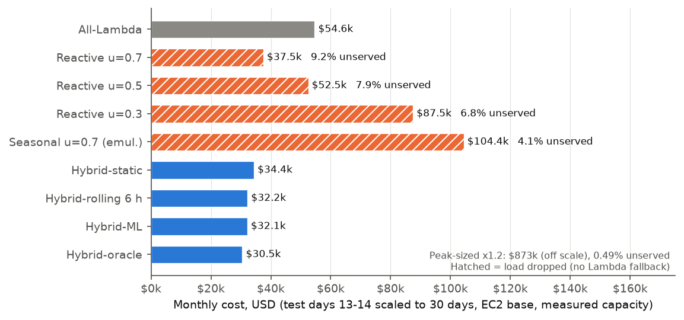
Simulation results
The hybrid wins on cost and unserved load; ML adds almost nothing over rolling
• Hybrid-rolling $32.2k vs all-Lambda $54.6k
• ML vs rolling: -0.25% (noise level)
• Headroom to oracle: 5.4%
• Energy (estimate): hybrid 3,455 kWh vs all-Lambda 1,040 kWh
Notes:
Test days 13 and 14 scaled to 30 days, EC2 base, container capacity measured on AWS. Hybrid rolling costs $32.2k, 41 percent below all-Lambda and 14 percent below reactive at u 0.7, which also drops 9.2 percent of load. Plainly: the ML forecaster is only 0.25 percent cheaper than the rolling six-hour quantile on test, and the whole headroom to the oracle is 5.4 percent. Energy, by an estimate based on the Cloud Carbon Footprint method, is lowest for all-Lambda: the hybrid saves money, not energy. Under the earlier assumed capacity of 16 the saving was larger; measured capacity is 6.4.

Slide 9
Live results on AWS
pending
Notes:
Live results pending.

Slide 10
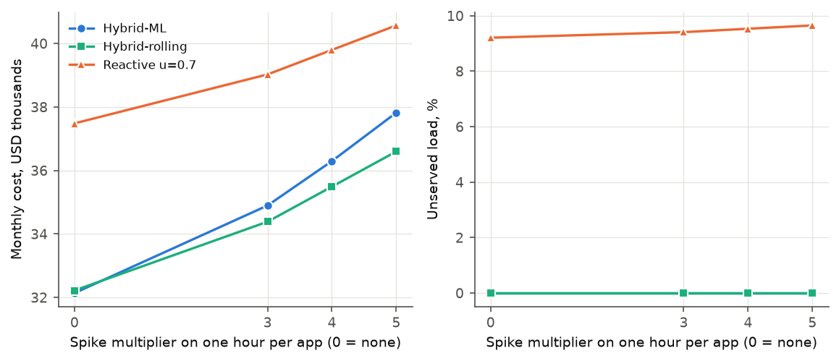
What if the prediction is wrong?
Under-prediction goes to Lambda; nothing is dropped
• Too small base: overflow to Lambda, higher cost, higher latency on cold start
• Too large base: idle containers, wasted money only
• Reactive: under-provisions and drops load
• x5 spike: +$4.4k (rolling) / +$5.7k (ML) per month, 0% dropped
Notes:
Under-prediction is cheap by design: the excess goes to Lambda, nothing is dropped. Over-prediction wastes f per idle unit-minute until the next decision. A reactive controller is wrong in the damaging way. In simulation we multiplied one hour per function by 3, 4 or 5 after the forecast was made: the hybrids served everything; a x5 spike adds $4.4k to $5.7k per month. The ML forecaster over-reacts after a spike because its features include the spiked hour; a production system would clip forecasts after an anomaly. Live arm D repeated this on AWS.

Slide 11
Limitations and future work
Honest boundaries
• Azure traffic, AWS prices
• One request type, one instance type, coarse capacity grid
• Short, compressed, single-run live arms
• Energy is an estimate; predictive scaling not run live
• Advantage depends on capacity and Lambda price
• Storage tiering and network cost (out of scope here)
• Fargate base, measured and run live
• Multi-region placement
• Anomaly-aware forecasts
• Overflow-only routing instead of weights
Notes:
Be upfront. Azure traffic is priced with AWS prices. Capacity is measured for one synthetic request on one instance type from a coarse grid. Live arms are short, time-compressed, single runs from one laptop. Energy is an estimate. AWS predictive scaling was not run live because it needs 24 hours of history. The hybrid advantage depends on measured capacity and Lambda price. Future work: storage tiering, network cost, a Fargate base, multi-region, anomaly-aware forecasting, and overflow-only routing.

Slide 12
Conclusion
A principled base, an honest result
• Newsvendor rule sets the base; matches brute force
• Hybrid: $32.2k/month, 0% dropped, vs $54.6k all-Lambda and reactive $37.5k with 9.2% dropped
• ML forecaster ≈ rolling quantile (reported plainly)
• Hybrid saves cost, not energy (estimate)
• Live AWS demo reconciled with simulator replay
Notes:
Summarise. The newsvendor rule gives a principled base size and matches brute force. In simulation the hybrid serves all load at $32.2k per month against $54.6k all-Lambda and $37.5k reactive with 9.2 percent dropped. The ML forecaster adds almost nothing over a rolling quantile, and by an estimate the hybrid does not save energy. The live AWS runs are reconciled with a simulator replay. Thank the audience and invite questions.

Slide 13
Backup: cost-model assumptions
Backup
Item | Value
Lambda duration | $0.0000167 per GB-s
Lambda requests | $0.0000002 per request
EC2 t3.medium | $0.0448 per hour
Fargate vCPU / GB | $0.04256 / $0.004655 per hour
EC2 capacity unit | 6.4 concurrent requests (measured; assumed 16)
Fargate capacity unit | 4 concurrent requests (assumed)
Prices retrieved | 2026-10-24
Notes:
Prices from the AWS Price List API for ap-south-1, retrieved on the date shown. Azure traffic is priced with AWS prices. Lambda memory is the larger of 128 MB and the application's memory. Container capacity is the measured value for EC2; the Fargate capacity is assumed.

Slide 14
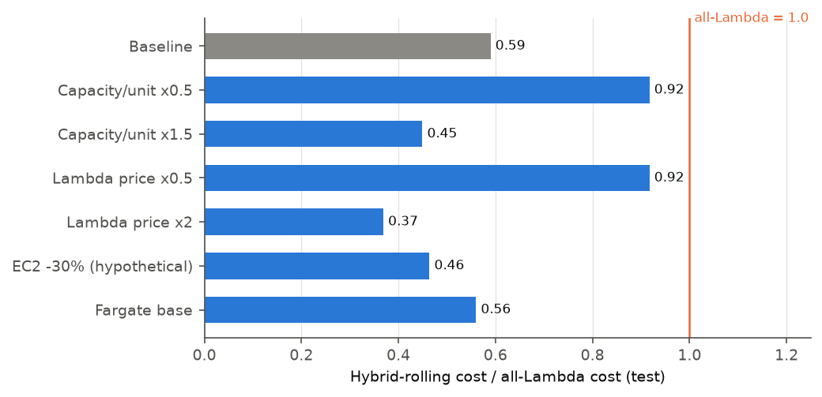
Backup: sensitivity
Backup
• Capacity x0.5: saves 8% vs all-Lambda
• Lambda price x0.5: saves 8%
• Assumed capacity 16: $17.0k vs $53.8k
Notes:
Hybrid-rolling cost relative to all-Lambda under each scenario. The advantage is large when containers carry more load per unit or Lambda is dearer, and small when capacity per unit is halved or Lambda is half price. The EC2 discount scenario is hypothetical, not an AWS-quoted figure.

