Slide 1



Dockers
What ?
Installation

Slide 2
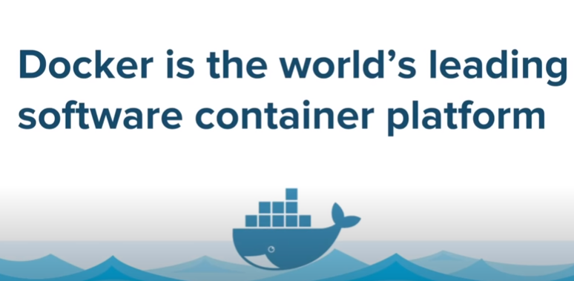
What is Docker

Slide 3
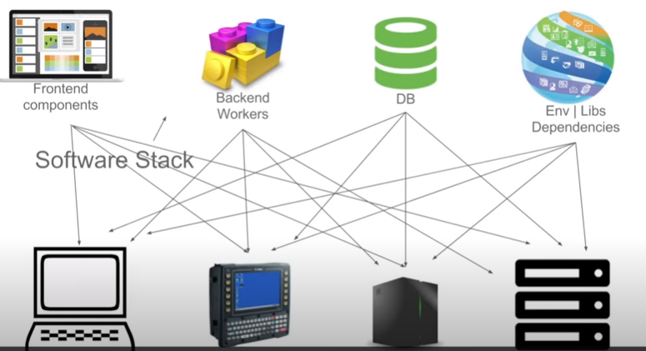
Docker

Slide 4
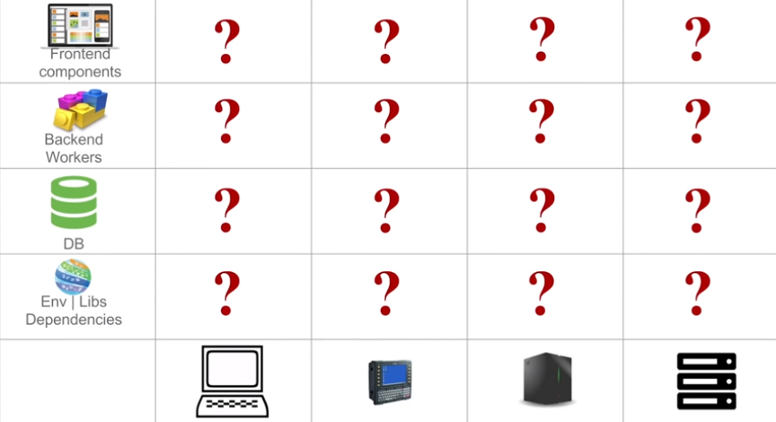
What is the Problem?

Slide 5
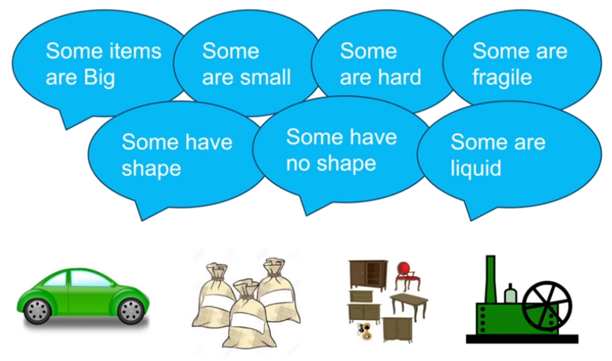
General Problem – Shipping

Slide 6
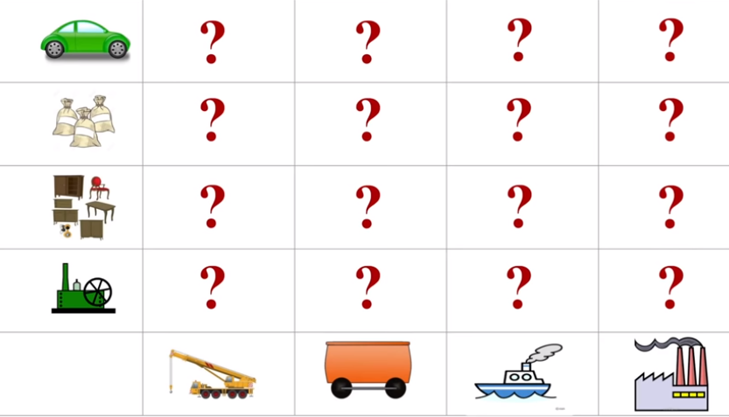
Similar Case in Transportation/Shipping

Slide 7
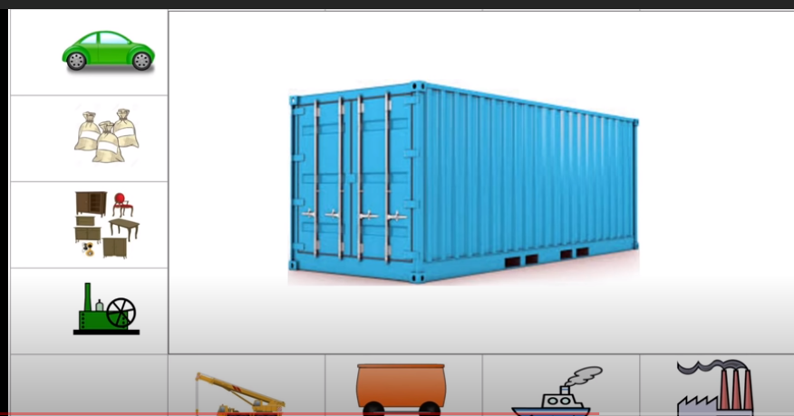
Similar Case in Transportation

Slide 8
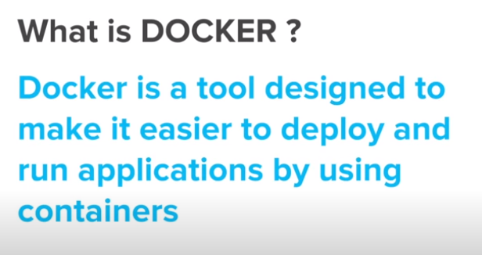
What is Docker

Slide 9
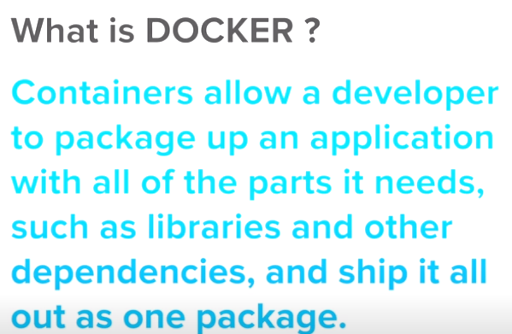

Slide 10
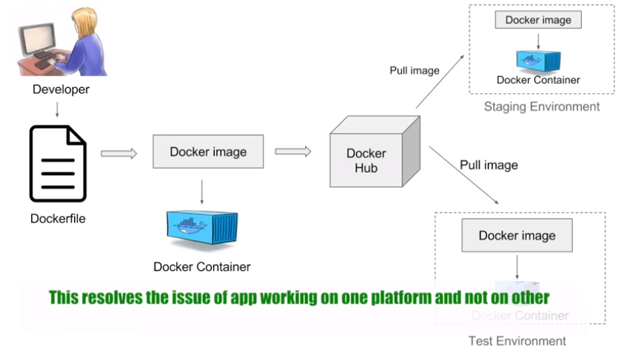
How Docker Works – General Workflow

Slide 11
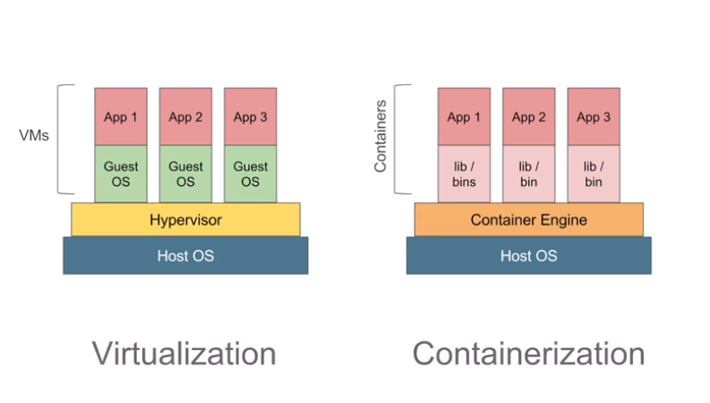
Virtualization Vs Containerization

Slide 12
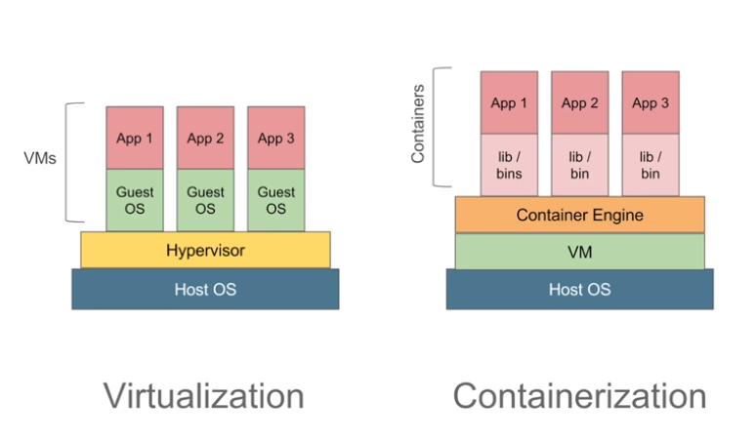
Virtualization Vs Containerization

Slide 13
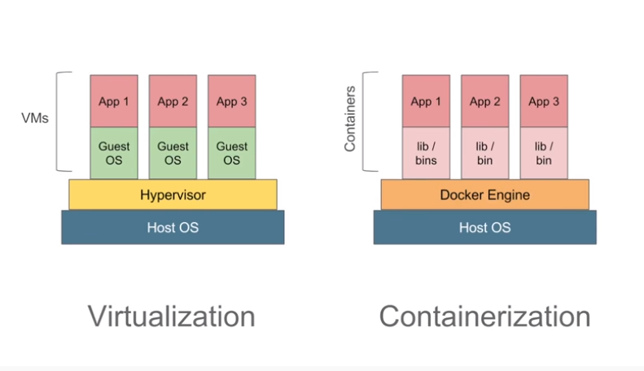
Virtualization Vs Containerization

Slide 14
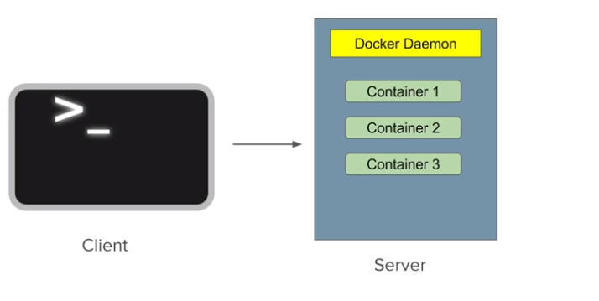
Docker has Client Server Architecture

Slide 15
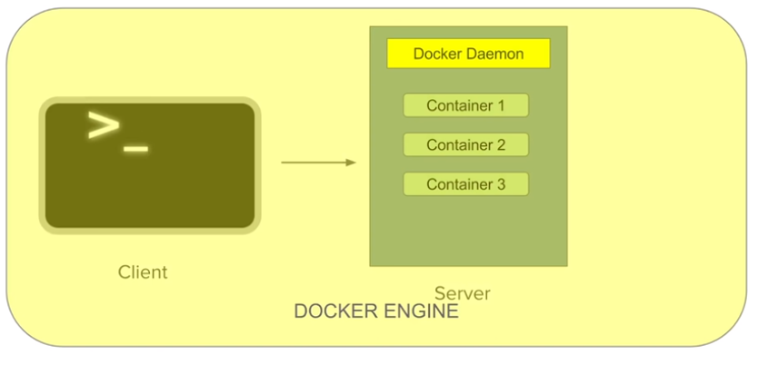
Docker has Client Server Architecture

Slide 16
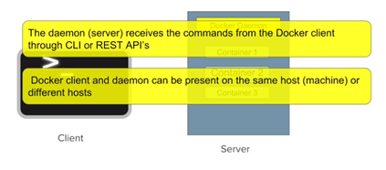
Docker has Client Server Architecture

Slide 17
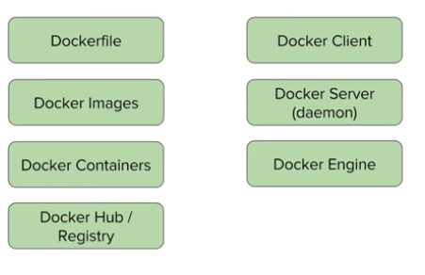
Basic Concept We have Covered @ Docker

Slide 18
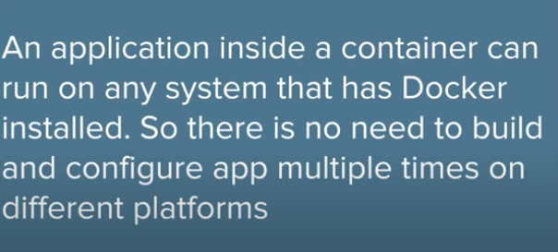
Benefits using Docker
Build App Only Once

Slide 19
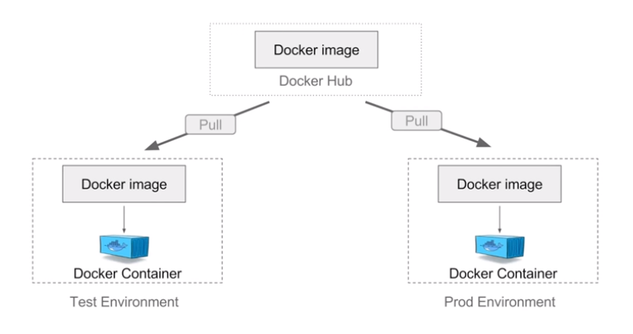
Benefits using Docker
Build App Only Once

Slide 20
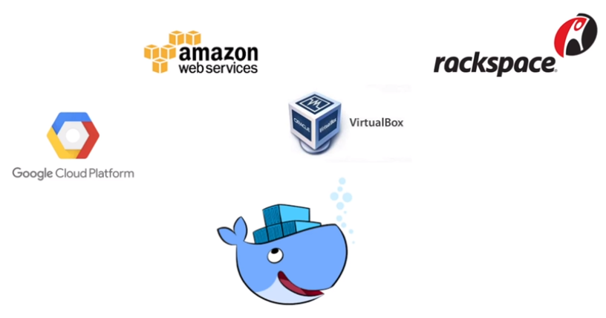
Benefits using Docker - Portability

Slide 21
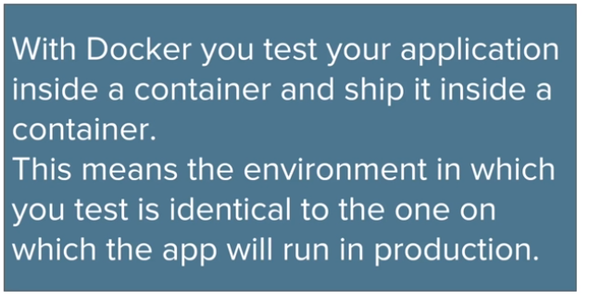
Benefits using Docker-Portability

Slide 22
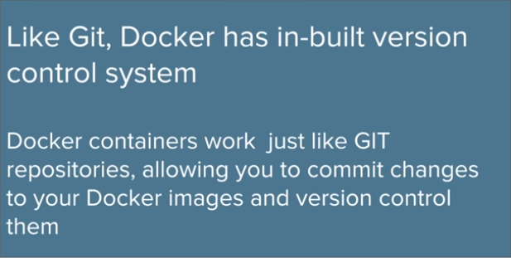
Benefits using Docker- Version Control System

Slide 23
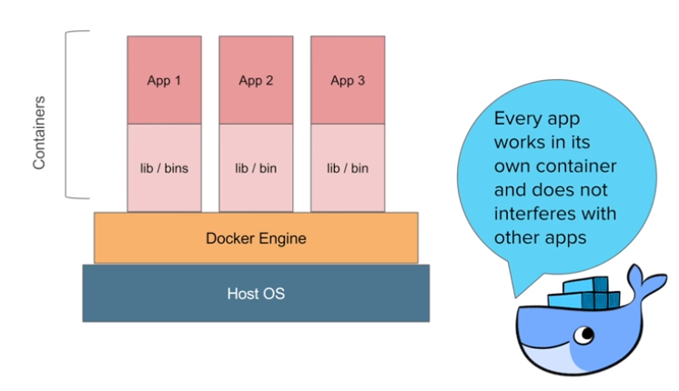
Benefits using Docker - Isolation

Slide 24
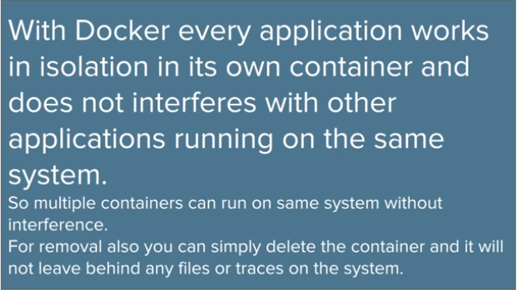
Benefits using Docker - Isolation

Slide 25
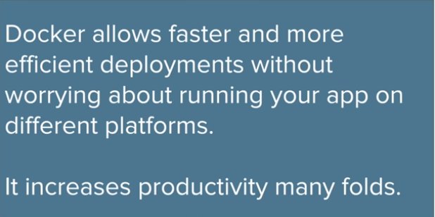
Benefits using Docker
Increases Productivity

Slide 26
Benefits using Docker
So Docker makes every deployment very easy very efficient and very faster
With all these features Docker makes DevOps very easy, efficient, and faster!!

Slide 27
Installation of Docker
Topics Covered
Prerequisite
Install Docker
Validating installation
Uninstall Docker

Slide 28
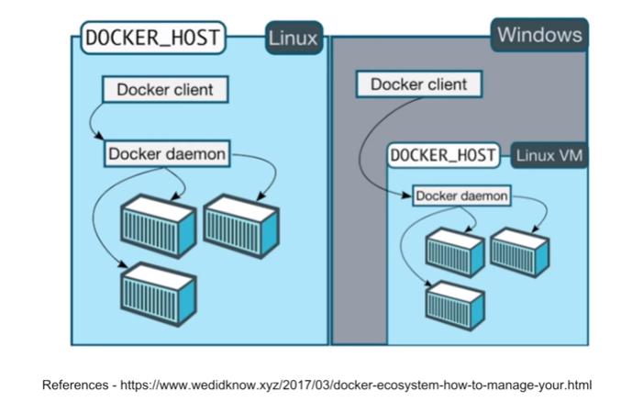
Installation of Docker

Slide 29
Installation of Docker
Prerequisite
OS - 64 bit
Windows 7 or Higher
We can check it on
https://docs.docker.com/docker-for-windows/install/

Slide 30
Installation of Docker
Use the following Link for installation
https://devconnected.com/how-to-install-docker-on-windows-7-8-10-home-and-pro/

Slide 31
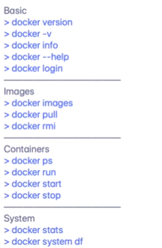
Docker Commands

Slide 32
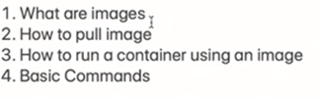
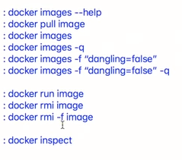

What are Images and How to Run Docker images

Slide 33



What and How to Create Container

Slide 34
Comparisons of various Continuous Integration Tools

Slide 35
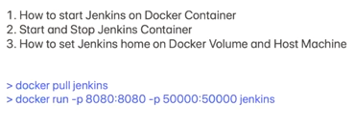
How to Run Jenkins on Docker Container

