Slide 1
Introduction to Machine Learning
Dept. of CSE, University of Asia Pacific

Slide 2
Learning
Humans learn from past experiences
Machines follow instructions
What if humans can train machines to learn from past experience?
Machines are like toddlers

Slide 3
Realm of Artificial Intelligence
Artificial Intelligence
Machine Learning
Neural Networks
Deep Learning

Slide 4
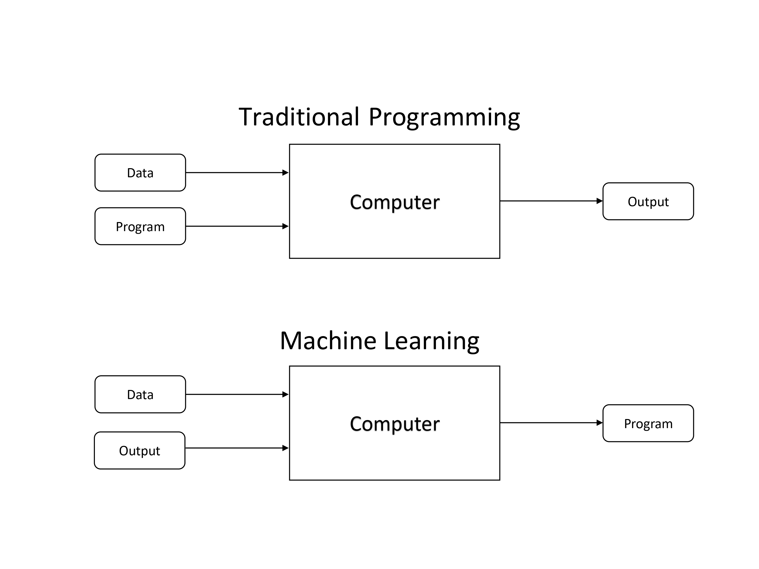
Programming vs Machine Learning

Slide 5
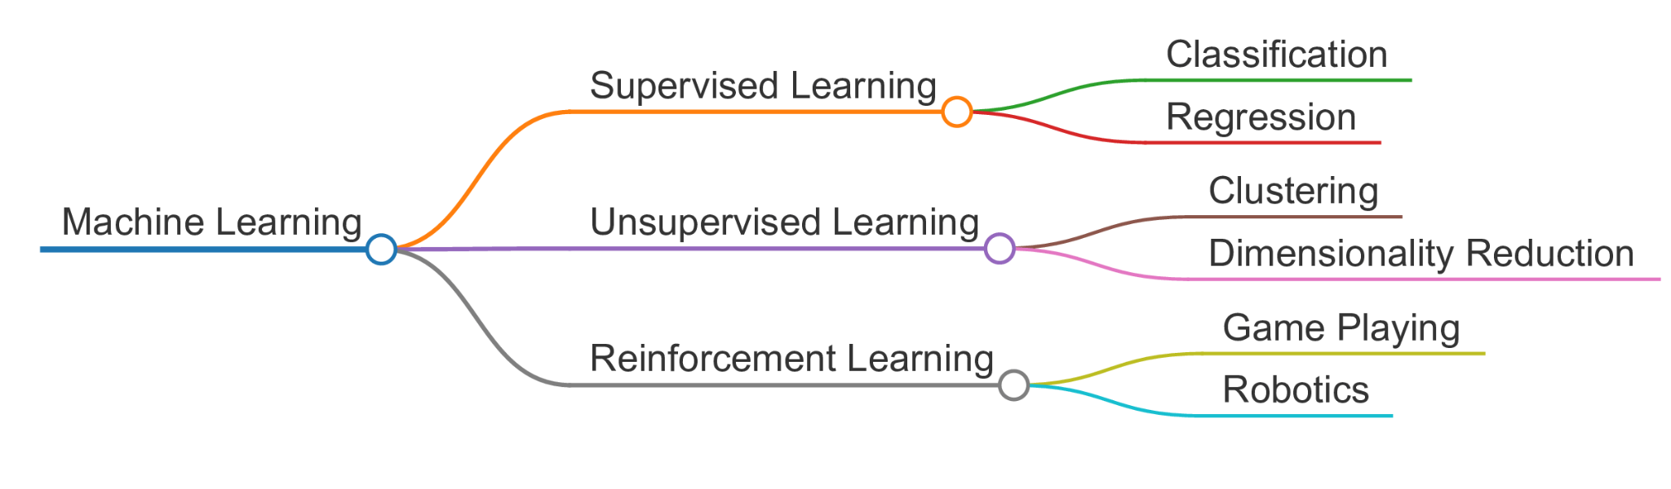
Types of Machine Learning

Slide 6
Supervised Learning
A type of learning where the model is trained on labeled data.
Examples:
Classification (e.g. Logistic Regression, Support Vector Machines)
Regression (e.g. Linear Regression)

Slide 7
Unsupervised Learning
A type of learning where the model works with unlabeled data to
discover patterns.
Examples:
Clustering (e.g., K-Means)
Dimensionality Reduction (e.g., PCA)

Slide 8
Reinforcement Learning
A type of learning where an agent learns to make decisions by
interacting with an environment.
Examples:
Autonomous Robot Navigation
Self driving cars

Slide 9
General Steps in Machine Learning
1. Data Collection
2. Data Preprocessing
3. Model Development
4. Model Training
5. Model Evaluation
6. Deployment

Slide 10
Questions?

