Slide 1
Assessing Model Performance
Dept. of CSE, University of Asia Pacific

Slide 2
Model Performance
Why evaluating?
  Ensures reliability and generalizability.
  Helps in model comparison.
When to evaluate?
  During model development, after tuning, and before deployment.

Slide 3
Holdout Validation
Split the dataset into two parts - training set and a test set
  Training Data: Data the model was trained on.
  Test Data: Data the model has not seen before.
Typically, with a split ratio of 70:30 or 80:20
Train (80%) | Test (20%)

Slide 4
K-Fold Cross-Validation
Training models on subsets of the available input data and evaluating on the complementary subset of the data
Split dataset into K folds
Train and validate model K times
Each subset used as a test set once, and the remaining K-1 subsets used as training data.

Slide 5
5-Fold Cross-Validation
Iteration 1 | Fold 1 | Fold 2 | Fold 3 | Fold 4 | Fold 5
Iteration 2 | Fold 1 | Fold 2 | Fold 3 | Fold 4 | Fold 5
Iteration 3 | Fold 1 | Fold 2 | Fold 3 | Fold 4 | Fold 5
Iteration 4 | Fold 1 | Fold 2 | Fold 3 | Fold 4 | Fold 5
Iteration 5 | Fold 1 | Fold 2 | Fold 3 | Fold 4 | Fold 5
 |  | Train | Test

Slide 6
Confusion Matrix
A table that summarizes the prediction results by comparing the actual with the predicted classes.
Terminology:
  True Positive (TP): Correctly predicted positive cases
  True Negative (TN): Correctly predicted negative cases
  False Positive (FP): Incorrectly predicted positive cases (actually negative)
  False Negative (FN): Incorrectly predicted negative cases (actually positive)

Slide 7
Confusion Matrix
Instances | 1 | 2 | 3 | 4 | 5 | 6 | 7 | 8 | 9 | 10 | 11 | 12
Actual Classification | 1 | 1 | 1 | 1 | 1 | 1 | 1 | 1 | 0 | 0 | 0 | 0
Predicted Classification | 0 | 0 | 1 | 1 | 1 | 1 | 1 | 1 | 1 | 0 | 0 | 0
Result | FN | FN | TP | TP | TP | TP | TP | TP | FP | TN | TN | TN

Slide 8
Confusion Matrix
 |  | Predicted condition
 | Total population P + N | Positive (PP) | Negative (PN)
Actual condition | Positive (P) | True positive (TP) | False negative (FN)
 | Negative (N) | False positive (FP) | True negative (TN)

Slide 9
Confusion Matrix
 |  | Predicted condition
 | Total = 8+4 = 12 | Fit 7 | Unfit 5
Actual condition | Fit 8 | 6 | 2
 | Unfit 4 | 1 | 3

Slide 10
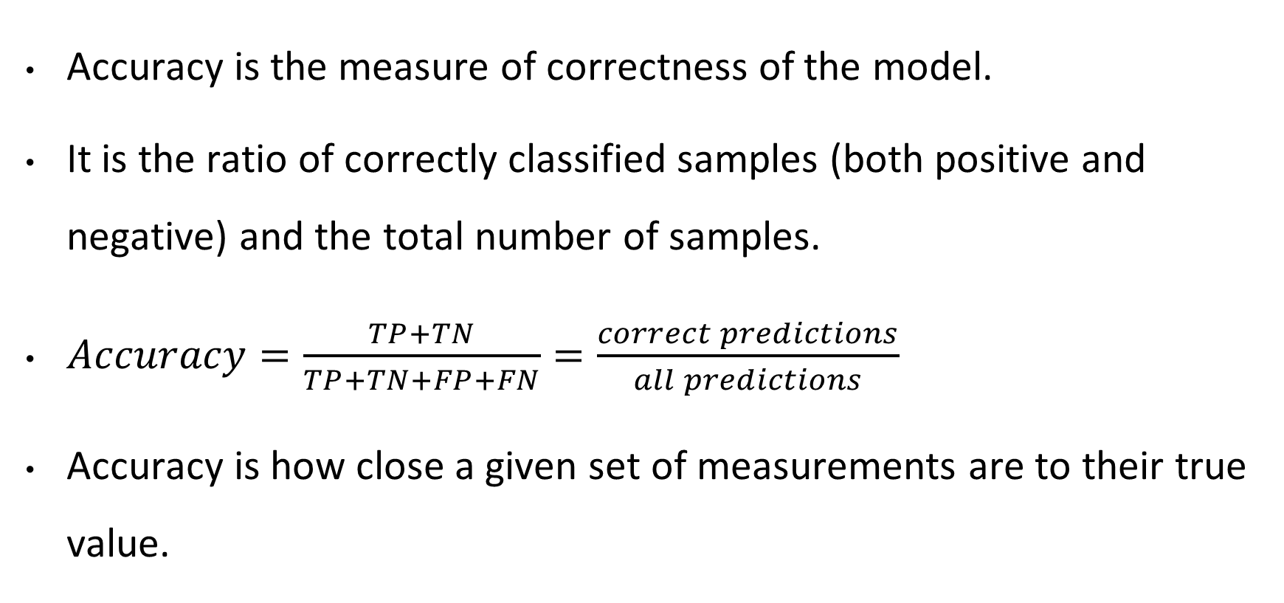
Accuracy
Accuracy is the measure of correctness of the model.
It is the ratio of correctly classified samples (both positive and negative) and the total number of samples.
$Accuracy=\frac{TP+TN}{TP+TN+FP+FN}=\frac{correct predictions}{all predictions}$
Accuracy is how close a given set of measurements are to their true value.

Slide 11
Drawbacks of Accuracy
It fails when the classes are imbalanced
Suppose a test dataset has a 99 : 1 ratio denoting Negative : Positive classes
A model that can classify all the instances as negative will get an accuracy of 99%

Slide 12
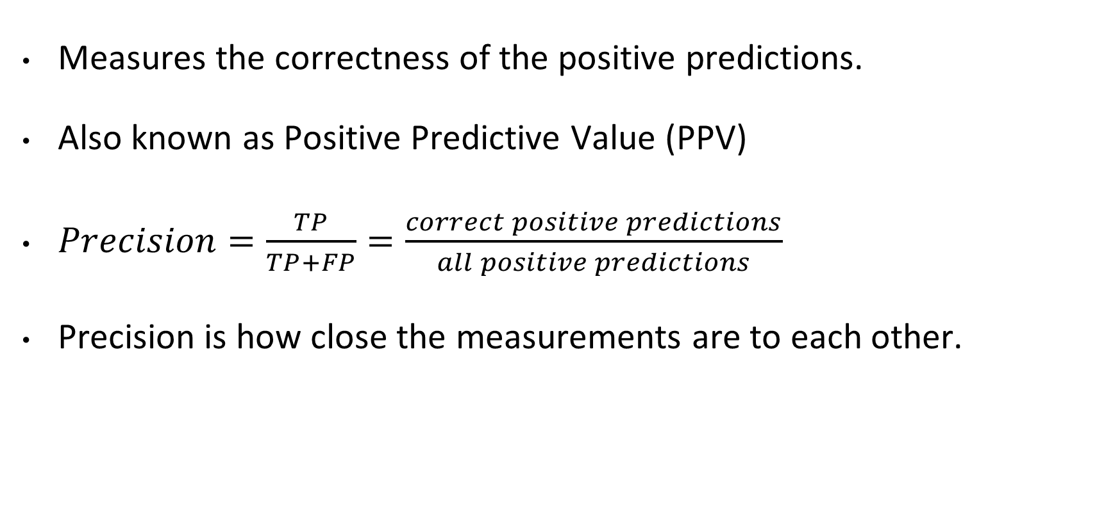
Precision
Measures the correctness of the positive predictions.
Also known as Positive Predictive Value (PPV)
$Precision=\frac{TP}{TP+FP}=\frac{correct positive predictions}{all positive predictions}$
Precision is how close the measurements are to each other.

Slide 13
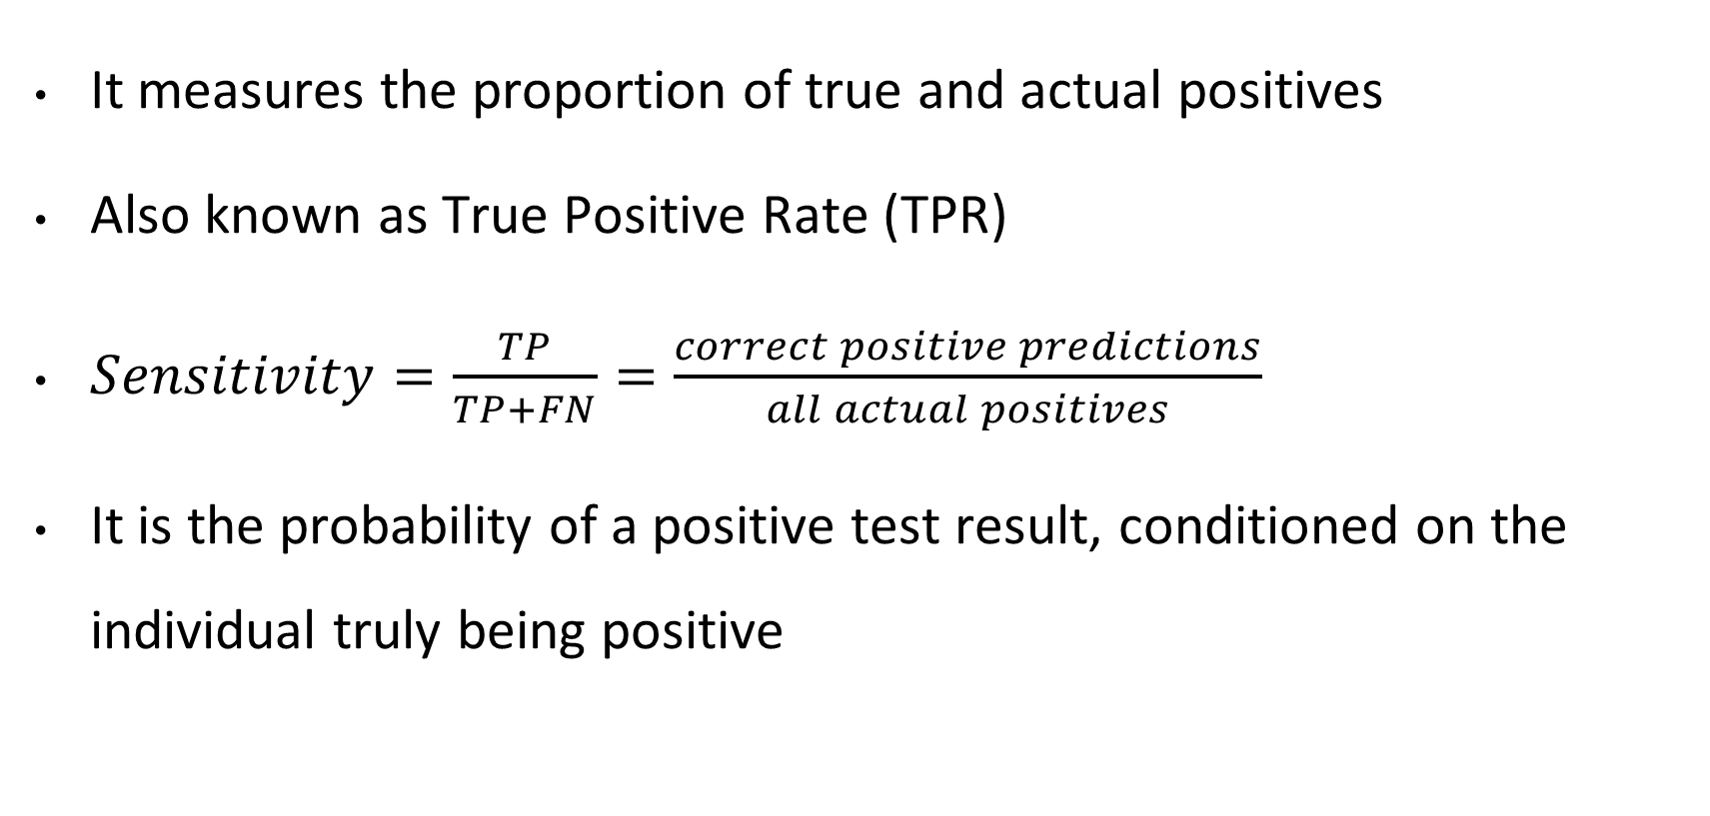
Sensitivity / Recall
It measures the proportion of true and actual positives
Also known as True Positive Rate (TPR)
$Sensitivity=\frac{TP}{TP+FN}=\frac{correct positive predictions}{all actual positives}$
It is the probability of a positive test result, conditioned on the individual truly being positive

Slide 14
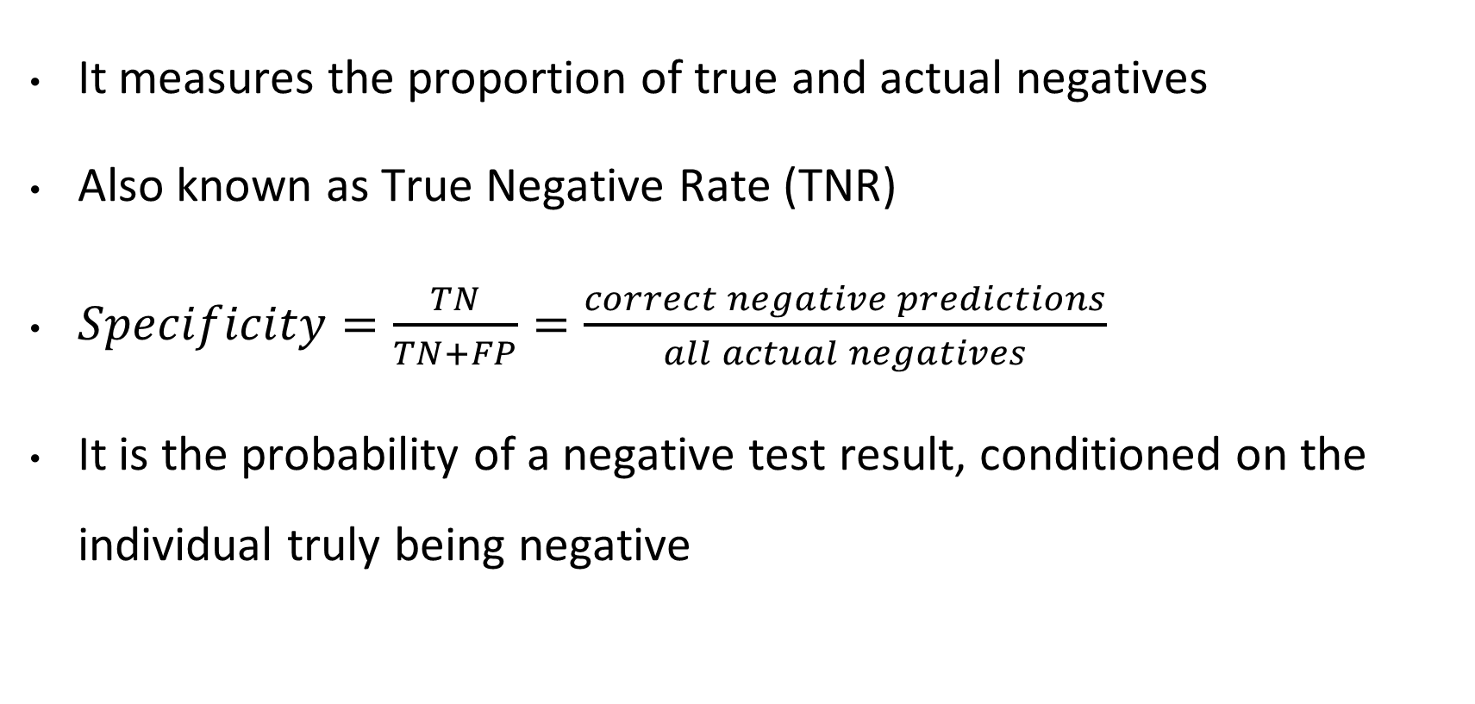
Specificity
It measures the proportion of true and actual negatives
Also known as True Negative Rate (TNR)
$Specificity=\frac{TN}{TN+FP}=\frac{correct negative predictions}{all actual negatives}$
It is the probability of a negative test result, conditioned on the individual truly being negative

Slide 15
Precision-Recall Tradeoff
Improving precision decreases recall, and vice versa.
A model trying to increase precision reduces the occurrence of false positives and the opposite for false negatives
A harmonic mean of these gives us a better insight

Slide 16

F-measure / F-score
F-measure is a measure of predictive performance
F₁ – score is the harmonic mean of precision and recall
  $F_{1}=\frac{2}{precision^{−1} + recall^{−1}}=\frac{2 × precision × recall}{precision + recall}$

Slide 17
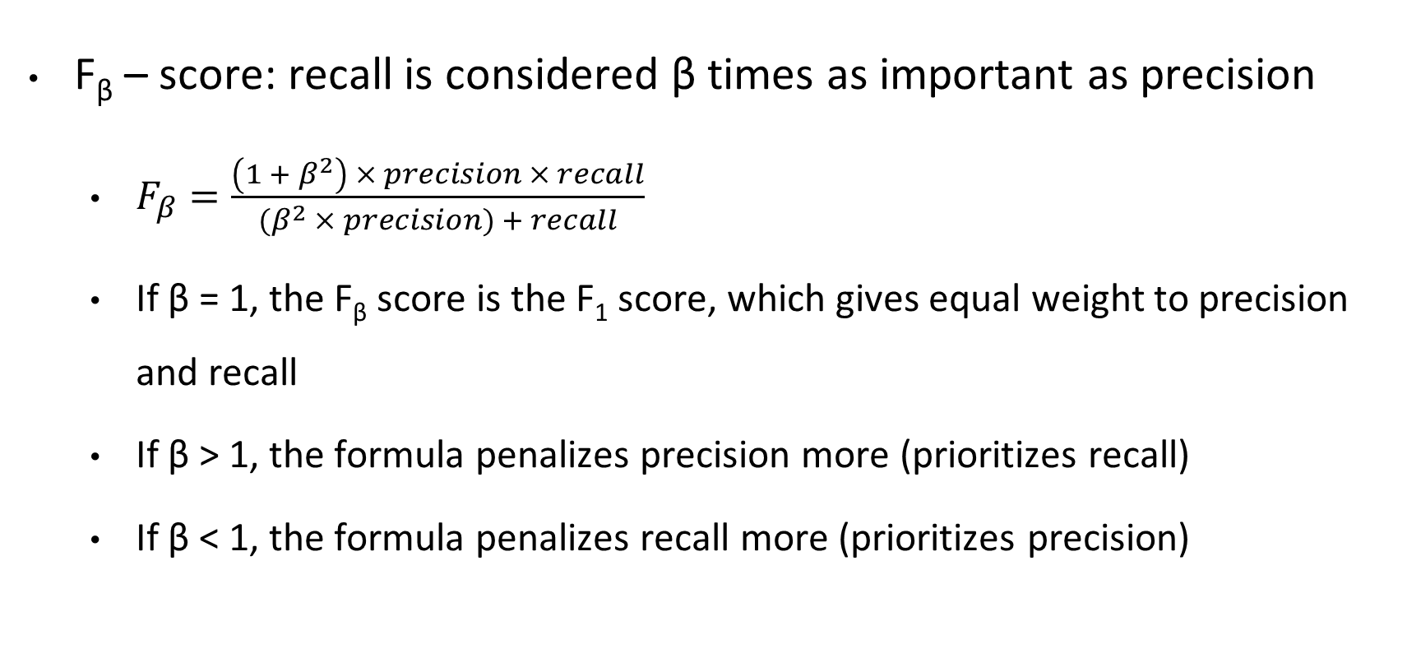
F-measure / F-score
F_{β} – score: recall is considered β times as important as precision
  $F_{β}=\frac{\left(1 + β^{2}\right) × precision × recall}{{(β}^{2} × precision) + recall}$
  If β = 1, the F_{β} score is the F₁ score, which gives equal weight to precision and recall
  If β > 1, the formula penalizes precision more (prioritizes recall)
  If β < 1, the formula penalizes recall more (prioritizes precision)

Slide 18
Confusion matrices with more categories
Confusion matrix can be used in multi-class classifiers
 |  | Predicted condition
 | Total = 8+4 = 16 | Fit 7 | Unfit 6 | At Risk 3
Actual condition | Fit 8 | 6 | 2 | 0
 | Unfit 4 | 1 | 2 | 1
 | At Risk 4 | 0 | 2 | 2

Slide 19
Questions?

