Slide 1
Supervised Learning
(Decision Tree)
Dept. of CSE, University of Asia Pacific

Slide 2
Decision Tree
A supervised learning algorithm
Mimics a tree-like model of decisions and outcomes
Used for classification and regression
Key Components:
  Root Node: Starting point (top of the tree)
  Decision Nodes: Branches based on feature splits
  Leaf Nodes: Final output (class or value)

Slide 3
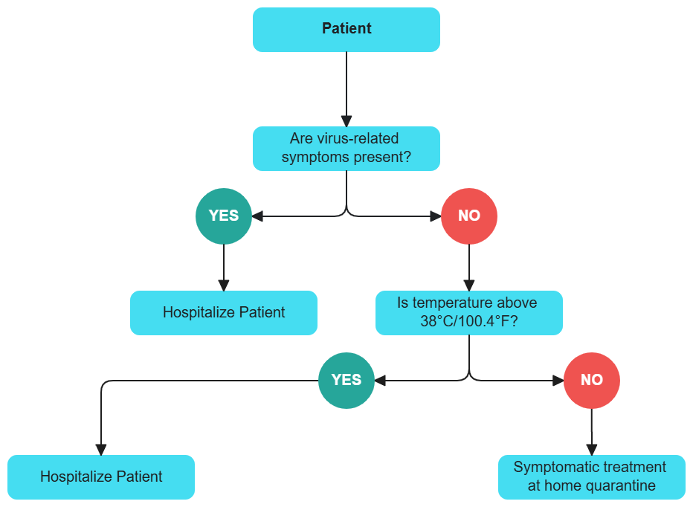
Decision Tree

Slide 4
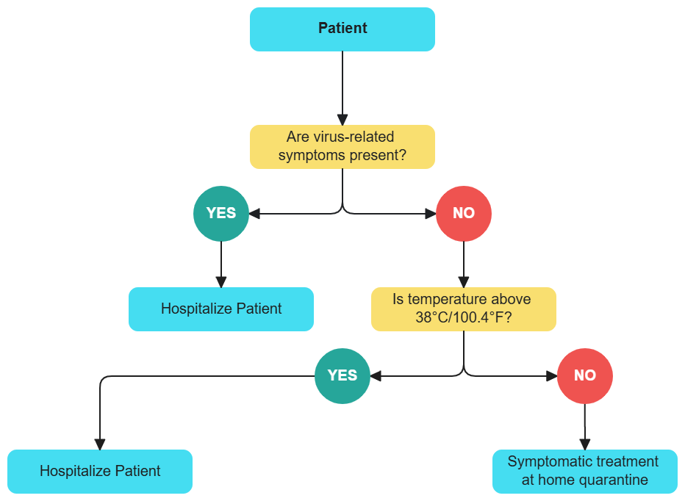
Decision Making
Starting from the root, the attribute values are tested against the tree
The path traced from root to leaf holds the class prediction for the tuple
Can be found the classification rules
Viral Syndrome? | Fever? | Decision?
No | Yes | Hospitalize

Slide 5
Decision Making (Cont.)
Test Data
Viral Syndrome? | Fever? | Decision?
No | No | ??

Slide 6
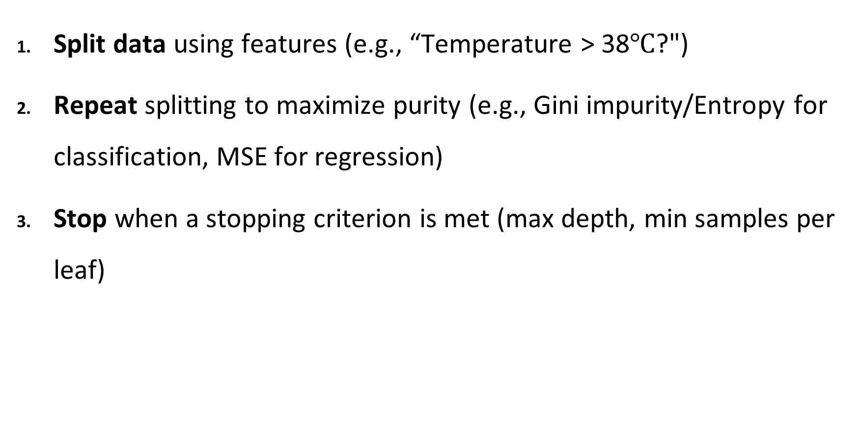
Tree Construction
Split data using features (e.g., “Temperature > 38$℃$?")
Repeat splitting to maximize purity (e.g., Gini impurity/Entropy for classification, MSE for regression)
Stop when a stopping criterion is met (max depth, min samples per leaf)

Slide 7
What if the Feature is not Discrete?
Discretization to form an ordinal categorical attribute
  Static – discretize once at the beginning
  Dynamic – ranges can be found by equal interval for example, bucketing, equal frequency bucketing (percentiles), or clustering.
Binary Decision: (A < v) or (A ≥ v)
  consider all possible splits and finds the best cut
  can be more compute intensive

Slide 8
Types of Split
Binary split: Divides values into two subsets
  Need to find optimal partitioning
Multi-way split: Use as many partitions as distinct values
Size
Size
Size
{Small, Medium}
{Medium,
Large}
{Small, Large}
{Large}
{Small}
{Medium}
Size
Small
Large
Medium

Slide 9
Attribute Selection Metrics
Information Gain
Gain Ratio
Gini Index

Slide 10
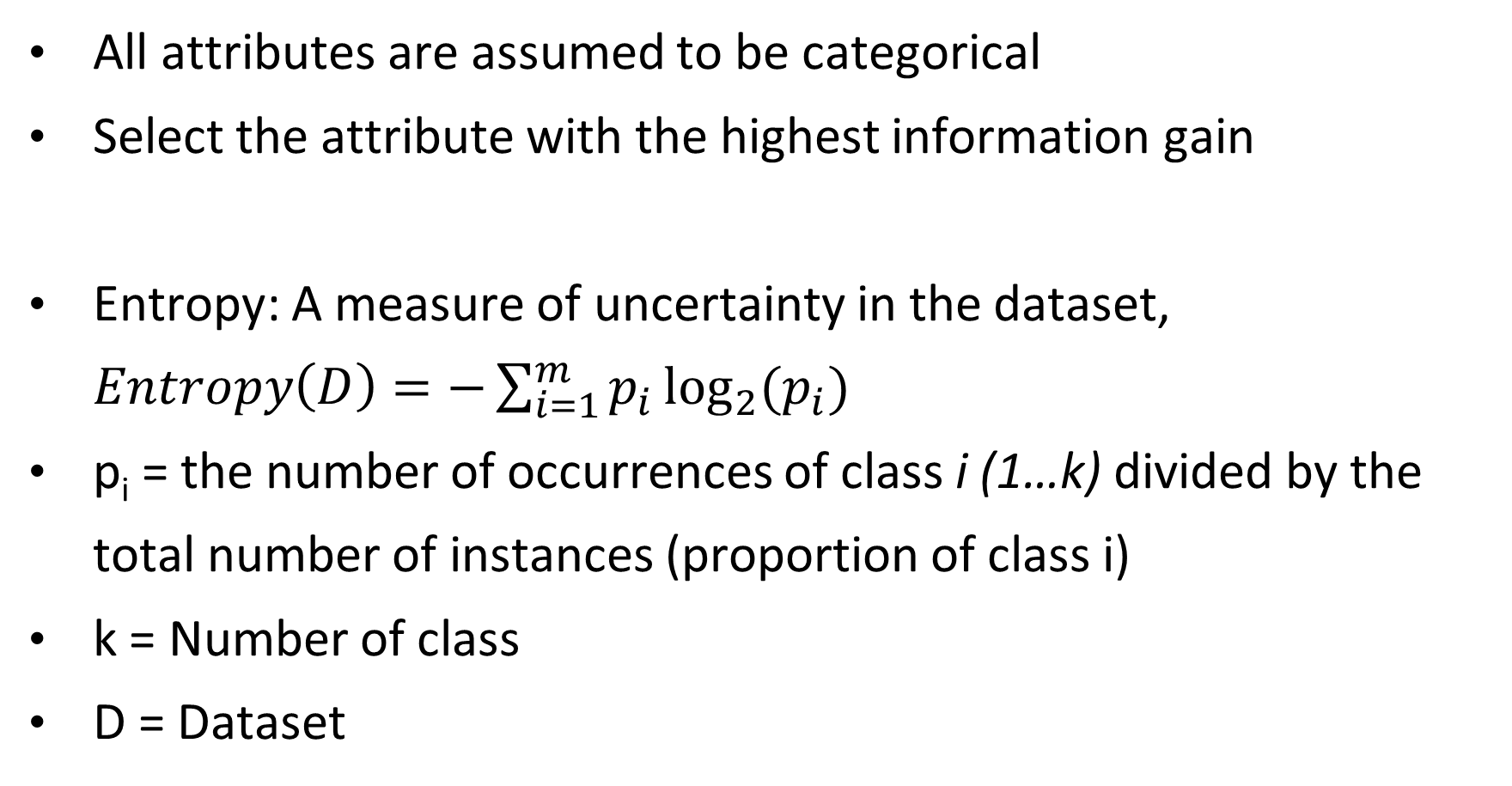
Information Gain (ID3)
All attributes are assumed to be categorical
Select the attribute with the highest information gain
Entropy: A measure of uncertainty in the dataset, $Entropy\left(D\right)=−\sum_{i=1}^{m}{p_{i}\log_{2}{{(p}_{i})}}$
p_{i} = the number of occurrences of class i (1…k) divided by the total number of instances (proportion of class i)
k = Number of class
D = Dataset

Slide 11
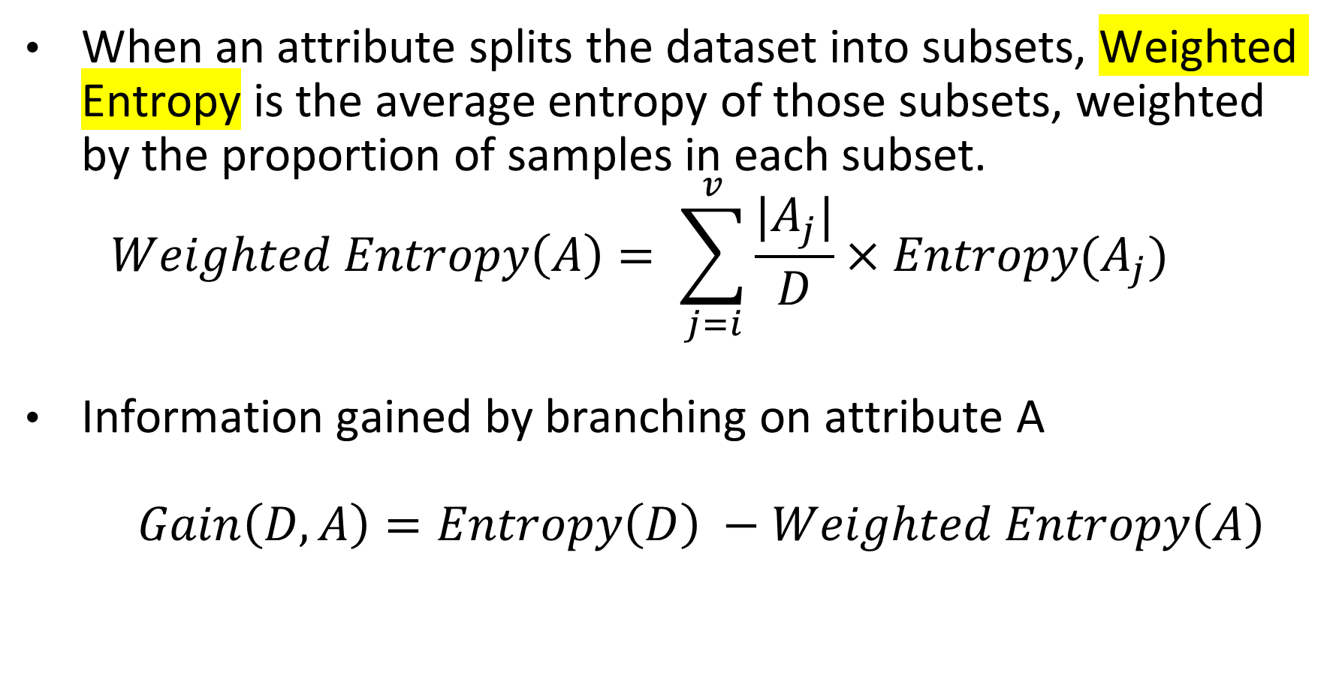
Information Gain (ID3)
When an attribute splits the dataset into subsets, Weighted Entropy is the average entropy of those subsets, weighted by the proportion of samples in each subset.
$$Weighted Entropy\left(A\right)= \sum_{j=i}^{v}{\frac{|A_{j}|}{D}×Entropy(A_{j})}$$
Information gained by branching on attribute A
$Gain\left(D, A\right)=Entropy\left(D\right) −Weighted Entropy\left(A\right)$

Slide 12
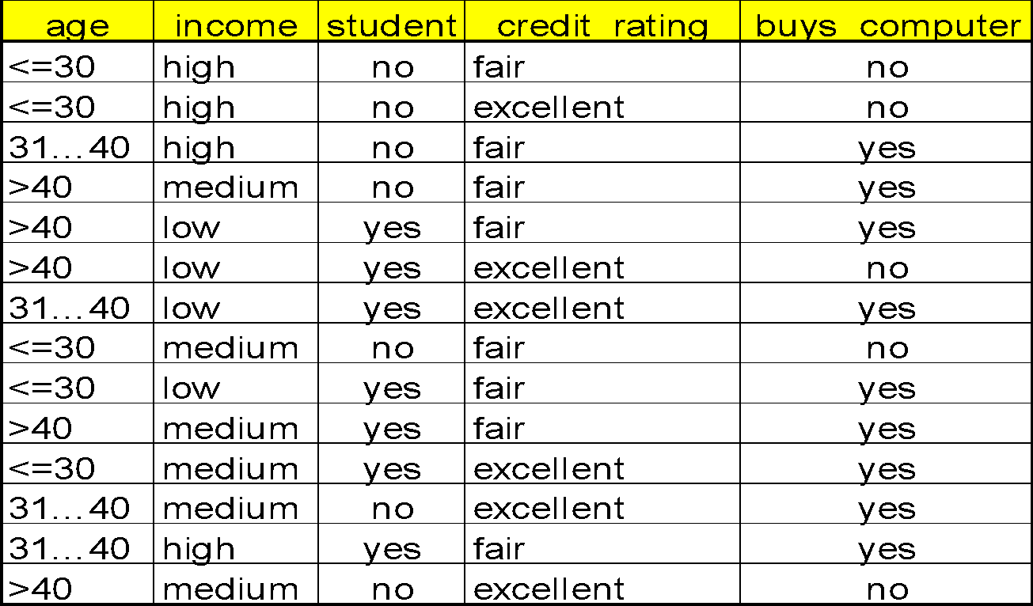
Example Dataset

Slide 13
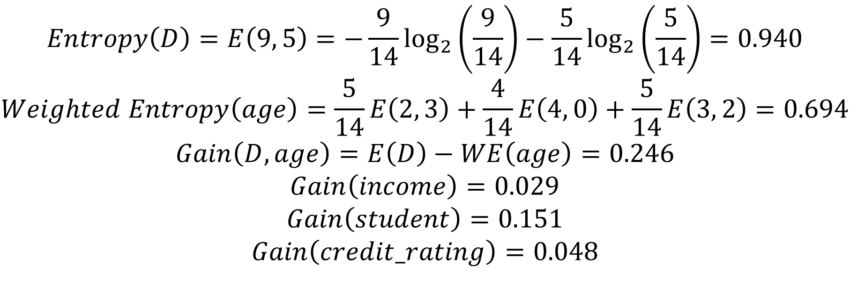
Example
$$Entropy\left(D\right)=E\left(9, 5\right)=−\frac{9}{14}\log_{2}\left(\frac{9}{14}\right)−\frac{5}{14}\log_{2}\left(\frac{5}{14}\right)=0.940$$
$$Weighted Entropy\left(age\right)=\frac{5}{14}E\left(2, 3\right)+\frac{4}{14}E\left(4, 0\right)+\frac{5}{14}E\left(3, 2\right)=0.694$$
$$Gain\left(D, age\right)=E\left(D\right)−WE\left(age\right)=0.246$$
$$Gain\left(income\right)=0.029$$
$$Gain\left(student\right)=0.151$$
$$Gain\left(credit_rating\right)=0.048$$
The attribute with the maximum gain is selected as the splitting category

Slide 14
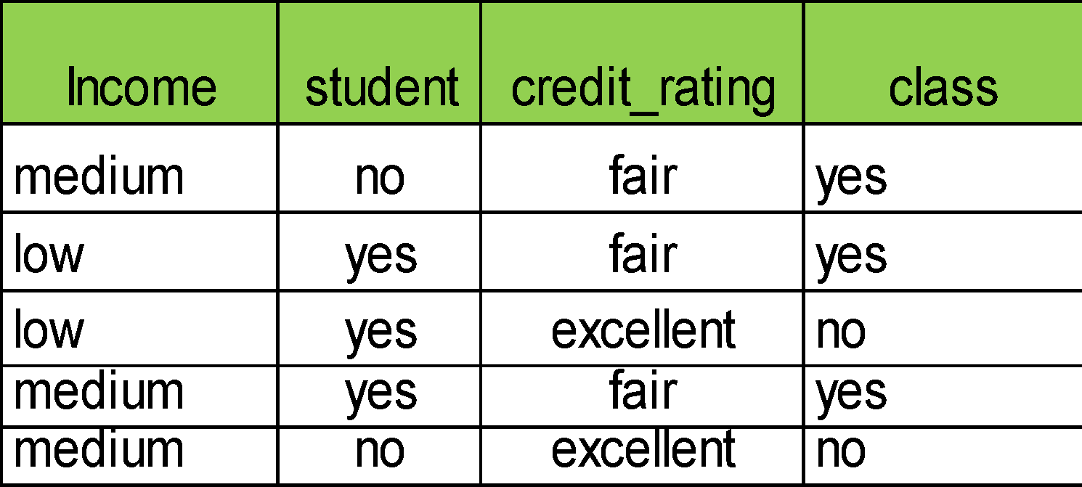
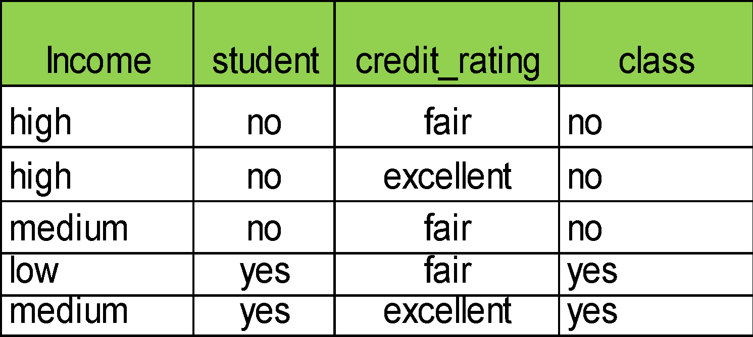
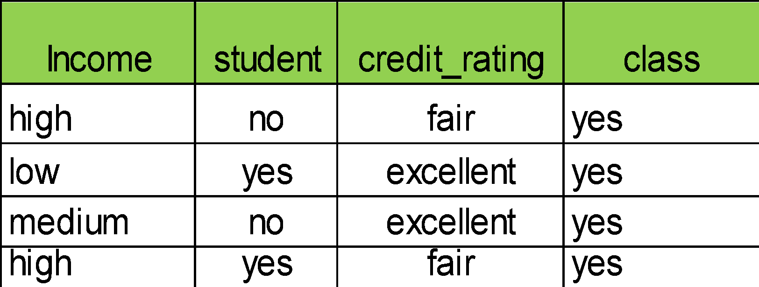
Example (Cont.)
Age?
>40
<=30
31…40

Slide 15
Example (Cont.)
age?
<=30
31...40
>40
student?
yes
credit rating?
no
yes
fair
excellent
no
yes
yes
no

Slide 16
Problems with Information Gain
Information gain measure is biased towards attributes with a large number of values
C4.5 (a successor of ID3) uses gain ratio to overcome the problem (normalization to information gain)

Slide 17
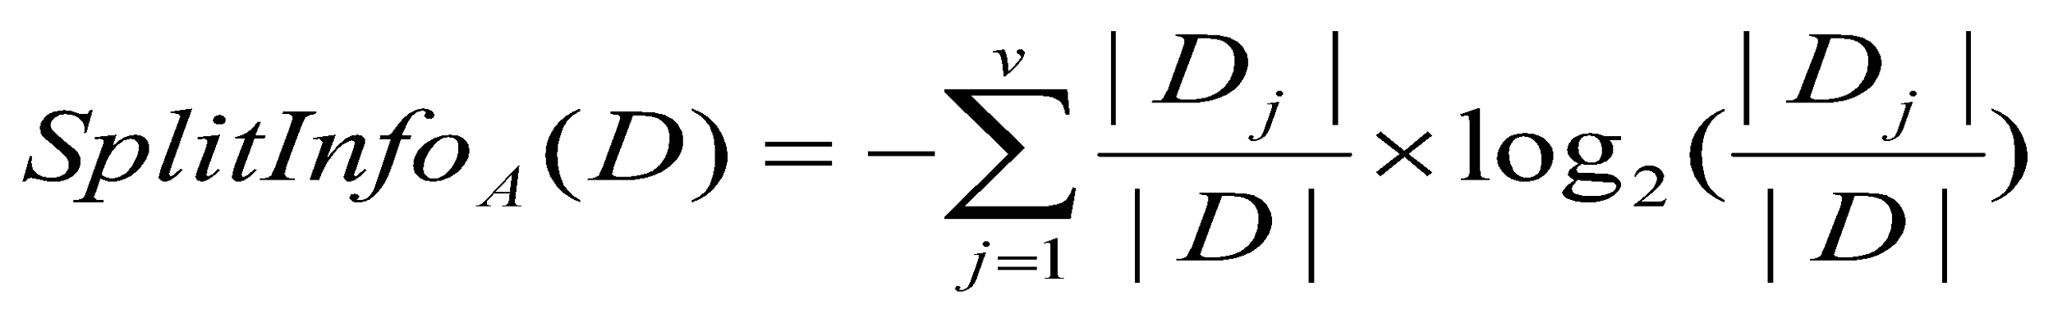
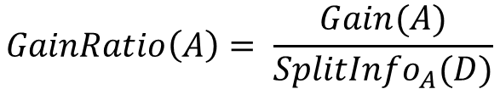
Gain Ratio (C4.5)
The attribute with the maximum gain ratio is selected as the splitting attribute

Slide 18
Problems with Gain Ratio
Disadvantage of C4.5-Gain Ratio
  Tend to prefer unbalanced split in which one partition is much smaller than the other.
CART (Classification & Regression Tree)
  CART creates a Binary Tree
  Implements Gini Index as a attribute selection measure.

Slide 19
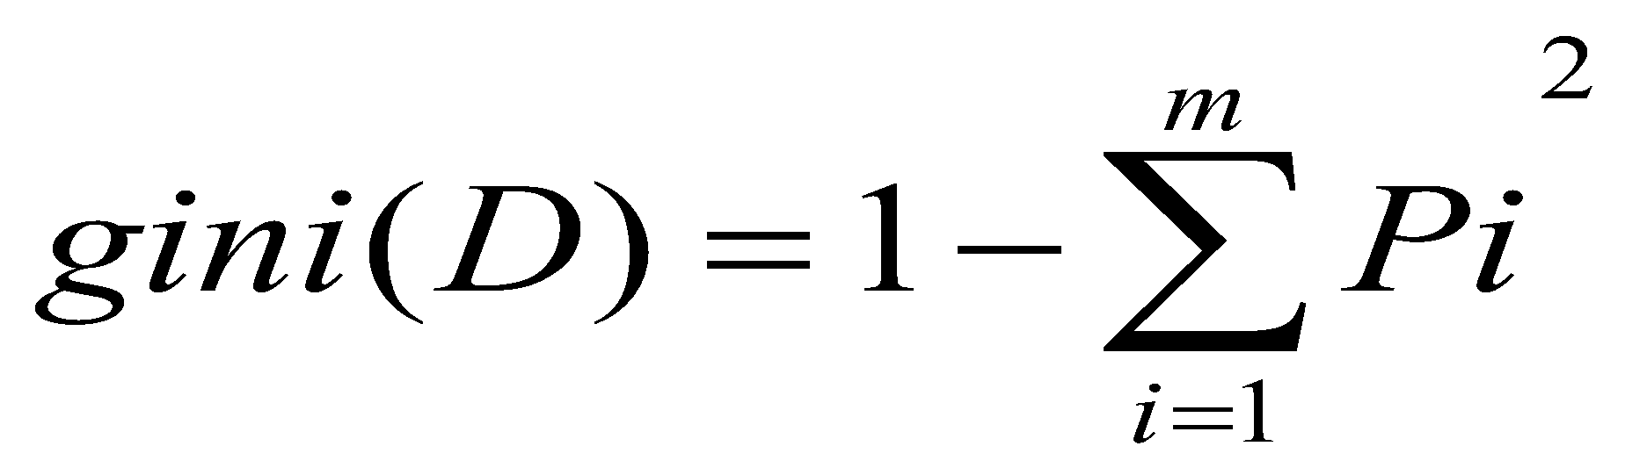
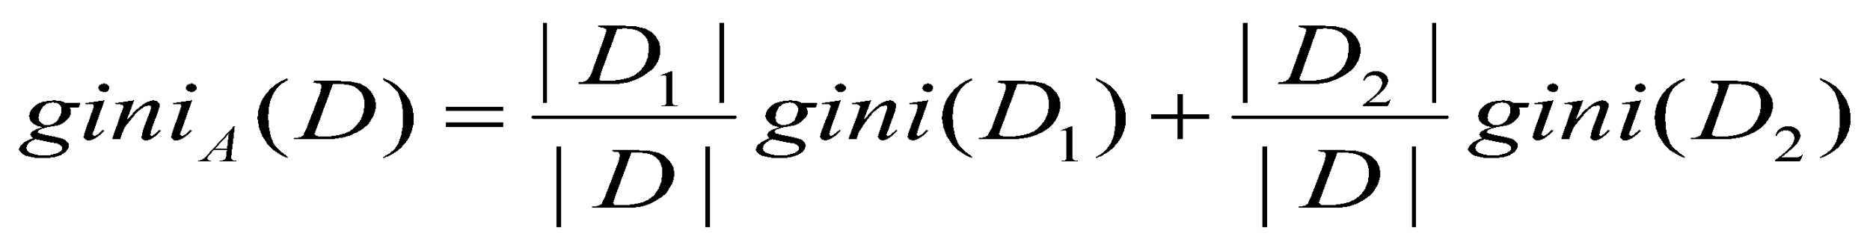
Gini Index
If a data set D contains examples from n classes, gini index, gini(D) is defined as
where p_{i} is the relative frequency of class j in D
If a dataset D is split on A into two subset D1 and D2, the gini index, gini(D) is defined as
The split is always binary
Reduction in impurity is defined as

Slide 20
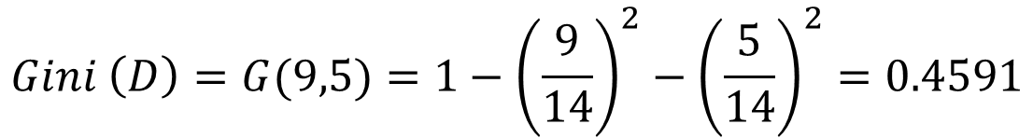
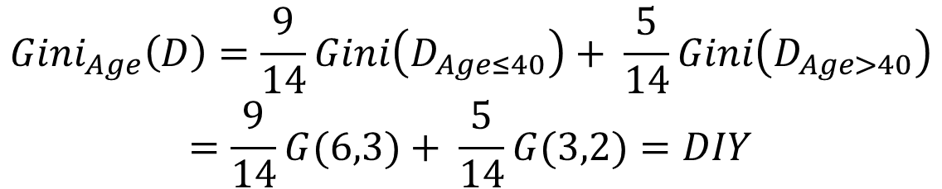

Example
The attribute with the Minimum Gini Index is selected as the splitting attribute

Slide 21
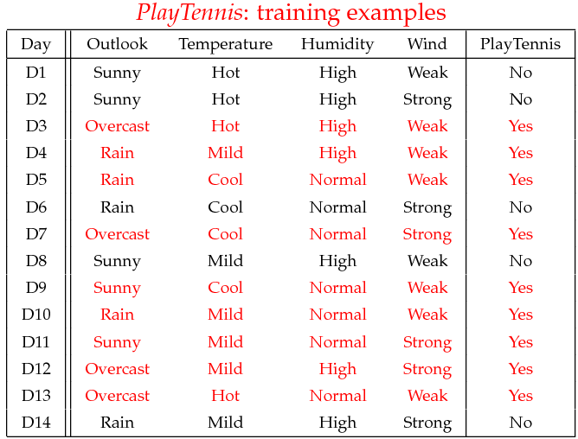
Practice Problem

Slide 22
Questions?

