Slide 1
Artificial Neural Network (Part 2)
Dept. of CSE, University of Asia Pacific

Slide 2
The XOR problem
Can neural units compute simple functions of input?
Notes:
Consider the task of computing elementary logical functions of two inputs, like AND, OR, and XOR. As a reminder, here are the truth tables for those functions:

Slide 3
Easy to build AND or OR with perceptrons
AND
OR
Notes:
It’s very easy to build a perceptron that can compute the logical AND and OR functions of its binary inputs
Here's an example of
logical AND, showing weights w1 = 1 and w2 = 1 and bias weight b = −1 and logical OR, showing weights w1 = 1 and w2 = 1 and bias weight b = 0. These weights/biases are just one from an infinite number of possible sets of weights and biases that would implement the functions.

Slide 4
Not possible to capture XOR with perceptrons

Slide 5
Why? Perceptrons are linear classifiers
Perceptron equation given x₁ and x₂, is the equation of a line
w₁x₁ + w₂x₂ + b = 0
This line acts as a decision boundary
0 if input is on one side of the line
1 if on the other side of the line
Notes:
Why? Crucially, the perceptron is a linear classifier. For a two-dimensional input x1 and x2, the perception equation, w1 x1 + w2 x2 + b = 0 is the equation of a line. (We can see this by putting it in the standard linear format: x2 = (−w1/w2)x1 + (−b/w2).)
This line acts as a decision boundary in two-dimensional space in which the output 0 is assigned to all inputs lying on one side of the line, and the output 1 to all input points lying on the other side of the line
If we had more than 2 inputs, the decision boundary becomes a hyperplane instead of a line, but the idea is the same, separating the space into two categories.

Slide 6
Decision boundaries
XOR is not a linearly separable function!
Notes:
These figures shows the possible logical inputs (00, 01, 10, and 11) and the line drawn by one possible set of parameters for an AND and an OR classifier. Notice that there is simply no way to draw a line that separates the positive cases of XOR (01 and 10) from the negative cases (00 and 11).
CLICK
We say that XOR is not a linearly separable function. Of course we could draw a boundary with a curve, or some other function, but not a single line.

Slide 7
Solution to the XOR problem
XOR can't be calculated by a single perceptron
XOR can be calculated by a layered network of units.
ReLU
ReLU
Notes:
Let’s see an example of how to compute XOR using two layers of ReLU-based units.
The middle layer (called h) has two units, and the output layer (called y) has one unit. These weights and biases will computes XOR.
Consider input x = [0, 0] ]. If we multiply each input value by the appropriate weight, sum, and then add the bias b, DO THIS ON SLIDE we get the vector [0 -1] apply the ReLU and we get [0 0], and the final value is 0.

Slide 8
The hidden representation h
(With learning: hidden layers will learn to form useful representations)
Notes:
It’s also instructive to look at the intermediate results, the outputs of the two hidden nodes h1 and h2.
Here are the values of the h layer for all 4 inputs. Notice that hidden representations of the two input points x = [0 1] and x = [1 0] (the two cases with XOR output = 1) are merged to the single point h = [1 0]. The merger makes it easy to linearly separate the positive and negative cases of XOR. In other words, we can view the hidden layer of the network as forming a useful representation for the input.
In this example we just stipulated the weights. But for real examples the weights for neural networks are learned automatically using the error backpropagation algorithm we'll turn to. That means the hidden layers will learn to form useful representations. This intuition, that neural networks can automatically learn useful representations of the input, is one of their key advantages,

Slide 9
Feed Forward Neural Network (FFNN)
A typical feed forward ANN consists of:
Input Layer: Takes the input features.
Hidden Layer(s): One or more layers where neurons apply weights and activation functions to transform the input.
Output Layer: Produces the final prediction.

Slide 10
How It Works
Input is passed to the network.
Each neuron computes a weighted sum of its inputs and passes it through an activation function.
The result moves forward through the network — no loops or feedback.
The output layer returns the prediction.

Slide 11
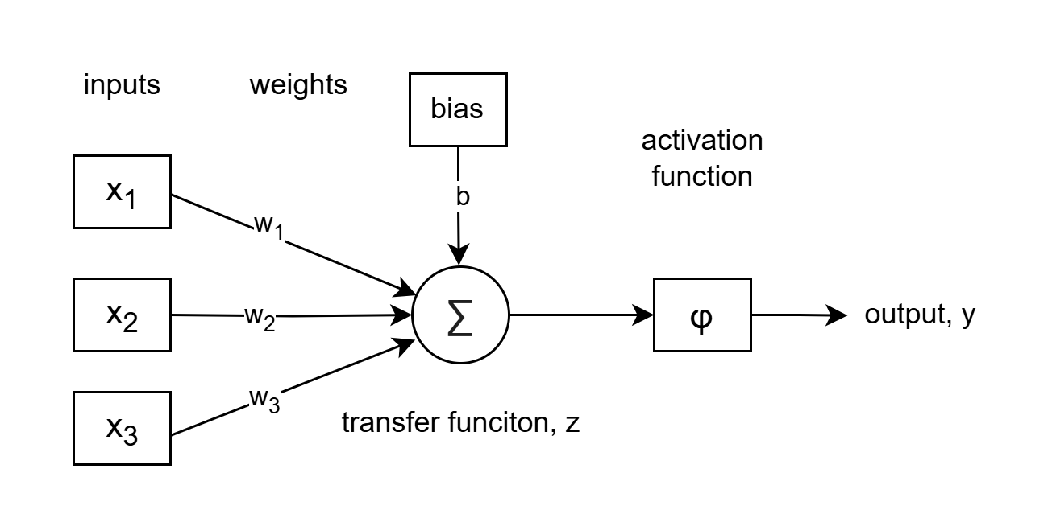

Mathematics
For a single neuron $y=φ(\sum_{i=0}^{n}{w_{i}x_{i}+b})$
where:
  $x_{i}:$ input features
  $w_{i}:$ weights
  $b:$ bias
  $φ:$ activation function
  $y:$ output

Slide 12
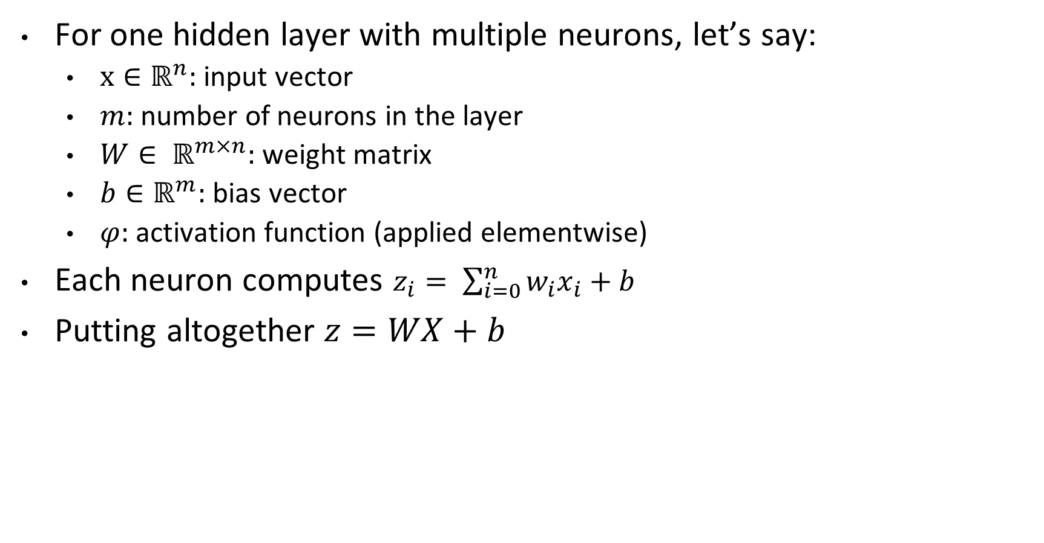
One Hidden Layer (Shallow NN)
For one hidden layer with multiple neurons, let’s say:
  $x∈ℝ^{n}:$ input vector
  $m:$ number of neurons in the layer
  $W∈ ℝ^{m×n}:$ weight matrix
  $b∈ℝ^{m}:$ bias vector
  $φ:$ activation function (applied elementwise)
Each neuron computes $z_{i}= \sum_{i=0}^{n}{w_{i}x_{i}+b}$
Putting altogether $z=WX+b$

Slide 13
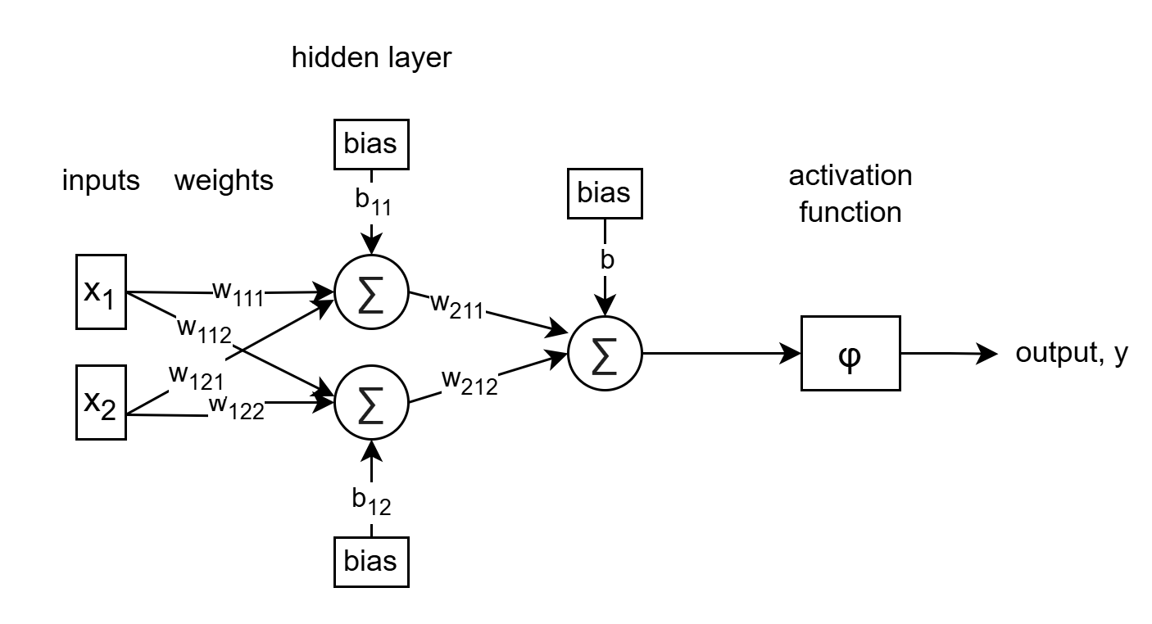
One Hidden Layer (Shallow NN)
W₂₂₁
$$y​=g(W_{l2}​⋅f(W_{l1}⋅X_{l1}+b_{l1}​)+b_{l2}​)$$

Slide 14

Multiple Hidden Layer (Deep NN)
$$y=g(W_{L}​⋅f_{L}​(W_{L−1}​⋅…f_{2}​(W_{2}​⋅f_{1}​(W_{1}​⋅X+b_{1}​)+b_{2}​)⋯+b_{L−1}​)+b_{L}​)$$

Slide 15
Multiple Output Neurons
How to get the output?
Each output neuron corresponds to a class.
  Use sigmoid activation for each output neuron.
  Apply a threshold (commonly 0.5) to convert to binary: python Copy Edit
Use softmax activation in the output layer.
  Use argmax to select the class with the highest probability
Custom binary output from multiple outputs
  Add a final layer
  Apply a logic or learned rule (e.g., majority vote, linear combination, etc.)

Slide 16

Loss Functions
Binary Cross-entropy, $L=−[y log(\hat{p}​)+(1−y)log⁡(1−\hat{p}​)]$
Categorical Cross-entropy, $L=−\sum_{j=1}^{C}{y_{j}log⁡({\hat{p}}_{j})}$
Mean Squared Error (MSE)
Mean Absolute Error (MAE)

Slide 17
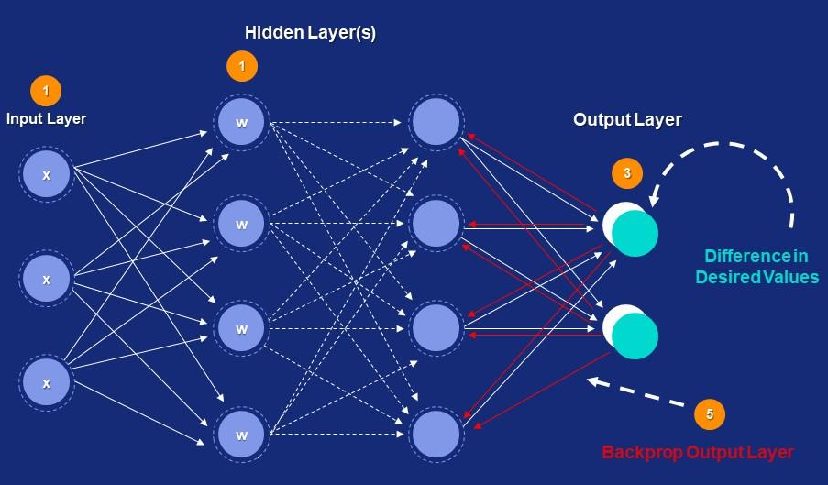
How the Neural Network learns

Slide 18
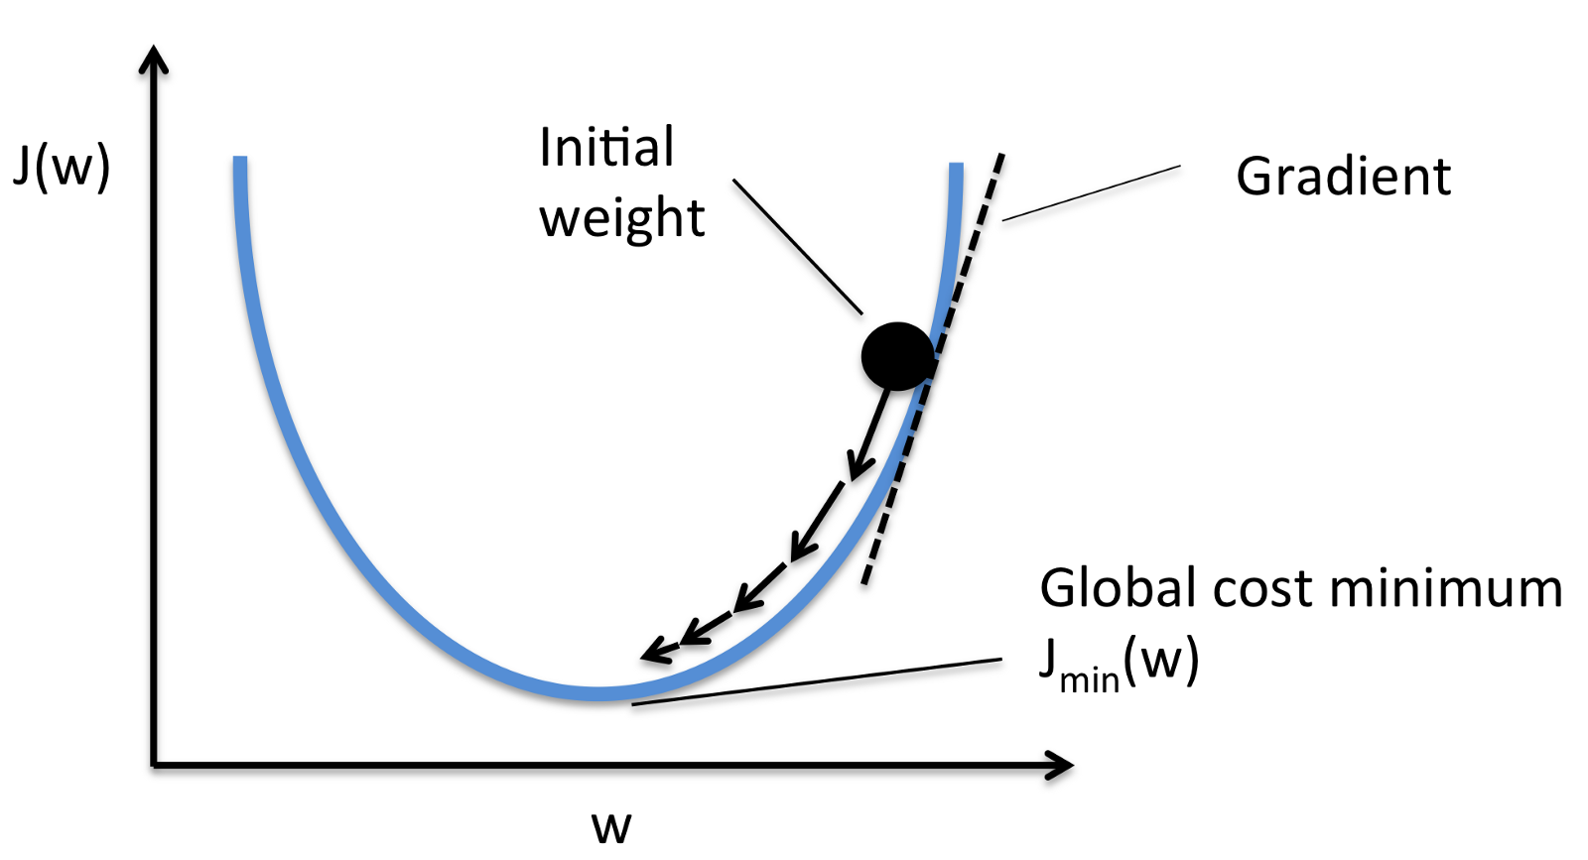
Gradient descent in backpropagation

Slide 19
Questions?

