Slide 1
Artificial Neural Network
Dept. of CSE, University of Asia Pacific

Slide 2
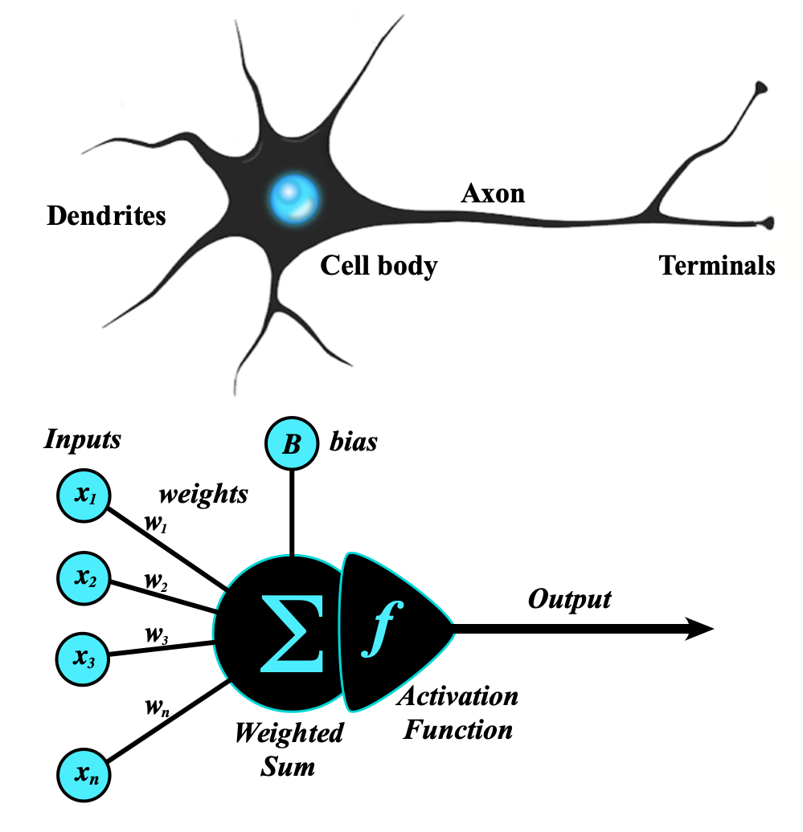
Artificial Neural Network (ANN)
Inspired by Biological Neurons – Mimics the human brain’s interconnected neurons to process complex data.

Slide 3
Single Neuron / Perceptron
Basic Structure:
Inputs: X=[x₁, x₂, ..., x_{n}]
Weights: W=[w₁, w₂, ..., w_{n}]
Bias: b
Activation Function: ϕ (e.g., Step, Sigmoid, ReLU)

Slide 4
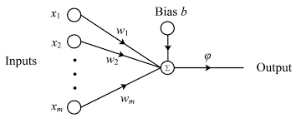

Single Neuron / Perceptron
Pre-activation step:
$$z= \sum_{i=0}^{n}{w_{i}x_{i}+b=w_{1}x_{1}+w_{2}x_{2}+ …+w_{n}x_{n}}+b$$
Activation function:
$$y=φ(z)$$

Slide 5
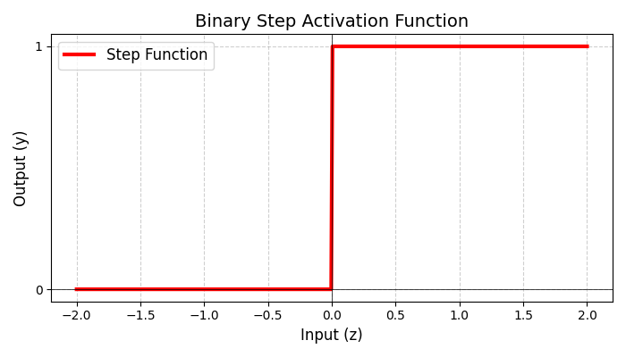
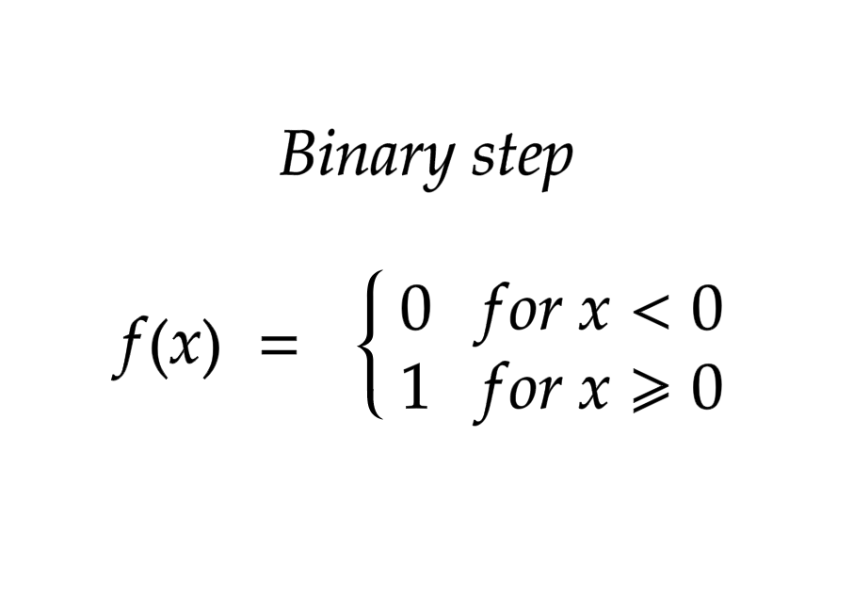
Activation Functions
Notes:
import numpy as np
import matplotlib.pyplot as plt
# Binary step function
def binary_step(z):
return 1 if z >= 0 else 0
# Generate data
z = np.linspace(-2, 2, 400)
y = np.array([binary_step(zi) for zi in z])
# Plot
plt.figure(figsize=(7, 4))
plt.plot(z, y, 'r-', linewidth=3, label='Step Function')
plt.title('Binary Step Activation Function', fontsize=14)
plt.xlabel('Input (z)', fontsize=12)
plt.ylabel('Output (y)', fontsize=12)
plt.grid(True, linestyle='--', alpha=0.6)
plt.axhline(0, color='black', linewidth=0.5)
plt.axvline(0, color='black', linewidth=0.5)
plt.legend(fontsize=12)
plt.yticks([0, 1])
plt.tight_layout()
plt.show()

Slide 6
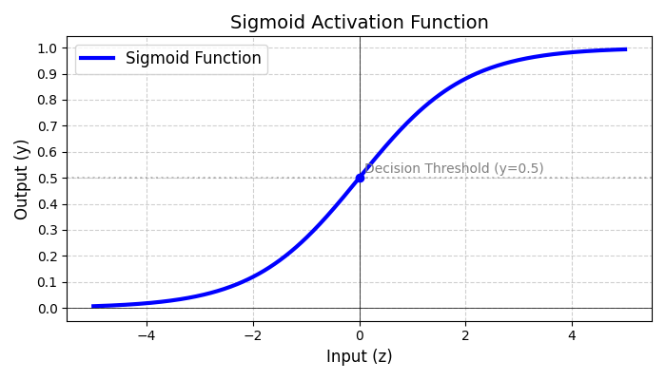
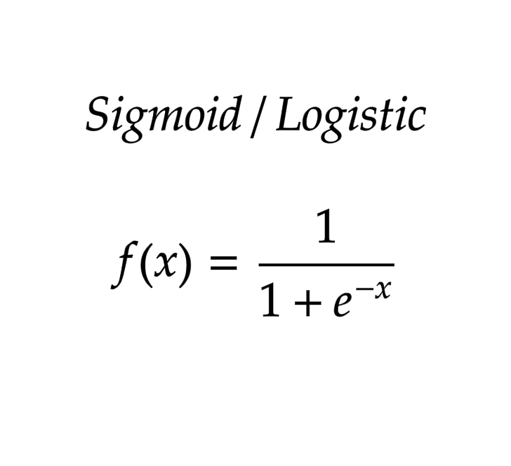
Activation Functions (Cont.)
Notes:
import numpy as np
import matplotlib.pyplot as plt
# Sigmoid function
def sigmoid(z):
return 1 / (1 + np.exp(-z))
# Generate data
z = np.linspace(-5, 5, 400)
y = sigmoid(z)
# Plot
plt.figure(figsize=(7, 4))
plt.plot(z, y, 'b-', linewidth=3, label='Sigmoid Function')
plt.title('Sigmoid Activation Function', fontsize=14)
plt.xlabel('Input (z)', fontsize=12)
plt.ylabel('Output (y)', fontsize=12)
plt.grid(True, linestyle='--', alpha=0.6)
plt.axhline(0, color='black', linewidth=0.5)
plt.axvline(0, color='black', linewidth=0.5)
# Add special annotations
plt.axhline(y=0.5, color='gray', linestyle=':', alpha=0.5)
plt.text(0.1, 0.52, 'Decision Threshold (y=0.5)', color='gray')
plt.scatter(0, 0.5, color='blue', zorder=5)
plt.legend(fontsize=12)
plt.yticks(np.arange(0, 1.1, 0.1))
plt.tight_layout()
plt.show()

Slide 7
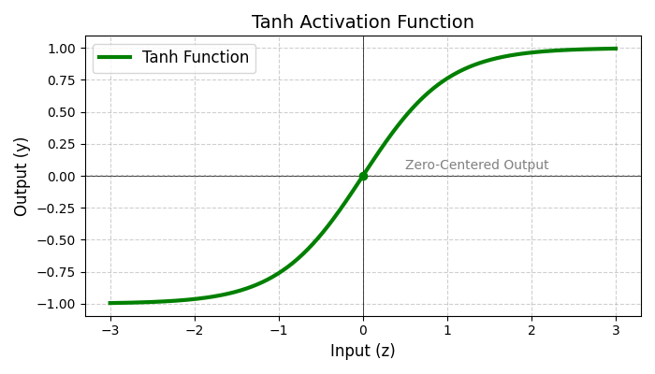
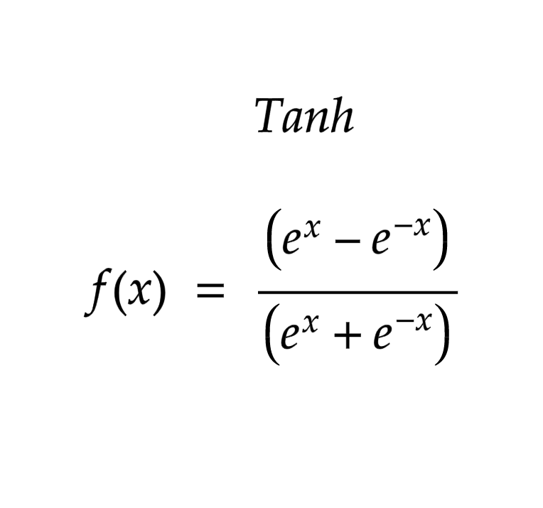
Activation Functions (Cont.)
Notes:
import numpy as np
import matplotlib.pyplot as plt
# Tanh function
def tanh(z):
return np.tanh(z)
# Generate data
z = np.linspace(-3, 3, 400)
y = tanh(z)
# Plot
plt.figure(figsize=(7, 4))
plt.plot(z, y, 'g-', linewidth=3, label='Tanh Function')
plt.title('Tanh Activation Function', fontsize=14)
plt.xlabel('Input (z)', fontsize=12)
plt.ylabel('Output (y)', fontsize=12)
plt.grid(True, linestyle='--', alpha=0.6)
plt.axhline(0, color='black', linewidth=0.5)
plt.axvline(0, color='black', linewidth=0.5)
# Add special annotations
plt.axhline(y=0, color='gray', linestyle=':', alpha=0.5)
plt.text(0.5, 0.05, 'Zero-Centered Output', color='gray')
plt.scatter(0, 0, color='green', zorder=5)
plt.legend(fontsize=12)
plt.yticks(np.arange(-1, 1.25, 0.25))
plt.tight_layout()
plt.show()

Slide 8
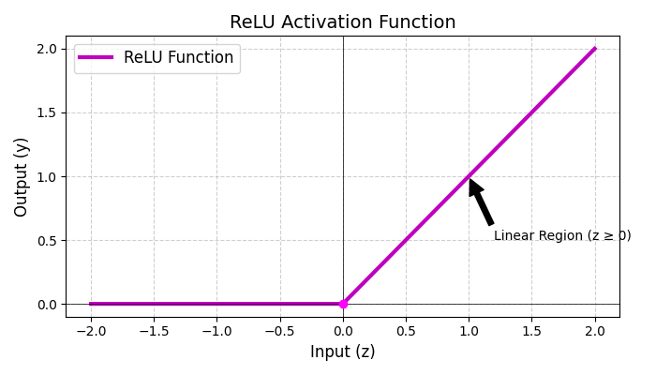
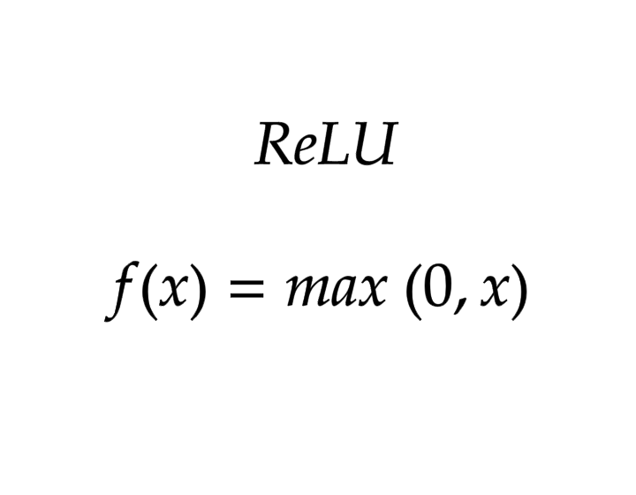
Activation Functions (Cont.)
Notes:
import numpy as np
import matplotlib.pyplot as plt
# ReLU function
def relu(z):
return np.maximum(0, z)
# Generate data
z = np.linspace(-2, 2, 400)
y = relu(z)
# Plot
plt.figure(figsize=(7, 4))
plt.plot(z, y, 'm-', linewidth=3, label='ReLU Function') # magenta color
plt.title('ReLU Activation Function', fontsize=14)
plt.xlabel('Input (z)', fontsize=12)
plt.ylabel('Output (y)', fontsize=12)
plt.grid(True, linestyle='--', alpha=0.6)
plt.axhline(0, color='black', linewidth=0.5)
plt.axvline(0, color='black', linewidth=0.5)
# Add special annotations
plt.annotate('Linear Region (z ≥ 0)',
xy=(1, 1), xytext=(1.2, 0.5),
arrowprops=dict(facecolor='black', shrink=0.05))
plt.scatter(0, 0, color='magenta', zorder=5)
plt.legend(fontsize=12)
plt.yticks(np.arange(0, 2.5, 0.5))
plt.tight_layout()
plt.show()

Slide 9
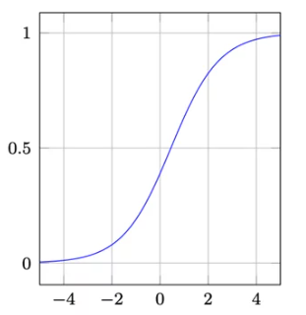

Activation Functions (Cont.)
Notes:
import numpy as np
import matplotlib.pyplot as plt
def softmax(x):
e_x = np.exp(x - np.max(x)) # stability improvement
return e_x / e_x.sum(axis=0)
# Generate a range of inputs (logits)
x = np.linspace(-5, 5, 100)
# Create a 3-class system with different biases
logits = np.vstack([x, x + 2, x - 2]) # shape (3, 100)
# Apply softmax to each column (i.e., across classes)
softmax_output = np.apply_along_axis(softmax, 0, logits)
# Plot the results
plt.figure(figsize=(10, 6))
for i in range(softmax_output.shape[0]):
plt.plot(x, softmax_output[i], label=f'Class {i+1}')
plt.title('Softmax Activation Function Visualization')
plt.xlabel('Input Logits')
plt.ylabel('Softmax Probability')
plt.legend()
plt.grid(True)
plt.show()

Slide 10

Perceptron Learning Rule
Error, $E=Target −Output$
Update weights & bias (if there is an error):
$$∆w_{i}=w_{i}+αEx_{i}$$
$$b_{new}=b_{old}+αE$$
where $α$ is the learning rate.

Slide 11

Perceptron Learning Example: AND Gate
Goal: to mimic AND logic, $y=x_{1}.x_{2}$
Training data:
x₁ | x₂ | y
0 | 0 | 0
0 | 1 | 0
1 | 0 | 0
1 | 1 | 1

Slide 12

AND Gate: Initialization
Initialize parameters (randomly)
  Weights, w₁ = 0.5, w₂ = 0.5
  Bias, b = -0.3
  Learning rate, $α=0.1$

Slide 13
AND Gate: Training Steps
Epoch 1:
  Sample (0, 0)
    z=(0.5x0)+(0.5x0)−0.3=−0.3
    y=Step(−0.3)=0
    Error (t−y): 0−0=0 → No update.
  Sample (0, 1):
    z = 0.2, y = 1, Error = 0 – 1 = -1 → Update
    W1 = 0.5 (no change as x1 = 0)
    W2 = 0.5 + 0.1 x (-1) x 1 =0.4
    b = -0.3 + 0.1 x (-1) = - 0.4
  Sample (1, 0)
    z = 0.1, y = 1, Error = -1 → Update
    W1 = 0.4, W2 = 0.4, b = - 0.5
  Sample (1, 1)
    z = 0.3, y = 1, Error = 0 → No update

Slide 14

AND Gate: Training Steps
Epoch 2:
  Weights now: w1 = 0.4, w2 ​= 0.4, b = −0.5
  (0,0): z=−0.5 → y = 0
  (0,1): z=−0.1 → y = 0
  (1,0): z=−0.1 → y = 0
  (1,1): z=0.3 → y = 1
  All predictions correct → Convergence achieved!
Decision Boundary: $0.4x_{1}+0.4x_{2}−0.5=0$
Try with a different settings!
  Weights, w₁ = 0.25, w₂ = 0.25
  Bias, b = -0.8
  Learning rate, $α=0.5$

Slide 15
Questions?

