Slide 1

CURRENCY CONVERTER PROJECT
PROJECT DONE BY:
ANAMIKA BARPAGGA 12109422
ANURAG SINGH 12111401
KOTHA ROHITH GUPTA 12105729

Slide 2
INTRODUCTION
Currency converter is a mini project in Java programming. It provides a web-based interface for exchanging money from one currency to another currency. For example, in this project the US dollar can be converted into euro, british pound, swiss franc, chinese yuan renminbi and japanese yen and vice-a-versa. In this project, javax.swing and awt package are used for creating GUI based application

Slide 3
KEY FEATURES
In this project we are going to Develop a Currency Converter in Java by using Swing Framework. This project is designed to convert one currency into another currency.Swing is the set of classes that provides more powerful and flexible components as compared to AWT. Swing elements aren't enforced by platform-specific code. They're written in java and it is platform-independent. And all swing elements are called lightweight elements.

Slide 4
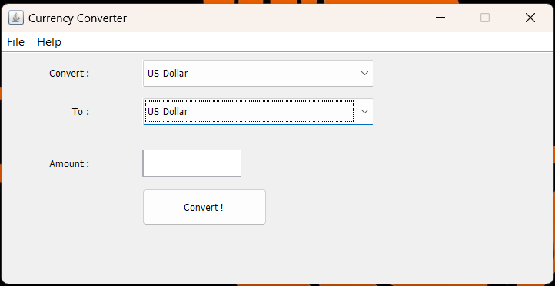
GUI SCREENSHOT

Slide 5
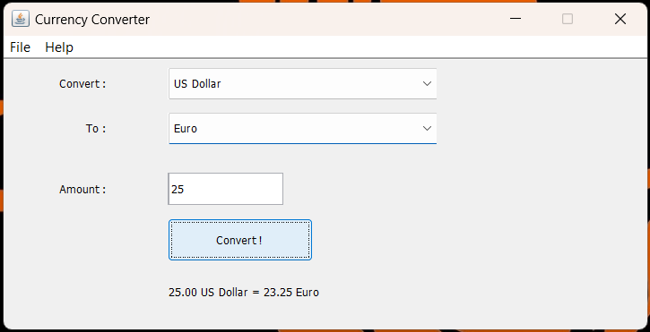

Slide 6
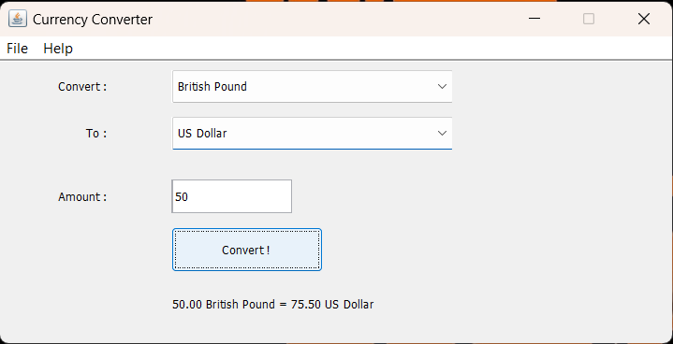

Slide 7
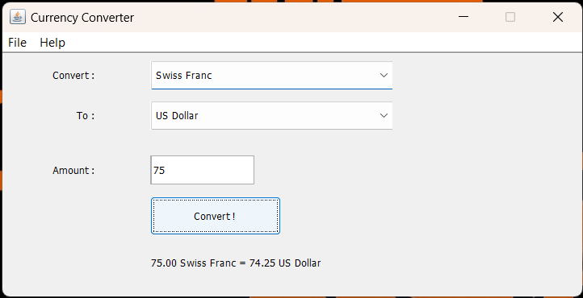

Slide 8





